Slide 1
Statistical Principles Biology 683 Heath Blackmon
Example test questions:
Describe the differences and advantages of vector vs raster images.
What is a sample vs a population.

Slide 2
Steps in making a great figure
Figure out the purpose of the figure. Usually you will have a sentence in the paper or a point you want to make in a talk.

Slide 3
Steps in making a great figure
Figure out the purpose of the figure. Usually you will have a sentence in the paper or a point you want to make in a talk.
Haploid chromosome number ranged from 7-50 across sample Polyneoptera species and an XO sex chromosome system was reconstructed as the most probable ancestral state for most orders.

Slide 4
Steps in making a great figure
Figure out the purpose of the figure. Usually you will have a sentence in the paper or a point you want to make in a talk.
Make a list of the data that will need to be included. Is it continuous, discrete, or more complex.
Haploid chromosome number ranged from 7-50 across sample Polyneoptera species and an XO sex chromosome system was reconstructed as the most probable ancestral state for most orders.

Slide 5
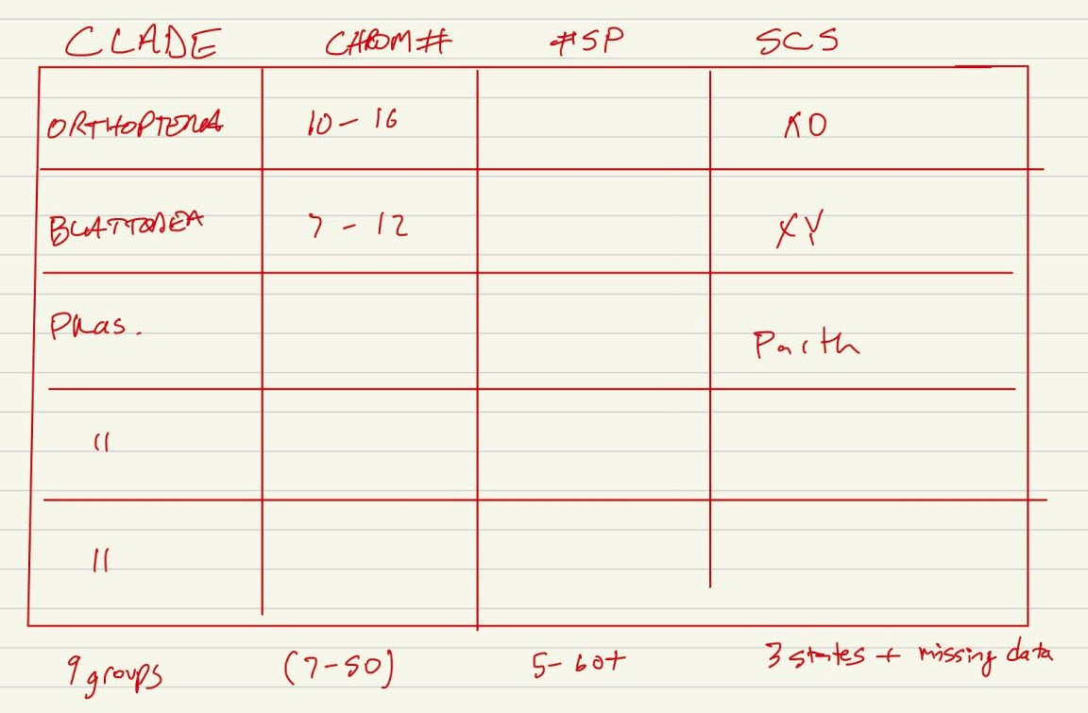
Steps in making a great figure
Figure out the purpose of the figure. Usually you will have a sentence in the paper or a point you want to make in a talk.
Make a list of the data that will need to be included. Is it continuous, discrete, or more complex.
Haploid chromosome number ranged from 7-50 across sample Polyneoptera species and an XO sex chromosome system was reconstructed as the most probable ancestral state for most orders.

Slide 6
Steps in making a great figure
Figure out the purpose of the figure. Usually you will have a sentence in the paper or a point you want to make in a talk.
Make a list of the data that will need to be included. Is it continuous, discrete, or more complex.
Sketch out what you think it will look like. Don’t waste time figuring out how to make the perfect plot in your tool until you have settled on a best approach. Check out other papers and the graph gallery for ideas.
Haploid chromosome number ranged from 7-50 across sample Polyneoptera species and an XO sex chromosome system was reconstructed as the most probable ancestral state for most orders.

Slide 7
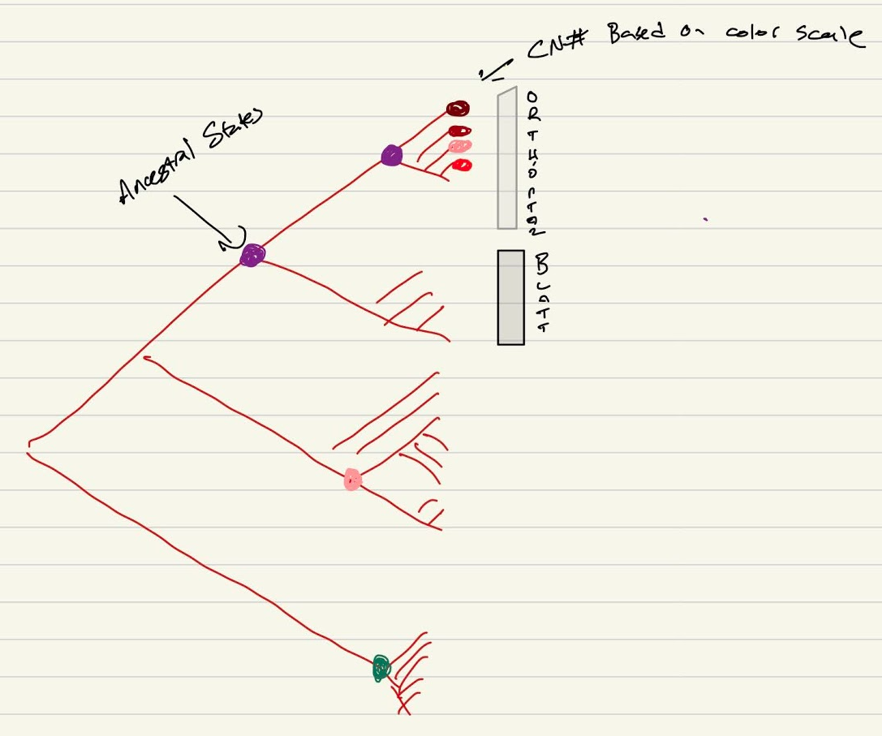
Steps in making a great figure
Figure out the purpose of the figure. Usually you will have a sentence in the paper or a point you want to make in a talk.
Make a list of the data that will need to be included. Is it continuous, discrete, or more complex.
Sketch out what you think it will look like. Don’t waste time figuring out how to make the perfect plot in your tool until you have settled on a best approach. Check out other papers and the graph gallery for ideas.
Haploid chromosome number ranged from 7-50 across sample Polyneoptera species and an XO sex chromosome system was reconstructed as the most probable ancestral state for most orders.

Slide 8
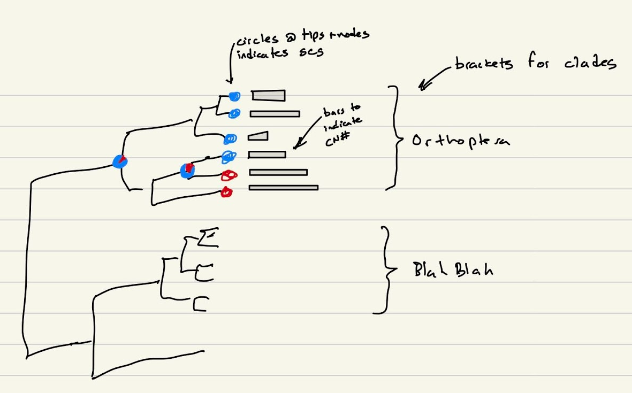
Steps in making a great figure
Figure out the purpose of the figure. Usually you will have a sentence in the paper or a point you want to make in a talk.
Make a list of the data that will need to be included. Is it continuous, discrete, or more complex.
Sketch out what you think it will look like. Don’t waste time figuring out how to make the perfect plot in your tool until you have settled on a best approach. Check out other papers and the graph gallery for ideas.
Haploid chromosome number ranged from 7-50 across sample Polyneoptera species and an XO sex chromosome system was reconstructed as the most probable ancestral state for most orders.

Slide 9
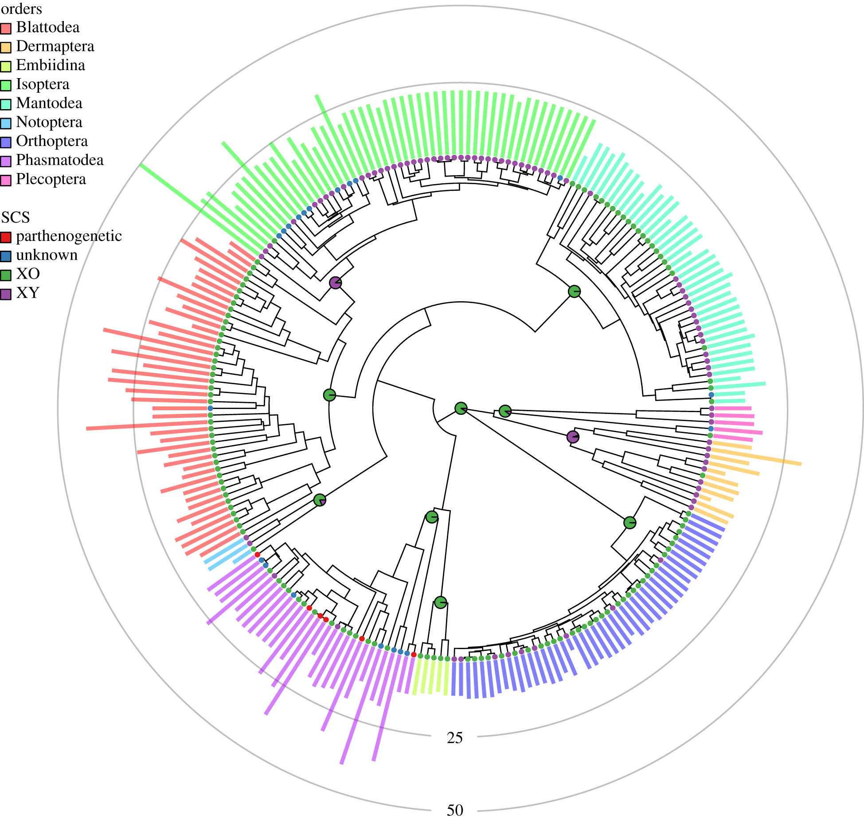
Steps in making a great figure
Figure out the purpose of the figure. Usually you will have a sentence in the paper or a point you want to make in a talk.
Make a list of the data that will need to be included. Is it continuous, discrete, or more complex.
Sketch out what you think it will look like. Don’t waste time figuring out how to make the perfect plot in your tool until you have settled on a best approach. Check out other papers and the graph gallery for ideas.
Haploid chromosome number ranged from 7-50 across sample Polyneoptera species and an XO sex chromosome system was reconstructed as the most probable ancestral state for most orders.

Slide 10
LIVE CODING
Scientific studies show that actively coding and completing computer tasks in an environment with intermittent assistance and individual practice far exceeds any other method of instruction.
I need to have a plan for a project that we are going to do (like testing the central limit theorem).
I need to make sure to break the task into 5-10 minute chunks of work.
You need to put green stickies and red stickies up as appropriate.
You need to put that red sticky up anytime it should be
I promise that if you do this by the end of the semester you will be much more comfortable with data analysis than you are today. I’m literally being paid to do this my only goal is for you to find this class useful and fun so that you will tell other people it is useful and they will take it to.

Slide 11
Central limit theorem
Imagine that we sample from the same population many times, so we have a bunch of different, independent samples.
Each sample will have a mean, but the means will be different due to chance. In principle, we could draw a histogram of these means.
In general, you only have one sample from a given population, however, so what can you infer about the distribution of the means from your sample?
The Central Limit Theorem states that regardless of the underlying population distribution of the variable of interest, the distribution of the population of means will be roughly normal.

Slide 12
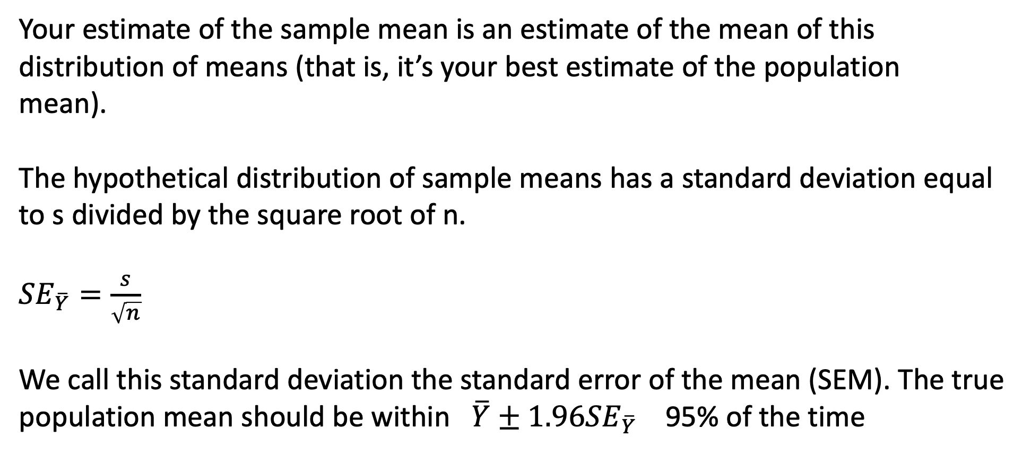
Central limit theorem
Your estimate of the sample mean is an estimate of the mean of this distribution of means (that is, it’s your best estimate of the population mean).
The hypothetical distribution of sample means has a standard deviation equal to s divided by the square root of n.
${SE}_{\overline{Y}}=\frac{s}{\sqrt{n}}$
We call this standard deviation the standard error of the mean (SEM). The true population mean should be within $\overline{Y}±1.96{SE}_{\overline{Y}}$ 95% of the time

Slide 13
Central limit theorem
Lets try that
create a population with a known mean.
sample from it and calculate the mean and standard error and see if it includes the true mean.
tally results and see if it worked about 95% of the time

Slide 14
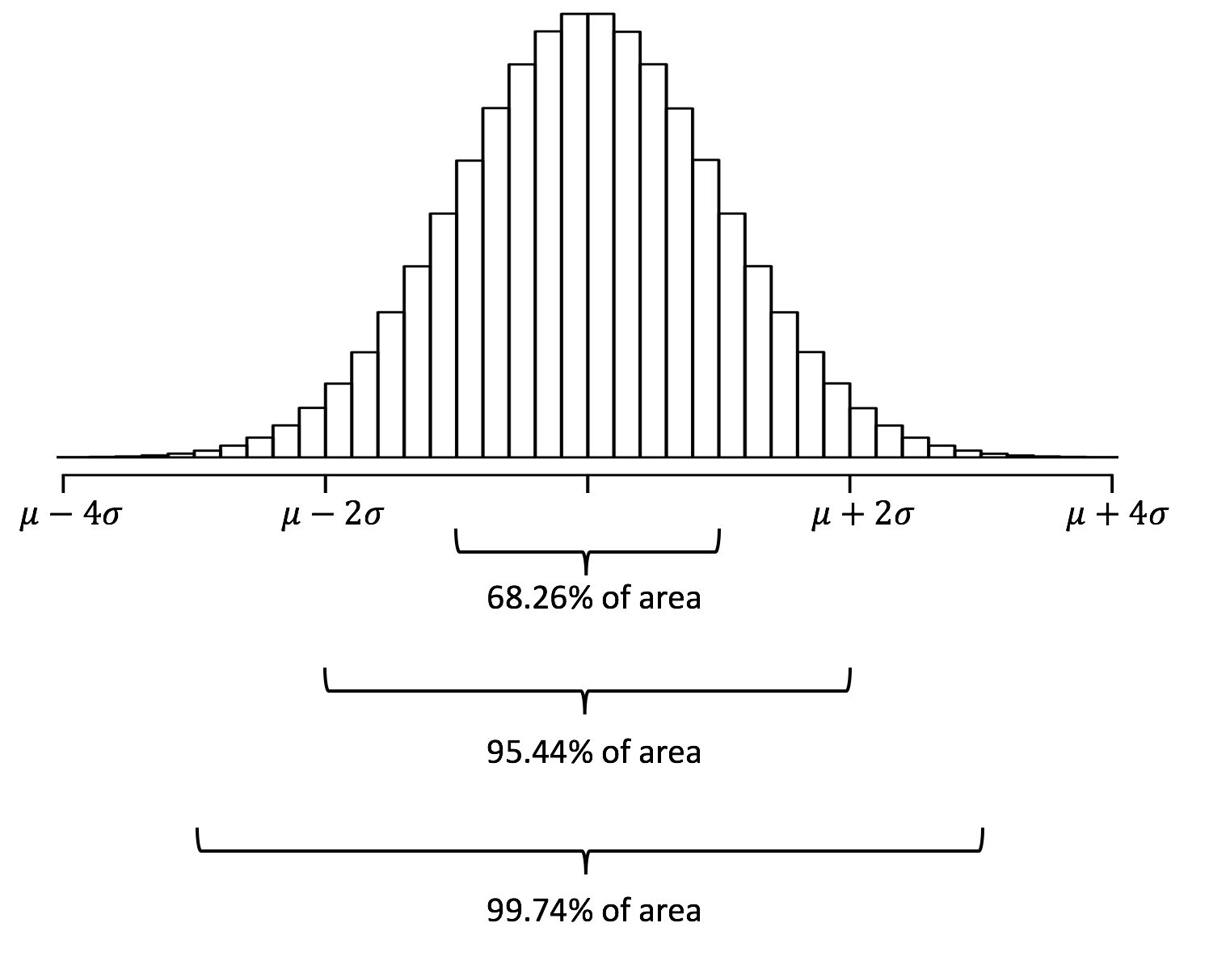
Estimating with uncertainty

Slide 15
Confidence Interval vs Credible Interval
z = 1.65 fo 90%
= 1.96 for 95%
= 2.58 for 99%
natural choice for things we go and measure in biological entities and we are interested in what the “true” mean value of the population is
Credible intervals are often used in Bayesian approaches. In these methods we often run an MCMC which yields an arbitrarily large number of estimates of our parameter of interest. It is not sensible to talk about the CI of a parameter estimate like this because it can always be narrowed to a point estimate with sufficient sample size.

Slide 16
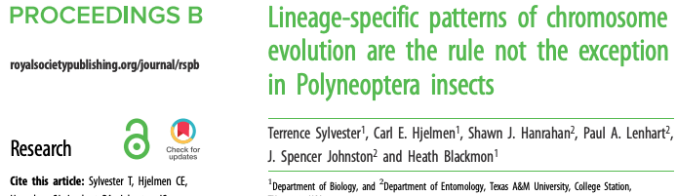
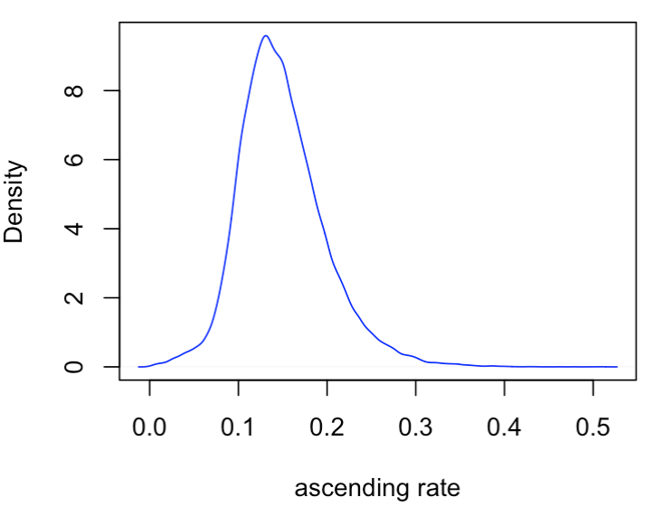
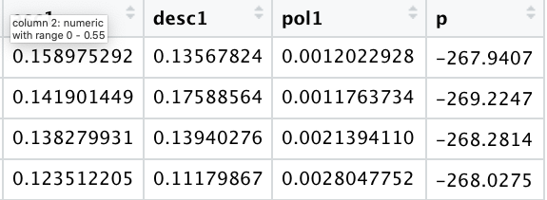
Confidence Interval vs Credible Interval
Frequentist 95% CI
0.149-0.150
95% HPD (credible interval)
0.06-0.26
10,000 rows

Slide 17
Some Experimental Design Considerations
Why do I need a control?
To interpret an experiment, we need to compare the experimental subjects to the correct reference group.
What about observational studies?
What is an appropriate control?
Ideal controls are identical to the experimental population, except for the one parameter being manipulated
The control population should be similar in all other respects to the experimental population
The control population should experience sham manipulations that simulate any manipulations applied to the experimental population
Sometimes you might need multiple different controls.

Slide 18
Avoiding Experimenter Bias
Experimenter bias is real
The results of your study can be influenced by your expectations
Randomization is key
1) HHHHHTHHHHHHHTTTTTHTT
2) THTHTHHTHTTHHTHTHHTTH
3) HTHTHTHTHTTHTHHTTHHTH

Slide 19
Avoiding Experimenter Bias
Experimenter bias is real
The results of your study can be influenced by your expectations
Randomization is key
Randomize assignment of subjects to controls and treatments (use R or random.org).
Humans are bad at recognizing and creating randomness.

Slide 20
Avoiding Experimenter Bias
Use a blind or double-blind experimental design
Blind: the subject doesn’t know whether it’s an experimental or control subject
Double-blind: neither the researcher nor subject know which subjects are experimental versus control
What is a more common connotation of blinding?
How can you apply this to your research?

Slide 21
Confounding Variables
A difference between groups that the experimenter fails to account for
A hidden variable that creates an apparent causal relationship that isn’t real
An experiment with confounded variables can be impossible to interpret and impossible to fix

Slide 22
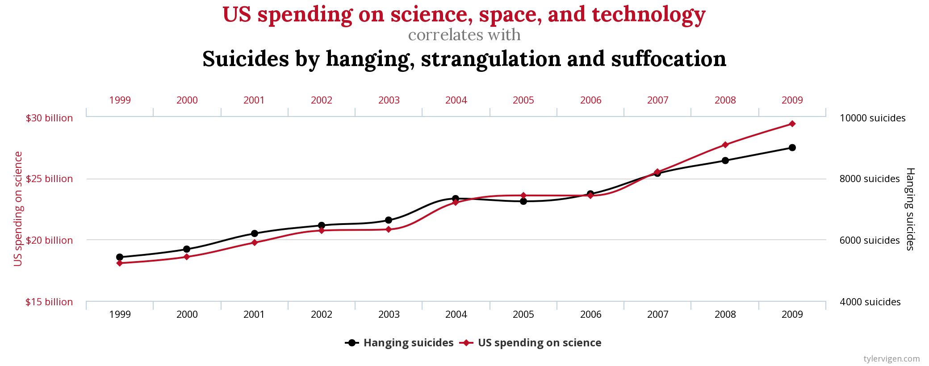
Confounding Variables

Slide 23
Confounding Variables

Slide 24
Confounding Example
Study type
Gene expression level
Diversification
Lung cancer and coffee
Behavior
Effective population size
Confounding variable
Tissue used
unobserved traits
coffee smoking correlation
maternal effects
breeding system

Slide 25
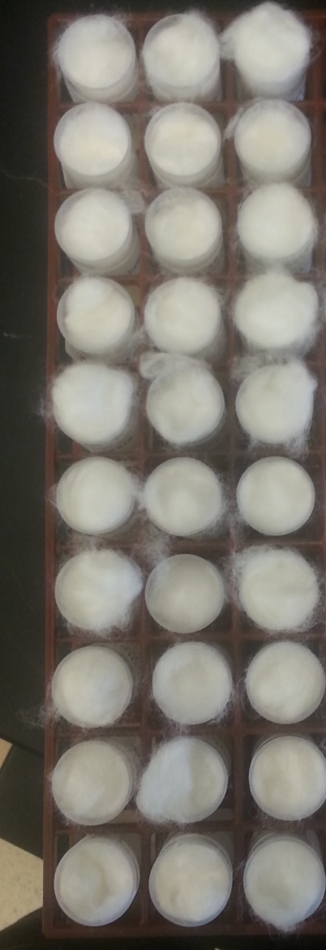
Redesign the procedure
Media A
Collect 750 beetles from a population cage.
Create 30 new vials with 25 beetles each.
Make the first 15 of these control vials and use food media A.
Make the next 15 of these experiment vials and use food media B.
Place in a rack as shown and place in the incubator.
Measure growth at day 15.
Media B

