Slide 1
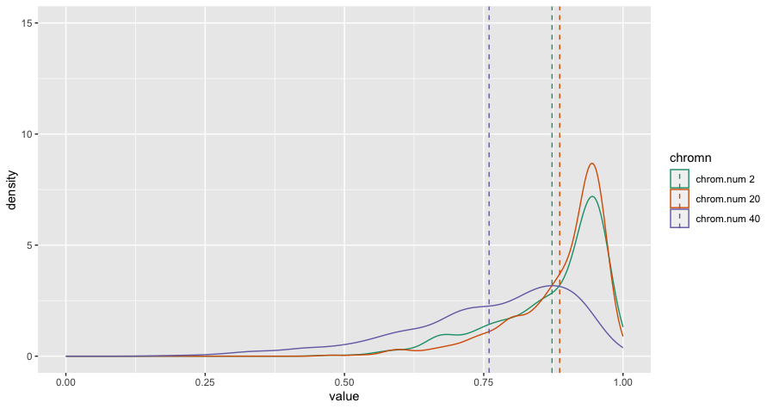
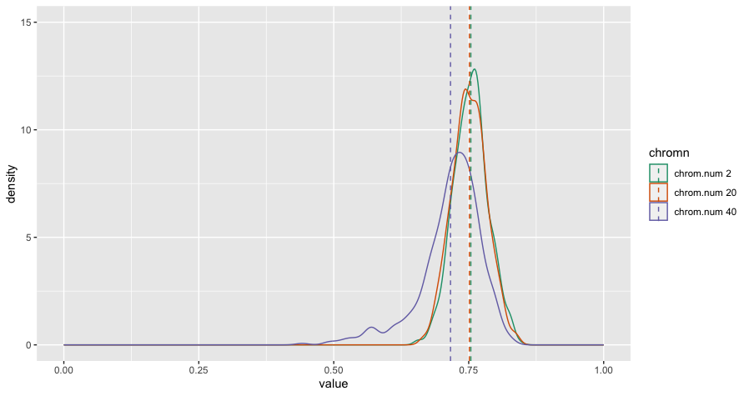
0.01 vs 0.3 Env Stab – Additive
Env=0.01
Env=0.3

Slide 2
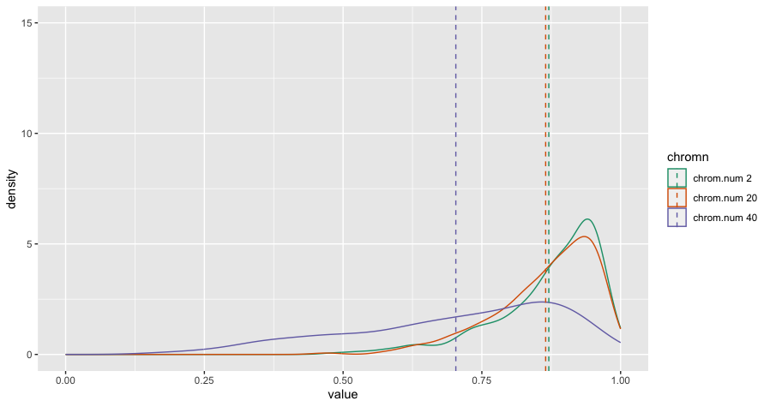
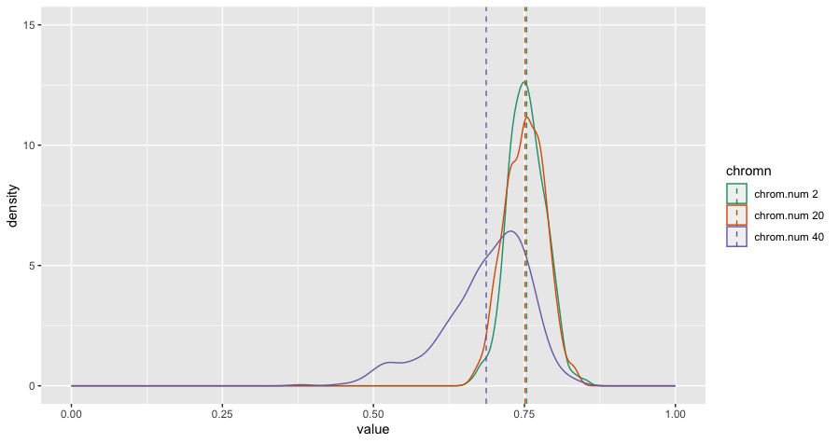
0.01 vs 0.3 Env Stab – Epistatic Decreasing
Env=0.01
Env=0.3

Slide 3
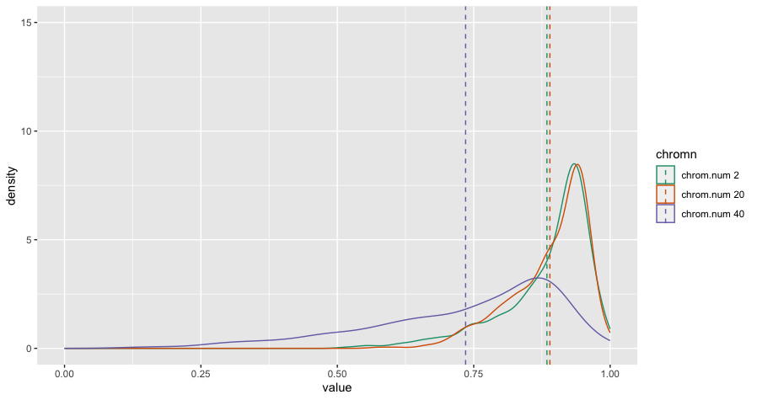
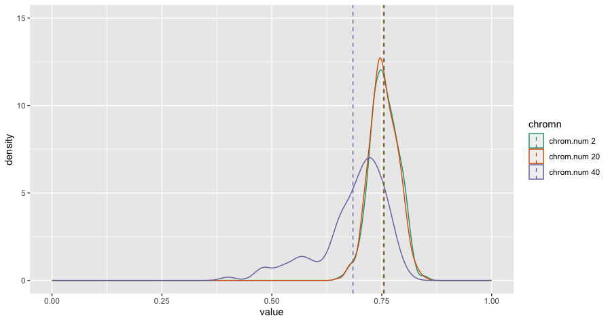
0.01 vs 0.3 Env Stab – Epistatic Increasing
Env=0.01
Env=0.3

Slide 4
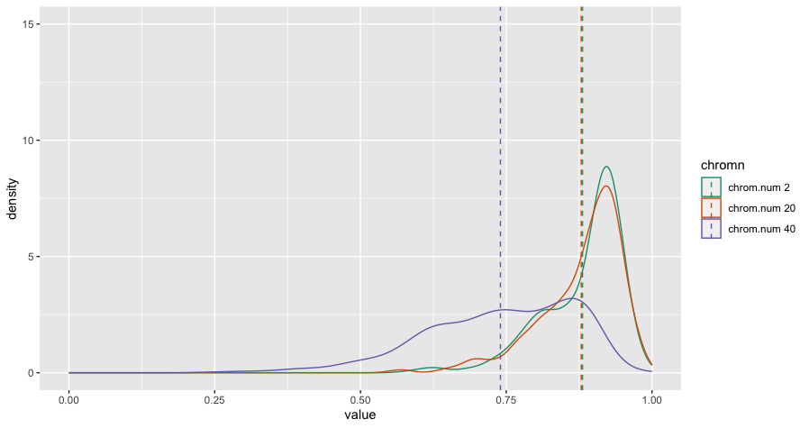
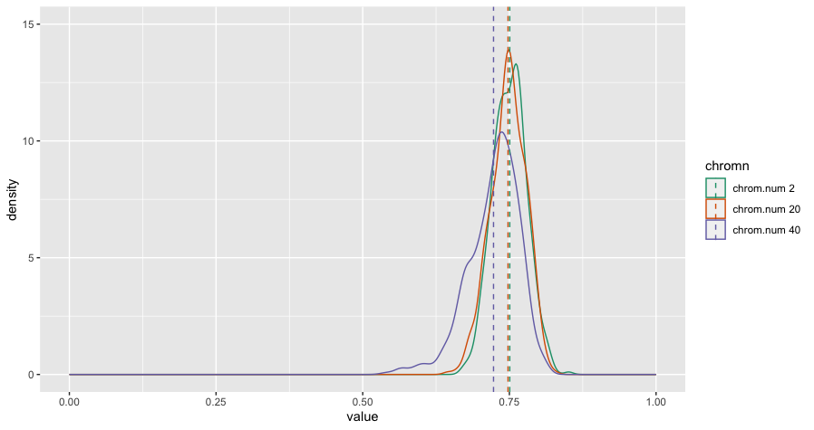
0.01 vs 0.3 Env Stab – Sign Epistasis
Env=0.01
Env=0.3

