Slide 1
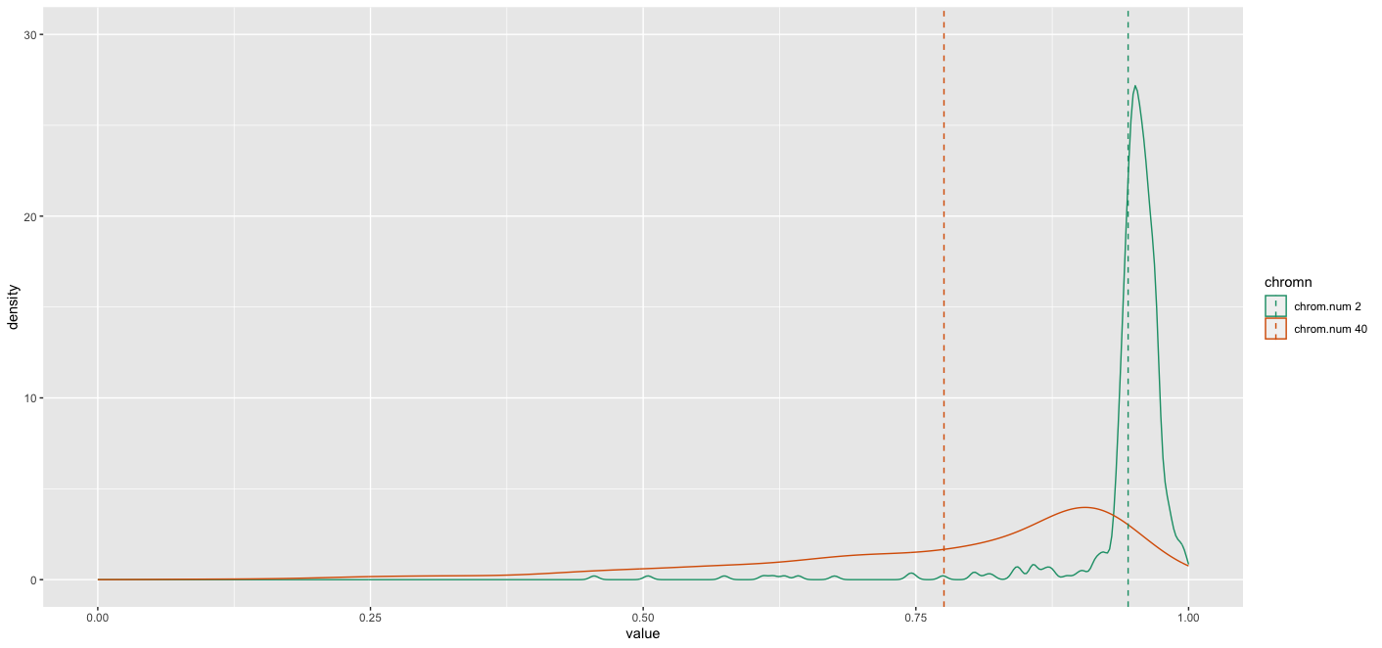
Prob.change = 0.001

Slide 2
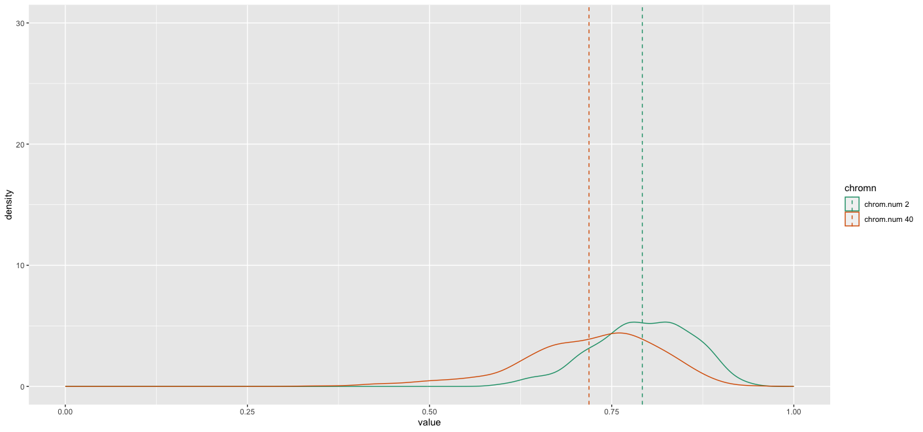
Prob.change = 0.0608

Slide 3
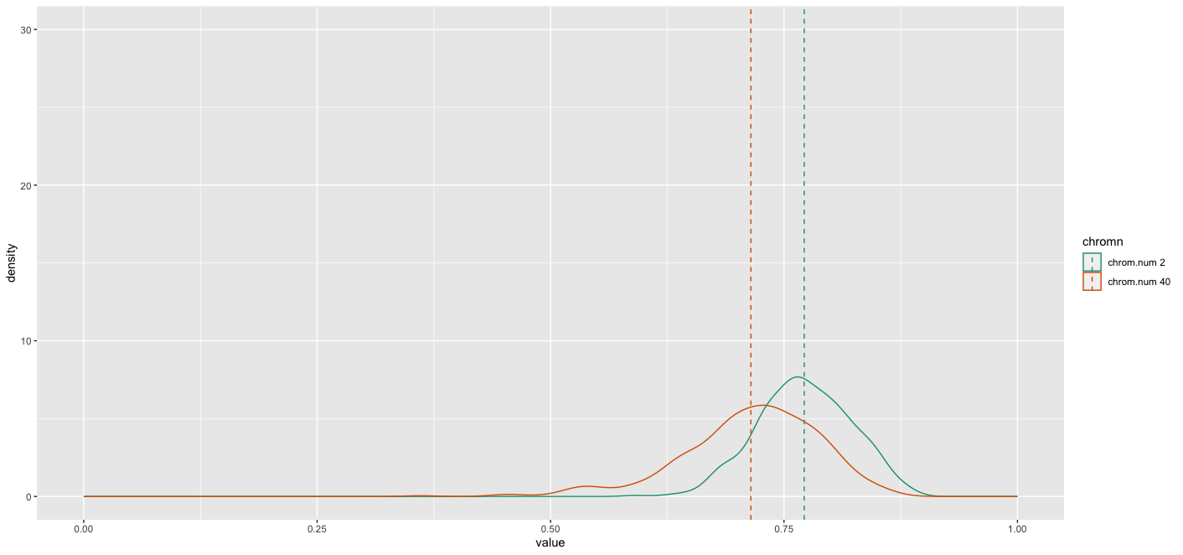
Prob.change = 0.1206

Slide 4
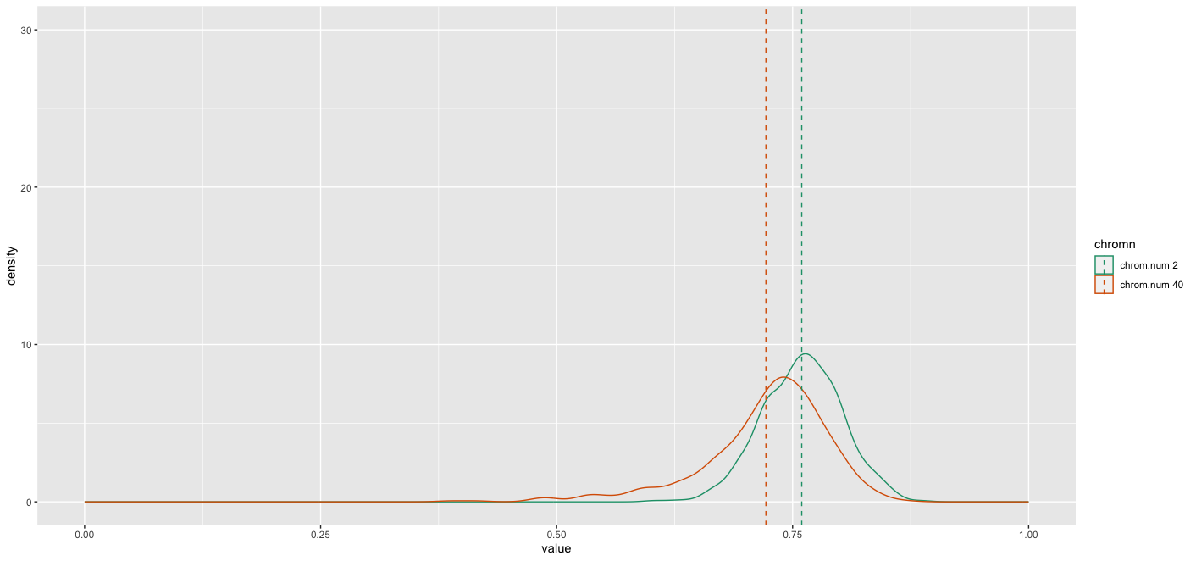
Prob.change = 0.1804

Slide 5
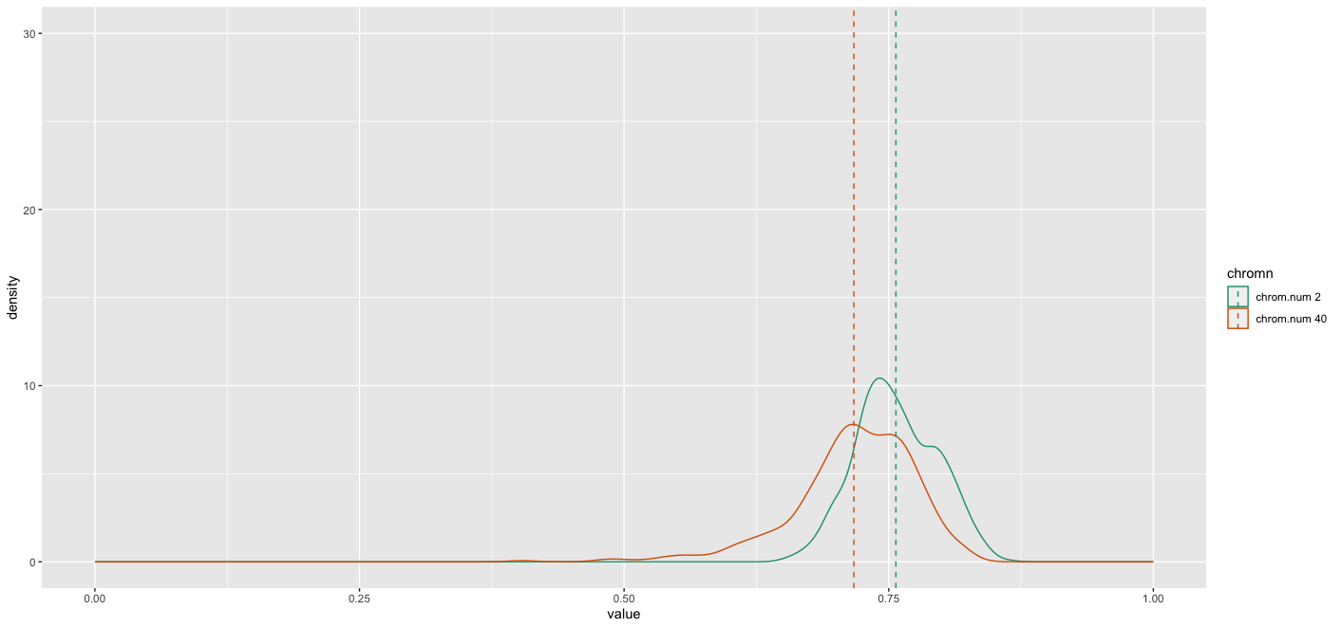
Prob.change = 0.2402

Slide 6
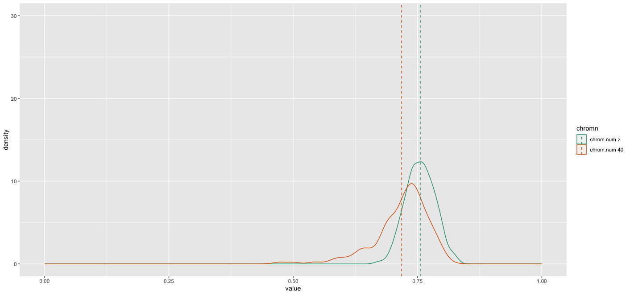
Prob.change = 0.3

