Slide 1
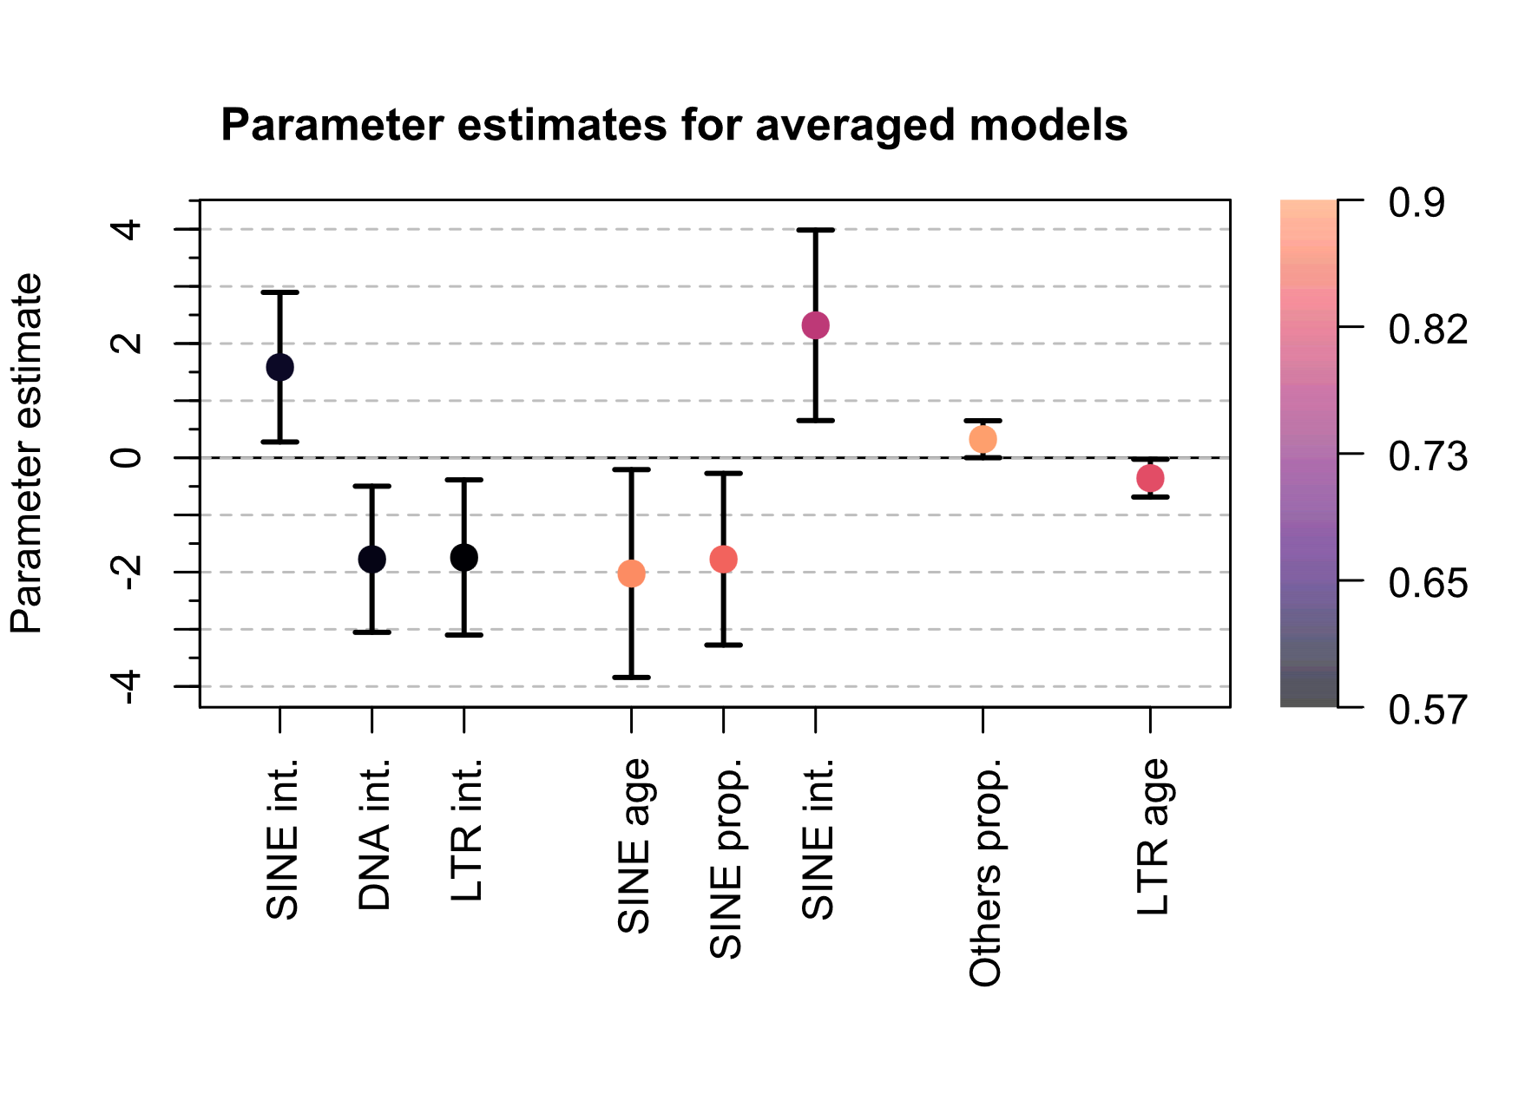
All clades
Mammals
Ray-finned
fish
Reptiles
Parameters with > 0.5 relative importance and CIs excluding 0 are shown.
Variable importance

