Slide 1
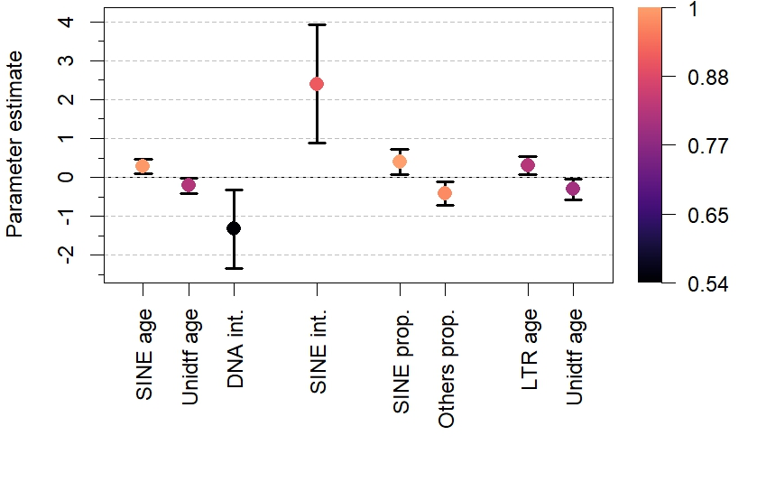
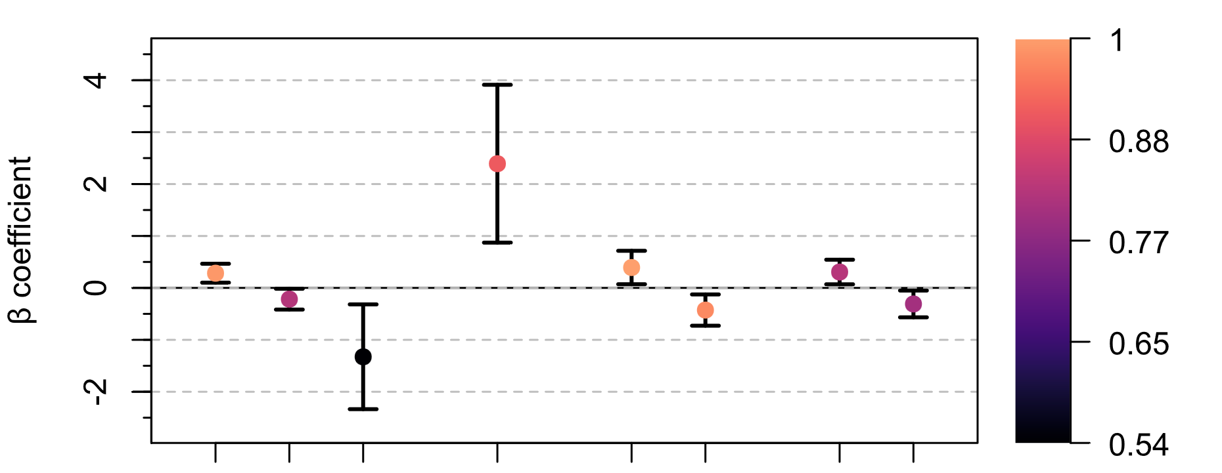
Ray-finned
fish
All clades
Mammals
Reptiles
Variable importance
Unknown age
LTR age
Others proportion
SINE proportion
Sine age
SINE age x prop.
Unknown age
DNA age x prop.

