Slide 1
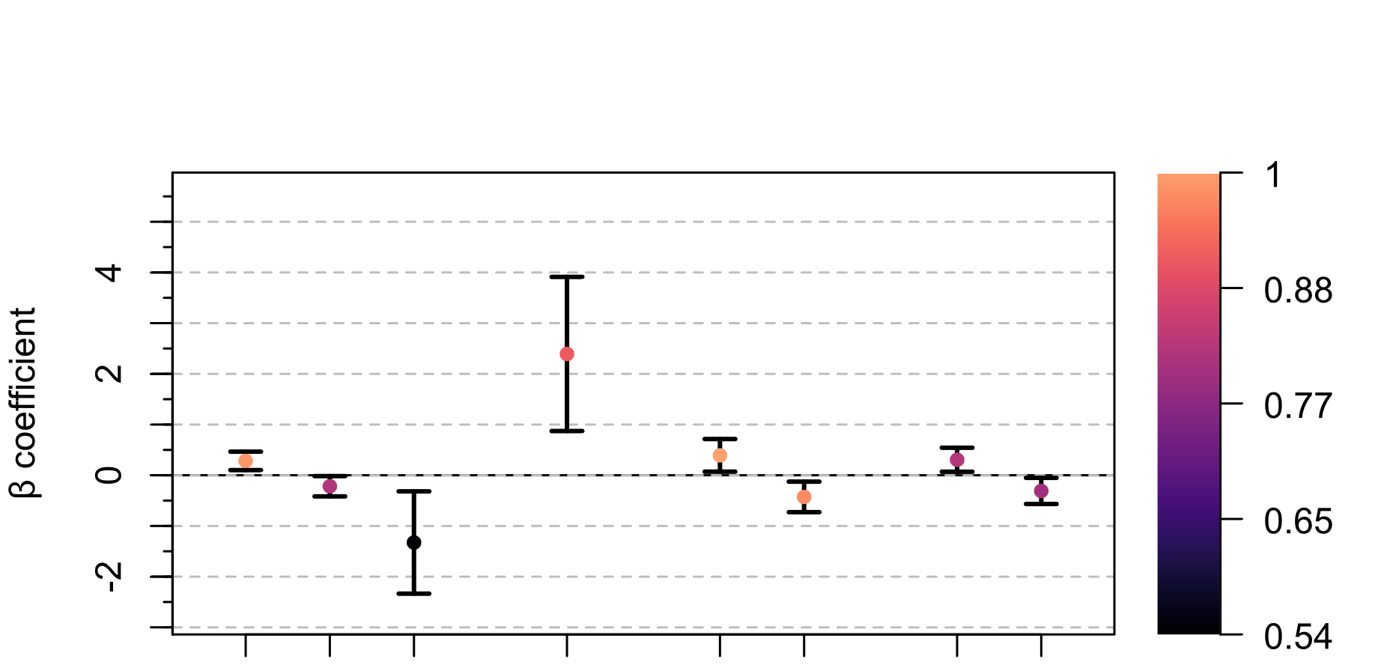
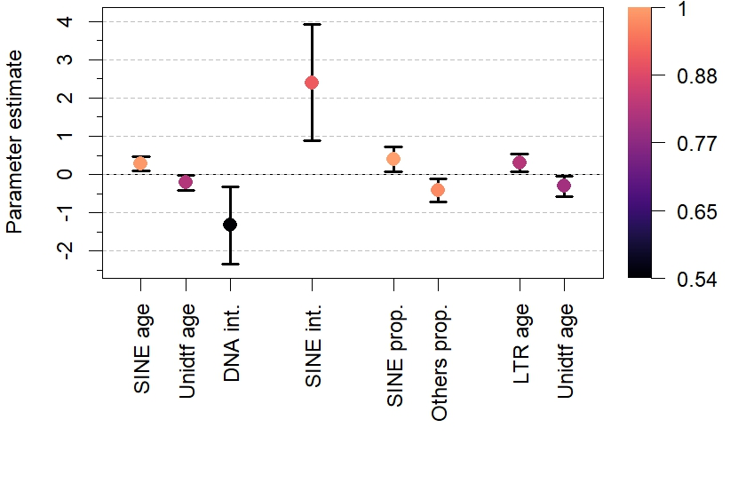


Ray-finned
fish
All clades
Mammals
Reptiles
All clades
Mammals
Ray-finned fish
Reptiles
Unknown age
Variable
importance
Others proportion
SINE age
LTR age
Unknown age
DNA age x prop.
SINE age x prop.
SINE proportion
Variable importance

Slide 2


