Slide 1
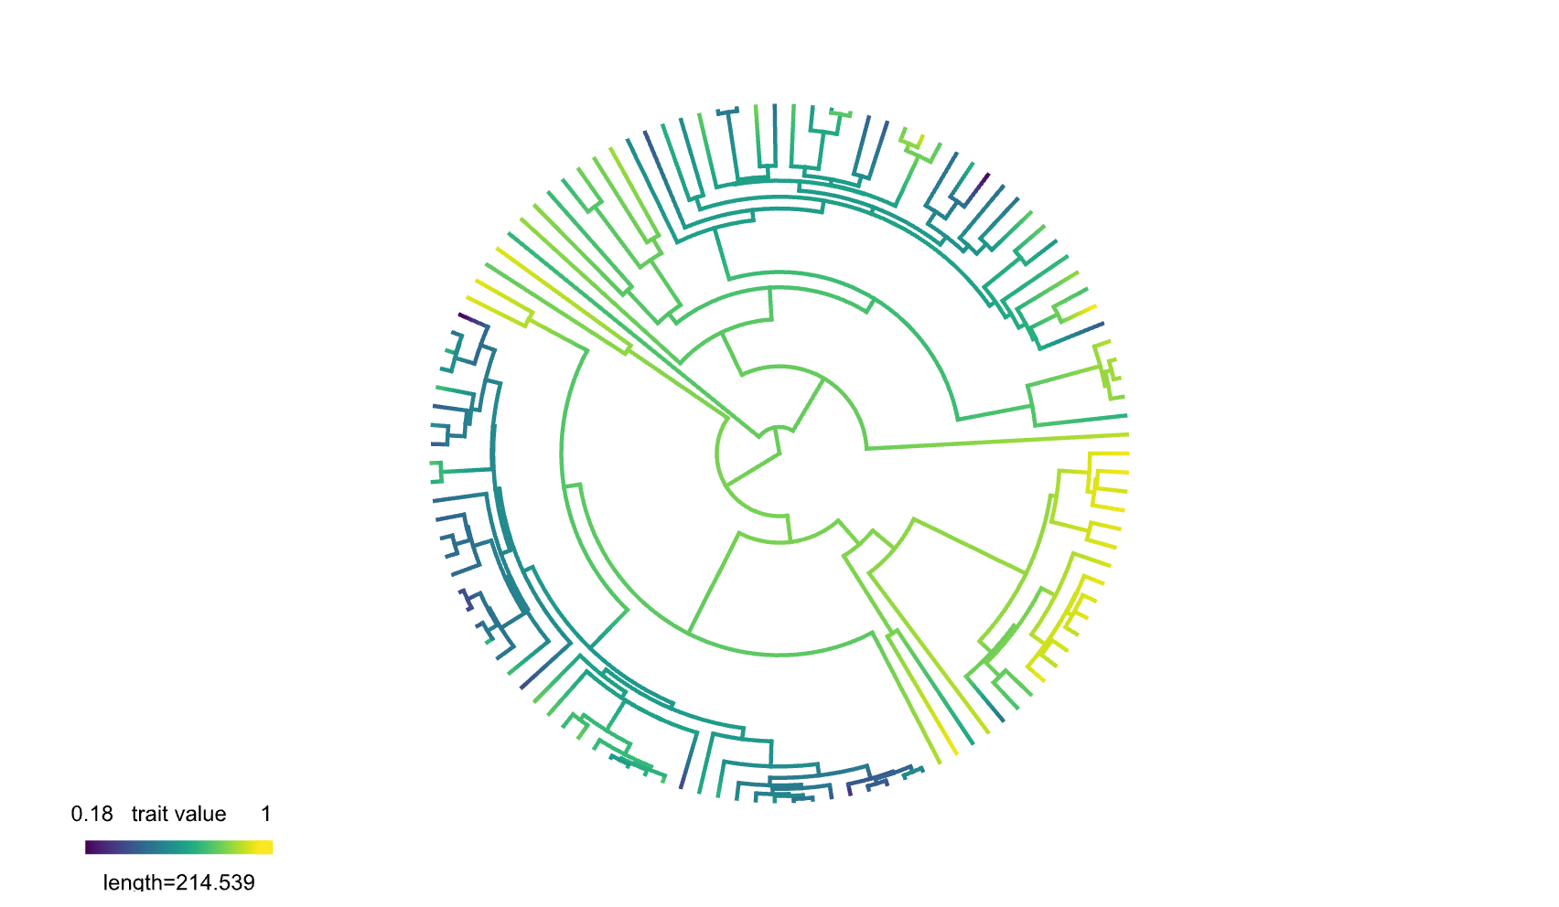
 | Total | Mammals | Ray-finned fish | Reptiles
Total | Age | Age | -- | Age
LINEs | -- | -- | Proportion | --
SINEs | -- | -- | Proportion | --
LTR retrotransposons | Age | Age | -- | --
DNA transposons | Proportion | Proportion | -- | --
Repeat
Clade
^{|β|}
0 1.19 3.78 9.44 21.8
Summary of linear models explaining gene density across different clades and repetitive element types. Each cell indicates the terms from the best-fit model (selected based on AIC), including repeat age, repeat volume, and any interactions. Models with any non-significant terms were excluded. Cell color indicates the magnitude of the beta coefficient (predictor variables are normalized from 0 to 1). The shade of cells is on a log scale. Cells representing models where beta coefficients have the opposite sign from the predicted hypothesis are outlined in red.

