Slide 1
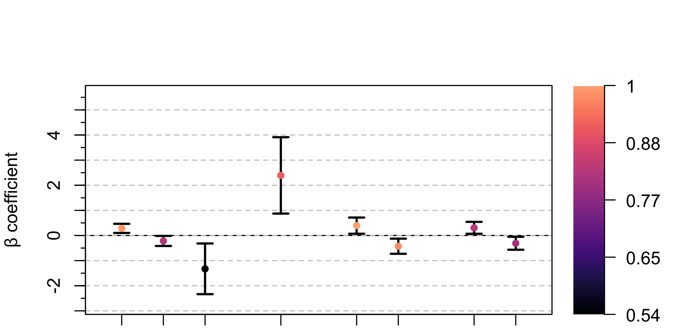
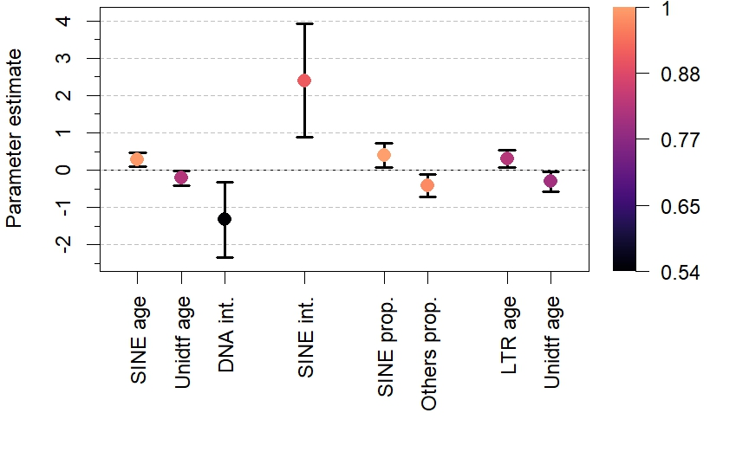


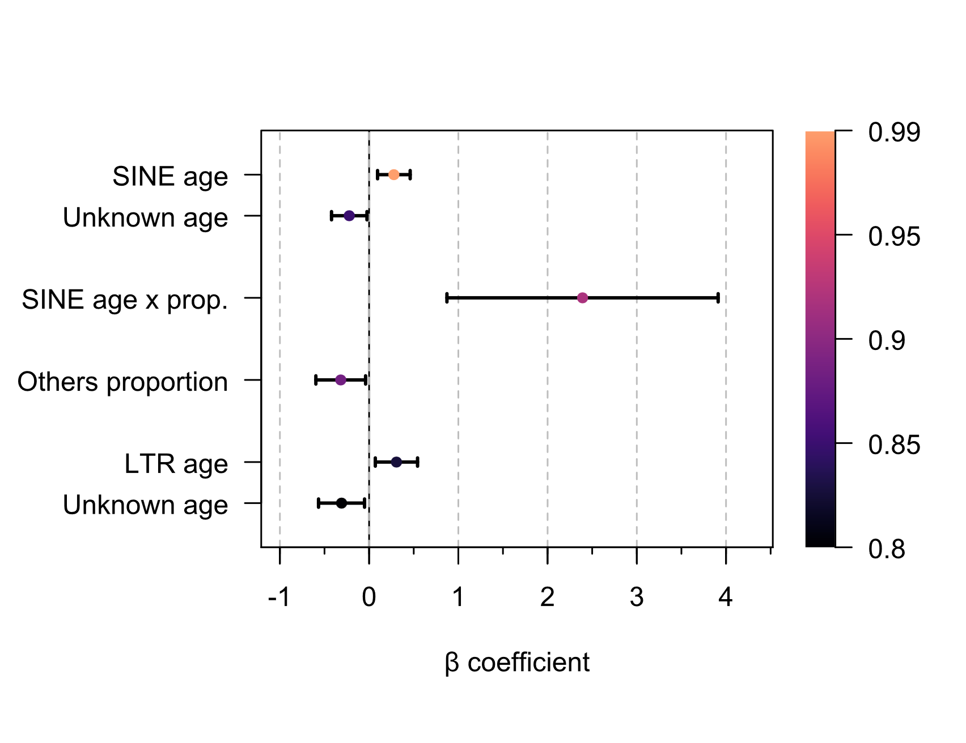
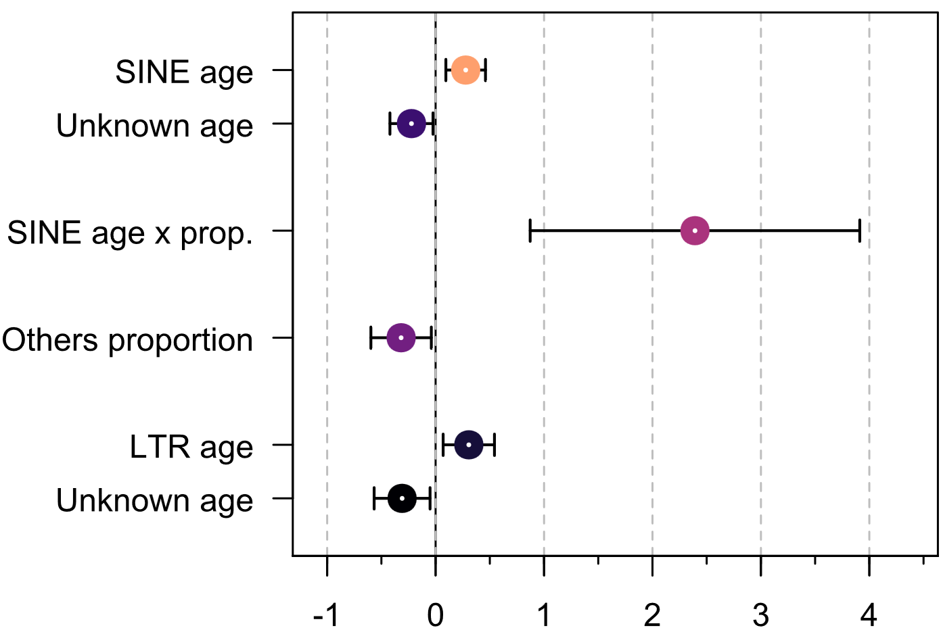
Ray-finned
fish
All clades
Mammals
Reptiles
All clades
Mammals
Ray-finned fish
Reptiles
Unknown age
Variable
importance
Others proportion
SINE age
LTR age
Unknown age
DNA age x prop.
SINE age x prop.
SINE proportion
Variable importance
Variable importance
0.8 0.85 0.9 0.95 0.99
Variable importance
Variable importance
0.8 0.85 0.9 0.95 0.99
0.8 0.85 0.9 0.95 0.99
Variable importance
0.8 0.85 0.9 0.95 0.99
Variable importance
0.8 0.85 0.9 0.95 0.99
All
species
Mammals
Ray-finned
fish
Variable importance
Reptiles
0.8
0.85
0.9
0.95
0.99
β coefficient

Slide 2
