Slide 1



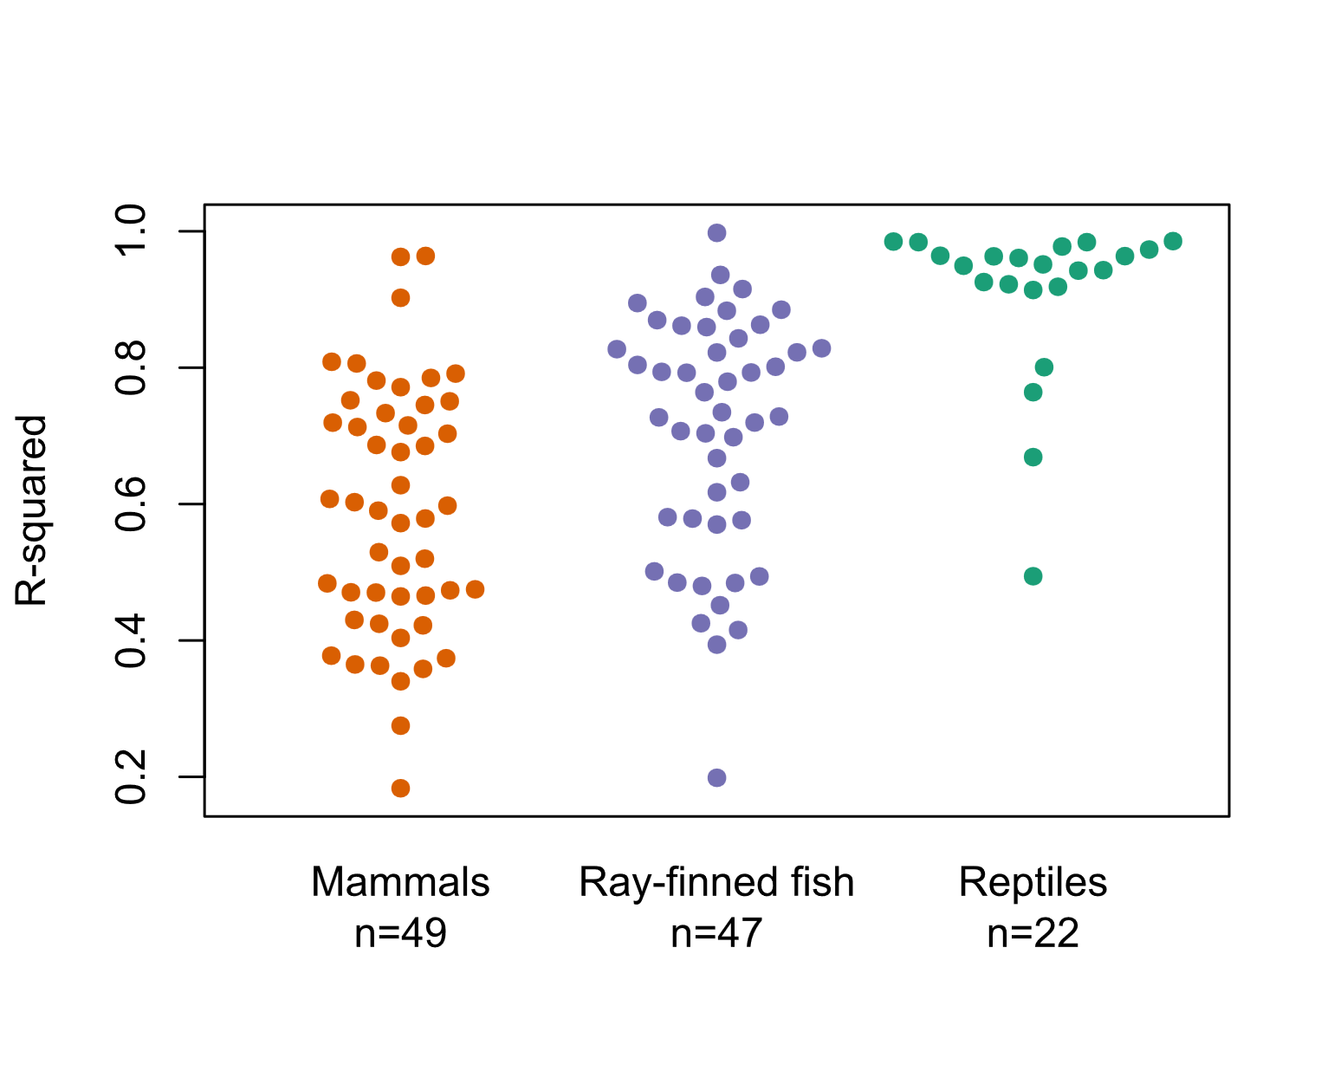
R²
R²
Phylogenetic ANOVA found no evidence that mean R²s differ between any clades.

