Slide 1
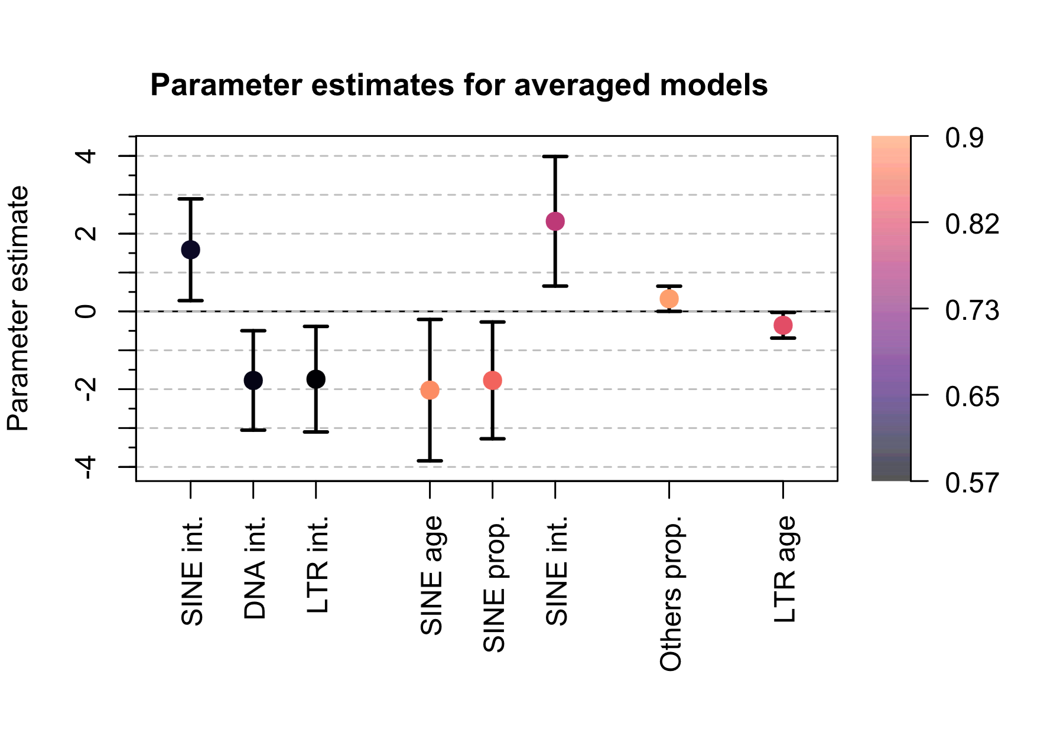
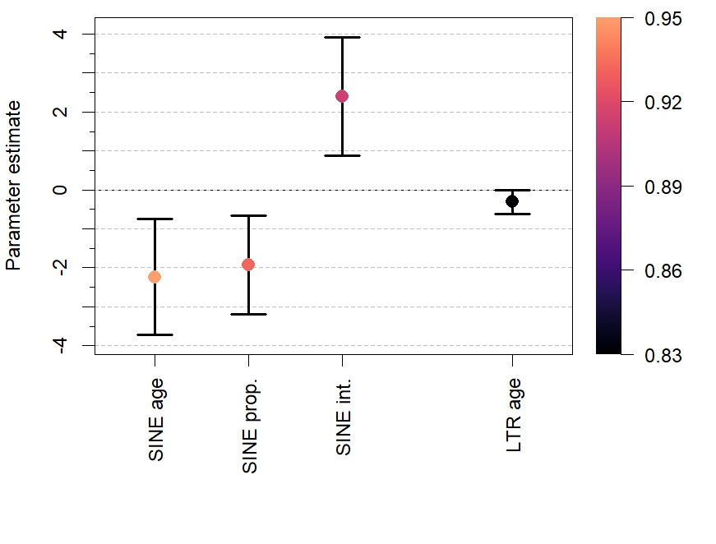
All clades
Mammals
Ray-finned
fish
Reptiles
Β-coefficient
Variable importance
Variable importance
Mammals
Reptiles
All clades
Mammals
Ray-finned
fish
Reptiles
Β-coefficient
Variable importance

