Slide 1
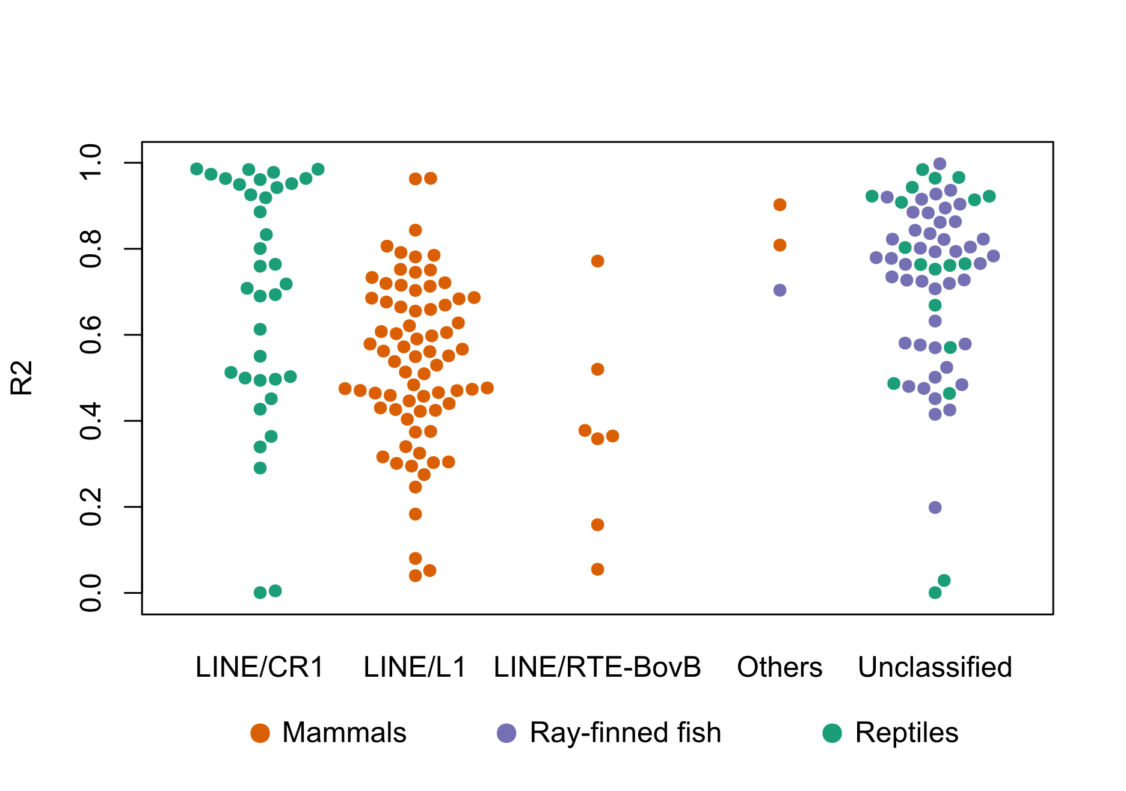
We hypothesized that different repeat types exhibit unique affinities for genomic regions, shaping the diversity of gene density variation across genomes. Yet, the dominant repeat class in each genome is consistent within clades, suggesting factors beyond repeat type also at play in shaping gene density variation across genomes.
R²
Largest repeat class in each genome

