Slide 1
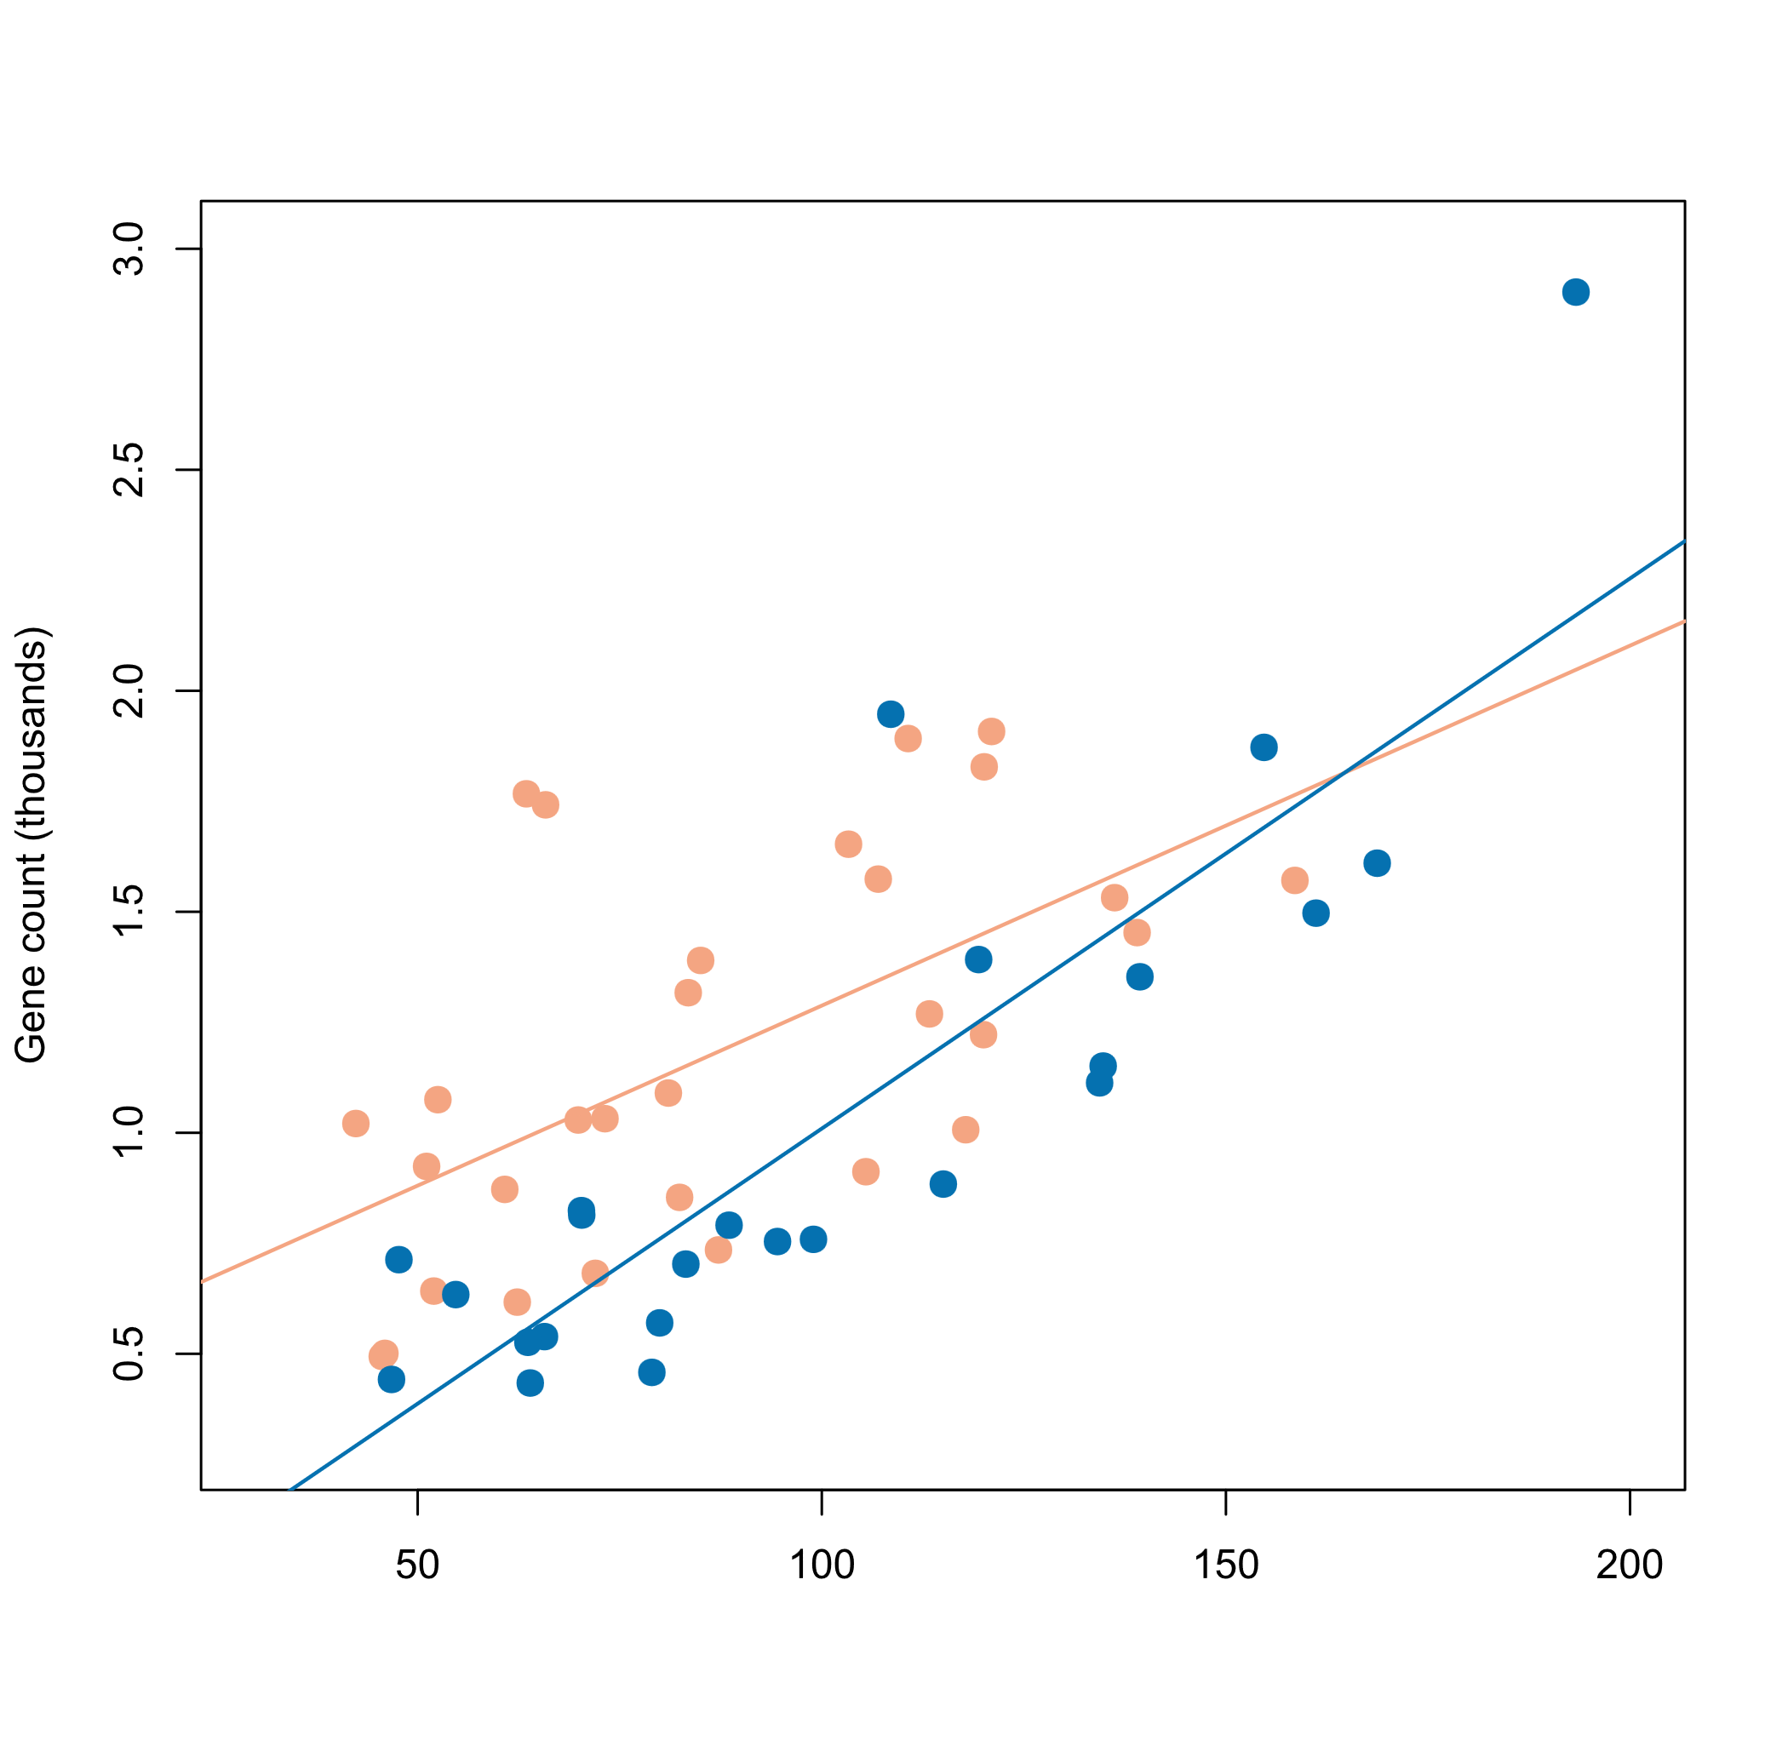
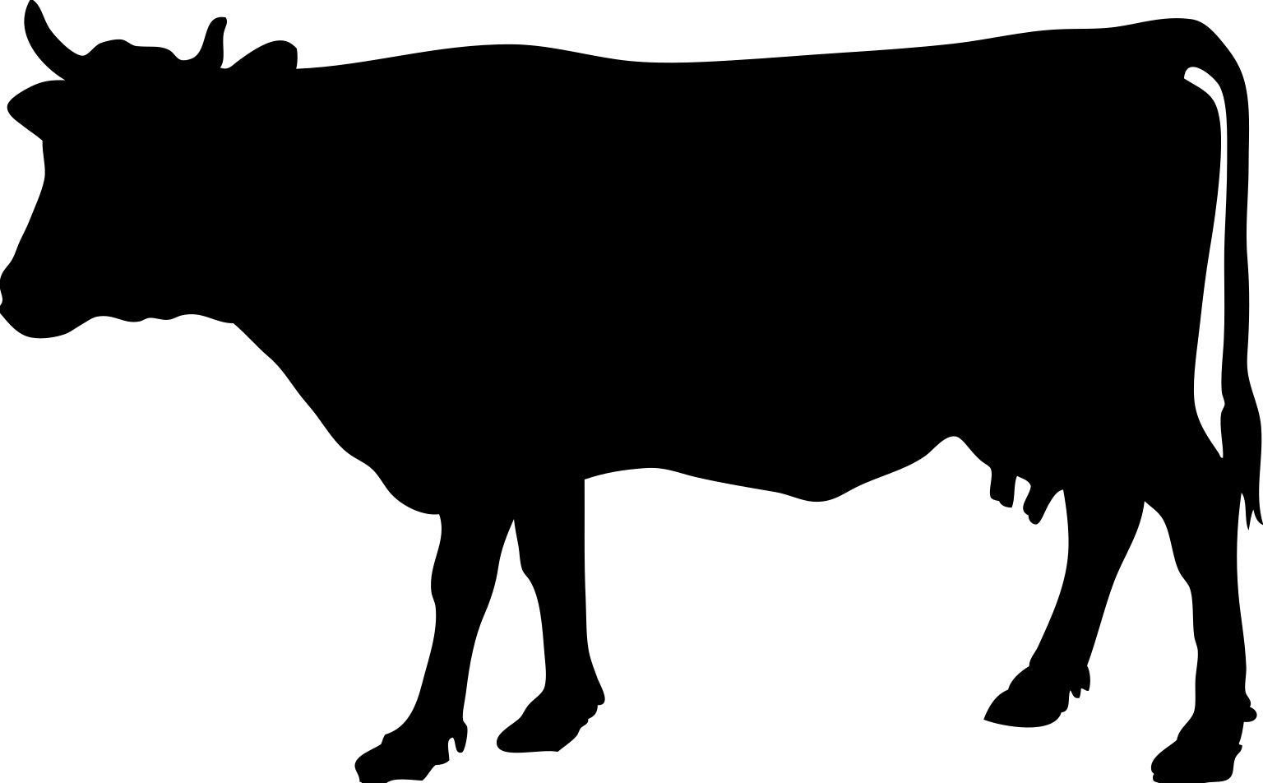
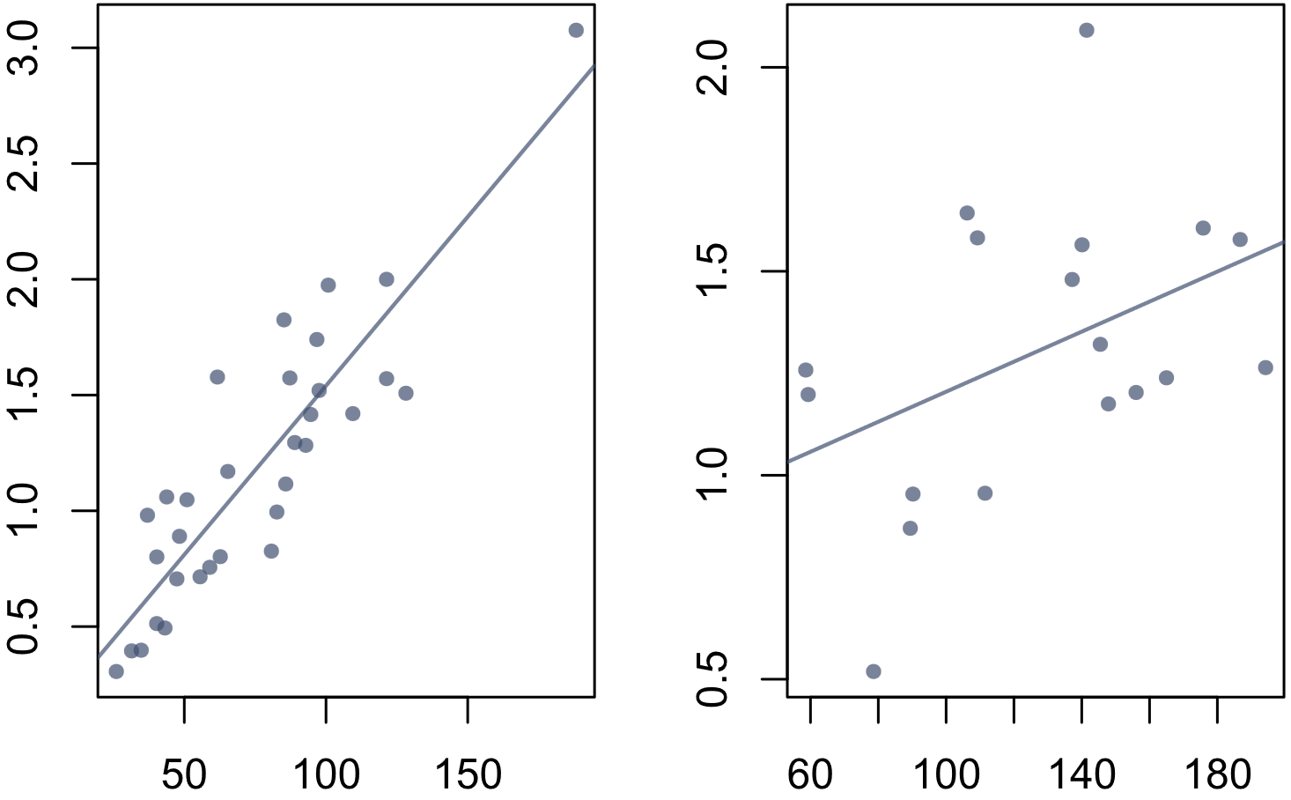
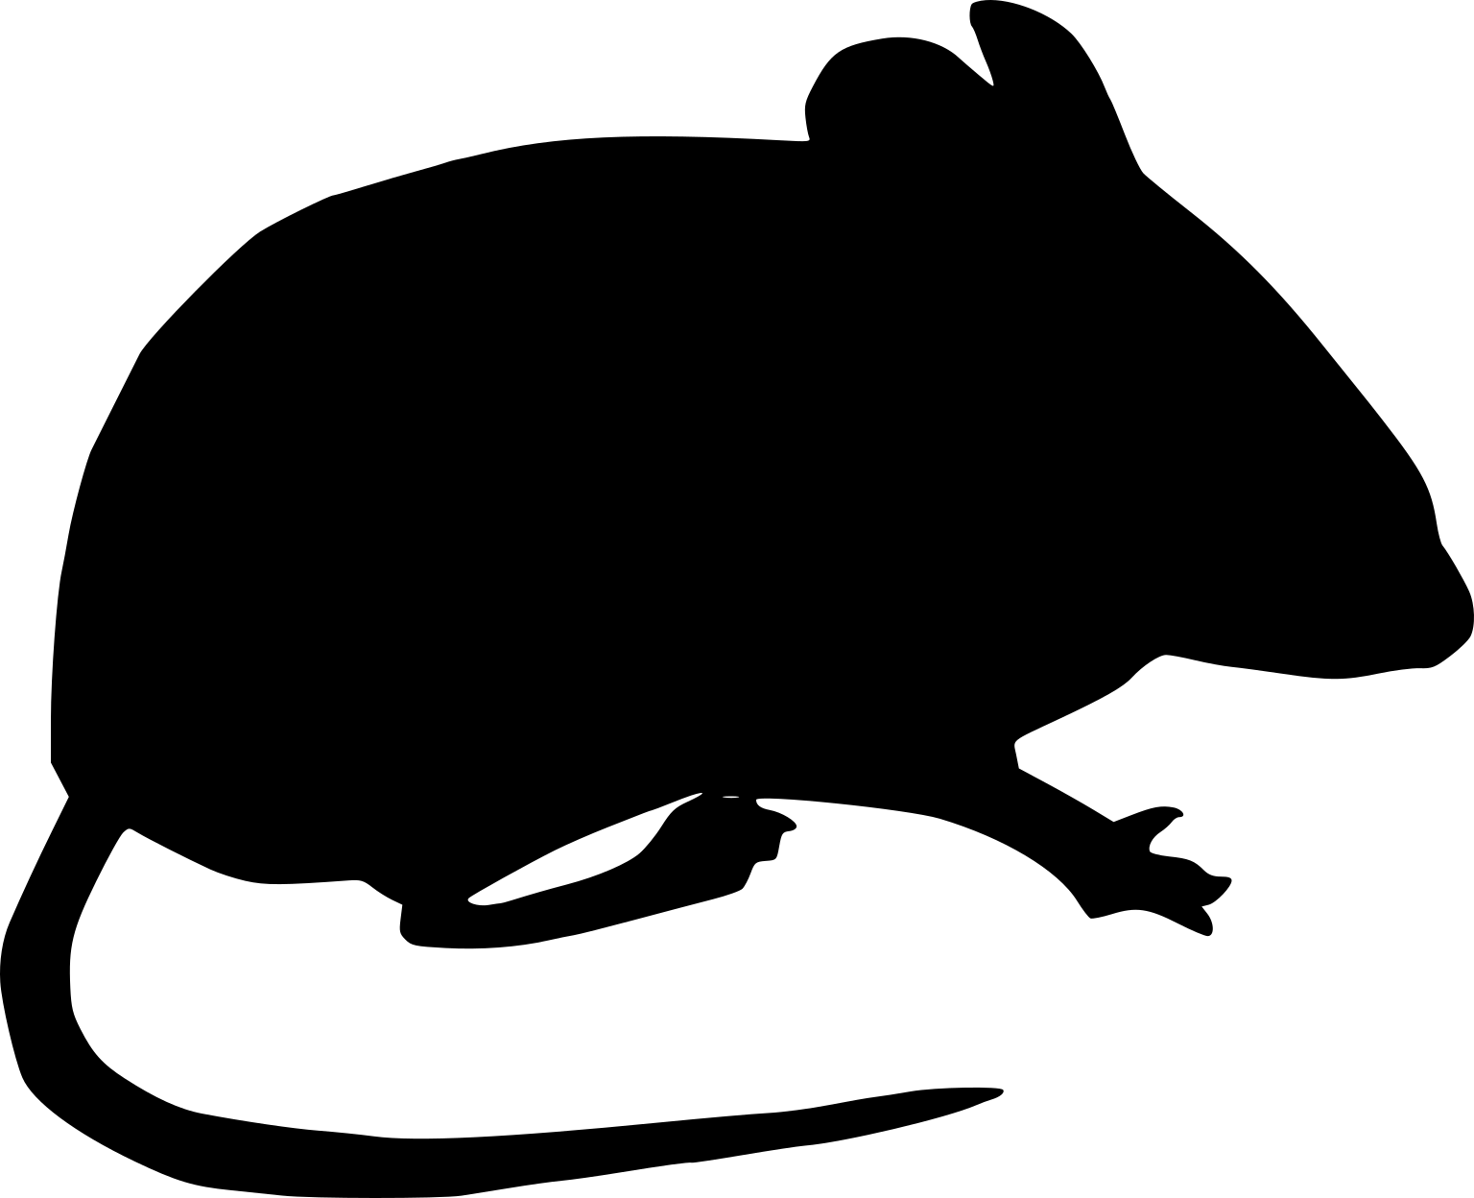
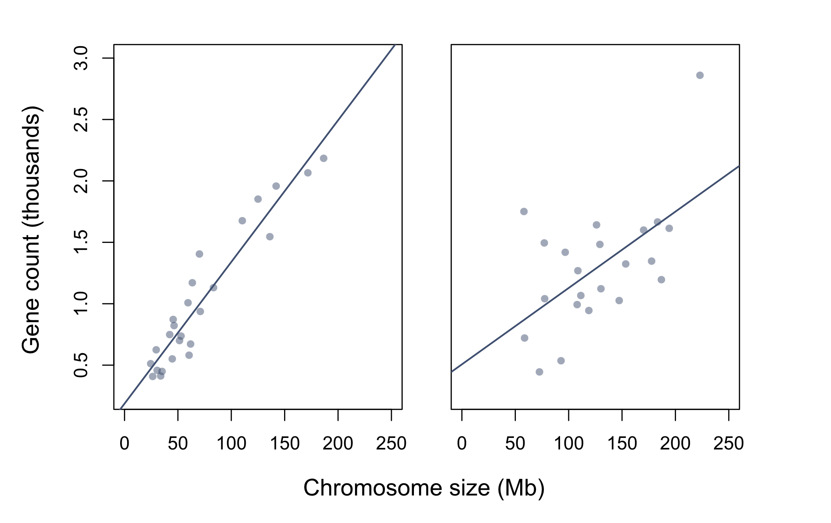
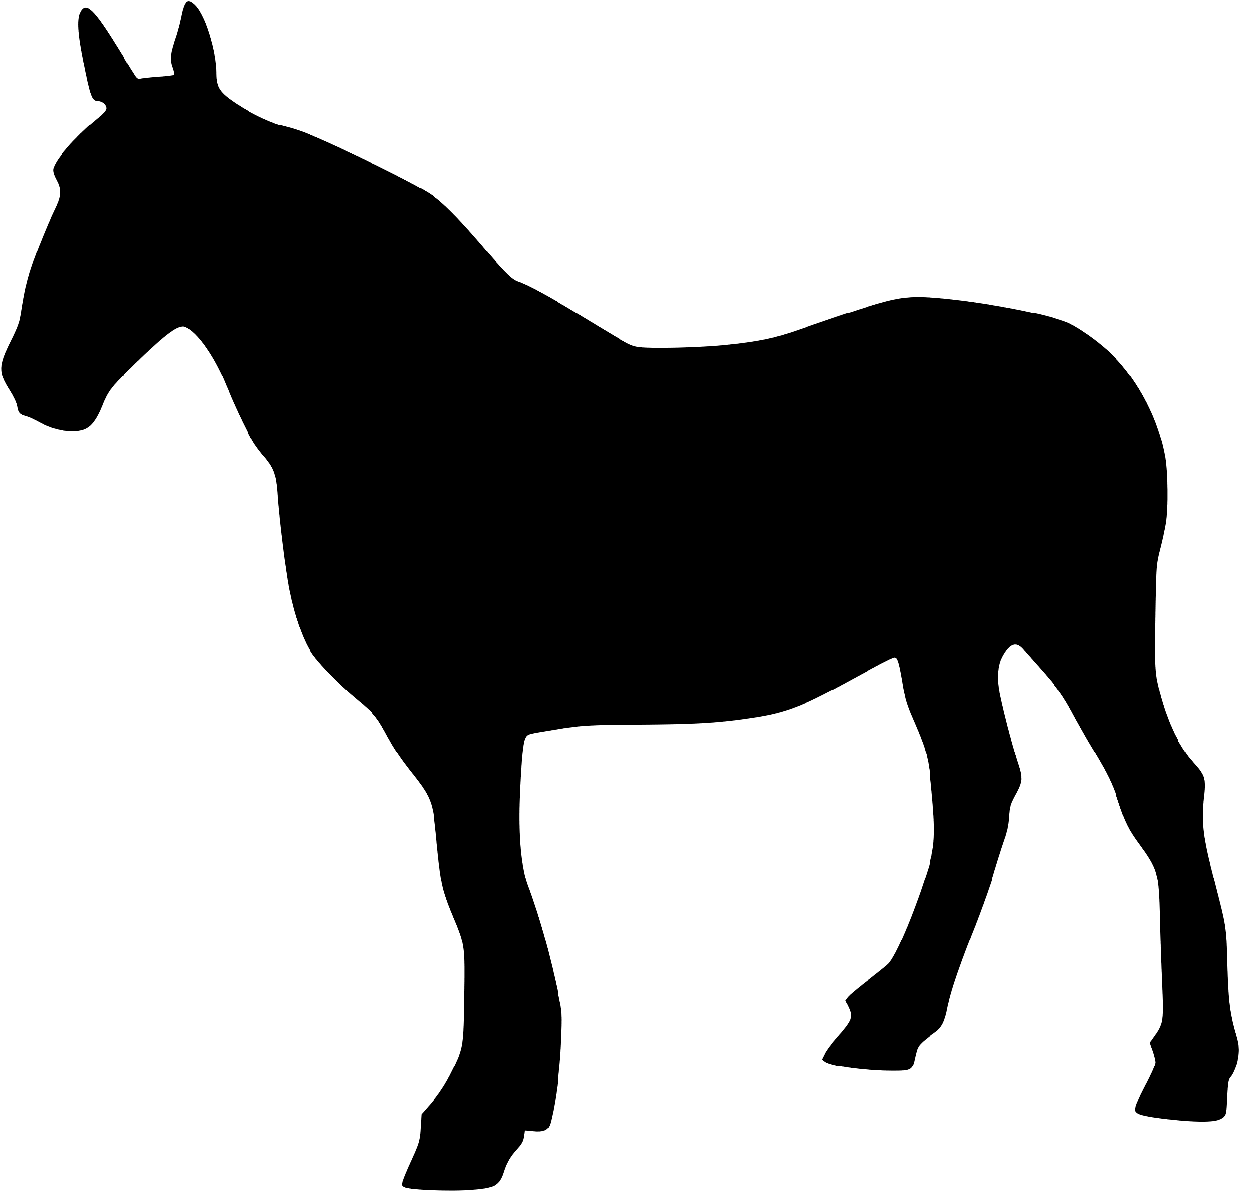
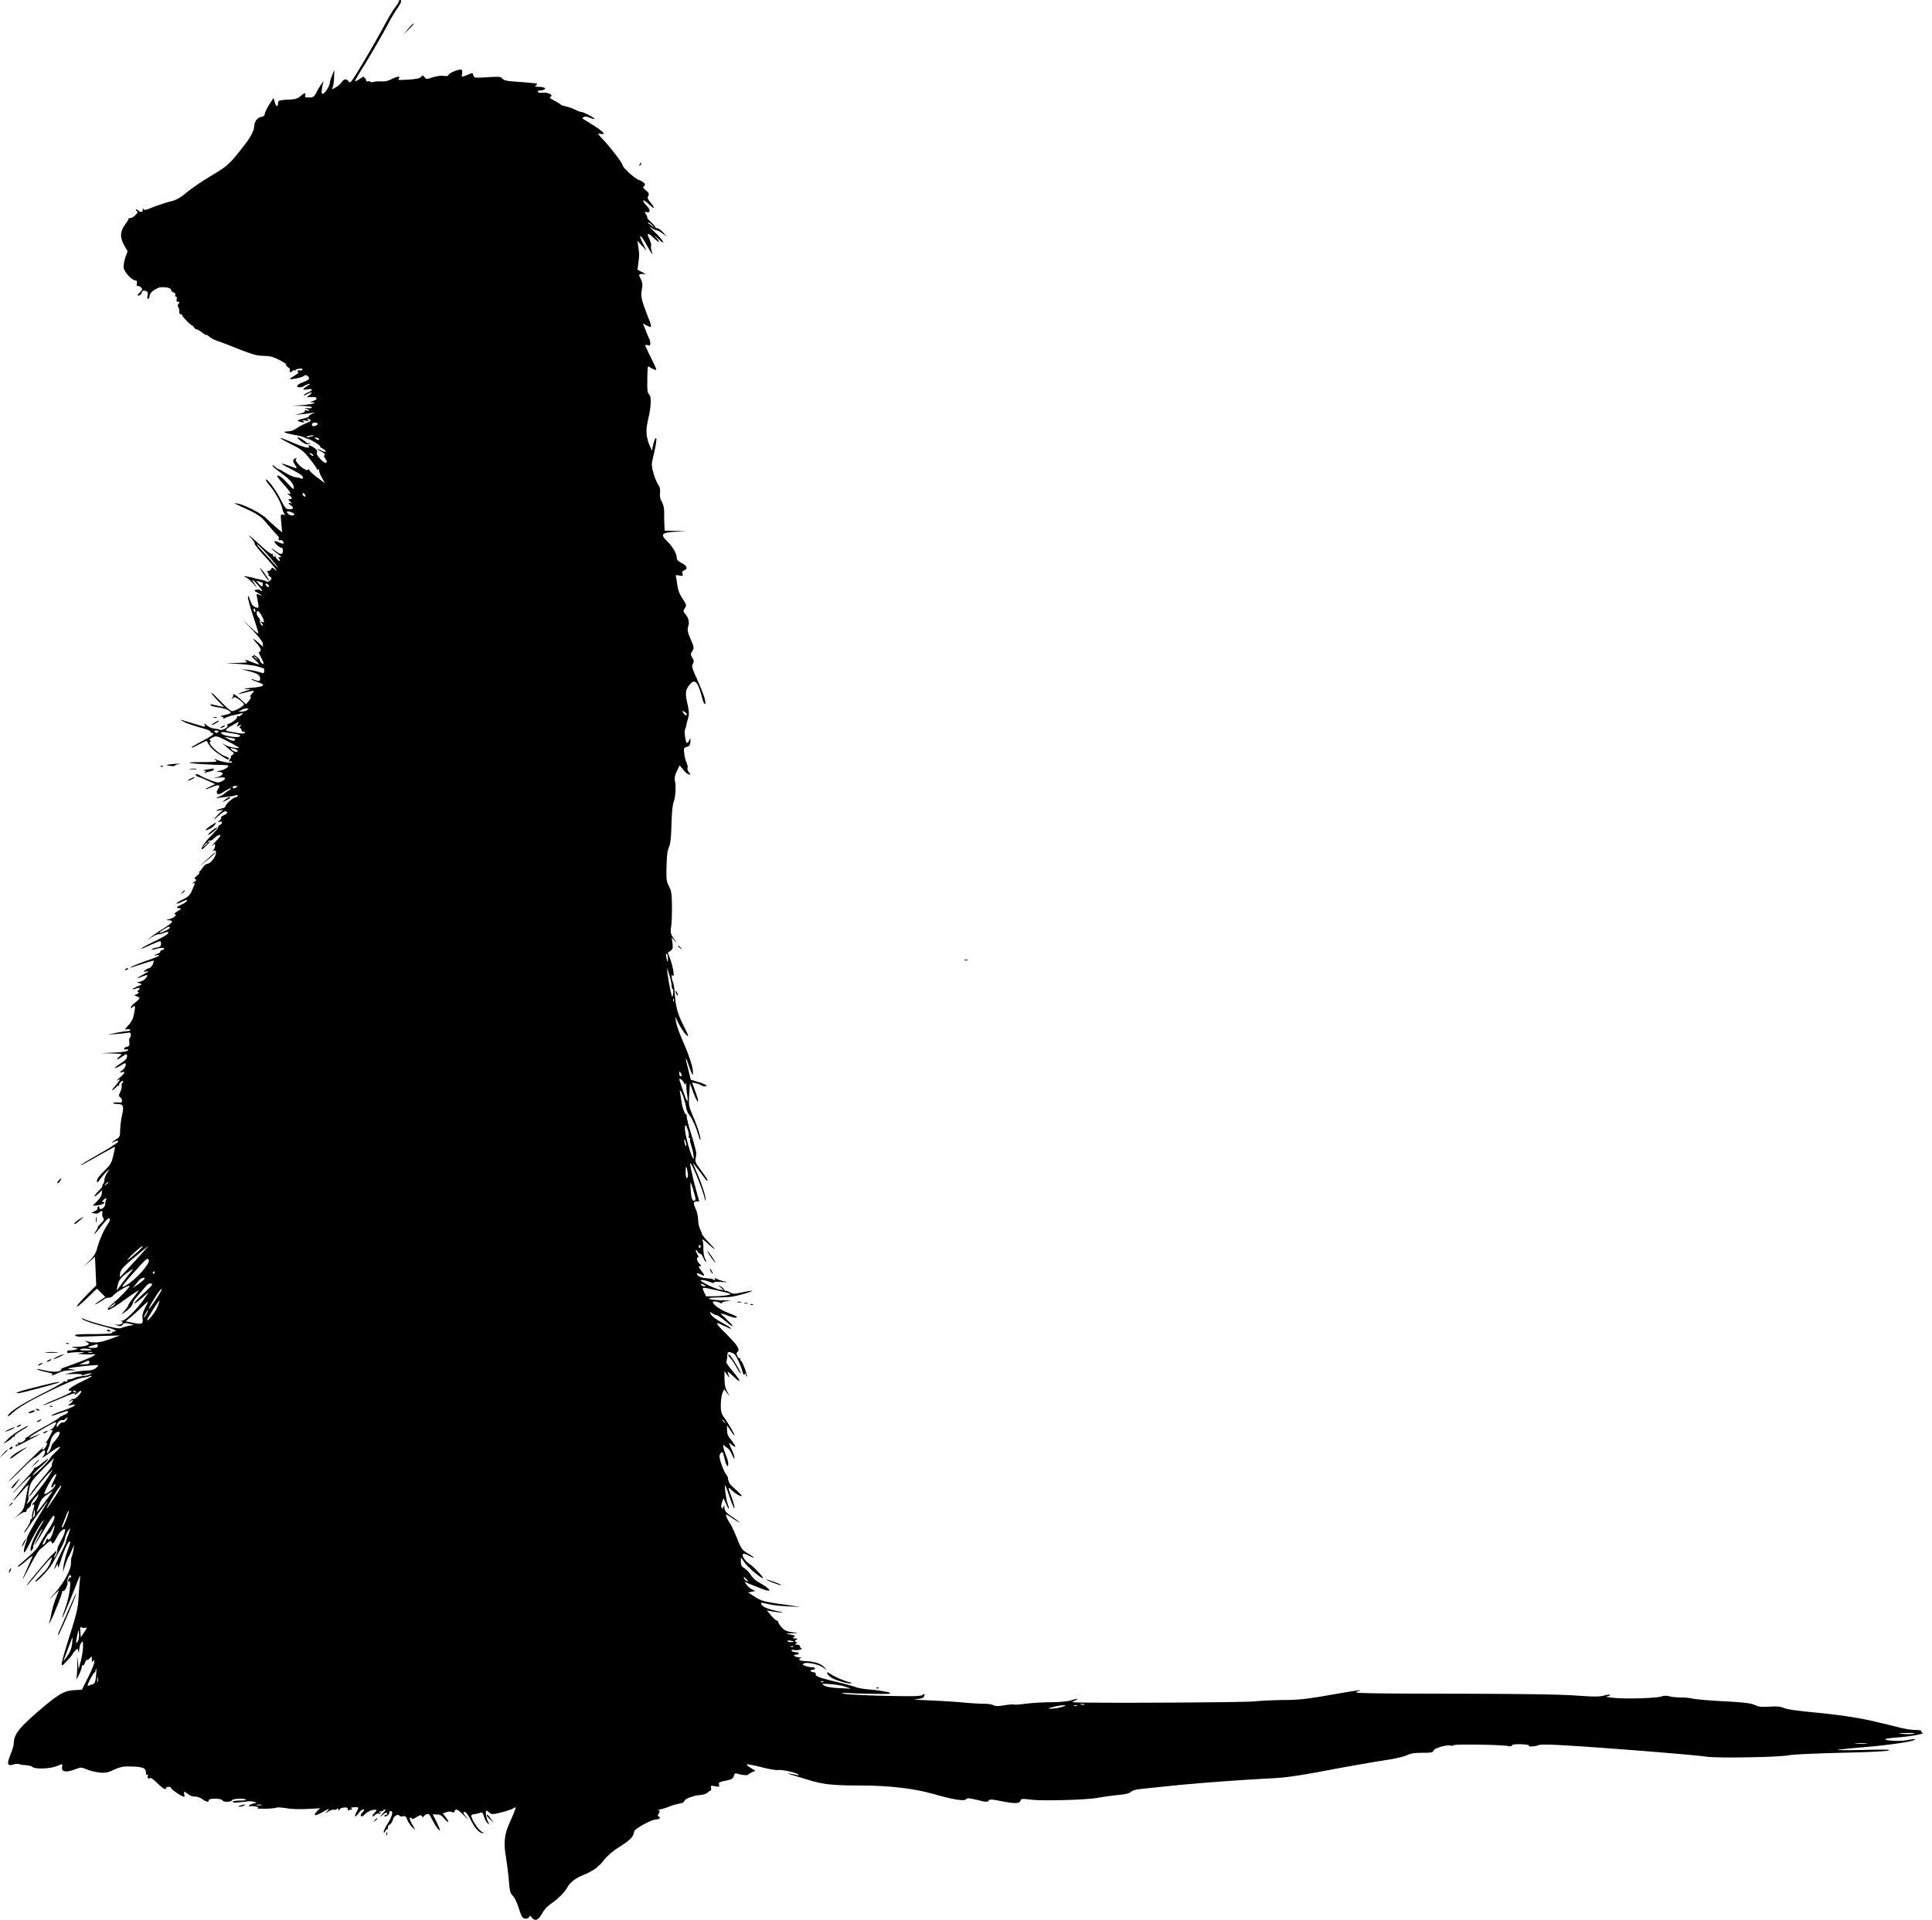
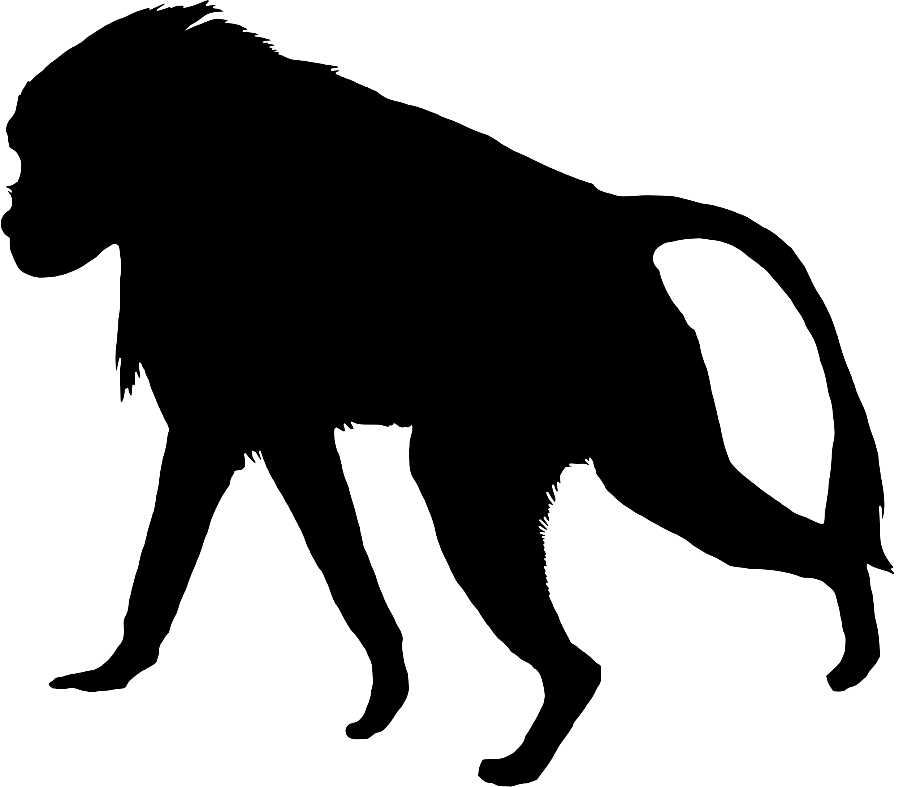

Domestic cattle; R² = 0.36
North American deer mouse; R² = 0.73
Gene count (thousands)
Gene count (thousands)
Deer mouse:
Edwin Price
https://creativecommons.org/licenses/by/4.0/
A
B
R² = 0.79
R² = 0.18
Chromosome size (Mb)
Chromosome size vs gene count for all chromosomes in the domestic cattle (coral) and North American deer mouse (blue). Trendlines depict simple linear regressions for each genome. Data points for the deer mouse show less deviation than those for the cow from each species' respective trendline, indicating more gene density variation in the cow genome. In this study, gene density variation is represented by the R² value of a genome’s linear regression model (see legend); chromosome size explains 73% of variance in deer mouse gene count but only 36% in cow.
Chromosome size (Mb)
R² = 0.34
R² = 0.90

Slide 2
