Slide 1
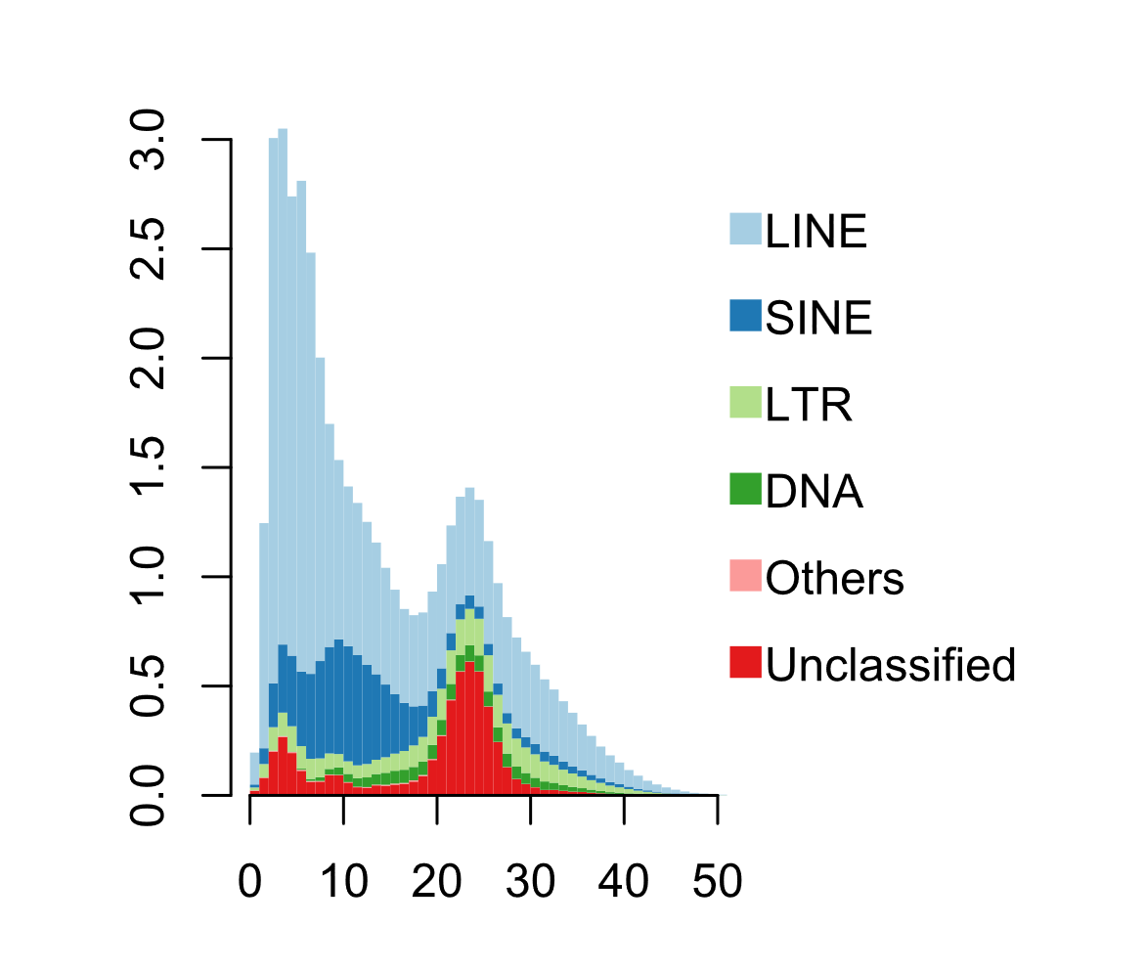
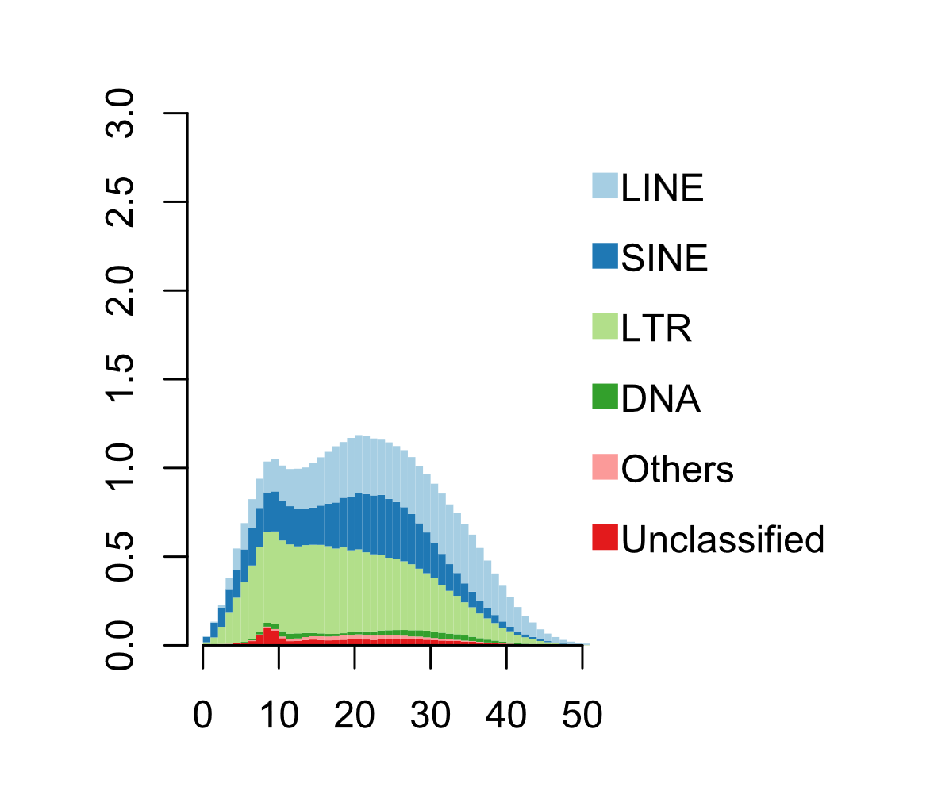
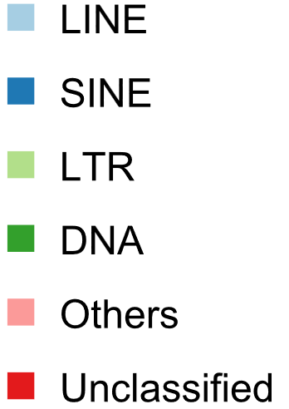


Deer mouse:
Edwin Price
https://creativecommons.org/licenses/by/4.0/
A
B
R²=0.36
R²=0.73
Percent of genome
Kimura 2-parameter divergence
Domestic cattle shows high gene density variation and high repeat activity while North American deer mouse shows low gene density variation and low repeat activity. We hypothesized that recent repeat expansions increase gene density due to repeats preferentially expanding in some genomic regions but not others.

Slide 2
