Slide 1
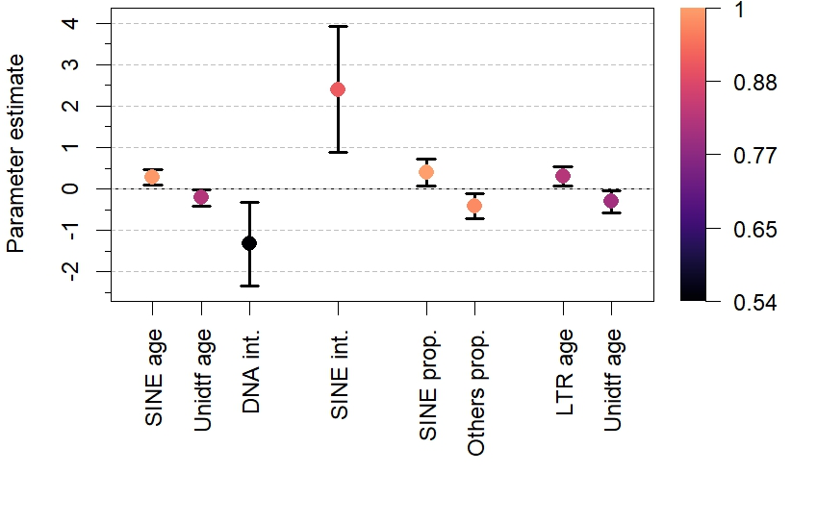
Ray-finned
fish
All clades
Mammals
Reptiles
Variable importance

