Slide 1







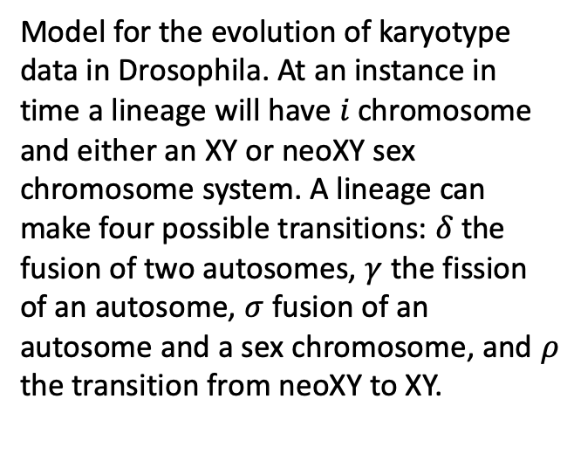

monocentric
ρ
Model for the evolution of karyotype data in Drosophila. At an instance in time a lineage will have $i$chromosome and either an XY or neoXY sex chromosome system. A lineage can make four possible transitions: $δ$ the fusion of two autosomes, $γ$ the fission of an autosome, $σ$ fusion of an autosome and a sex chromosome, and $ρ$ the transition from neoXY to XY.
$$δ$$
$$γ$$
$$i−1 i i+1 2i$$
$q01$
$q10$
holocentric
$$δ$$
$$γ$$
ρ
$$i−1 i i+1 2i$$

