Slide 1







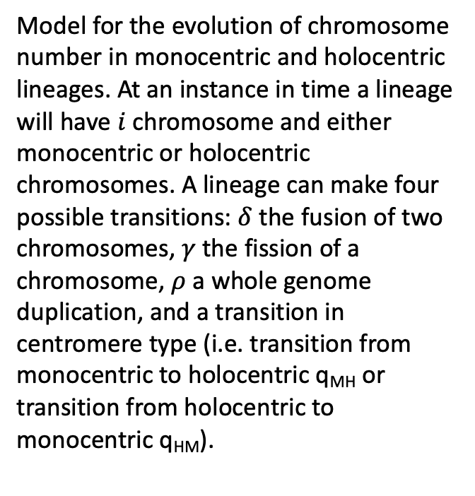

monocentric
ρ
Model for the evolution of chromosome number in monocentric and holocentric lineages. At an instance in time a lineage will have $i$chromosome and either monocentric or holocentric chromosomes. A lineage can make four possible transitions: $δ$ the fusion of two chromosomes, $γ$ the fission of a chromosome, $ρ$ a whole genome duplication, and a transition in centromere type (i.e. transition from monocentric to holocentric q_{MH} or transition from holocentric to monocentric q_{HM}).
$$δ$$
$$γ$$
$$i−1 i i+1 2i$$
$qMH$
$qHM$
holocentric
$$δ$$
$$γ$$
ρ
$$i−1 i i+1 2i$$

