Slide 1
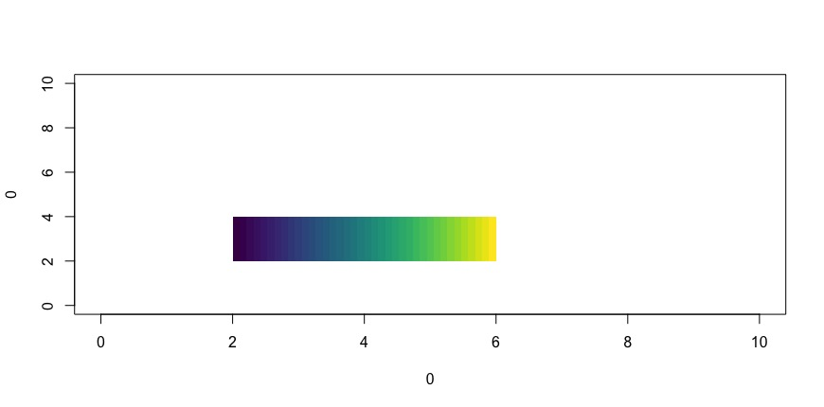
Lepidoptera
Mecoptera
Diptera
P(monocentric)
0 1
2 29 57 84
Haploid number

