Slide 1
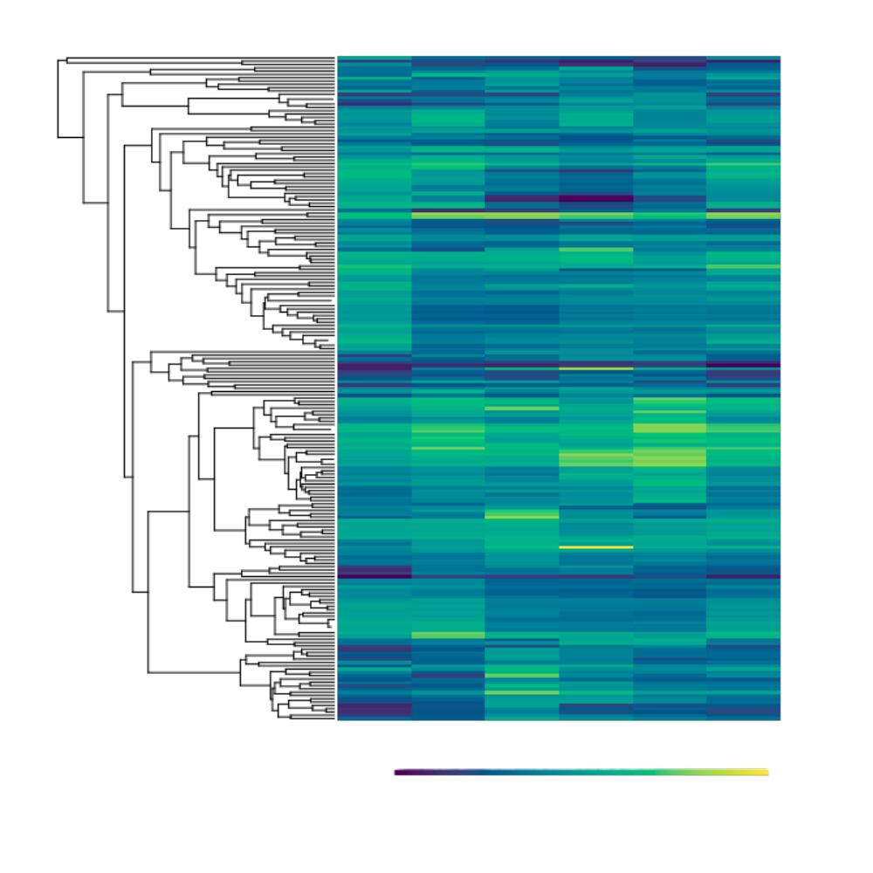
2-mer
3-mer
4-mer
5-mer
6-mer
Total
Ephemeroptera/ Odonata
Blattodea
Hemiptera
Hymenoptera
Coleoptera
Diptera
Lepidoptera
Standardized Values
-3 3

