Slide 1
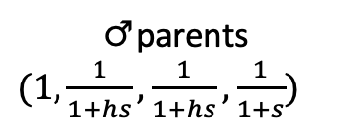
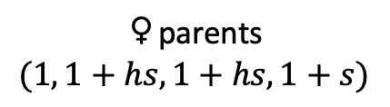

♀
Change in allele frequency
♂
New generation
♀gametes, ♂ gametes,
$$rd, h, s$$
♀parents
$$(1, 1+hs, 1+hs, 1+s)$$
♂parents
$(1, \frac{1}{1+hs},\frac{1}{1+hs},\frac{1}{1+s}$)
♀gametes
♂ gametes
OSR bias
Selection common sex
Rare sex Drift

