Slide 1

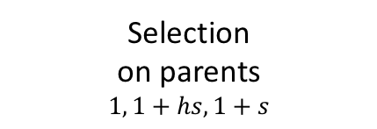
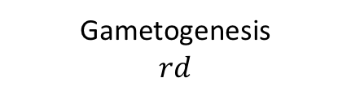

OSR bias
$$β, N$$
Selection
on parents
$$1, 1+hs, 1+s$$
Selection
on parents
$$1, \frac{1}{1+hs}, \frac{1}{1+s}$$
♀
♂
Random
Fertilization
Gametogenesis
Gametogenesis
$$rd$$
Sex determining locus X allele
Sex determining locus Y allele
Sexually Antagonistic locus (A₁, A₂)

