Slide 1

Header
Coleville’s Community Park
Home
LOGO
Quick Links:
Home
Navigation
Activities
About
Welcome section:
Welcome!
(also anything happening to the park
such as construction, closure, maintenance)
welcome message
Highlight reel
Highlight 1
Highlight 2
Highlight 3
Highlight 4
Highlight 5
Highlight info / picture
Highlight info / picture
Highlight info / picture
Highlight info / picture
Highlight info / picture
Footer

Slide 2
Header
Coleville’s Community Park
Navigation
LOGO
Quick Links:
Home
Navigation
Activities
About
Map
Address info
Address: 1234 Park Ave
Links to various maps
Parking info
(cost, availability, alternative parking like street parking)
Footer

Slide 3
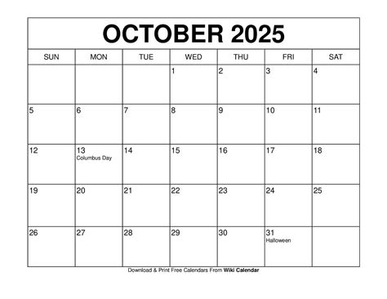
Header
Coleville’s Community Park
Activities
LOGO
Quick Links:
Home
Navigation
Activities
About
Events Calander:
Activities:
Playground
Picnic area
Paths / trails
Sport field(s)
Restroom location(s)
- Event 1 -
Details, important info, requirements, dates, etc
- Event 2 -
Details, important info, requirements, dates, etc
- Event 3 -
Details, important info, requirements, dates, etc
Footer

Slide 4
Coleville’s Community Park - About
Header
Coleville’s Community Park
About
Quick Links:
Home
Navigation
Activities
About
LOGO
Quick Links:
Home
Navigation
Activities
About
Short description of park’s history:
    Date founded
    Founders
    Original purpose and context
    Major achievements and milestones
Goals:
Preservation of nature
  Details of how this goal has been or is being completed
educating the community on sustainable practices
  Details of how this goal has been or is being completed
recycling, composting
  Details of how this goal has been or is being completed
Footer

Slide 5
Header
Coleville’s Community Park
Home
Header
Coleville’s Community Park
Navigation
Header
Coleville’s Community Park
Activities
Header
Coleville’s Community Park
About
Welcome!
Map
- Event 1 -
Details, important info, requirements, dates, etc.
- Event 2 -
Details, important info, requirements, dates, etc.
- Event 3 -
Details, important info, requirements, dates, etc.
Short description of park’s history:
Date founded
Founders
Original purpose and context
Major achievements and milestones
welcome message
Highlight reel
Highlight 1
Highlight info / picture
Activities:
Playground
Picnic area
Paths / trails
Sport field(s)
Restroom location(s)
Goals:
Preservation of nature
Details of how this goal has been or is being completed
educating the community on sustainable practices
Details of how this goal has been or is being completed
recycling, composting
Details of how this goal has been or is being completed
Address info
Address: 1234 Park Ave
Links to various maps
Footer
Parking info
(cost, availability, alternative parking like street parking)
Footer
Footer
Footer

