Slide 1
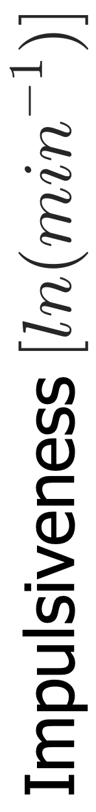
t_{rise} vs. t_{decay}
vs. t_{rise}, t_{decay,} t_{flare}
vs.
vs.
(a)
(b)
Rise Phase Duration, t_{rise} [min]
Duration, t_{flare}
Decay Phase Duration, t_{decay} [min]
Flare Duration, t_{flare} [min]

Slide 2
vs. Reconnection Rate,
Impulsiveness
Reconnection Rate

Slide 3
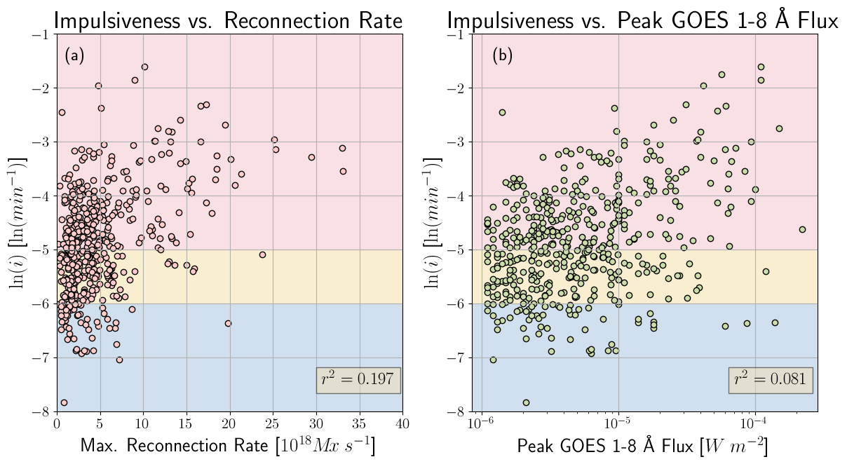
Max. Reconnection Rate
Peak GOES 1-8 Å Flux

Slide 4
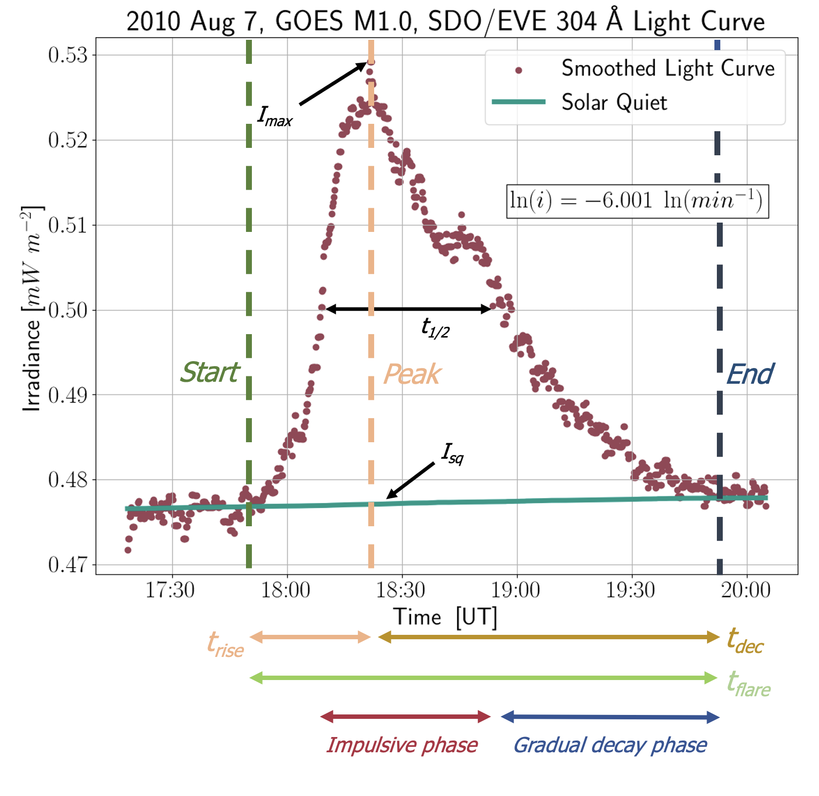
Start, impulsive phase*
Start, flare
Peak, flare
End, flare
Start, gradual decay phase*

