Slide 1
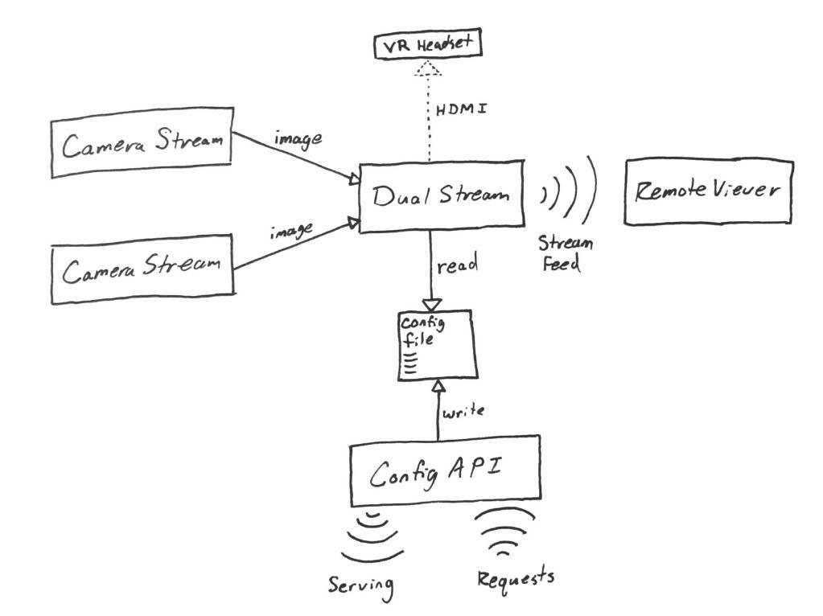

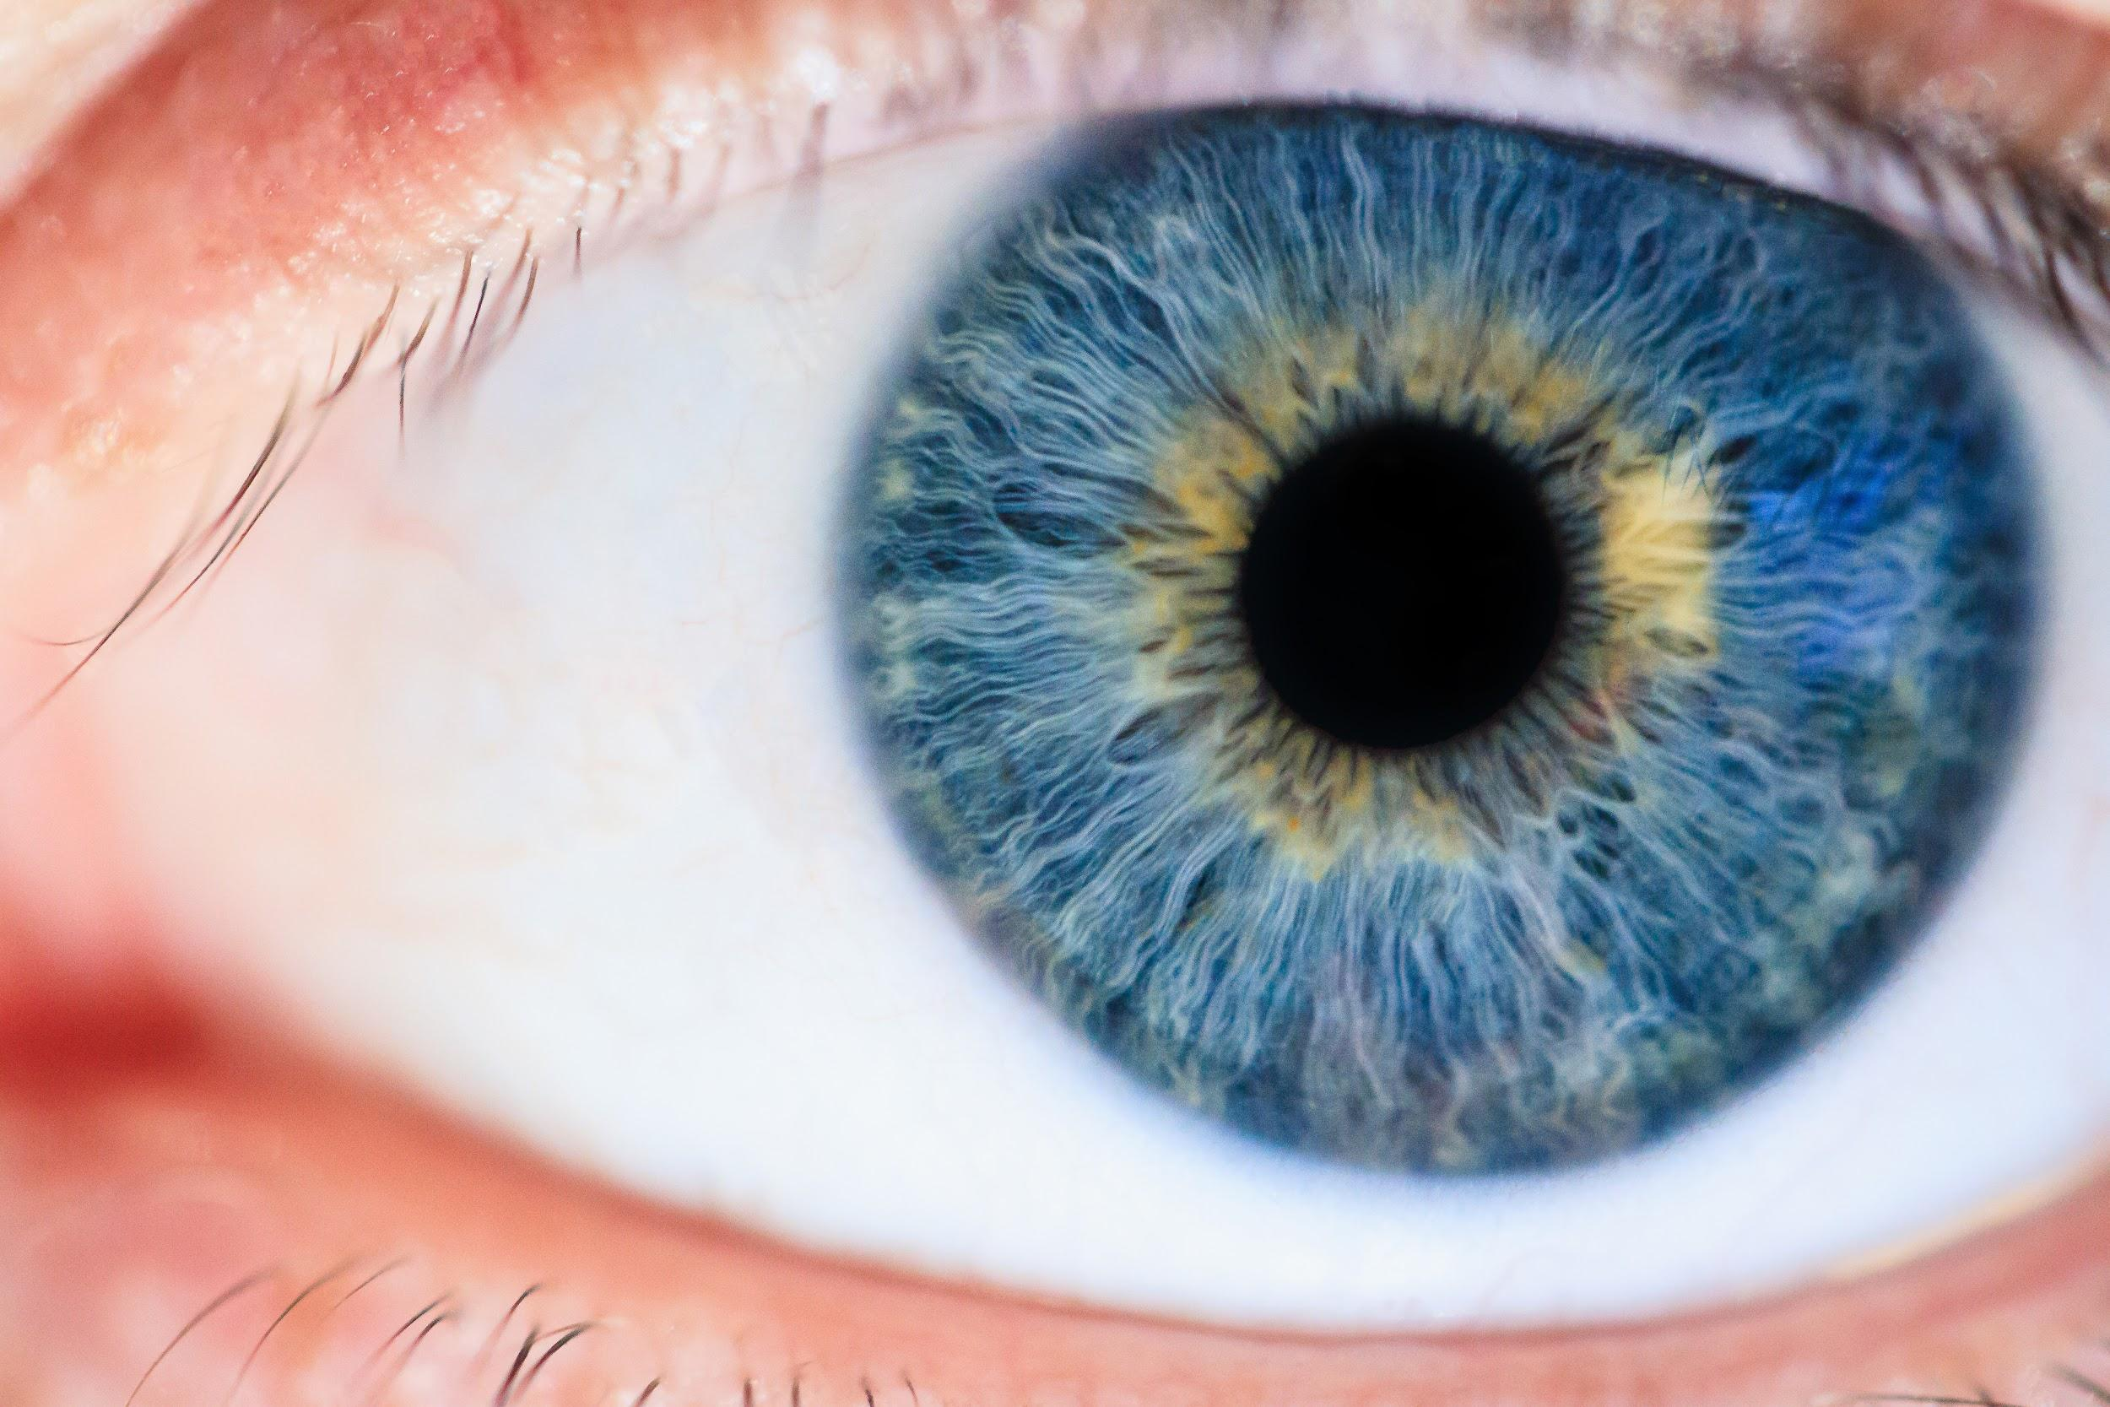

Real Time Telemedicine in Ophthalmology
Objective: Digitize slit-lamp microscope viewing such that multiple users in different locations can see a patient’s eye simultaneously.
;Bryce Kushner, Sam McCauley, Shelby Stocker, Cole Terrell

