Slide 1
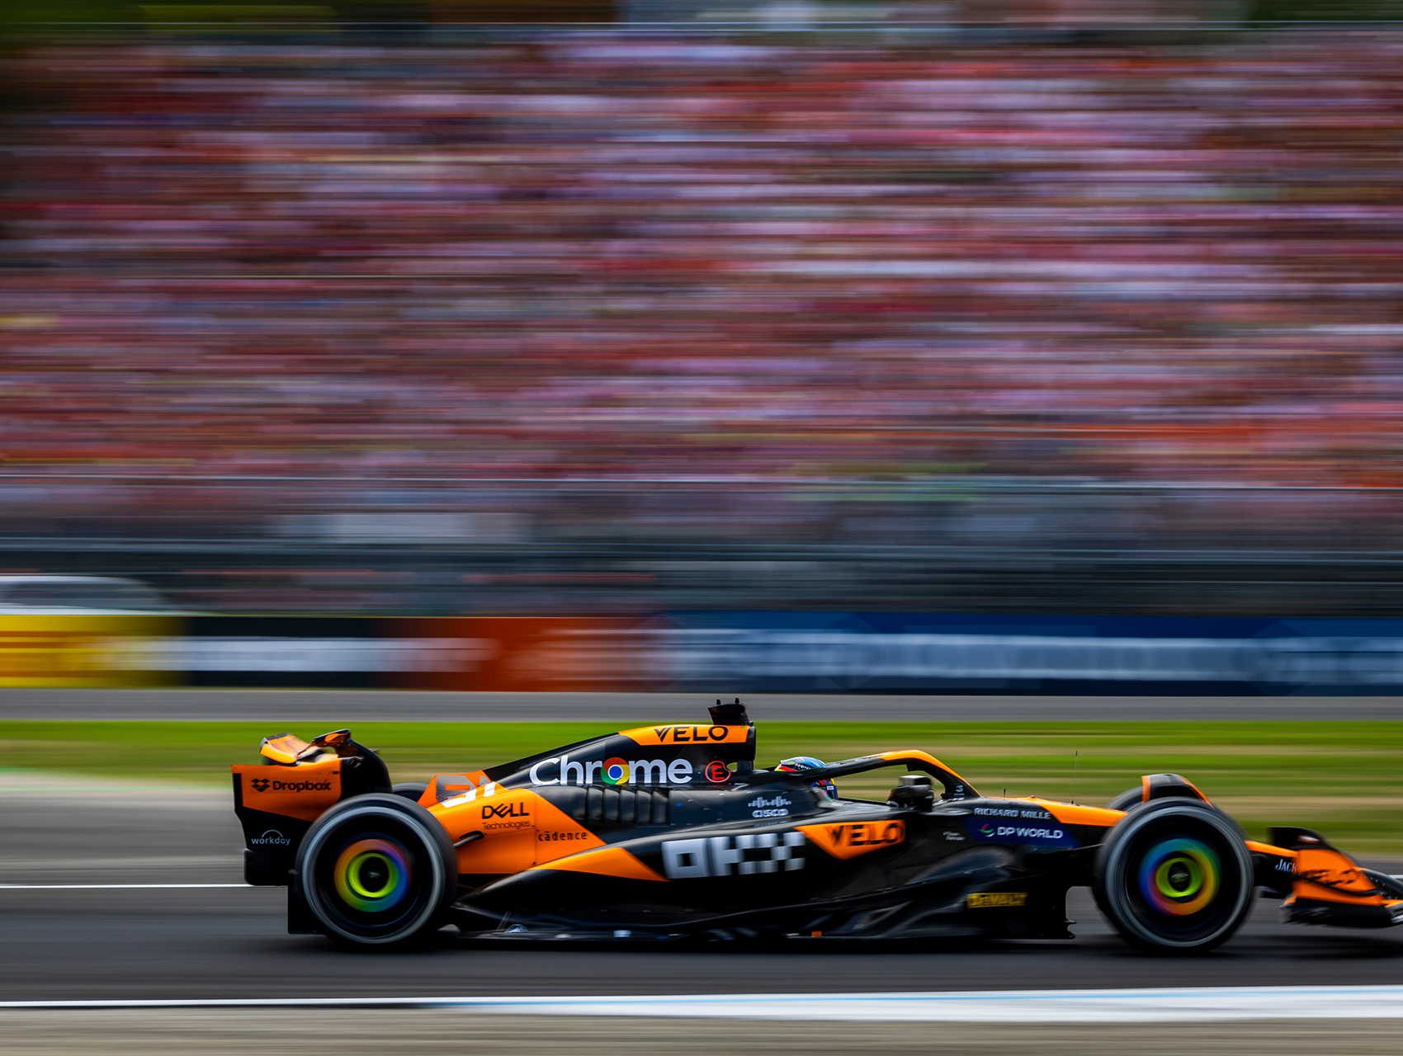
F1 Qualifying Data Analysis
By: Cole Wagner

Slide 2
Agenda
Project Goals
Literature Review
Data Source
Methods
Shiny Demonstration
Discussion

Slide 3

Project Goals
Goal
Use weather attributes to predict lap time for Formula One qualifying sessions.
Potential Consumer
Formula One teams who want to assess how well their drivers perform in various weather conditions.

Slide 4
Literature Review
“Formula 1 Lap Time Modeling Using Generalized Additive Models”
“Predicting the Outcome of NASCAR Races: The Role of Driver Experience”
Used a GAMM with random intercepts for driver to predict lap time during a race.
Predictors consisted of basic car, driver, and track information, such as lap, tire compound, team, etc.
Used model to run simulations to determine the best lap for a pit stop
Linear regression model to predict the finishing position of a NASCAR driver.
Mainly focused on the effect of driver experience and used interaction terms with starting position and track length

Slide 5
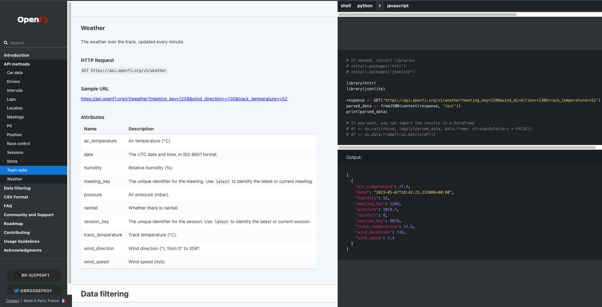
Data Source
OpenF1 API

Slide 6
Methods: Data Wrangling
Join session, lap, weather, track, and driver data from OpenF1
4,410 rows (laps) and 34 columns
Remove all laps with no weather data (12 rows)
KNN impute 19 remaining missing values
Use type_convert() function

Slide 7
Methods: Data Wrangling (cont.)
Set ID variables and Rainfall to factors
Apply the “107% rule”
Select only relevant weather and track variables
Normalize numeric predictors and dummy encode categorical predictors
Final Dataset: 3,967 rows and 11 columns (outcome: lap duration)

Slide 8
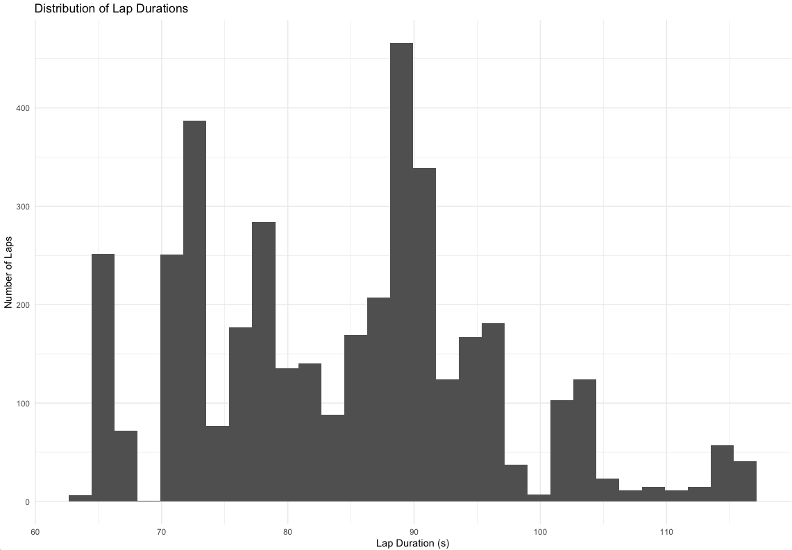
Methods: Understanding the Outcome
Summary Statistics
Minimum | 64.31
1st Quartile | 73.99
Median | 85.68
Mean | 84.48
3rd Quartile | 91.18
Maximum | 116.98

Slide 9
Methods: Model Comparison
Model Type | MAE | RMSE | R Squared
Linear Regression | 0.939 | 1.337 | 0.987
Bayesian LR w/ Random Intercept for Track | 0.936 | 1.337 | 0.987
Random Forest | 0.378 | 0.522 | 0.998
XGBoost | 0.402 | 0.547 | 0.998
*All metrics are resampled means from 10-Fold CV Repeated 2 times

Slide 10
Methods: Random Forest Exploration
Model | MAE | RMSE | R Squared
RF w/ All Predictors (32) | 0.378 | 0.522 | 0.998
RF w/ Only Weather Predictors (7) | 0.392 | 0.567 | 0.998
RF w/ Weather Predictors and no Mexico City | 0.394 | 0.600 | 0.997
*All metrics are resampled means from 10-Fold CV Repeated 2 times

Slide 11
Shiny Demonstration
https://oh8w2h-cole-wagner.shinyapps.io/F1Qualifying/

Slide 12
Discussion
Limitations
Data limited to only 2023 and 2024
Future Work
See how weather data impacts race outcomes
Conclusions
Pressure, humidity, and temperature are the most important weather factors for predicting lap time.
The association between weather predictors and lap time is largely nonlinear.

Slide 13
Thank You!

Slide 14
References
Casella, C., & Vidoni, P. (2017). Formula 1 lap time modeling using generalized additive models. In Proceedings of MathSport International 2017 Conference (p. 87).
Allender, M. (2008). Predicting the outcome of NASCAR races: The role of driver experience. Journal of Business & Economics Research (JBER), 6(3).

