Slide 1
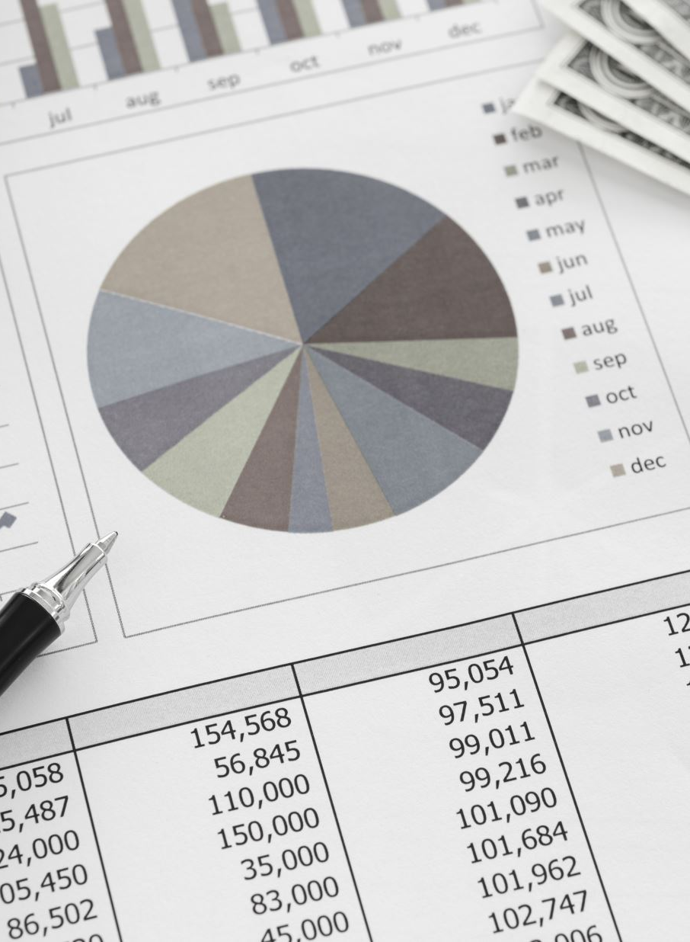
Corporate Bankruptcy Analysis
By: Cole Wagner

Slide 2
Table of Contents
Introduction
Data Summary
Data Preprocessing
Data Modeling
Discussion
Q&A

Slide 3
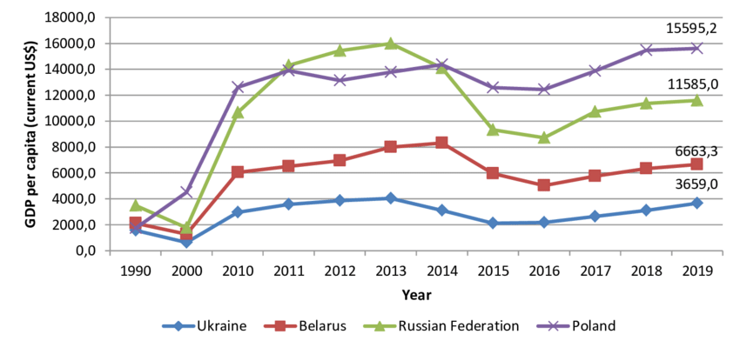
Introduction
Poland’s economy is growing, but not invincible.
Many companies have flourished, but some have failed.
How do we forecast which companies will go bankrupt in the future?
Figure 1 – Eastern European GDP Growth Comparison
https://www.researchgate.net/figure/GDP-per-capita-current-US-Ukraine-Poland-Russian-Federation-Belarus_fig1_346790814

Slide 4
Research Goals
Build a model to predict which companies will go bankrupt within a given forecasting period
Find the most important factors in determining the outcome of a company

Slide 5
Data Summary
Five datasets, one for each year in the forecasting period
43,405 companies total
64 predictors, all financial ratios
Response: whether the company went bankrupt

Slide 6
Data Preprocessing: Initial Formatting
1.
Join datasets
2.
Create a year variable
3.
Rename all predictors

Slide 7
Data Preprocessing: Missing Values
Number of Variables | Number of Missing Values
2 | >5000
2 | (4999, 1000)
6 | (999, 500)
54 | <500
Remove (current assets – inventory) / long-term liabilities and sales(n-1) / sales(n)
Hot deck impute all other missing values

Slide 8
Data Modeling: Overview
Three modeling frameworks:
- Basic logistic regression
- Elastic net logistic regression
- XG boost
Three preprocessing methods
- Baseline (normalizing, removing correlated predictors, etc.)
- Baseline + SMOTE upsampling (no-information rate = 0.95)
- Baseline + SMOTE + Principal component analysis (PCA)

Slide 9
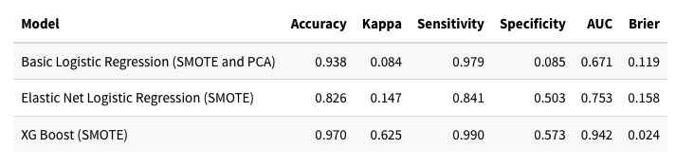
Data Modeling: Results
Table 1 – Overall Model Comparison

Slide 10
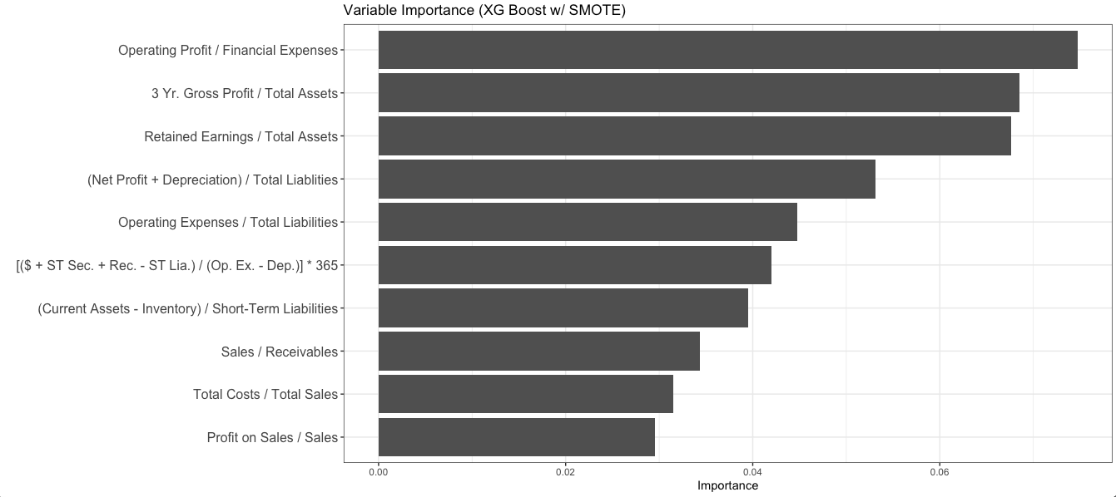
Data Modeling: Results
Figure 2 - XG Boost w/ SMOTE Variable Importance Plot

Slide 11
Discussion
XG Boost is far and away the best framework for this analysis.
SMOTE upsampling solidly increased model performance across all frameworks.
The ratio of operating profit to financial expenses is very important in predicting the financial future of a company.

Slide 12
Q&A

