Slide 1

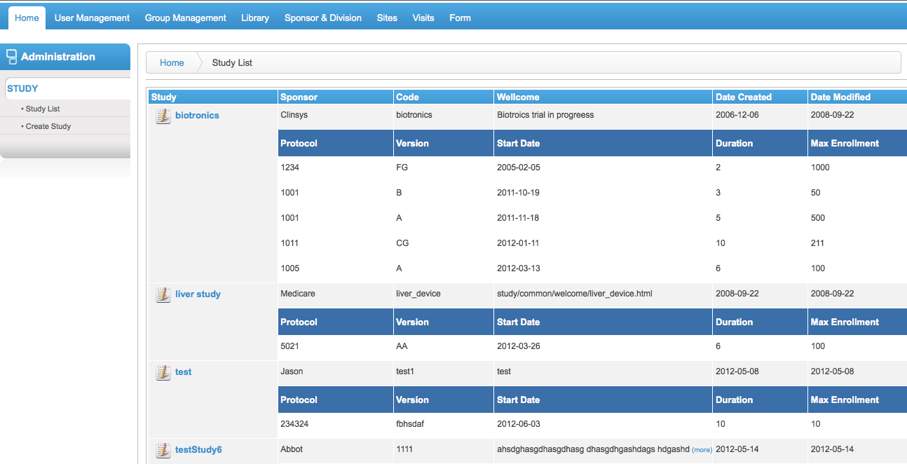
Home screen will show a list of studies, their protocols and their timelines. If user has the appropriate rights, they can create a study

Slide 2
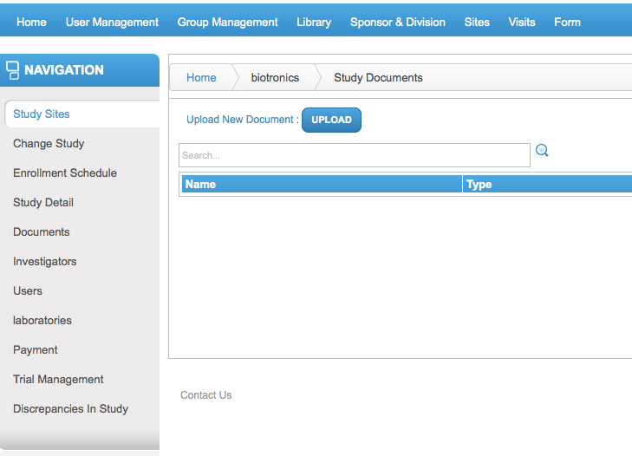
Users are able to upload and download documents at the study level and site level

Slide 3
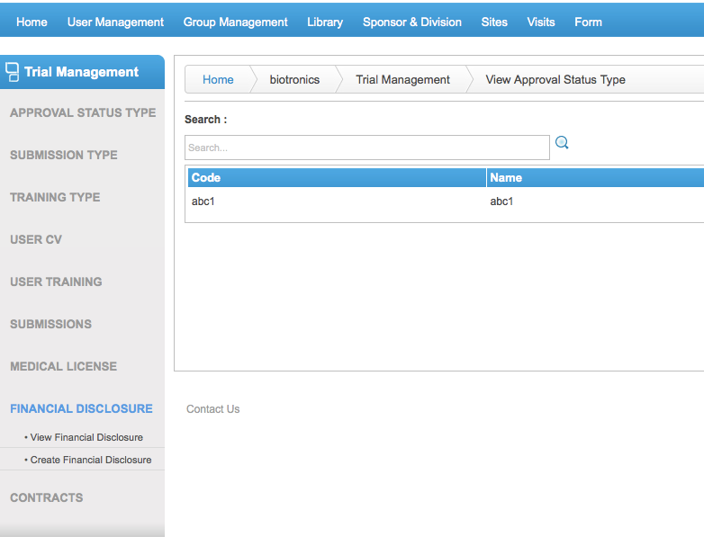
Complete trial management modules allowing the users to capture the submissions (IRB, FDA, etc), Medical license, contracts, financial and more. This can be accessed at the study level

Slide 4
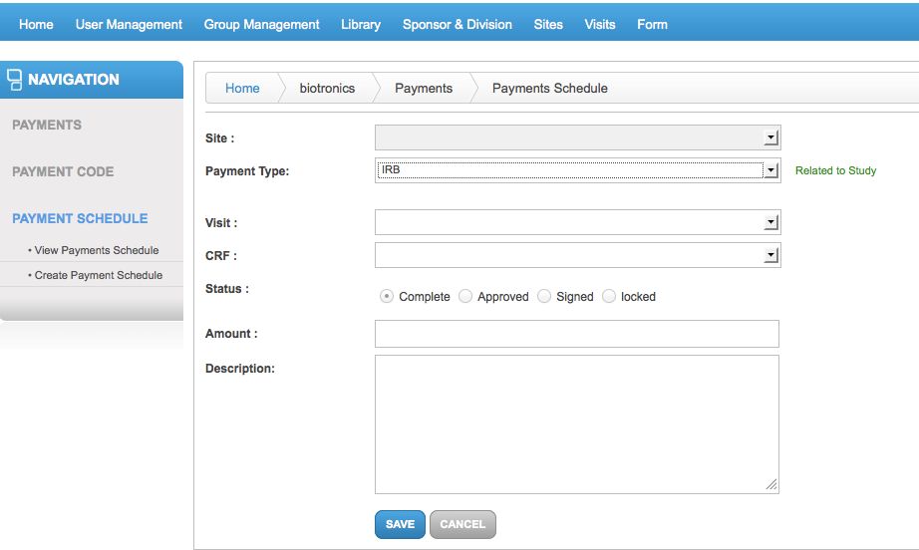
Users can create payments adhoc or schedule payments based on a visit or crf status

Slide 5
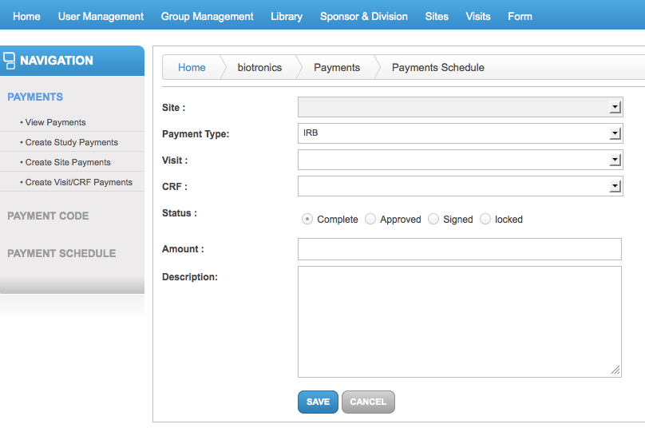

Slide 6
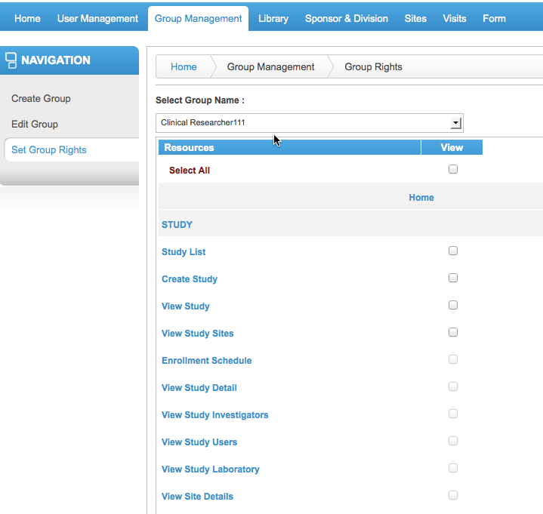
After creating a group, user must set the group rights by selecting what actions the user can have within a particular form

Slide 7
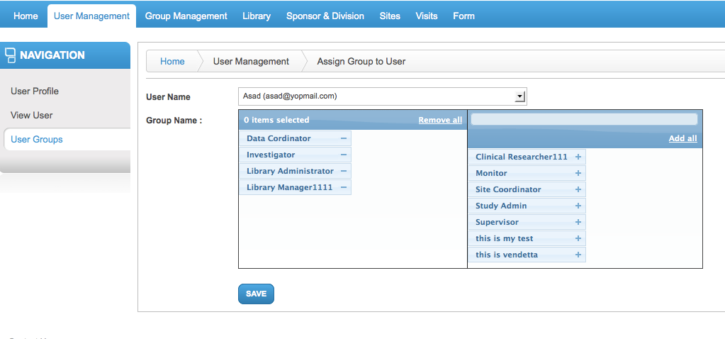
Each user can have one or more roles. An admin can add or remove group roles from a user

Slide 8
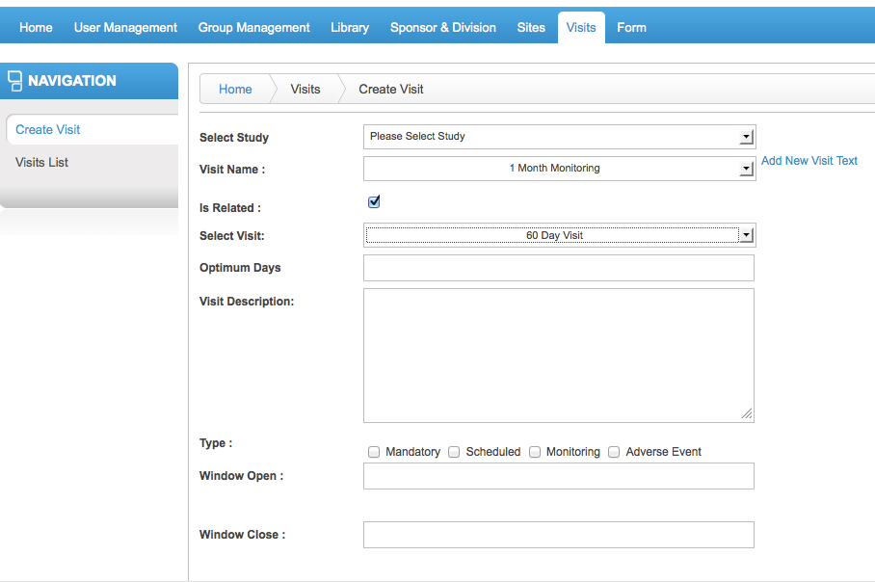
System allows users to create a visit schedule. If this is the primary visit, then “Is Related” is blank. Otherwise, “Is Related” means that a specific visit is related to another given the number of days it should be collected after

Slide 9
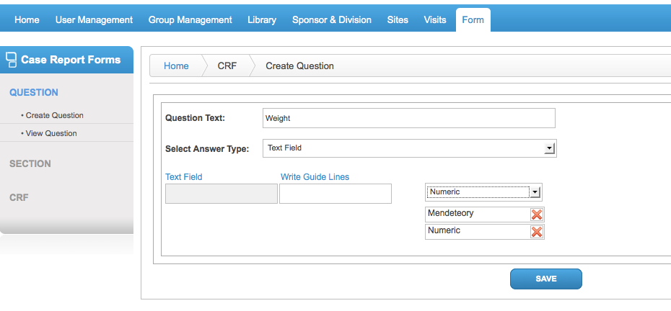
The system is based on a library of data. Each form is made up of one or more sections and each section is made up of one or more questions. Field, Sections and CRFs are re-usable across studies

Slide 10
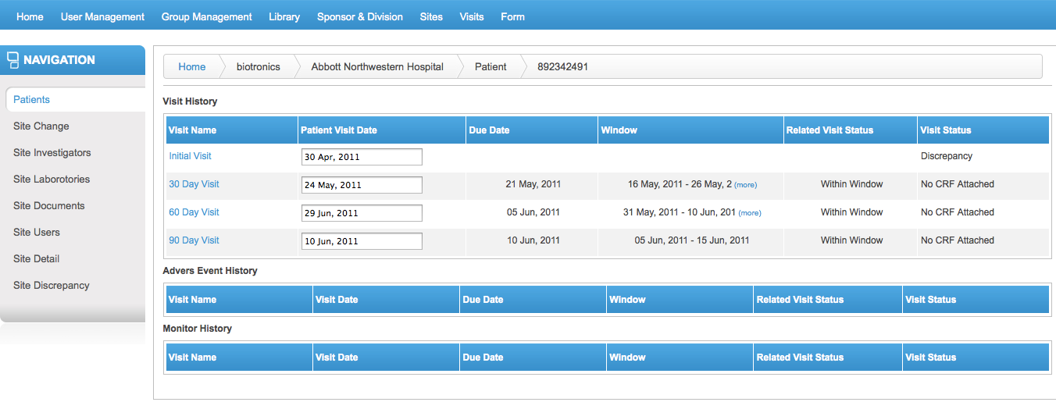
Below is an example of visit schedule. The Visit view is grouped by visit history, adverse events and monitoring events.

Slide 11
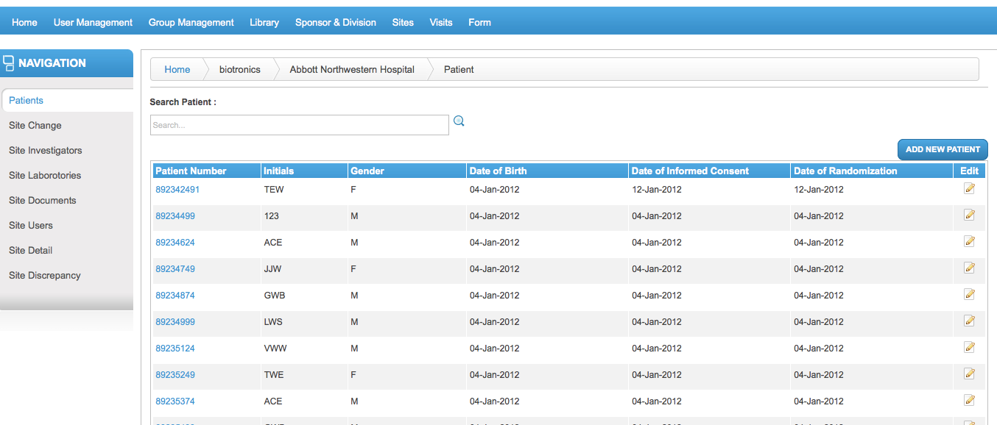

Slide 12
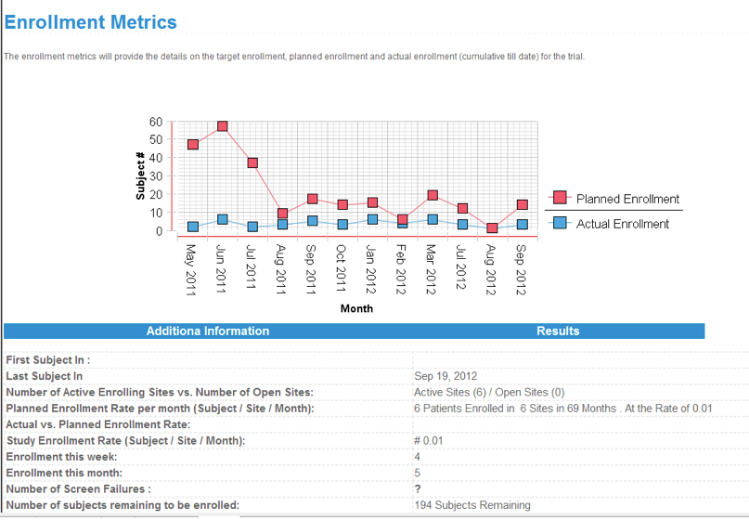

Slide 13
