Slide 1

in modern browsers
Javascript Performance

Slide 2

http://js-engine-performance.wikidot.com/

Slide 3
WHY NOW
?

Slide 4
because THIS
function init() {
alert(“hello user”);
}
is slowly becoming...

Slide 5
(function($){$.extend($.fn,{validate:function(options){if(!this.length){options&&options.debug&&window.console&&console.warn("nothing selected, can't validate, returning nothing");return;}var validator=$.data(this[0],'validator');if(validator){return validator;}validator=new $.validator(options,this[0]);$.data(this[0],'validator',validator);if(validator.settings.onsubmit){this.find("input, button").filter(".cancel").click(function(){validator.cancelSubmit=true;});if(validator.settings.submitHandler){this.find("input, button").filter(":submit").click(function(){validator.submitButton=this;});}this.submit(function(event){if(validator.settings.debug)event.preventDefault();function handle(){if(validator.settings.submitHandler){if(validator.submitButton){var hidden=$("<input type='hidden'/>").attr("name",validator.submitButton.name).val(validator.submitButton.value).appendTo(validator.currentForm);}validator.settings.submitHandler.call(validator,validator.currentForm);if(validator.submitButton){hidden.remove();}return false;}return true;}if(validator.cancelSubmit){validator.cancelSubmit=false;return handle();}if(validator.form()){if(validator.pendingRequest){validator.formSubmitted=true;return false;}return handle();}else{validator.focusInvalid();return false;}});}return validator;},valid:function(){if($(this[0]).is('form')){return this.validate().form();}else{var valid=true;var validator=$(this[0].form).validate();this.each(function(){valid&=validator.element(this);});return valid;}},removeAttrs:function(attributes){var result={},$element=this;$.each(attributes.split(/\s/),function(index,value){result[value]=$element.attr(value);$element.removeAttr(value);});return result;},rules:function(command,argument){var element=this[0];if(command){var settings=$.data(element.form,'validator').settings;var staticRules=settings.rules;var existingRules=$.validator.staticRules(element);switch(command){case"add":$.extend(existingRules,$.validator.normalizeRule(argument));staticRules[element.name]=existingRules;if(argument.messages)settings.messages[element.name]=$.extend(settings.messages[element.name],argument.messages);break;case"remove":if(!argument){delete staticRules[element.name];return existingRules;}var filtered={};$.each(argument.split(/\s/),function(index,method){filtered[method]=existingRules[method];delete existingRules[method];});return filtered;}}var data=$.validator.normalizeRules($.extend({},$.validator.metadataRules(element),$.validator.classRules(element),$.validator.attributeRules(element),$.validator.staticRules(element)),element);if(data.required){var param=data.required;delete data.required;data=$.extend({required:param},data);}return data;}});$.extend($.expr[":"],{blank:function(a){return!$.trim(""+a.value);},filled:function(a){return!!$.trim(""+a.value);},unchecked:function(a){return!a.checked;}});$.validator=function(options,form){this.settings=$.extend({},$.validator.defaults,options);this.currentForm=form;this.init();};$.validator.format=function(source,params){if(arguments.length==1)return function(){var args=$.makeArray(arguments);args.unshift(source);return $.validator.format.apply(this,args);};if(arguments.length>2&&params.constructor!=Array){params=$.makeArray(arguments).slice(1);}if(params.constructor!=Array){params=[params];}$.each(params,function(i,n){source=source.replace(new RegExp("\\{"+i+"\\}","g"),n);});return source;};$.extend($.validator,{defaults:{messages:{},groups:{},rules:{},errorClass:"error",validClass:"valid",errorElement:"label",focusInvalid:true,errorContainer:$([]),errorLabelContainer:$([]),onsubmit:true,ignore:[],ignoreTitle:false,onfocusin:function(element){this.lastActive=element;if(this.settings.focusCleanup&&!this.blockFocusCleanup){this.settings.unhighlight&&this.settings.unhighlight.call(this,element,this.settings.errorClass,this.settings.validClass);this.errorsFor(element).hide();}},onfocusout:function(element){if(!this.checkable(element)&&(element.name in this.submitted||!this.optional(element))){this.element(element);}},onkeyup:function(element){if(element.name in this.submitted||element==this.lastElement){this.element(element);}},onclick:function(element){if(element.name in this.submitted)this.element(element);else if(element.parentNode.name in this.submitted)this.element(element.parentNode)},highlight:function(element,errorClass,validClass){$(element).addClass(errorClass).removeClass(validClass);},unhighlight:function(element,errorClass,validClass){$(element).removeClass(errorClass).addClass(validClass);}},setDefaults:function(settings){$.extend($.validator.defaults,settings);},messages:{required:"This field is required.",remote:"Please fix this field.",email:"Please enter a valid email address.",url:"Please enter a valid URL.",date:"Please enter a valid date.",dateISO:"Please enter a valid date (ISO).",number:"Please enter a valid number.",digits:"Please enter only digits.",creditcard:"Please enter a valid credit card number.",equalTo:"Please enter the same value again.",accept:"Please enter a value with a valid extension.",maxlength:$.validator.format("Please enter no more than {0} characters."),minlength:$.validator.format("Please enter at least {0} characters."),rangelength:$.validator.format("Please enter a value between {0} and {1} characters long."),range:$.validator.format("Please enter a value between {0} and {1}."),max:$.validator.format("Please enter a value less than or equal to {0}."),min:$.validator.format("Please enter a value greater than or equal to {0}.")},autoCreateRanges:false,prototype:{init:function(){this.labelContainer=$(this.settings.errorLabelContainer);this.errorContext=this.labelContainer.length&&this.labelContainer||$(this.currentForm);this.containers=$(this.settings.errorContainer).add(this.settings.errorLabelContainer);this.submitted={};this.valueCache={};this.pendingRequest=0;this.pending={};this.invalid={};this.reset();var groups=(this.groups={});$.each(this.settings.groups,function(key,value){$.each(value.split(/\s/),function(index,name){groups[name]=key;});});var rules=this.settings.rules;$.each(rules,function(key,value){rules[key]=$.validator.normalizeRule(value);});function delegate(event){var validator=$.data(this[0].form,"validator");validator.settings["on"+event.type]&&validator.settings["on"+event.type].call(validator,this[0]);}$(this.currentForm).delegate("focusin focusout keyup",":text, :password, :file, select, textarea",delegate).delegate("click",":radio, :checkbox, select, option",delegate);if(this.settings.invalidHandler)$(this.currentForm).bind("invalid-form.validate",this.settings.invalidHandler);},form:function(){this.checkForm();$.extend(this.submitted,this.errorMap);this.invalid=$.extend({},this.errorMap);if(!this.valid())$(this.currentForm).triggerHandler("invalid-form",[this]);this.showErrors();return this.valid();},checkForm:function(){this.prepareForm();for(var i=0,elements=(this.currentElements=this.elements());elements[i];i++){this.check(elements[i]);}return this.valid();},element:function(element){element=this.clean(element);this.lastElement=element;this.prepareElement(element);this.currentElements=$(element);var result=this.check(element);if(result){delete this.invalid[element.name];}else{this.invalid[element.name]=true;}if(!this.numberOfInvalids()){this.toHide=this.toHide.add(this.containers);}this.showErrors();return result;},showErrors:function(errors){if(errors){$.extend(this.errorMap,errors);this.errorList=[];for(var name in errors){this.errorList.push({message:errors[name],element:this.findByName(name)[0]});}this.successList=$.grep(this.successList,function(element){return!(element.name in errors);});}this.settings.showErrors?this.settings.showErrors.call(this,this.errorMap,this.errorList):this.defaultShowErrors();},resetForm:function(){if($.fn.resetForm)$(this.currentForm).resetForm();this.submitted={};this.prepareForm();this.hideErrors();this.elements().removeClass(this.settings.errorClass);},numberOfInvalids:function(){return this.objectLength(this.invalid);},objectLength:function(obj){var count=0;for(var i in obj)count++;return count;},hideErrors:function(){this.addWrapper(this.toHide).hide();},valid:function(){return this.size()==0;},size:function(){return this.errorList.length;},focusInvalid:function(){if(this.settings.focusInvalid){try{$(this.findLastActive()||this.errorList.length&&this.errorList[0].element||[]).filter(":visible").focus();}catch(e){}}},findLastActive:function(){var lastActive=this.lastActive;return lastActive&&$.grep(this.errorList,function(n){return n.element.name==lastActive.name;}).length==1&&lastActive;},elements:function(){var validator=this,rulesCache={};return $([]).add(this.currentForm.elements).filter(":input").not(":submit, :reset, :image, [disabled]").not(this.settings.ignore).filter(function(){!this.name&&validator.settings.debug&&window.console&&console.error("%o has no name assigned",this);if(this.name in
this

Slide 6
With the evolution of complex applications, browsers need to keep up to be able to deliver what developers need in terms of performance.
DONE?
what
can
be
most modern browsers employ optimization techniques such as:
compiling source code into byte-code or native code
fast source code / byte code inerpreting
hidden classes
fast property access
fast garbage collection
type optimisation
many others

Slide 7







CE AM
TESTAT

Slide 8
HOW WE
TESTED
purpose
built
tests
mathematical operations
identifier resolution
data access
arrays
regex
strings
DOM
SHA1
canvas
also, the V8 Benchmark Suite

Slide 9
MathTest.prototype.Run = function() {
var tmp = 0;
for(var i = 0; i < 500000; i++){
Math.pow(i, i);
Math.sin(i);
Math.sqrt(i);
tmp = tmp + ((i * i) << 2) / i;
}
}
MATH

Slide 10
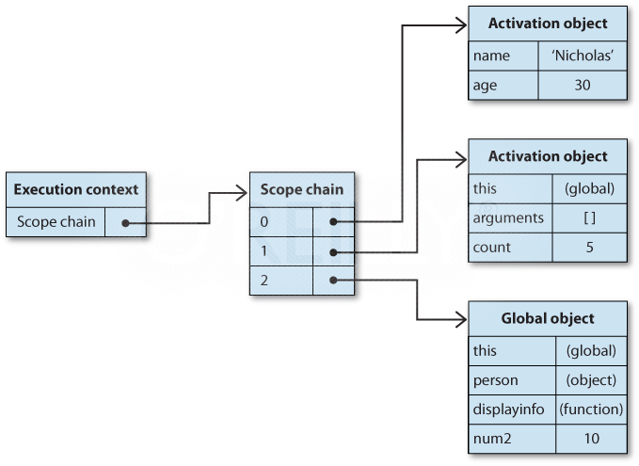
Identefier
resolution
ResolutionTest.prototype.Run = function() {
foo1 = 0;
foo2 = 0;
_RecursiveCall(1000);
}
function _RecursiveCall(depth) {
if(depth <= 0) {
var tmp = 0;
for(var i = 0; i < 5000000; i++) {
/*read access*/
tmp = foo1;
/*write access*/
foo2 = foo1;
}
} else {
_RecursiveCall(--depth);
}
}

Slide 11

Data access
DataAccessTest.prototype.Run = function() {
var tmp = 0;
/*literal read / write + variabiles*/
for(var i = 0; i < 2000000; i++) {
tmp = 0;
tmp = tmp;
tmp = "some string";
tmp = tmp;
}
/*properties access*/
tmp.prop1 = 0;
tmp.prop2 = 0;
tmp.prop3 = 0;
for(var i = 0; i < 200000; i++) {
tmp.prop1 = tmp.prop2 * tmp.prop2;
tmp["prop1"] = tmp["prop2"] * tmp["prop2"];
}
tmp = []; tmp[0] = 0;
/*array access*/
for(var i = 1; i < 2000000; i++) {
tmp[i] = tmp[i - 1] + tmp[i - 1];
}
}

Slide 12
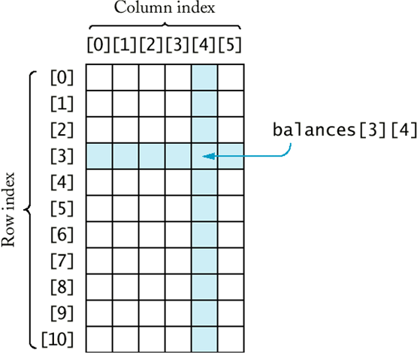
ARRAYS
ArraysTest.prototype.Run = function() {
var tmp1 = [];
var tmp2 = [];
for(var i = 0; i < 500000; i++) {
tmp1.push(i);
tmp2.push(i);
}
var tmp = tmp1.concat(tmp2);
tmp.reverse();
tmp1.join();
for(var i = 0; i < 500000; i++) {
tmp1.pop();
tmp2.pop();
}
}

Slide 13
RegEX
RegexTest.prototype.Run = function() {
var tmp = " this is some random string ... this is some random string ... ";
for(var i = 0; i < 500000; i++) {
tmp.match("[a-zA-z]..d?om[ ]*");
}
}

Slide 14
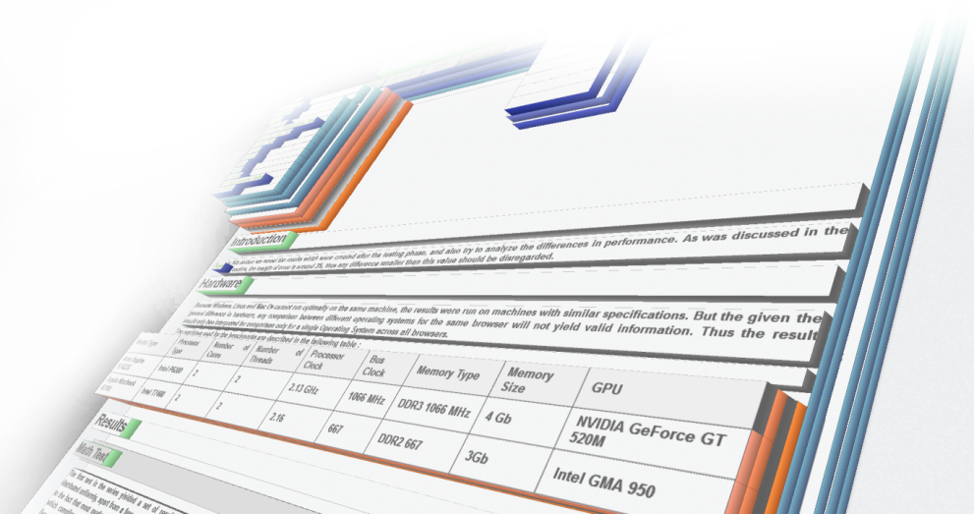
DomTest.prototype.Run = function() {
var root = document.createElement("div");
document.body.appendChild(root);
/*dom creation and attributes*/
for(var i = 0; i < 50000; i++) {
var child = document.createElement("div");
child.setAttribute("width", "100");
child.getAttribute("width");
root.appendChild(child);
}
var child = root.firstChild;
/*dom traversal and css properties*/
while((child = child.nextSibling) != null) {
child.style.display = "block";
child.style.color = "#FFF";
}
var child = document.createElement("div");
child.setAttribute("id", "someChild");
root.appendChild(child);
document.getElementsByTagName("div").length;
document.getElementById("someChild");
/*removal of nodes*/
for(var i = 0; i < 50000; i++ ) {
root.removeChild(root.firstChild);
}
document.body.removeChild(root);
}
DOM

Slide 15
STRINGS
StringsTest.prototype.Run = function() {
var tmp = [];
for(i = 0; i < 200000; i++) {
tmp[i] = "this is some ".toUpperCase() + "string".toLowerCase();
tmp[i].indexOf('o');
}
tmp.join().split(' ');
}

Slide 16

SHA1
Sha1Test.prototype.Run = function() {
for(var i = 0; i < 10000; i++ ) {
SHA1("some text");
}
}

Slide 17
CanvasTest.prototype.Run = function () {
var canvas = document.createElement("canvas");
canvas.width = 800;
canvas.height = 600;
var ctx = canvas.getContext("2d");
/*shape drawing*/
for(var i = 0; i < 200; i++) {
ctx.fillRect(0, 0, 800, 600);
ctx.beginPath();
ctx.moveTo(0, 100);
ctx.lineTo(800, 100);
ctx.arc(400, 100, 400, Math.PI / 2, 1.5 * Math.PI, false);
ctx.fill();
ctx.fillText("some text", 100, 100);
}
/*pixel manipulation*/
var imageData = ctx.getImageData(0, 0, 800, 600);
for(var i = 0; i < 3000; i++) {
for(var i in imageData)
imageData[i] = i + 0.1;
ctx.putImageData(imageData, 0, 0);
}
}
CANVAS

Slide 18
?

Slide 19
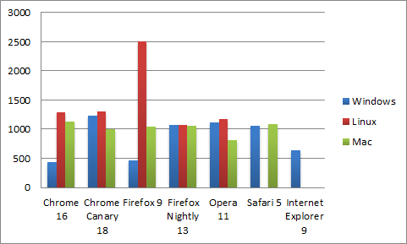
MATH
moste browsers use some form of source compilation into either intermediate bytecode or native machine code.
this means that most primitive calculations take toughly the same time across all browsers, apart from a few anomalies
YES we retested Firefox under windows and linux, but no change was recorded.
WHY?

Slide 20
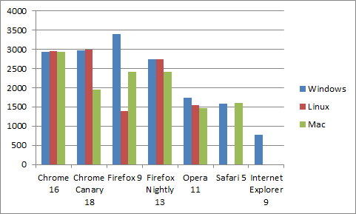
Identefier
resolution
the top browsers managed to have constant look-up time regardless of recursion depth and the size of the scope chain.
bottom browsers however were affected heavely by recursion depth
WHY?

Slide 21
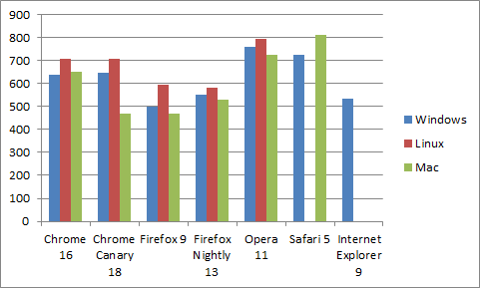
DATA
access
most modern JavaScript engines use hidden classes or a method of inline caching the adress of previously searched properties
this makes the performance among all browsers closer than in other tests
WHY?

Slide 22
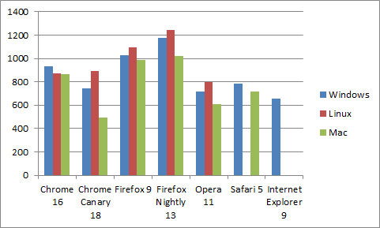
ARRAYS
as with most benchmarks used, a very important factor in performance is the speed of the compiled source code
accessing contiguous zones of memory is made faster by knowing the exact location of every member in an array, characteristic brough by bytecode or native machine code
WHY?

Slide 23
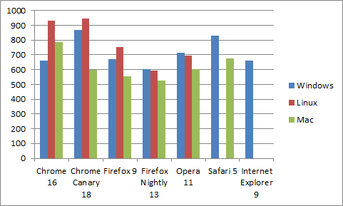
RegEX
some JavaScript engines use special techniques to optimize regular expression solving.
some compile the entire source code, some just create specialized blocks of machine code specifically for regular expressions.
due to the average length of the expression and text, the time needed to compile the source code did not surpass the time needed to solve the expression
WHY?

Slide 24
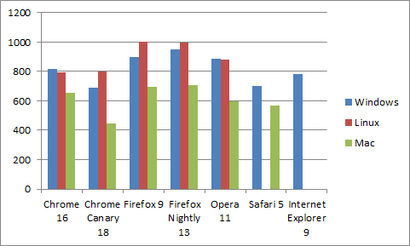
STRINGS
the strings test saw the closest range of result, only a 27% difference bretween the top browser
this is due largely because, passed source compilation, there isn’t a great range of optimizations that can be done on string manipulation
WHY?

Slide 25
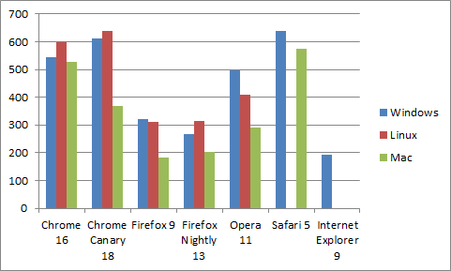
DOM
Google Chrome and Safari share the same layout engine, WebKit, which has a major impact on DOM manipulation in JavaScript
this is why they are both at the top with relatively close performance
WHY?

Slide 26
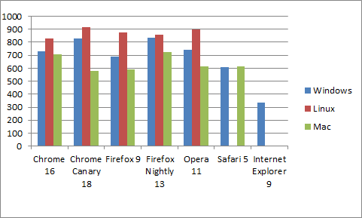
SHA1
because the SHA1 algorithm is comprised of mostly primitive mathematical and bitwise operations
this test was a continuation of the Math test, seeing similar results, with the same uniformly distributed results
WHY?

Slide 27
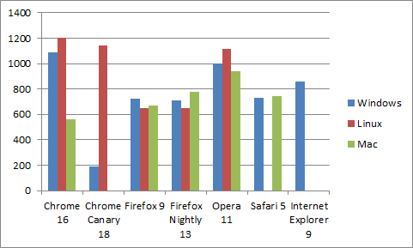
CANVAS
the key factor in canvas performance is the utilization of the GPU to do most of the 2D rendering. This is why the top scorers had the best GPU accelerated system
it should be noted, that for every browser all systems related to GPU acceleration were turned on, enabeling them to extract the maximum performance they can
WHY?

Slide 28
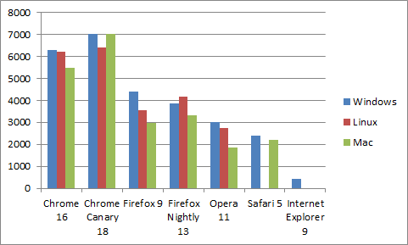
V8
Benchmark Suite
It’s no suprise that the Google benchmark suite had their in-house built browser as the top scorer
but what about Internet Explorer? The JIT compiler is only available to the 32 bit version of the browser, which was not used on the testing machine (as it has a 64 bit operating system).
WHY?

Slide 29
?
BEST
SO
WHICH
BROWSER
HAD
THE
RESULT

Slide 30
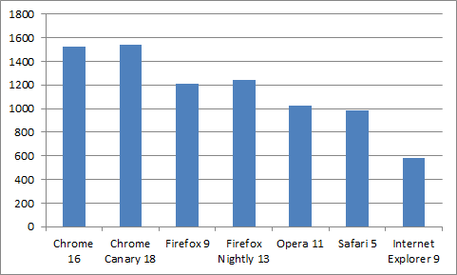
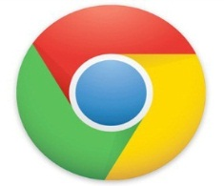



Slide 31
http://js-engine-performance.wikidot.com/
Catalin Dumitru
Iustina Camelia Melinte
colin.dumitru@gmail.com
iustina.melinte@gmail.com

