Slide 1
Alternative Interdomain Routing Schemes
Colin Scott
Notes:
Put affiliations in parentheses
Add sponsors: Google, Cisco, NSF

Slide 2
Normal Discussion

Slide 3
Today’s Discussion
Notes:
Maybe we can make it like a choose your own adventure

Slide 4
Notes:
Ok, this is annoying

Slide 5
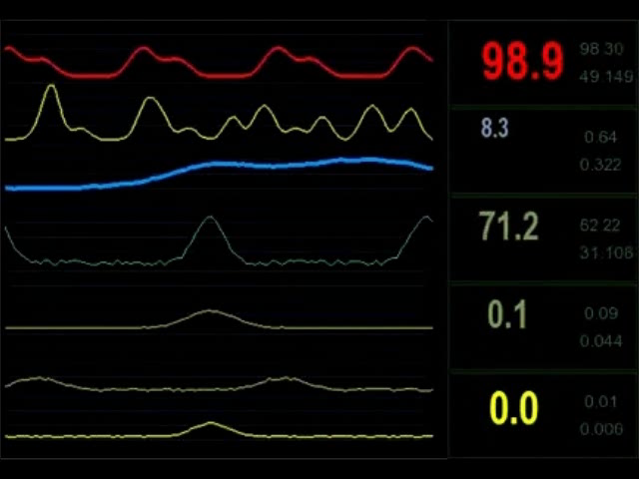
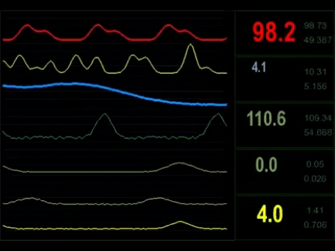
Notes:
But we’d like to do remote health monitoring … this is plain dangerous.

Slide 6
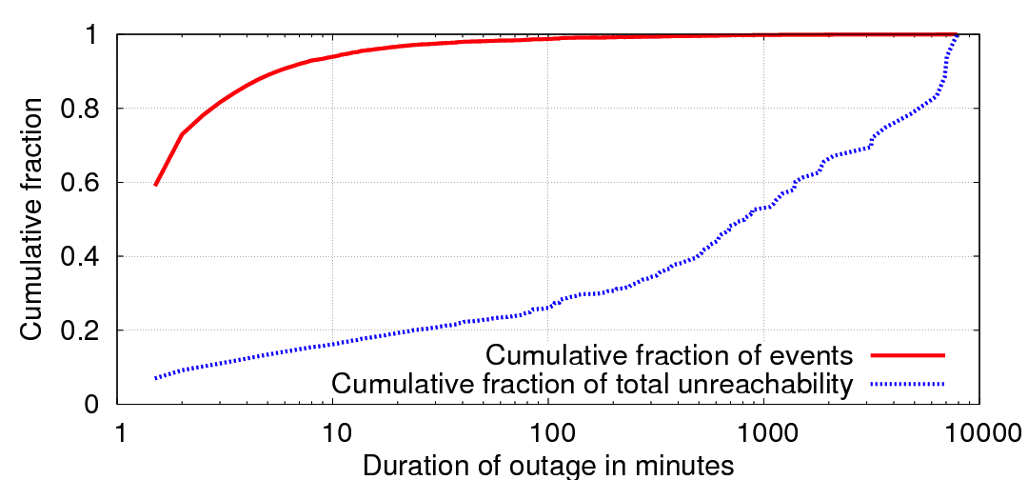

How common are these outages?
Monitor network outages from Amazon’s EC2
2 million outages in two months
Portion of outages
Long outages account for 90% of the downtime
86% of outages are less than 5 minutes
Portion of total downtime
Notes:
Most outages are short – good!
But those long ones – responsible for most of the downtime

Slide 7
Internet Routing
A goal of the Internet is global reachability
But, BGP fails to achieve this goal
Physical paths exist, but not BGP paths
10-15% of BGP updates cause loops and blackholes
90% of all packet losses on the Internet due to loops
Notes:
Global reachability == every address is reachable from every other address
BGP, the routing protocol of the internet fails to reach this goal.
i.e. though physical paths exist, packets don’t make it to the destination
Simulation results showed that a single link failure can cause a significant portion
of the Internet to experience transient disconnectivity
Lots of studies on BGP

Slide 8
Example
5: 4-5
5: 3-4-5
5: 1-5
5: 4-5
5: 2-4-5
1
2
3
4
Destination
5
Notes:
Routing table is shown above the Ases 2, 3, 6
The path in yellow is the selected best path
Remaining paths are listed in order of preference

Slide 9
Link Failure
5: 4-5
5: 3-4-5
5: 1-5
5: 4-5
5: 2-4-5
1
2
5:4-5
3
4
Link 4-5 fails
AS4 withdraws path
from upstream ASes
5
Notes:
Routing table is shown above the Ases 2, 3, 6
The path in yellow is the selected best path
Remaining paths are listed in order of preference

Slide 10
Lack of Consistency
The underlying cause of all these problems is inconsistent global state
Link failures
Traffic engineering
Scheduled Maintenance
Link coming up
Protocol behavior complex, unpredictable
No indicator of when system converged to consistent state
Notes:
Routers by design operate on inconsistent distributed state
Clearly, inconsistency is bad

Slide 11
Consensus Routing
Lesson from distributed system design:
De-couple safety and liveness
Safety: Forwarding tables are always consistent and policy compliant
Liveness: Routing system adapts to failures quickly
Notes:
We borrow an old lesson in dist system design
In the context of internet routing: safety defined as ‘ forwarding tables consistent, policy compliant. required for correctness
Liveness: routing system adapts to failures quickly, and maintains availability
Different mechanisms appropriate for each

Slide 12
Safety
How do we ensure consistency?
Apply updates only after they have reached everyone
Apply updates at the same time everywhere
Notes:
2 simple rules: apply updates only after they have reached everyone
apply updates at the same time everywhere
With these two principles in mind, the mechanism follows in a rather straightforward manner
Next few slides will be chunking through the mechanism

Slide 13
Deciding on Routes
Centralized Consensus Algorithm (PAXOS)
Notes:
Tier 1 providers run the consensus nodes

Slide 14
Atomic Commit
One set of routes per “epoch”
Routers only apply routes after all other routers have access to those policies
Mark each packet with a single epoch

Slide 15
Liveness
After link failure, new path announced
Need to wait till path reaches everyone
Takes time!
Solution: Dynamically re-route around the failed link
use existing techniques
Pre-computed backup paths
Detour routing
Notes:
We’ve looked at how we can provide safety.
Let us now consider a mechanism for liveness …
As defined earlier: liveness corresponds to ‘system adapting to changes quickly and maintaining availability’
To maintain consistency, … need to wait
This delay can lead to unavailability
This ensures that while we are waiting for the system to converge to a stable state, we don’t have long periods of disconnectivity
Illustration of the operational difference between BGP and consensus routing

Slide 16
Conclusions
BGP’s transient problems are due to inconsistent global state
Consensus routing enables consistent routing state with opaque policies
key technique: separation of safety and liveness
Maintain consistency whenever possible.
Only route on inconsistent information when necessary.
Notes:
BGP’s transient problems are due to inconsistent global state
Consensus routing maintains consistency by separating safety and liveness
It makes routing predictable and possibly securable
We can have an Internet that has high availability!

Slide 17
Beautiful Idea!
Food for thought:
Did this paper impact academic research?
(Yes!)
Did this paper impact practice?
(Only indirectly – we’ll come back to this)
Notes:
We’ll return to these questions momentarily

Slide 18
What’s wrong with Internet routing?
Full-mesh iBGP doesn’t scale
# sessions, control traffic, router memory/cpu
Route-reflectors help by introducing hierarchy
but introduce configuration complexity, protocol oscillations/loops
Hard to manage
Many highly configurable mechanisms
Difficult to model effects of configuration changes
Hard to diagnose when things go wrong
Hard to evolve
Hard to provide new services, improve upon protocols

Slide 19
Routing Control Platform
What’s causing these problems?
Each router has limited visibility of IGP and BGP
No central point of control/observation
Resource limitations on legacy routers
Solution: compute routes from central point, remove protocols from routers
Inter-AS Protocol
RCP
RCP
RCP
network
network
network
Notes:
Why drawing RCP above network boxes – just say orally, that it’s not part of the forawarind plane

Slide 20
RCP in a single ISP
RCP
iBGP
Better scalability: reduces load on routers
Easier management: configuration from a single point
Easier evolvability: freedom from router software
Notes:
Then bring up 3 points after describe slide (Animate)
On this slide – say what it is that y’uouve impelemntede, this is an imprlmentation that emultates full mesh, empasisze per router decision making ←- very important piont to bring up!!! Say why is not just a route reflector.
Put text on slide to say why arrows going in both directions, available routes up and assigned routes down.
Reduce number of routers, just show some on maybe just internal ones send up igp. Maybe just say gets igp, and take out lines to internal routers.

Slide 21
Principle 1
Compute Routes Using Consistent State

Slide 22
Example of a Forwarding Loop
d
RR1
RR2
3
1
1
3
C1
C2
1
C1 learns BGP route to destination from RR1
C2 learns BGP route to destination from RR2
C1 sends packets to RR1 via its IGP shortest path which traverses C2
C2 sends packets to RR2 via its IGP shortest path which traverses C1
Persistent forwarding loop ☹

Slide 23
Path Computation on Consistent View
d
RR1
RR2
RCP
“RR2”
1
1
“RR2”
3
3
C1
C2
1
RCP learns all externally learned routes
Computes consistent router-level paths
Benefits:
Intrinsic loop freedom and faster convergence
RCP does not have to stick to BGP decision process
Can “pin” paths for traffic engineering and other purposes

Slide 24
Principle 2
(Centrally) Control Routing Protocol Interaction

Slide 25
BGP-IGP Interaction
BGP route selection process uses IGP costs to tie-break between equally good egress points
If multiple egress points, choose the one with shortest IGP path (known as “hot potato” routing)
Once egress-point is selected, BGP relies on IGP to reach the egress point
d
d
A
B
A
B
10
10
11
9
C
Path cost change due to
failure, traffic engineering
or maintenance
C

Slide 26
Principle 3
Support Flexible, Expressive Policies

Slide 27
Centralized Configuration
10.0.0.1
A
C
192.168.0.1
Sprint
UUNet
RCP
RCP implements policies for entire AS
Knows about sessions to all other ASes
Implements policies in terms of relationship with Ases
Today’s router configuration cannot capture this
Benefits
Simpler configuration
Do not have to tag routes with state

Slide 28
Interdomain RCP: All ASes have RCPs
Before: RCP gets all eBGP routes from neighbors
eBGP
RCP
iBGP
After: ASes exchange routes via RCP
RCP
Inter-AS Protocol
RCP
RCP
iBGP
AS 1
AS 2
AS 3
Physical
peering

Slide 29
Practical Challenges
Scalability
Decision elements responsible for many routers
Reliability
Surviving failures of decision elements and routers
Consistency
Ensuring multiple decision elements behave consistently
Security
Network vulnerable to attacks on decision elements
Interoperability
Legacy routers and neighboring domains
Response time
Delays between decision elements and routers
Notes:
The paper outlines a bunch of future work

Slide 30
ONIX (OSDI’10 Paper)
Distributed coordination
Integrated with ZooKeeper
Useful for leader election, locking, barriers, etc.
Scalability
Partition: different tasks, switches, or parts of the NIB,
Aggregate: combine statistics and topology information
Reliability
Network failures: application’s responsibility
Reachability to ONIX: reliable protocol, multipath, etc.
ONIX failure: distributed coordination amongst replicas

Slide 31
Consistent Updates
Abstractions for Consistent Updates [HotNet’11, SIGCOMM’12]
Fabric [HotSDN’11]
LOUP [HotNets’12]
…

Slide 32
Yet!
Almost none of this literature sprung directly from RCP!
Why?
One theory: Multi-domain is way too hard. (Start with single domain!)
Notes:
Rather, it came out of SDN (Martin Casado et al.)

Slide 33

My issues with this paper
“Using standard distributed systems protocols”
“Overlay networks lack direct control over IP-layer”

Slide 34
My issues with this paper (2)
Emphasized “enabling innovation”
But anything that can be accomplished with a centralized solution can also be accomplished with distributed protocols
Notes:
Some of you may have heard me make this same complaint

Slide 35
Close Call
“routing protocol functionality should be separated from the routers”
Yet the paper (correctly) doesn’t do away with IGP
Intra-domain routing protocols work very well
Provably self-stabilizing
React to failures quickly
Already widely supported

Slide 36
Prediction
Changing inter-domain routing is hard
Yet,
I predict upcoming work on wide-area SDN*
*based on discussions with Ethan Katz-Bassett

Slide 37

Prediction
SDN provides a centralized view that you can optimize over, coordinate with, and reason about
Recent systems give better visibility and control into other ASes and how their routing affects traffic the origin’s traffic (WhyHigh, RevTR, Lifeguard, etc.)
Flatter Internet, more direct peering more paths to choose from

Slide 38
Prediction
ISPs are run pretty poorly in general
Google (in particular) depends on the availability of other ISPs, and they have a huge incentive ($$) to improve availability
They want to: (a) understand the impact of routing changes, (b) exert (or give) more control over ISP’s routing decisions without doing thing that would mess up Google’s traffic

Slide 39
Prediction
A huge portion of traffic now comes from a small number of CDNs. This means:
Paths are now content eyeball (no intermediate ASes)
Caches bytes out >> bytes across backbone
slight changes to request routing cause HUGE changes in eyeball traffic
TE changes in this world (lots more control, also worse consequences of screwing up)

