Slide 1
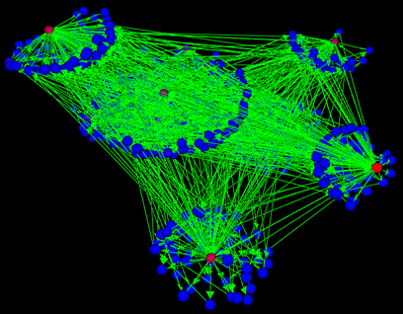

PL, meet Networking
Colin Scott, Andreas Wundsam, Scott Shenker

Slide 2
Overview
Symbolic execution -> detect policy-violations
Axiomatic semantics -> prove correctness

Slide 3
Symbolic Execution
Symbolic Execution
Goal: Which code path will be taken for a given input?
y = read()
y = 2 * y
if (y <= 12)
fail()
else
print("OK")
Notes:
For the first half of this talk, we’ll be talking about Symbolic execution, which is a relatively straightforward concept. And hopefully it will be decidable.

Slide 4
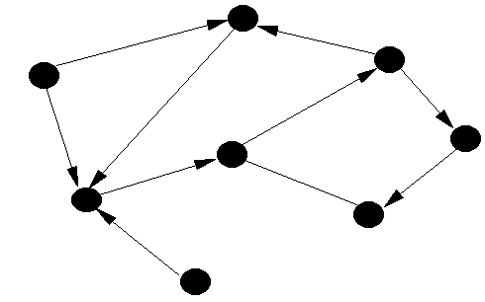
Formalism for Networking
Networks:
Packets:
0110110101101
1001101110110
10011110001…
* Peyman et al., Header Space Analysis, NSDI ‘12
Notes:
We’re going to try to do the same thing for computer networks.

Slide 5
Formalism for Networking
Routers:
* Peyman et al., Header Space Analysis, NSDI ‘12

Slide 6
Formalism for Networking
Configuration:
Packet Forwarding:
* Peyman et al., Header Space Analysis, NSDI ‘12
Notes:
We’ll come back to this in a bit

Slide 7
Symbolic Execution For Networking
Goal: Which network path will be taken for a given input?

Slide 8
Symbolic Execution For Networking
Compute from routing tables
For each host:
Insert symbolic packet
Iteratively apply

Slide 9
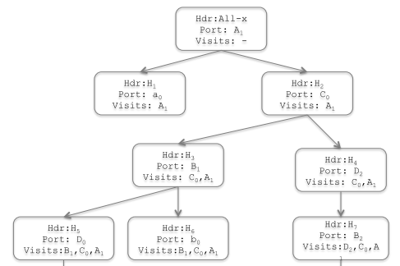
Symbolic Execution For Networking
End Result: Propagation Graph
Notes:
Just like you would obtain from running symbolic execution on code

Slide 10
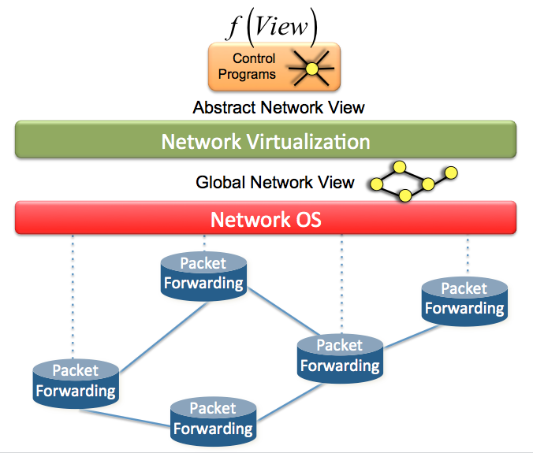
Brief Aside: Software-Defined Networking
Notes:
OK, so why do we care? Well, we can use it to detect bugs in network control software. Looks something like this: switches

Slide 11
Example Policy-Violation
“Pepsi can’t talk to Coca-Cola”
Pepsi VM
…
Coca-Cola VM

Slide 12
Proving Correctness
Can we prove correctness of network software?
Notes:
So what we described there was a “runtime” check for bugs. In some scenarios, we might want to do better than that. Imagine for example, a multi-tenant network, where Coca-Cola and Pepsi want to be damn sure that they can’t be snooped on by their neighbors. So we might want to prove that the algorithm that performs translations here is correct.

Slide 13
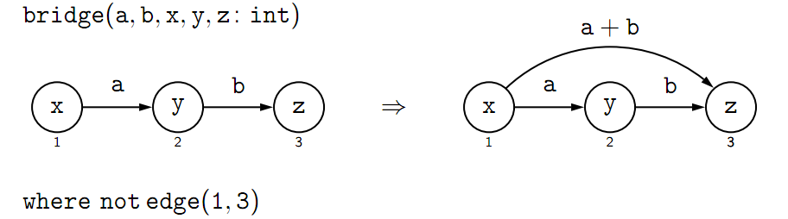
GP Graph Programming
* Poskitt, Plump, Hoare Style Verification of Graph Programs
Notes:
I’m going to demonstrate that by abstracting away the details of graphs algorithms, we prove properities of algorithms very natrually.
Maybe one other takeaway: non-determinism is going to make this easier too.

Slide 14
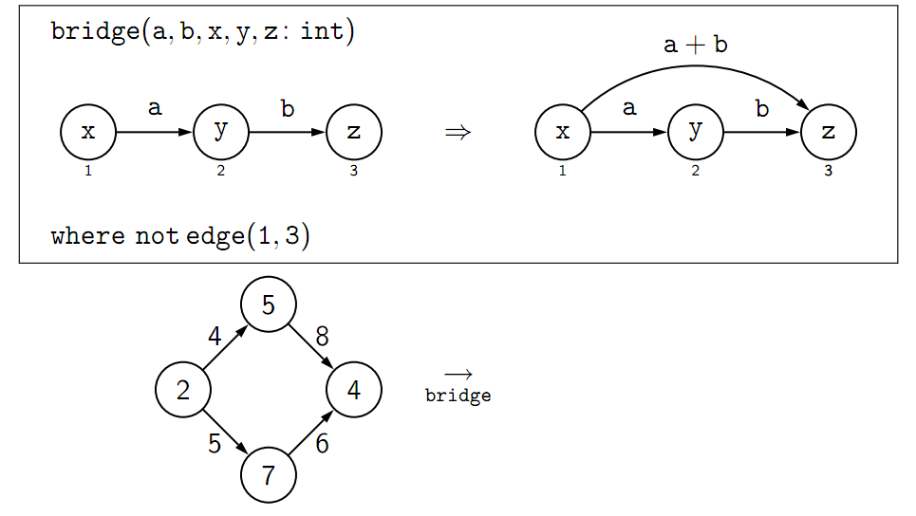
GP Graph Programming
* Poskitt, Plump, Hoare Style Verification of Graph Programs
Notes:
Assumption: transactional updates (implemented with two-phase commit)

Slide 15
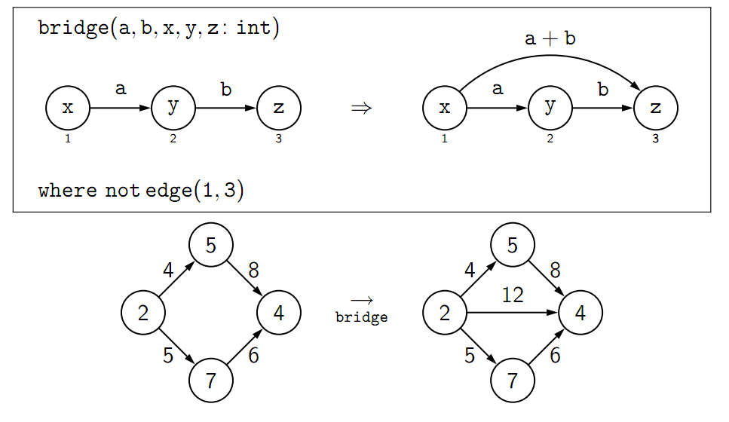
GP Graph Programming
* Poskitt, Plump, Hoare Style Verification of Graph Programs

Slide 16
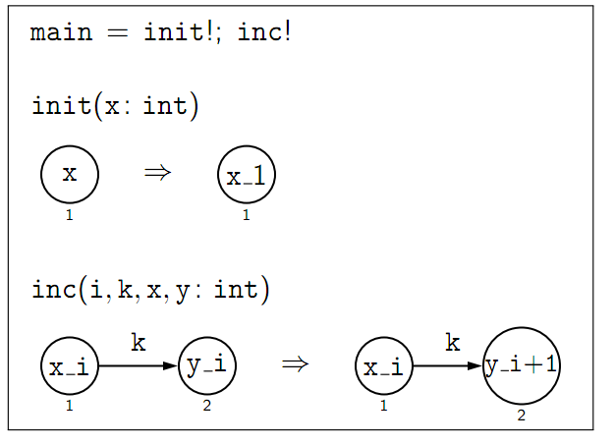
GP Graph Coloring

Slide 17
Proving Correctness
Goal: Hoare-style axiomatic semantics to prove graph programs correct

Slide 18

Proving Correctness
Assertions can range over anything (not just integers and booleans)
Notes:
The key insight here is that assertions, as in pre- and post-conditions, don’t have to….

Slide 19
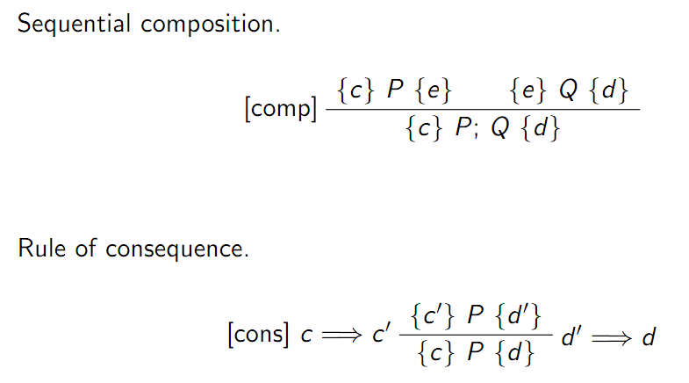
Axiomatic Semantics

Slide 20
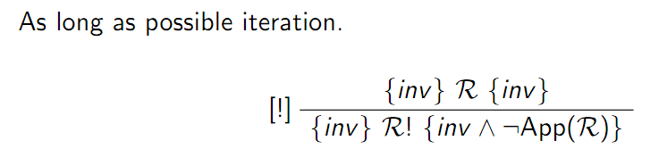
Axiomatic Semantics

Slide 21
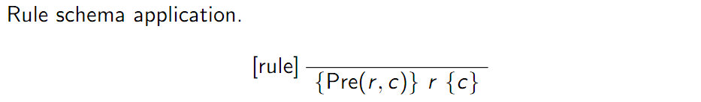
Axiomatic Semantics
Notes:
Now this is essentially assignment in normal impertivate Hoare semantics.
Starting with a rule schema r and E-condition c as a postcondition, the
transformation Pre is used to construct a precondition such that if
G |= Pre(r , c), and the application of r to G results in a graph H, then
H |= c.

Slide 22
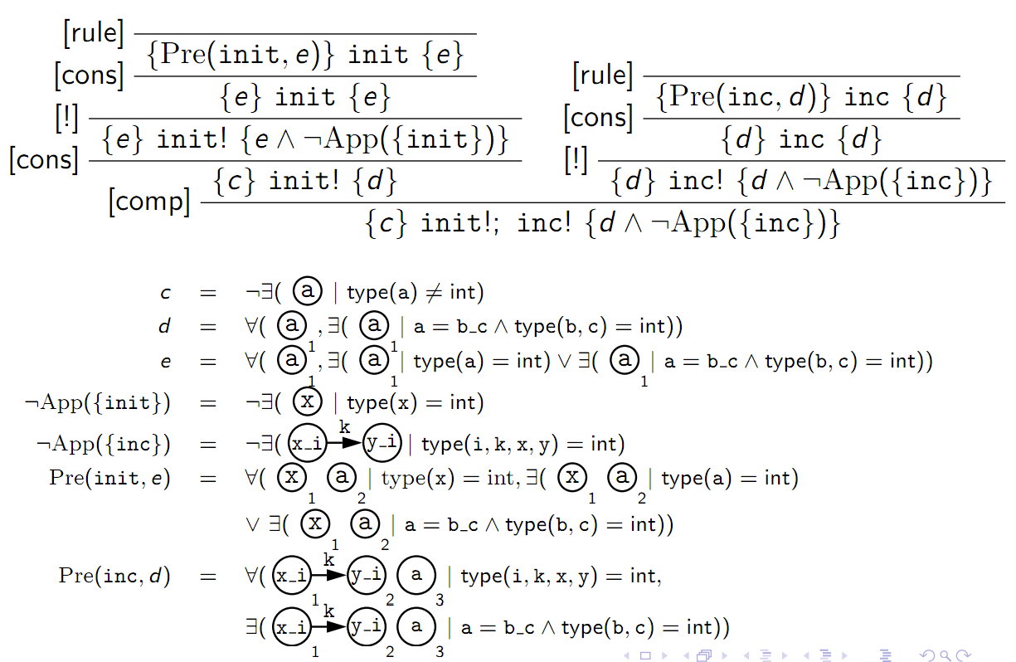

Slide 23
Summary
PL techniques FTW!
I adapted symbolic execution to find bugs in network software
I demonstrated correctness proving for network algorithms

Slide 24
Symbolic Headerspace
First Bit
0
1
0x
11
1
Second Bit
0

Slide 25
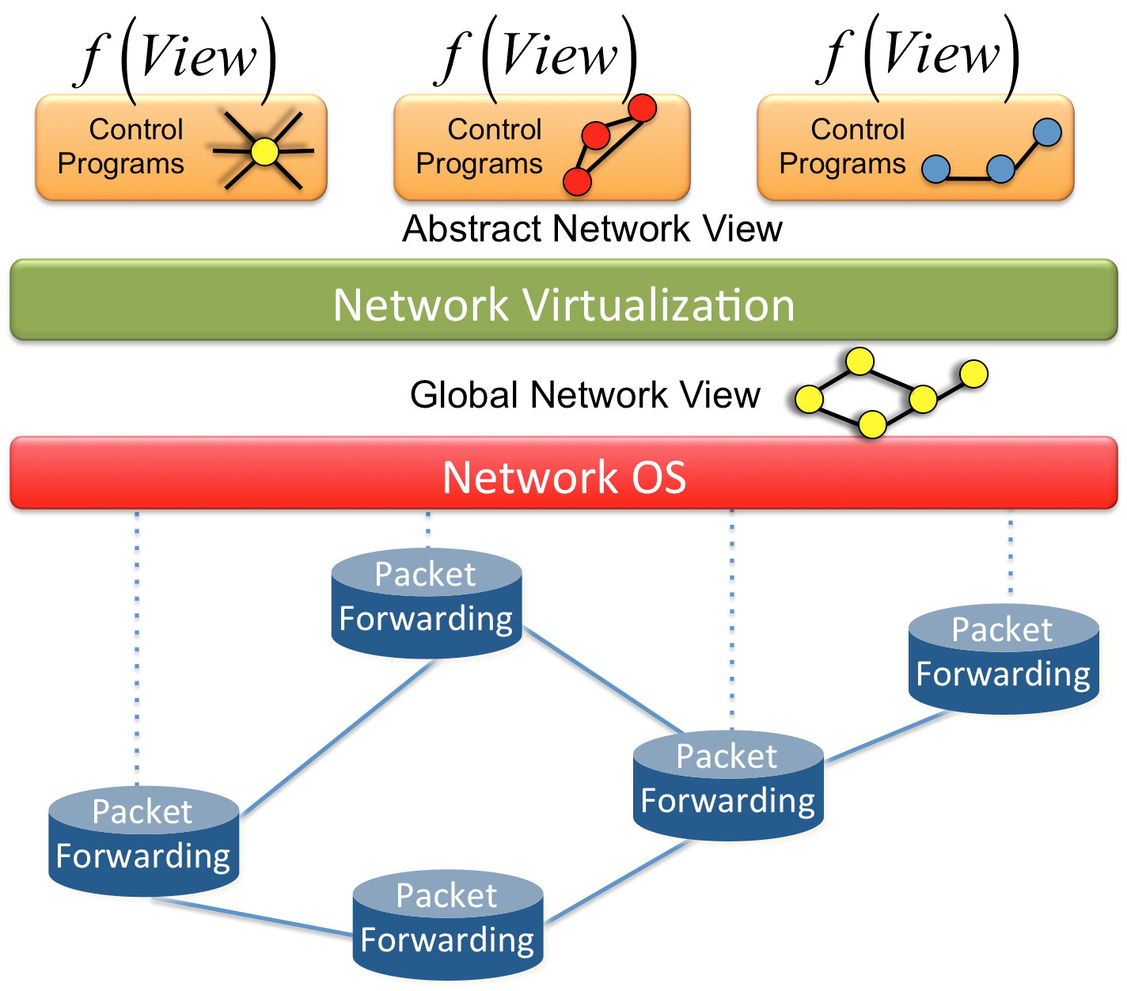
Symbolic Execution For Networking
Goal: detect policy-violations
“Network doesn’t do what I tell it to”
Notes:
hard part is scale: delays, failures, independent entities

Slide 26
Symbolic Execution For Networking
Approach:
Demonstrate isomorphism between behavior of virtual view and physical network

Slide 27
Symbolic Execution For Networking
Network Behavior:
“Packets’ final locations”
Notes:
This is just the leaves of the propagation graph! This is just the fixed-point computiation of the transformation functions.

Slide 28
Policy compliance
“All paths in logical network should have a corresponding path in the physical network”
Notes:
NOT isomorphism! The correspondence usually not going to be one to one. This is why we only care about the final location of the packet.
Show the two graphs

Slide 29
More GP constructs
Sequential composition: P; Q
If-then-else: if C then P else Q
As-long-as-possible iteration: P!

Slide 30
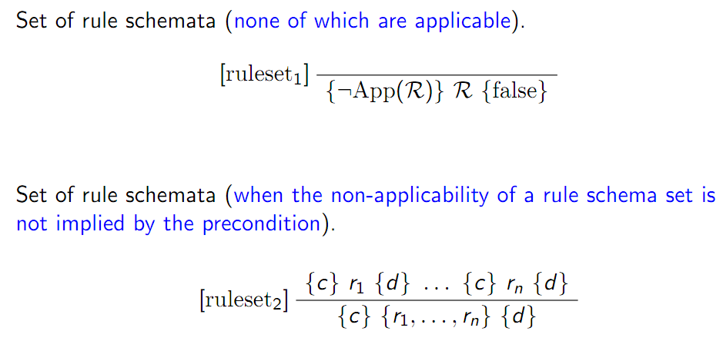
Axiomatic Semantics
Notes:
This top one says: if no graph transformation rule applies to the graph, then no post-condition can be satisfied.
The bottom one says: if a rule set applies to a graph, then the post-condition must hold for any rule in the set (since chosen non-deterministically)

