Slide 1
LIFEGUARD: Practical Repair of Persistent Route Failures
Ethan Katz-Bassett (USC), Colin Scott (UW/UCB),
David Choffnes, Italo Cunha (UW), Valas Valancius,
Nick Feamster (GT), Harsha Madhyastha (UCR),
Tom Anderson, Arvind Krishnamurthy (UW)
This work is generously funded in part by Google, Cisco and the NSF.
Notes:
Put affiliations in parentheses
Add sponsors: Google, Cisco, NSF

Slide 2
Notes:
Ok, this is annoying

Slide 3
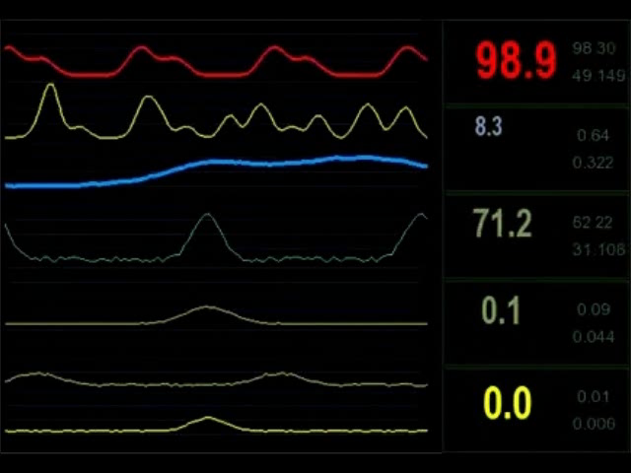
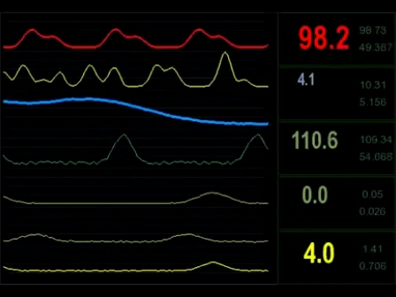
Notes:
But we’d like to do remote health monitoring … this is plain dangerous.

Slide 4
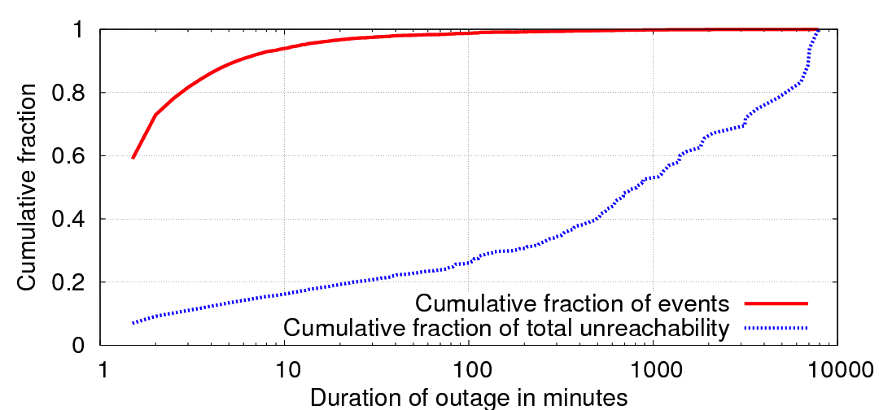

How common are these outages?
Monitor network outages from Amazon’s EC2
2 million outages in two months
Portion of outages
Long outages account for 90% of the downtime
86% of outages are less than 5 minutes
Portion of total downtime
Notes:
Most outages are short – good!
But those long ones – responsible for most of the downtime

Slide 5
Reasons for Long-Lasting Outages
Long-term outages are:
Caused by routers advertising paths that do not work
E.g., corrupted memory on line card causes black hole
E.g., bad cross-layer interactions cause failed MPLS tunnel
Repaired over slow, human timescales
Not well understood
Complicated by lack of visibility into or control over routes in other ISPs
LIFEGUARD: Practical Repair of Persistent Route Failures
Notes:
That example gives an idea of why problems last so long

Slide 6
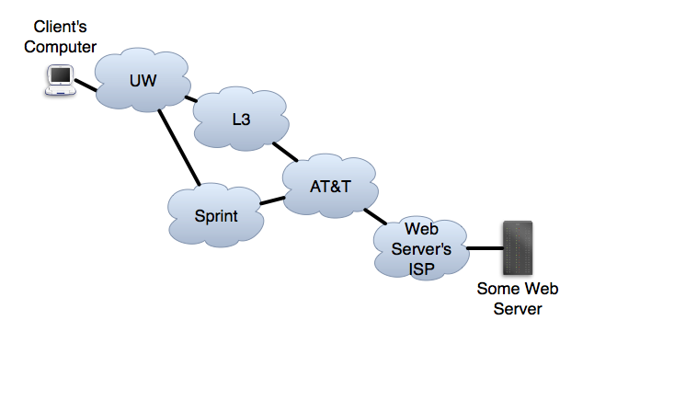
Establishing Inter-Network Routes
UWL3ATTWS
L3ATTWS
ATTWS
SprintATTWS
WS
Border Gateway Protocol (BGP)
Internet’s inter-network routing protocol
Network chooses path based on its own opaque policy ($$)
Forward your preferred path to neighbors
6

Slide 7
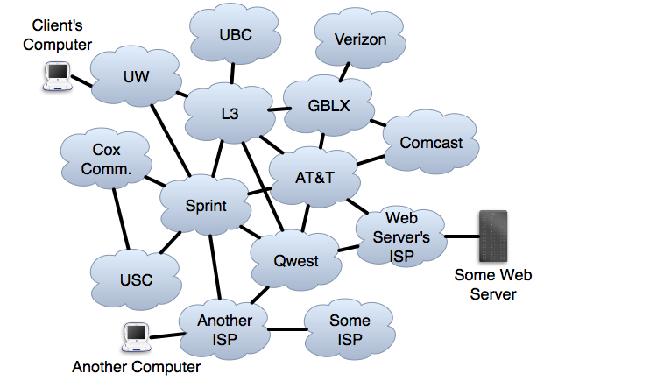
Self-Repair of Forward Paths
Choose a path that avoids the problem.
LIFEGUARD: Practical Repair of Persistent Route Failures
Notes:
Fix with path diversity.

Slide 8
What about reverse path failures?
~90% of paths on the Internet are asymmetric!
*Y. He, M. Faloutsos, S. Krishnamurthy, and B. Huffaker. On routing asymmetry in the Internet. In Autonomic Networks Symposium in Globecom, 2005.

Slide 9
Ideal Self-Repair of Reverse Paths
LIFEGUARD: Practical Repair of Persistent Route Failures
Notes:
WS wants a way to control paths to it.
No direct control over path chosen
Signal “Don’t use L3 to reach the Web Server”

Slide 10
A Mechanism for Failure Avoidance
Forward path: Choose route that avoids ISP or ISP-ISP link
Reverse path: Want others to choose paths to my prefix P that avoid ISP or ISP-ISP link X
Want a BGP announcement AVOID(X,P):
Any ISP with a route to P that avoids X uses such a route
Any ISP not using X need only pass on the announcement
LIFEGUARD: Practical Repair of Persistent Route Failures
Notes:
Not enough to get multiple providers
Remember, we are talking about problems when router is advertising a route that doesn’t work
No direct way to control what they choose
Want a BGP announcement

Slide 11
Ideal Self-Repair of Reverse Paths
AVOID(L3,WS)
AVOID(L3,WS)
AVOID(L3,WS)
LIFEGUARD: Practical Repair of Persistent Route Failures
Notes:
WS wants a way to control paths to it.
No direct control over path chosen
Signal “Don’t use L3 to reach the Web Server”

Slide 12
BGP Doesn’t Have AVOID!
How can we approximate AVOID?
Hint: how does BGP avoid loops?

Slide 13
Practical Self-Repair of Reverse Paths
UW → L3 → ATT → WS
L3 → ATT → WS
ATT → WS
Sprint → Qwest → WS
WS
AISP → Qwest → WS
Qwest → WS
LIFEGUARD: Practical Repair of Persistent Route Failures
Notes:
All it controls is what it announces - <CLICK>“hey guys, the server is over here, figure it out”
<CLICK THROUGH ANNOUNCEMENTS UNTIL FAILURE>
So how can it announce in a way that hints to others to route around L3?

Slide 14
Practical Self-Repair of Reverse Paths
UW → L3 → ATT → WS
UW → Sprint → Qwest → WS → L3→ WS
?
L3 → ATT → WS
ATT → WS
ATT → WS → L3→ WS
WS → L3→ WS
Sprint → Qwest → WS → L3→ WS
WS
Sprint → Qwest → WS
AVOID(L3,WS)
AISP → Qwest → WS → L3→ WS
Qwest → WS → L3→ WS
AISP → Qwest → WS
Qwest → WS
BGP loop prevention encourages switch to working path.
LIFEGUARD: Practical Repair of Persistent Route Failures
Notes:
I’m going to show you how we can announce AVOID using a technique known as BGP POISONING
Need first WS so neighbors know the next hop
Need other WS to signal that WS owns prefix
Let’s see what the effect of that announcement is

Slide 15
That’s outage avoidance
How do we detect outages in the first place?
And how do we know who to AVOID?

Slide 16
Locating Internet Failures
How it works today
Customer complains to network operator
Operator sends test traffic to confirm
If confirmed:
Who is causing the problem?
Is it affecting just me?
LIFEGUARD: Practical Repair of Persistent Route Failures
Notes:
- suppose a guy at an ISP ops center gets a call from a customer that the customer can't reach <whatever the destination was>
- well, the first thing he might try is to see if he can reach it and get a response - that's called a ping
- well, that fails. the next thing he might want to know is where the problem is, so he can start figuring out how to fix it. traceroute is a tool that we can use to tell us how traffic is routed towards a destination
- the TR stops in L3 chicago (or whatever it was). so perhaps L3 is having a problem. but maybe it is just some config affecting the local network, so he'd like to try to test it from other locations. so he emails a mailing list to get other people to check..
and then you could work in, "well, say the problem is in L3. what happens? well, maybe he needs to call up L3, which could take awhile. but, actually, the other TR ends in a different hop. is it one problem? 2? did the problem shift? and, actually, traffic could be reaching the destination and failing on the way back

Slide 17
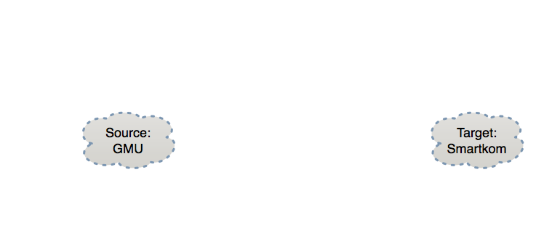






How does LIFEGUARD locate a failure?
Before outage:
Historical
Current
Historical atlas enables reasoning about changes
Traceroute yields only path from GMU to target
Reverse traceroute reveals path asymmetry
LIFEGUARD: Practical Repair of Persistent Route Failures
Notes:
TARGET (not destination)
Only showing some reverse paths, but measure all
Current approach is painful, slow and often misleading
We need more information to reason about an outage

Slide 18
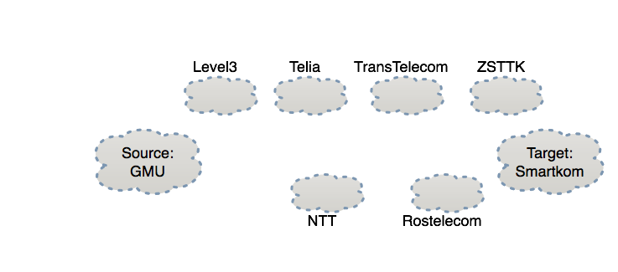



How does LIFEGUARD locate a failure?
During outage:
Problem with ZSTTK?
Ping? Fr:VP
Ping! To:VP
Historical
Current
Forward path works
LIFEGUARD: Practical Repair of Persistent Route Failures
Notes:
Other vantage points allow a richer view and direction isolation

Slide 19
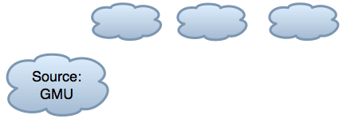

How does LIFEGUARD locate a failure?
During outage:
NTT:Ping? Fr:GMU
GMU:Ping! Fr:NTT
Historical
Current
Forward path works
LIFEGUARD: Practical Repair of Persistent Route Failures
Notes:
Test which hops have paths to GMU

Slide 20

How does LIFEGUARD locate a failure?
During outage:
Rostele: Ping? Fr:GMU
Historical
Current
Forward path works
Rostelcom is not forwarding traffic towards GMU
LIFEGUARD: Practical Repair of Persistent Route Failures
Notes:
Draw a line where all hops on one side have working path to GMU and all hops on other side don’t have a working path

Slide 21
How LIFEGUARD Locates Failures
LIFEGUARD:
Maintains background historical atlas
Isolates direction of failure
Tests historical paths in failing direction to prune candidate failure locations
Once failure located, use BGP loop prevention to AVOID the problem
LIFEGUARD: Practical Repair of Persistent Route Failures
Notes:
Identifying where the problem is a big win
The operator can get in touch with the remote network causing the problem and YELL at them
But can we make the repair faster, without requiring the involvement of the other network?

