Slide 1
Network Troubleshooting
Colin Scott, Andreas Wundsam, Justine Sherry, Scott Shenker

Slide 2
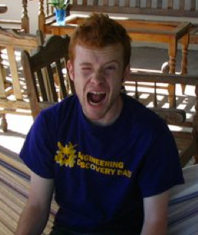
Request
But don’t carrier hotels blah-dee-blah?
Crazy idea! What if you did blah-dee-blah?

Slide 3

Request Invitation
Derail my talk!

Slide 4

Nice Day

Slide 5

Bad Day

Slide 6
Bad Day

Slide 7
Nice Day

Slide 8
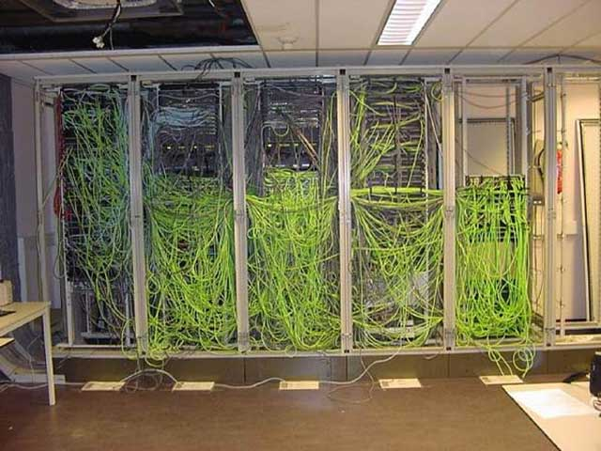
Reality

Slide 9
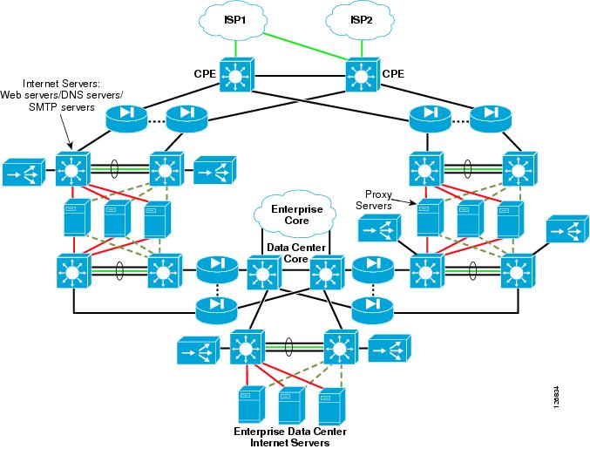
Reality
Huge Scale
Completely Distributed
Highly Dynamic
Heterogeneous
Virtualized
Multi-tenant
….

Slide 10
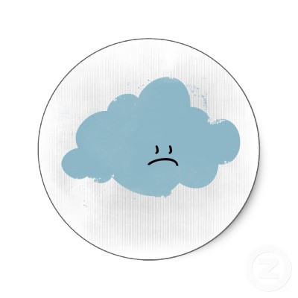



Reality
Inconsistencies
are everywhere!
Notes:
Unlike a tightly meshed cluster, where failures are relatively rare… Networks will ALWAYS be inconsistent.
In our world, it’s a fact of life that it will be inconsistent!!! When do we reach a point when this breaks our system?
What pushes your system over the edge?
So, how bad is it? Does it matter? What can we do about it?
Not necessarily a bad thing, but it can be!
NOT binary!

Slide 11

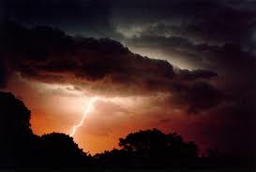
Research Question
How do pernicious inconsistencies come about?
How do they differ from benign inconsistencies?

Slide 12
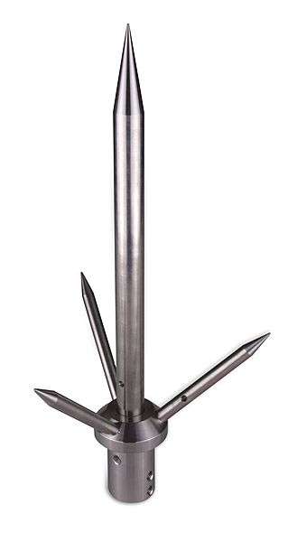
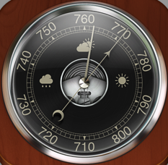
Tools
Barometer
“Invariant Checker”
Mechanism to detect inconsistencies
Lightning rod
“Simulator”
Platform to experiment with:
Network configuration
Traffic mixes
Event orderings
Failures
…
Notes:
For the rest of the talk

Slide 13
Talk Overview
SDN as an enabler
Barometer:
Formalism for invariant checking
Mechanism
Lightning Rod:
Simulator for exercising the barometer
Conclusion

Slide 14
What we’ll need from the network
Policy specification
Global view of network state
Notes:
These tools require two things from the network. To calibrate the barometer, we need some notion of how the network is supposed to behave. And for the lightning rod to be tractable, we’re going to need to a global view of the network state.

Slide 15
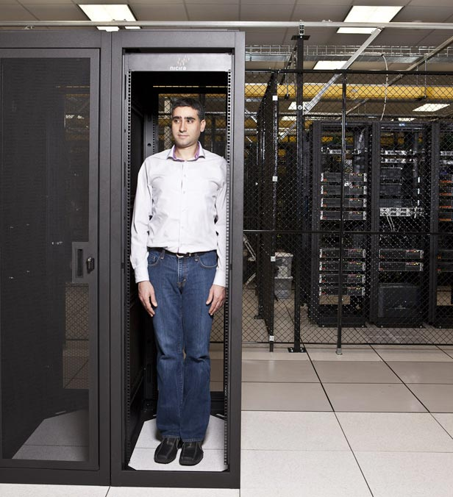
Enter Software-defined Networking

Slide 16
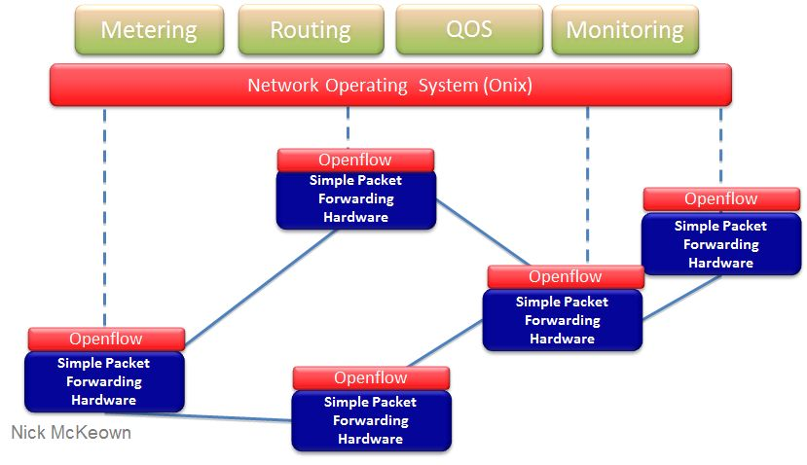
Software-defined Networking

Slide 17
SDN Layering
Control Application
Very simple policy specification
Global view of the network state
Virtual View
Physical View
Physical Network
Notes:
If you live in Scott Shenker’s world, SDN has a very nice layered architecture.
INTERFACES, narrow, well-defined

Slide 18
Barometer
Inconsistency:
“The network doesn’t do what the control program tells it to”
Notes:
OK, so back to our tools. What exactly do we mean by inconsitencies? We mean something

Slide 19
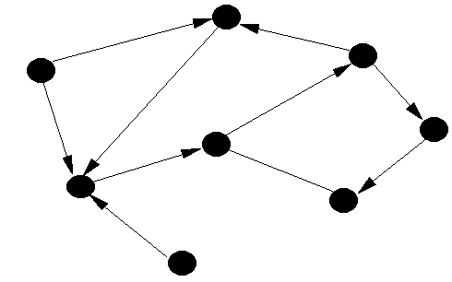
Formally
Networks:
Packets:
Switches:
0110110101101
1001101110110
10011110001…
* Peyman et al., Header Space Analysis, NSDI ‘12
Notes:
But let’s be a little more formal than that. You can think of…

Slide 20
Formally
Network Forwarding:
Network Traversal:
* Peyman et al., Header Space Analysis, NSDI ‘12

Slide 21
Formally
Network Behavior:
Notes:
What we really care about is the behavior of the network. This is just a mapping, from packets and edges, to their final destinations. Basically the set of all possible paths.

Slide 22
SDN Layering
Control Application
Virtual View
Physical View
Physical Network
Notes:
Back to SDN: like I mentioned before, layered architecture. At each layer is a representation of the network state. These are just graphs!

Slide 23
Formal Invariant
“All paths in the virtual network should have a corresponding path in the physical network”
Notes:
NOT isomorphism! The correspondence usually not going to be one to one. This is why we only care about the final location of the packet.

Slide 24
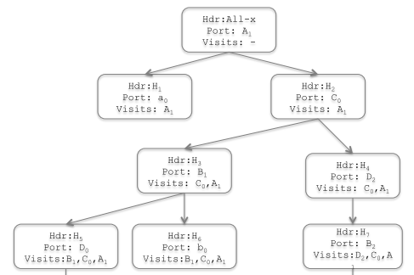
Checking Correspondence
Take snapshot of
Compute
Compute
For each access link
Insert symbolic packet
Iteratively apply
Check
}

Slide 25
Barometer Wrap Up
Mechanism to detect inconsistencies at a particular point in time.
Now what?

Slide 26
Lightning Rod
We want to explore system executions
In particular, we’re looking for corner cases
Notes:
Recall that the goal of this work is to get an understanding of how network catastrophes come about. So what we want to do is put the system into different scenarios. In particular, we’re interested in the kind of corner cases that bring about storms.
Repeat: benign vs. pernicious

Slide 27
Lightning Rod
Notes:
This is a really high-level depiction of our system. Essentially what we’re going to do is simulate the entire execution of the physical network. In a single process, we model switches in the network. We then run control servers on top of this, but we interpose on all of the communication channels.
Mechanisn to explore those research questions! Not a software artefact….
Mark properties: delay, re-ordering, failure modes, ….

Slide 28
Using the Lightning Rod
Insert input traffic. Either:
Fuzzed
Production traces
Manipulate events:
Cause delays, drops
Induce failures
Filter out irrelevant events
Track inconsistencies
t₀
t₁
t₂
Notes:
So the way a network operator might use this…

Slide 29
Putting it all together
Goal:
Understand inconsistencies in the network
Barometer: “Invariant checker”
Infer inconsistencies at any point in time
Lightning Rod: “Simulator”
Explore system executions
Enabled by observation: SDN provides layering

Slide 30
Future Work
Evaluate: run debugger on third-party controllers
Multi-tenant virtualized network
Scale-out BGP router
Ethane
…
Gather library of corner-case traces
Get people to use it!

Slide 31

Thanks!

