Slide 1

How Did We Get Into This Mess?Automated Diagnosis for SDN
Colin Scott, Andreas Wundsam, Sam Whitlock, Andrew Or, Eugene Huang, Kyriakos Zarifis, Scott Shenker
Notes:
TODO: need to

Slide 2

How many events in a DC network?
20,000 servers * 4 VMs / server = 80,000 VMs
(6 migrations / day / VM) +
(2 power up|down / day / VM) *
80,000 VMs = 640,000 VM events / day
~= 450 VM changes / minute [1]
8.5 network error events / minute [2]
1 policy change / tenant / day *
2000 tenants ~= 1 policy change / minute

Slide 3
How many events in a DC network?
= ~500 events / minute

Slide 4

Something goes wrong!

Slide 5
Best practice: Logs
Manual analysis of log files

Slide 6
Best practice: Logs
?
Controller A
Switch 1
Switch 2
Switch3
Controller B
Switch 4
Switch 5
Switch 6
Controller C
Switch 7
Switch 8
Switch 9

Slide 7
Goal
Identify the minimal set of inputs that trigger the bug

Slide 8
Minimal Causal Set
?
Controller A
Switch 1
Switch 2
Switch3
Controller B
Switch 4
Switch 5
Switch 6
Controller C
Switch 7
Switch 8
Switch 9
Notes:
OK, so how are we going to get from here…

Slide 9
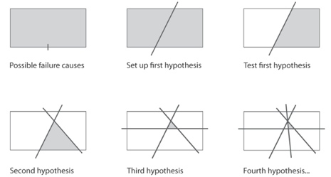
High-Level Approach
Modify history!

Slide 10

Analogy

Slide 11
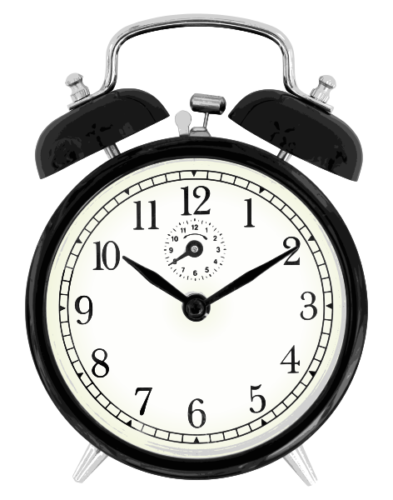

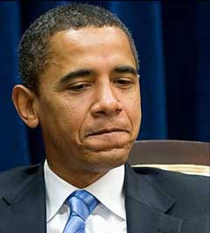
Analogy

Slide 12
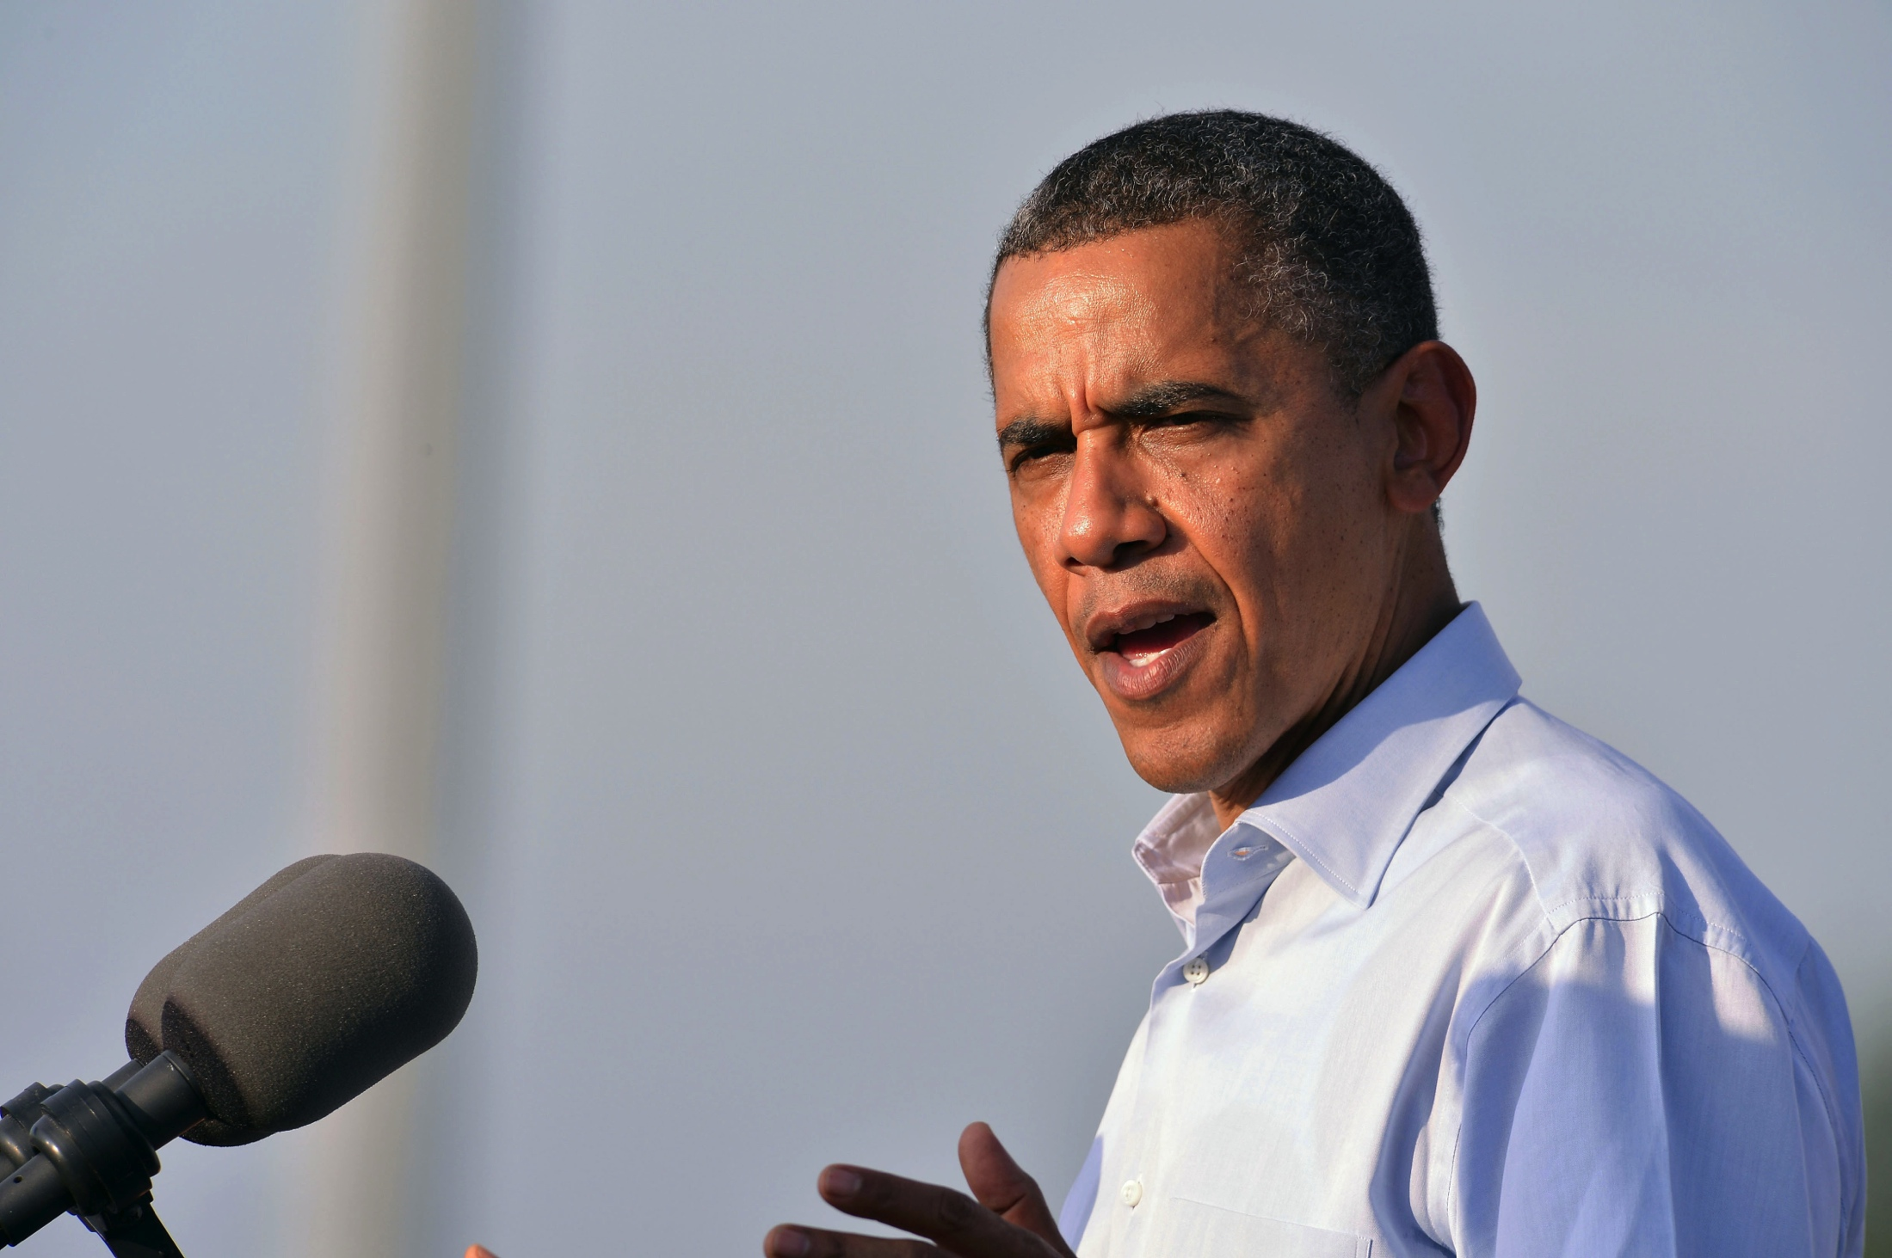
Analogy

Slide 13
Need to Reason About Equivalence!
≈

Slide 14
Summary
Goal: automatically diagnose network correctness violations
Approach: iteratively alter history
Check us out:
ucb-sts.github.com/sts/

Slide 15
Backup

Slide 16
References
[1] V. Soundararajan and K. Govil. Challenges in building scalable virtualized datacenter management. SIGOPS Operating Systems Review ’10.
[2] A. Greenberg, J. R. Hamilton, N. Jain, S. Kandula, C. Kim, P. Lahiri, D. A. Maltz, P. Patel, and S. Sengupta. VL2: a scalable and flexible data center network, Sec. 3.4. SIGCOMM ’09.

Slide 17
Simulator
Notes:
This is a really high-level depiction of our system. Essentially what we’re going to do is simulate the entire execution of the physical network. In a single process, we model switches in the network. We then run control servers on top of this, but we interpose on all of the communication channels.
Mechanisn to explore those research questions! Not a software artefact….
Mark properties: delay, re-ordering, failure modes, ….

