Slide 1
Minimizing Test Cases for Distributed Systems
Colin Scott
UC Berkeley Qualifying Exam
October 30th, 2014

Slide 2
What is a Distributed System?
Multiple machines:
Machines communicate over a network
No shared clock
Concurrent computation
Possibility of failures

Slide 3
Distributed Systems are Complex
Challenges:
Stringent requirements
Concurrency
Asynchrony
Partial failure
+ Challenges of normal software dev

Slide 4
Distributed Systems are Bug-Prone
Distributed correctness faults:
Race conditions
Atomicity violations
Deadlock
Livelock
…
+ Normal software bugs
Notes:
We’re interested in bugs that cause safety violations. Messages might be lost, etc.

Slide 5
Example Bug (Floodlight, 2012)
Crash
Master
Ping
Pong
Ping
Backup
Master
Notify
Notify
ACK
Blackhole persists!
Switch
Link Failure
Notes:
NOTE: describe briefly what SDN is here

Slide 6
Best Practice: Logs
Human analysis of log files
Notes:
From what I saw at Nicira and Google, the most common way to troubleshoot these problems is for a human to analyze log files

Slide 7
Best Practice: Logs
Crash
Master
Ping
Pong
Ping
Backup
Master
Notify
Notify
ACK
Blackhole persists!
Switch
Link Failure
Notes:
The developer is not given this nice, concise log!

Slide 8
Best Practice: Logs
?
Controller A
Switch 1
Switch 2
Switch3
Controller B
Switch 4
Switch 5
Switch 6
Controller C
Switch 7
Switch 8
Switch 9
…
Notes:
TODO: add forward pointer to how large real logs are.

Slide 9
Our Goal
Allow developers to focus on fixing the underlying bug
Notes:
NOTE: expand more on experience in industry.
While this kind of debugging isn’t very visible to researchers,
This is a real problem in the commercial world
Our intent is to build real techniques that can be integrated into existing commercial testbeds
That would cope with real software

Slide 10
Thesis
Possible to automatically identify minimal sequences of inputs that trigger bugs
Notes:
Today I’ll show you how.

Slide 11
Why minimization?
Smaller event traces are easier to understand
G. A. Miller. The Magical Number Seven, Plus or Minus Two: Some Limits on Our Capacity for Processing Information. Psychological Review ’56.
Notes:
The key idea here is that the smaller the event trace, the easier it will be for humans to understand. This is certainly true from our own experience, and it also corroborated by psychology research.

Slide 12
Outline
What are we trying to do?
How do we do it?
High-level approach
Blackbox SDN control software
What am I going to do next?
Sound approach for general dist’systems
Has this been done before?
Notes:
NOTE: there is lots of work, but we do not believe that anyone has approached minimization in the way that we do.
“For the rest of this talk, I’m going to first try to convince you that there is a real problem with the way troubleshooting is done today.
I’ll start by spending a bit more time detailing what exactly it is we’re trying to do.
Then I’ll present the general approach.
Then I’ll present the details of how we apply this general approach to one domain: SDN control softwrae
Then I’ll present future work.

Slide 13



Minimal Causal Sequence
Output:
V(i.e. violation occurs)
V
Notes:
NOTE: what we really care about is smallness, not minimality. But we achieve smallness by aiming for this formal property of minimality.

Slide 14
Minimal Causal Sequence
?
Controller A
Switch 1
Switch 2
Switch3
Controller B
Switch 4
Switch 5
Switch 6
Controller C
Switch 7
Switch 8
Switch 9
…

Slide 15
Minimal Causal Sequence
Crash
Master
Ping
Pong
Ping
Backup
Master
Notify
Notify
ACK
Blackhole persists!
Switch
Link Failure
Notes:
The developer is not given this nice, concise log!

Slide 16
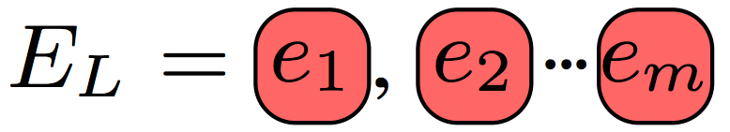
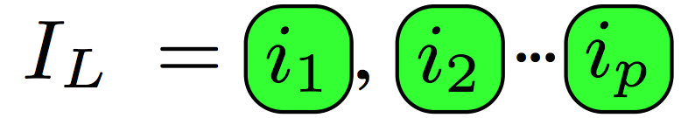
Assume We’re Given:
Invariant violation (safety condition)
Partially-ordered event sequence:
External events (e.g. link failures, commands)
Internal events (message deliveries)
Ability to replay event sequences
Notes:
We use the testbed that the companies already have in place to find bugs. We assume that the

Slide 17
Where We Obtain Requisites
Local Machine
(unit/integration tests)
Production
Environment
QA Testbed

Slide 18
Where Bugs are Found
Symptoms found:
On developer’s local machine (unit and integration tests)
In production environment
On quality assurance testbed
Notes:
Describe what kinds of bugs these might be: loop, blackhole, breach of tenant isolation.
Take more time. Unit test, their own code. Integration test, it's on your local machine. QA, random inputs, hard to understand, QA infrastructure gives us infrastructure to replay. Then production is too late.

Slide 19
QA Testbed
Node 1
Node N
Software Under Test
QA Testbed
Test Harness
Test Coordinator

Slide 20
Outline
What are we trying to do?
How do we do it?
High-level approach
Blackbox SDN control software
What am I going to do next?
Sound approach for general dist’systems
Has this been done before?
Notes:
“For the rest of this talk, I’m going to first try to convince you that there is a real problem with the way troubleshooting is done today.
I’ll start by spending a bit more time detailing what exactly it is we’re trying to do.
Then I’ll present the general approach.
Then I’ll present the details of how we apply this general approach to one domain: SDN control softwrae
Then I’ll present future work.

Slide 21

Approach: Delta Debugging¹ Replay
Events (link failures, crashes, host migrations) injected by test orchestrator
✔
✗
?
1. A. Zeller et al. Simplifying and Isolating Failure-Inducing Input. IEEE TSE ’02
Notes:
NOTE: say “start system from known state”
TODO: describe what would happen during interference, in a concise way.
Right now the cuts we make are based on time. But you could imagine doing this slicing based on nodes in the topology, or combinations of types of events.
If any of you are aware of the work, this technique is called delta debugging.
When you apply delta debugging to a distributed system rather than a single program, you run into some challenges.

Slide 22
Two Requisites for Minimization
Two requisites for minimization:
Selecting Events to Replay
Scheduling Events During Replay

Slide 23
Key Point
Must Carefully Schedule Replay Events To Achieve Minimization!
Notes:
Verbal: And this is our contribution

Slide 24
Outline
What are we trying to do?
How do we do it?
High-level approach
Blackbox SDN control software
What am I going to do next?
Sound approach for general dist’systems
Has this been done before?
Notes:
NOTE: we started out in SDN, but afterwards realized that the techniques we were developing aren’t specific to SDN for the most part.
“For the rest of this talk, I’m going to first try to convince you that there is a real problem with the way troubleshooting is done today.
I’ll start by spending a bit more time detailing what exactly it is we’re trying to do.
Then I’ll present the general approach.
Then I’ll present the details of how we apply this general approach to one domain: SDN control softwrae
Then I’ll present future work.

Slide 25
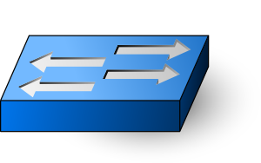
SDN Architecture
Controller 1
Controller 2
Controller N
Notes:
TODO: Say more? Multiple controllers for scale/HA, managing multiple switches, with no single entity having a global view.

Slide 26
Approach: Modify Testbed
Controller 1
Controller N
Control Software
QA Testbed
Test Coordinator
Notes:
NOTE: everything below this line is what the test coordinator has control over.
We use the *same*, preexisting QA infrastructure that companies already have in place. We just need to employ our techniques to this infrastucture.

Slide 27
Challenges for Scheduling
Asynchrony
Divergent execution
Non-determinism
Notes:
NOTE: as you can probably tell, these are general challenges. Here we develop practical heuristics for dealing with them that are emperically validated. We’re currently working on developing a model to show how to provide provable guarentees on how we cope with them.
TODO: cut these subbullets?

Slide 28
Challenge: Asynchrony
Asynchrony definition:
No fixed upper bound on relative speed of processors
No fixed upper bound on time for messages to be delivered
Dwork & Lynch. Consensus in the Presence of Partial Synchrony. JACM ‘88

Slide 29
Challenge: Asynchrony
Need to maintain original event order
Crash
Master
Ping
Ping
Pong
Timeout
Backup
Master
port_status
port_status
ACK
Blackhole persists!
Switch
Link Failure
Timeout

Slide 30
Challenge: Asynchrony
Need to maintain original event order
Crash
Master
Ping
Ping
Pong
Timeout
Backup
New Routing Table!
Master
port_status
Blackhole avoided!
Switch
Link Failure
Notes:
NOTE: as we replay subsequences, we’re going to try to keep as many of these causal dependencies from the original intact. Next slide:

Slide 31
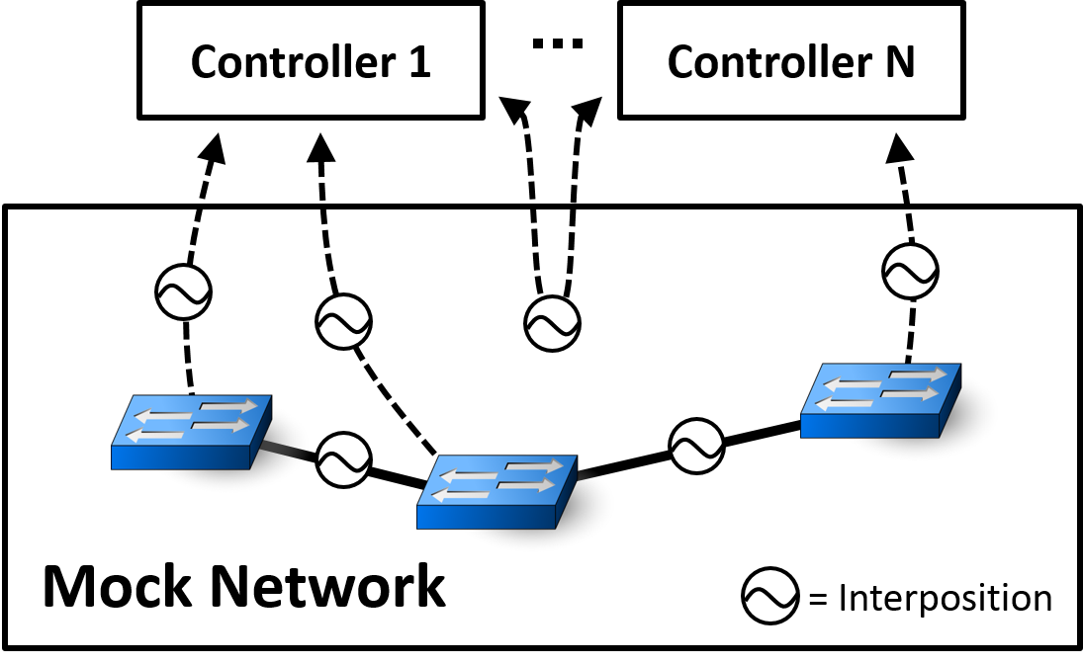
Coping with Asynchrony
Use interposition to maintain causal dependencies
Notes:
NOTE: interposition gives us messages during the *recording* phase.=
And we achieve this by interposing on the internal events. As we observe messages, we allow them through in a way that is consistent with the causal dependencies from the original execution.
If you were a company with a QA testbed, you would just need to add interposition. We built our own, since no open source were available for SDN

Slide 32
Challenge: Divergence
Asynchrony
Divergent execution
Syntactic Changes
Absent Events
Unexpected Events
Non-determinism

Slide 33
Divergence: Absent Internal Events
Prune Earlier Input..
Crash
Master
Ping
Pong
Ping
Backup
Master
Policy change
Notify
Notify
ACK
Switch
Link Failure
Host Migration

Slide 34
Divergence: Absent Internal Events
Some Events No Longer Appear
Crash
Master
Ping
Pong
Ping
Backup
Master
Policy change
Notify
Switch
Link Failure
Host Migration

Slide 35
Solution: Peek Ahead
Infer which internal events will occur
Crash
Master
Ping
Pong
Ping
Backup
Master
Policy change
Notify
Switch
Link Failure
Host Migration
Notes:
TODO: Say: take a snapshot

Slide 36
Challenge: Non-determinism
Asynchrony
Divergent execution
Non-determinism

Slide 37
Coping With Non-Determinism
Replay multiple times per subsequence
Assuming i.i.d., probability of not finding bug modeled by:
If not i.i.d., override gettimeofday(), multiplex sockets, interpose on logging statements
Notes:
Other tricks:
- multiplexed sockets
- override gettimeofday and rand
- interpose on logging library
- interpose on intra-controller messages

Slide 38
Approach Recap
Replay events in QA testbed
Apply delta debugging to inputs
Asynchrony: interpose on messages
Divergence: infer absent events
Non-determinism: replay multiple times
Notes:
Cut?

Slide 39
Evaluation
How well does it work?
Notes:
“I’m going to first try to convince you that there is a real problem with the way troubleshooting is done today.
Then I’m going to describe a system and the techniques we apply within this system to make troubleshooting easier.
Then I’ll end by showing you how well the system works.

Slide 40
Evaluation Methodology
Evaluate on 5 open source SDN controllers (Floodlight, NOX, POX, Frenetic, ONOS)
Quantify minimization for:
Synthetic bugs
Bugs found in the wild
Qualitatively relay experience troubleshooting with MCSes

Slide 41
Case Studies
1596
719
17 case studies total
Substantial minimization except for 1 case
Conservative input sizes
Not replayable
(n)
(m)
Discovered Bugs
Known Bugs
Synthetic Bugs
Notes:
First note that in all cases except for one, were were able to substantially decrease the initial input size. And note that these initial input sizes are small compared to what you would find in a production QA testbed. We found the bugs quickly. And we also showed that

Slide 42
Comparison to Naïve Replay
Naïve replay: ignore internal events
Naïve replay often not able to replay at all
5 / 7 discovered bugs not replayable
1 / 7 synthetic bugs not replayable
Naïve replay did better in one case
2 event MCS vs. 7 event MCS with our techniques

Slide 43
Qualitative Results
15 / 17 MCSes useful for debugging
1 non-replayable case (not surprising)
1 misleading MCS (expected)

Slide 44
Outline
What are we trying to do?
How do we do it?
High-level approach
Blackbox SDN control software
What am I going to do next?
Sound approach for general dist’systems
Has this been done before?
Notes:
“For the rest of this talk, I’m going to first try to convince you that there is a real problem with the way troubleshooting is done today.
I’ll start by spending a bit more time detailing what exactly it is we’re trying to do.
Then I’ll present the general approach.
Then I’ll present the details of how we apply this general approach to one domain: SDN control softwrae
Then I’ll present future work.

Slide 45
Previous Work is Unsatisfying
How do we know MCSes are minimal?
And we don’t believe the problem is specific to SDN!
Notes:
Can’t explain why they work or how close they’re to optimal
Would like approach to apply to general distributed systems

Slide 46
Proposed Work
Explain why MCSes are (close to) minimal
Show that techniques apply to other distributed systems
Notes:
Can’t explain why they work or how close they’re to optimal
Would like approach to apply to general distributed systems

Slide 47
Ideal Solution
What we’d like: provably minimal MCSes produced with reasonable time/effort

Slide 48

Ideal Solution
Provably correct [infeasible!] approach:
Certify each subsequence
Original
✗
Replay 1
✔
Replay 2
✗
Replay 3
✔
Replay 4
✔
Replay 5
✗
Notes:
CAREFUL: say “whether a schedule exists” rather than “subsequence triggers the bug”

Slide 49

Ideal Solution
To certify subsequence, explore all possible schedules
Subsequence
Schedule 1
?
Schedule 2
?
Schedule 3
?
Schedule 4
?
…

Slide 50
Plausible Solution: Model Checking
Implementation-level model checkers control the schedule
Traditionally: used to find (all) bugs
Here: use to find execution paths to a specific bug

Slide 51
Issues With Model Checking
Problem: schedule space may be unbounded! [1]
1. M. K. Aguilera, W. Chen, and S. Toueg. Heartbeat: A Timeout- Free Failure Detector for Quiescent Reliable Communication. IWDA ’97.
Notes:
Even if we’re only using model checker to find a specific bug rather than all bugs (as is
By using bounded model checking, we sacrifice some soundness properties, i.e. guarentees on minimality, in favor of applicibility to real systems

Slide 52
Issues With Model Checking
Workaround: use bounded model checking
All bugs
MCS not minimal
Minimal with
blackbox
Minimal with k-bounded
schedule enumeration

Slide 53
Computational Intractability [1/3]
Problem: bounded exploration of schedule space likely still intractable
Notes:
NOTE: even after applying state-of-the-art model checking optimizations like dynamic partial order reduction.
Now a second problem is that even after bounding our exploration of the state space, it’s quite possible that it’s computationally intractable to explore all possible schedules even within a fixed number of steps, and

Slide 54
Computational Intractability [2/3]
First Approach: Leverage information from prior executions
✗
Prior Subseq.
Current Subseq.
?
?
Edit Dist. 1
?
Edit Dist. 1
?
Edit Dist. 2
Notes:
Luckily, because we’re using MCs in a different way than they are traditionally used, we have degress of freedom to explore optimizations that traditional uses of model checking don’t have access to .
E.g. try to minimize edit distance from original schedule in hope of finding bug-triggering schedules quickly

Slide 55
Computational Intractability [3/3]
Second Approach: Tailor schedule exploration according to empirical behavior of specific systems
Uniform communication patterns in consensus protocols
ACID transactions as inputs in distributed databases
Quiescence in SDN control software
…
Notes:
The idea here is to first observe prior executions of the systems, then use those observations to predict schedules that seem likely to produce violations. Or, if the system has certain architectural properties, e.g. atomicity in databases, use those properties to prune space of schedules to explore.
“Modular verification”

Slide 56
Evaluation Approach
Key metric: # of schedules explored before violation discovered
Plan: Empirically evaluate scheduling strategies on cases where MCS is known
Notes:
CAREFUL about the word `heuristic`
The idea here is to first observe prior executions

Slide 57
Outline
What are we trying to do?
How do we do it?
High-level approach
Blackbox SDN control software
What am I going to do next?
Sound approach for general dist’systems
Has this been done before?
Notes:
“For the rest of this talk, I’m going to first try to convince you that there is a real problem with the way troubleshooting is done today.
I’ll start by spending a bit more time detailing what exactly it is we’re trying to do.
Then I’ll present the general approach.
Then I’ll present the details of how we apply this general approach to one domain: SDN control softwrae
Then I’ll present future work.

Slide 58
Related work
Thread Schedule Minimization
Isolating Failure-Inducing Thread Schedules. SIGSOFT ’02.
A Trace Simplification Technique for Effective Debugging of Concurrent Programs. FSE ’10.
Program Flow Analysis
Enabling Tracing of Long-Running Multithreaded Programs via Dynamic Execution Reduction. ISSTA ’07.
Toward Generating Reducible Replay Logs. PLDI ’11.
Best-Effort Replay of Field Failures
A Technique for Enabling and Supporting Debugging of Field Failures. ICSE ’07.
Triage: Diagnosing Production Run Failures at the User’s Site. SOSP ’07.
Notes:
TODO: work out dialogue for this part.
And, as far as we know, no one has used a model checker in this way to find shortest paths to specific violations. Most other work uses model checkers to find all possible bugs.

Slide 59
Timeline
Past:
Blackbox SDN Control Software [SIGCOMM 2014]
…
Future:
Sound approach for general dist’sys [planned: SOSP 2015]
Extensions: more formal treatment, performance bugs, configuration errors, deploy to production environment…
Graduation:
Spring 2016
Notes:
A

Slide 60
Backup

Slide 61
Conclusion
Possible to automatically minimize execution traces for SDN control software
System (23K+ lines of Python) evaluated on 5 open source SDN controllers (Floodlight, NOX, POX, Frenetic, ONOS) and one proprietary controller
Currently generalizing, formalizing approach
ucb-sts.github.com/sts/
Notes:
NOTE: we’re applying to other distributed systems, largely because we don’t believe our technique is specific to SDN
To sum up, I hope I've convinced you that we identified a real problem, built a real system to minimize execution traces, and showed that it really works.
The source code for the system, and replayable traces for all of our case studies are available online at this URL. The system is actively being used, and we’re currently integrating into the development workflow for ONOS.
We're now doing this in a more formalized manner, not just unsatisfying empirical heuristics. because we don’t actually believe that there’s anything about our technique that’s specific

Slide 62
Bugs are costly and time consuming
Software bugs cost US economy $59.5 Billion in 2002 [1]
Developers spend ~50% of their time debugging [2]
Best developers devoted to debugging
National Institute of Standards and Technology 2002 Annual Report
P. Godefroid et al., Concurrency at Microsoft- An Exploratory Study. CAV ‘08
Notes:
REPLACE: with a real, concrete example.

Slide 63
Ongoing work
Formal analysis of approach
Apply to other distributed systems (databases, consensus protocols)
Investigate effectiveness of various interposition points
Integrate STS into ONOS (ON.Lab) development workflow

Slide 64
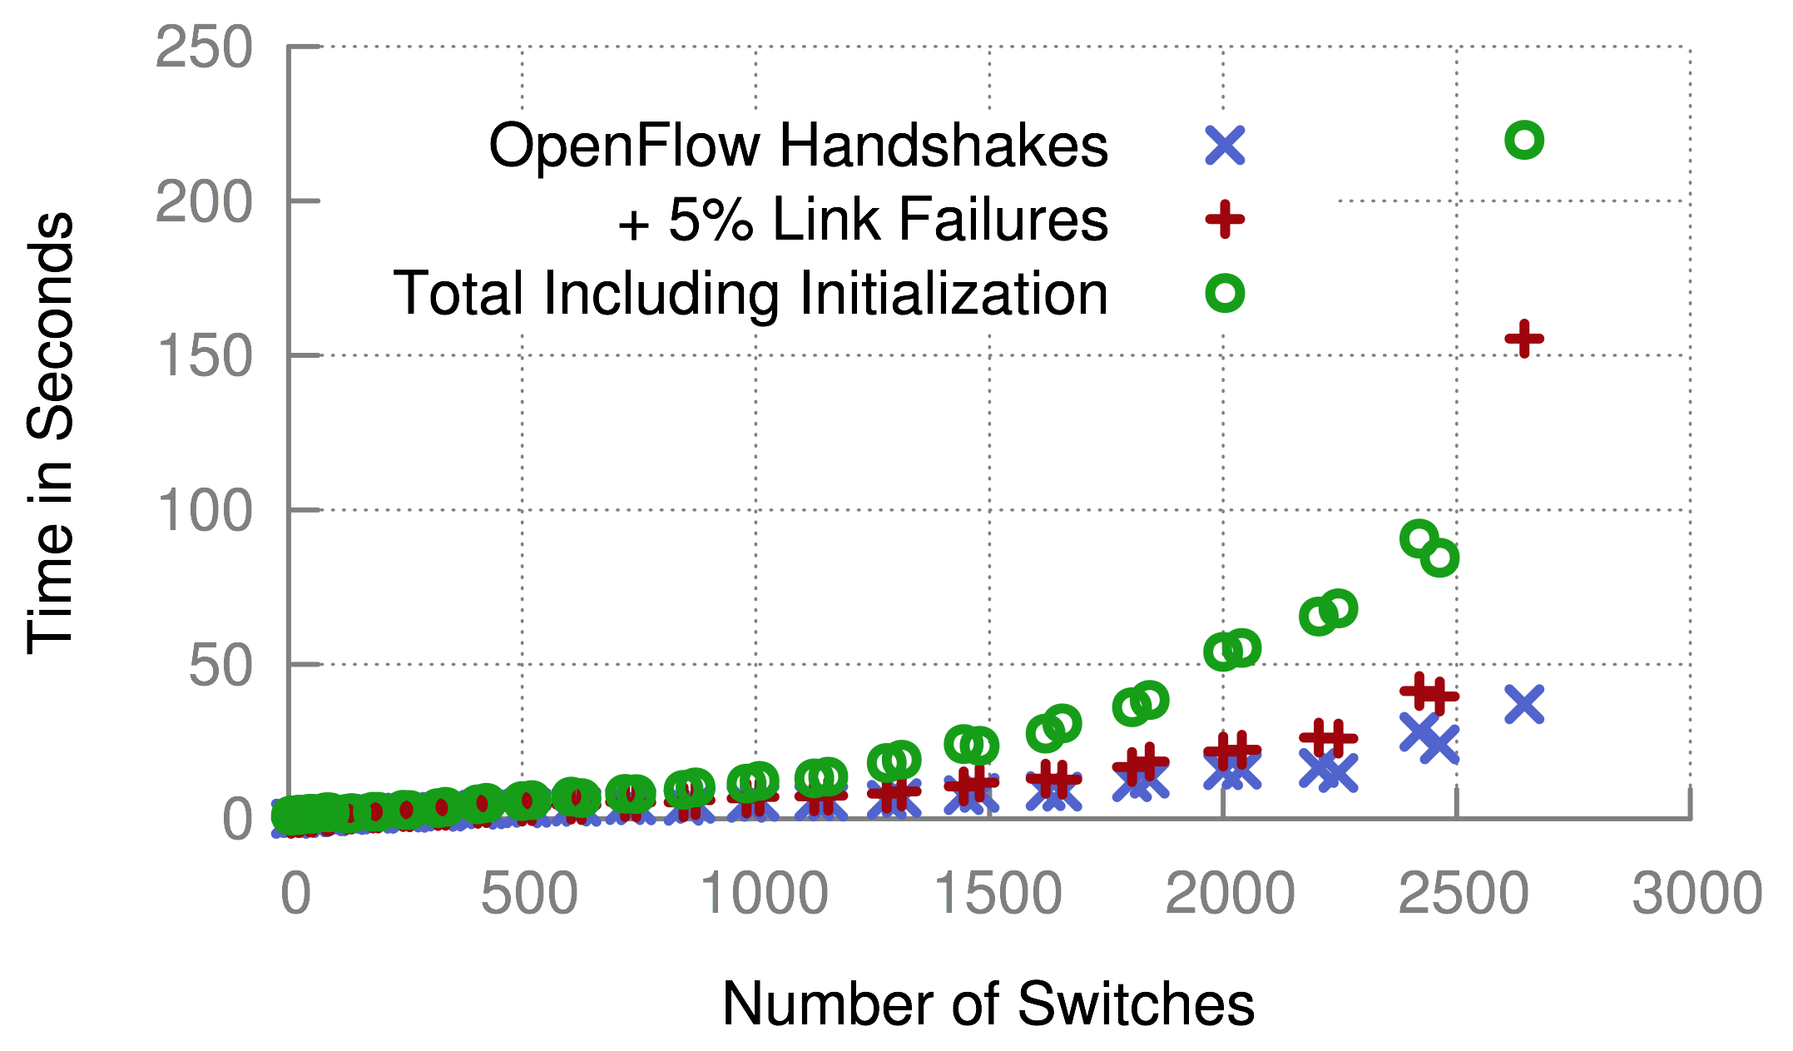
Scalability

Slide 65
Case Studies
Techniques provide notable benefit vs. naïve replay
15 / 17 MCSes useful for debugging
misleading (expected)
non-replayable
inflated
Not replayable
Not replayable
Not replayable
Not replayable
Not replayable
Not replayable
Not replayable
Discovered Bugs
Known Bugs
Synthetic Bugs
Notes:
First note that our techniques are a notable improvement over naïve, especially for discovered bugs, which are the ones we care about.
All of our case studies except three were beneficial in helping us find the root cause of the bug.

Slide 66
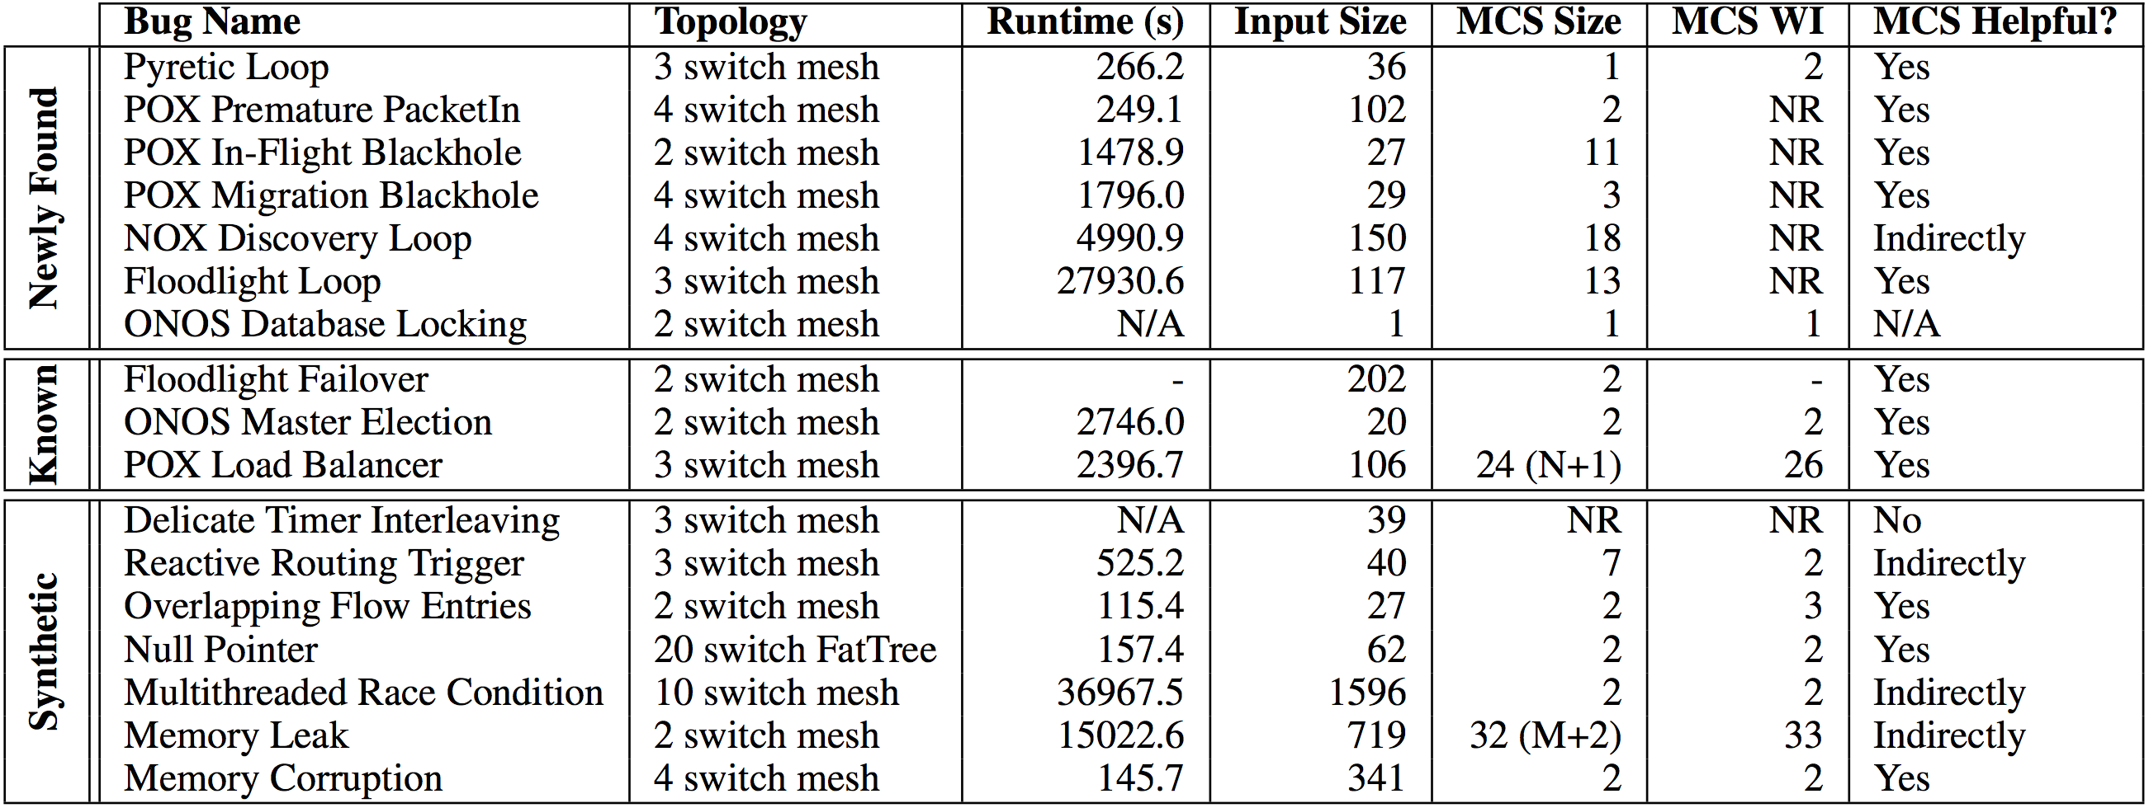
Case Studies
Notes:
Take more time. Defend against input sizes being small.

Slide 67
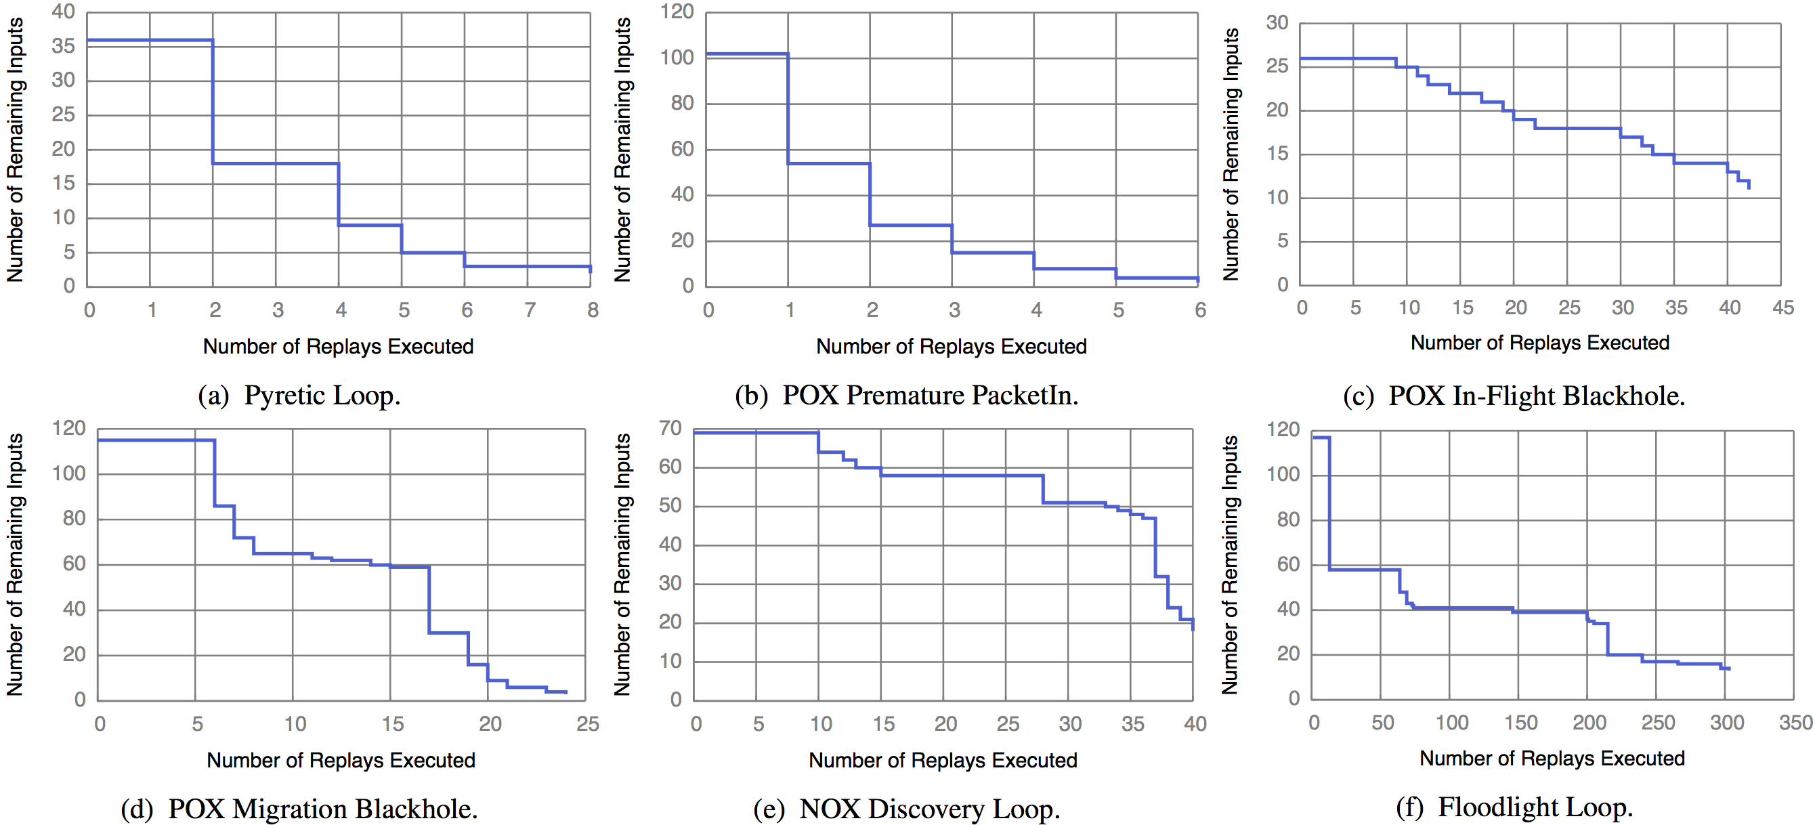
Runtime

Slide 68
Coping with Non-Determinism

Slide 69
Replay Requirements
Need to maintain original happens-before relation
Includes internal events
Message Deliveries
State Transitions
Notes:
Now once we have this replay infrastructure in place, we need to schedule the test inputs chosen by delta debugging in a way that maximizes our chances that we’ll be able to reproduce the bug, so that delta debugging can minimize the trace as much as possible. The formal requirement for guarenteeing this outcome is that we need to …

Slide 70
Naïve Replay Approach
Schedule events according to wall-clock time
t₁ t₂ t₃ t₄ t₅t₆t₇ t₈ t₉ t₁₀
Notes:
Not related work, just the most obvious thing to do.
But as we’ll show in the evaluation, this doesn’t work!
TODO: not so sure.

Slide 71
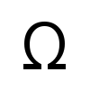
Complexity
Best Case | Worst Case
Delta Debugging: (log n) replays Each replay: O(n) events Total: (nlog n) | Delta Debugging: O(n) replays Each replay: O(n) events Total: O(n²)
Notes:
Key issue is not complexity, it’s running in parallel overnight. Reduce dev time at all costs!
Optimizations:
- can be parallelized
Can take periodic snapshots
Causal annotations

Slide 72
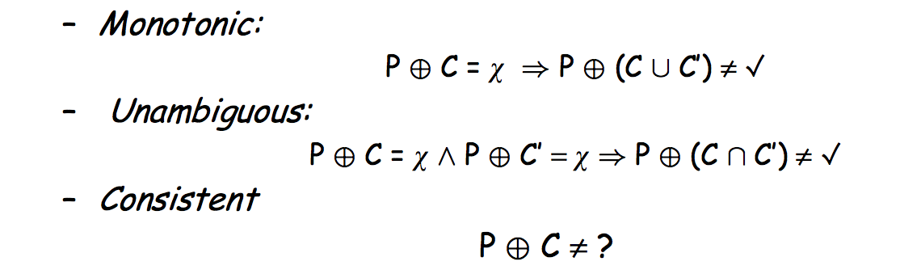
Assumptions of Delta Debugging

Slide 73
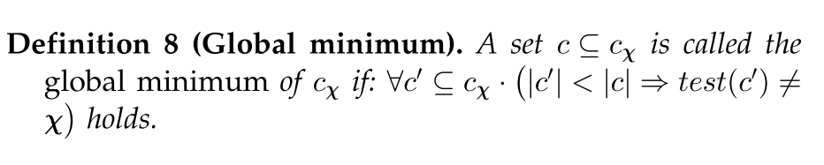
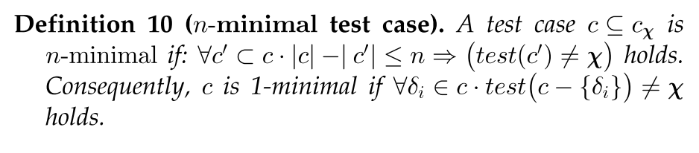
Local vs. Global Minimality

Slide 74
Forensic Analysis of Production Logs
Logs need to capture causality: Lamport Clocks or accurate NTP
Need clear mapping between input/internal events and simulated events
Must remove redundantly logged events
Might employ causally consistent snapshots to cope with length of logs

Slide 75
Instrumentation Complexity
Code to override gettimeofday(), interpose on logging statements, and multiplex sockets:
415 LOC for POX (Python)
722 LOC for Floodlight (Java)

Slide 76
Improvements
Many improvements:
Parallelize delta debugging
Smarter delta debugging time splits
Apply program flow analysis to further prune
Compress time (override gettimeofday)

Slide 77
Divergence: Syntactic Changes
Prune Earlier Input..
Crash
Master
Ping
Seq=3
Pong
Seq=4
Ping
Seq=5
Timeout
Backup
Master
port_status
xid=12
port_status
xid=13
ACK
Switch
Link Failure
Timeout

Slide 78
Divergence: Syntactic Changes
Sequence Numbers Differ!
Crash
Master
Ping
Seq=2
Pong
Seq=3
Ping
Seq=4
Timeout
Backup
Master
port_status
xid=11
port_status
xid=12
ACK
Switch
Link Failure
Timeout

Slide 79
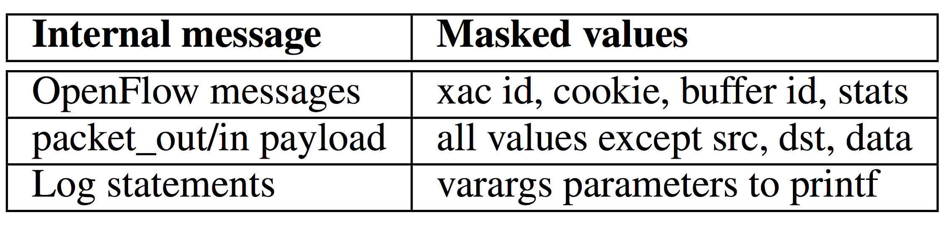
Solution: Equivalence Classes
Mask Over Extraneous Fields

Slide 80
Solution: Peek ahead

Slide 81
Divergence: Unexpected Events
Prune Input..
Master
Crash
Ping
Pong
Ping
…
Backup
Master
Switch
Notes:
TODO: slide is broken. X on switch shouldn’t be there.

Slide 82
Divergence: Unexpected Events
Unexpected Events Appear
Master
Crash
Ping
Pong
Ping
…
Backup
Master
LLDP
Switch
Notes:
TODO: slide is broken. X on switch shouldn’t be there.

Slide 83
Solution: Emperical Heuristic
Theory:
Divergent paths → Exponential possibilities
Practice:
Allow unexpected events through

