Slide 1

A Longitudinal Study of Bridget Connell Scott
Colin Scott, Maria Clow
Notes:
TODO: UW
This research is funded by the national science foundation, as well as Robert and Kate Scott.

Slide 2
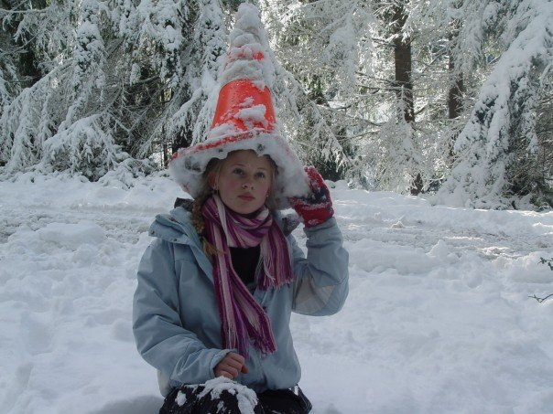
Motivation
Notes:
Bridget and Jeff are getting married
I’m Bridget’s older brother

Slide 3
Status Quo
Colin is a cynic

Slide 4
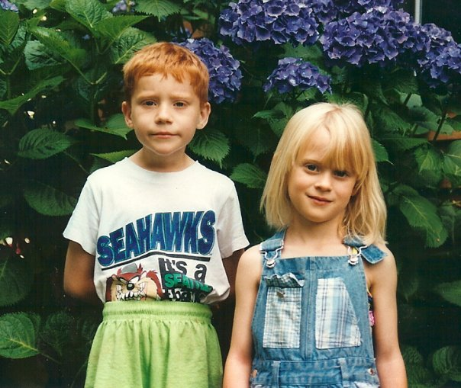
Our Goal
Notes:
Embarrass Bridget

Slide 5
Outline
Problem Statement
Research Methodology
Measurement Results

Slide 6
Experimental Design
Qualitative analysis:
24 years of case studies!

Slide 7
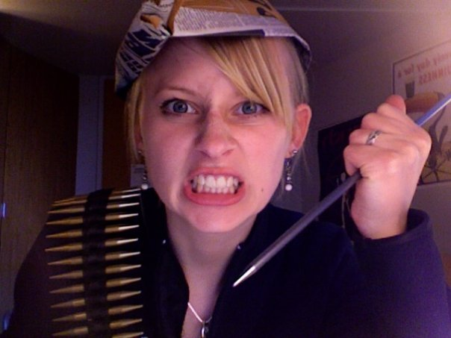
Measurement Results

Slide 8
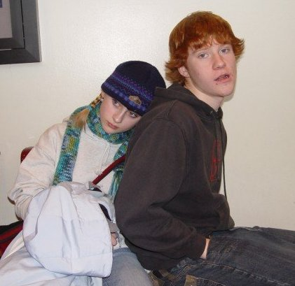
Measurement Results

Slide 9
Related Work
The rest of you!
Notes:
Possibly cut

Slide 10
Conclusion
Notes:
Picture of Jeff and Bridget.
w

