Slide 1

Automated Troubleshooting for Software-Defined Networks
Colin Scott, Andreas Wundsam, Sam Whitlock, Andrew Or, Eugene Huang, Kyriakos Zarifis, Scott Shenker
Notes:
TODO: need to

Slide 2

How many events in a DC network?
20,000 servers * 4 VMs / server = 80,000 VMs
(6 migrations / day / VM) +
(2 power up|down / day / VM) *
80,000 VMs = 640,000 VM events / day
~= 450 VM changes / minute [1]
8.5 network error events / minute [2]

Slide 3
How many events in a DC network?
= ~500 events / minute

Slide 4

Something goes wrong!

Slide 5
Best practice: Logs
Manual analysis of log files

Slide 6
Best practice: Logs
?
Controller A
Switch 1
Switch 2
Switch3
Controller B
Switch 4
Switch 5
Switch 6
Controller C
Switch 7
Switch 8
Switch 9

Slide 7
Goal
Identify the minimal set of events that trigger the bug

Slide 8
Minimal Causal Set
Crash
Master
Ping
Pong
Ping
…
Backup
Master
Link Down!
Not Master...
Link Down!
Blackhole persists!
Switch
Link Failure
Notes:
To here?

Slide 9
Minimal Causal Set
?
Controller A
Switch 1
Switch 2
Switch3
Controller B
Switch 4
Switch 5
Switch 6
Controller C
Switch 7
Switch 8
Switch 9
Notes:
OK, so how are we going to get from here…

Slide 10
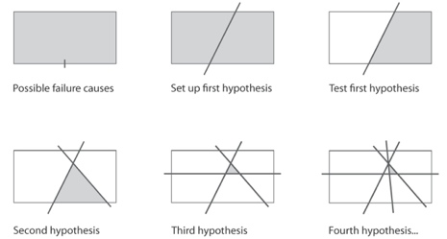
High-Level Approach
Modify history!

Slide 11
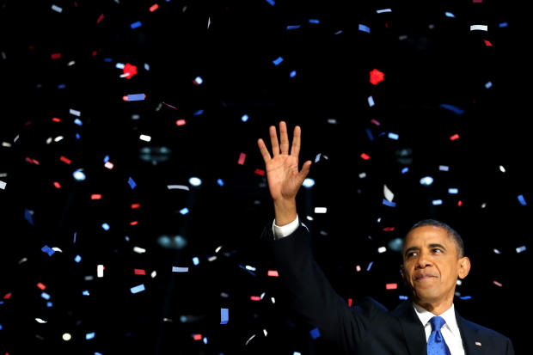
Replaying Altered History is Hard

Slide 12
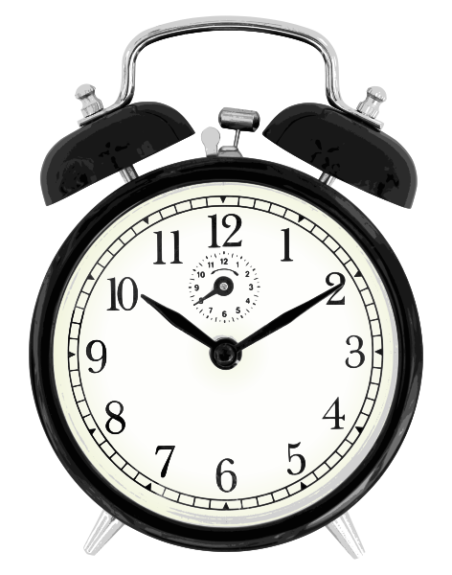

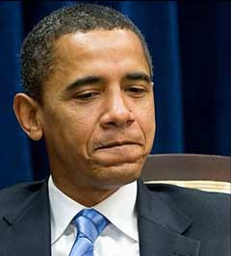
Pruning Causes Divergence

Slide 13
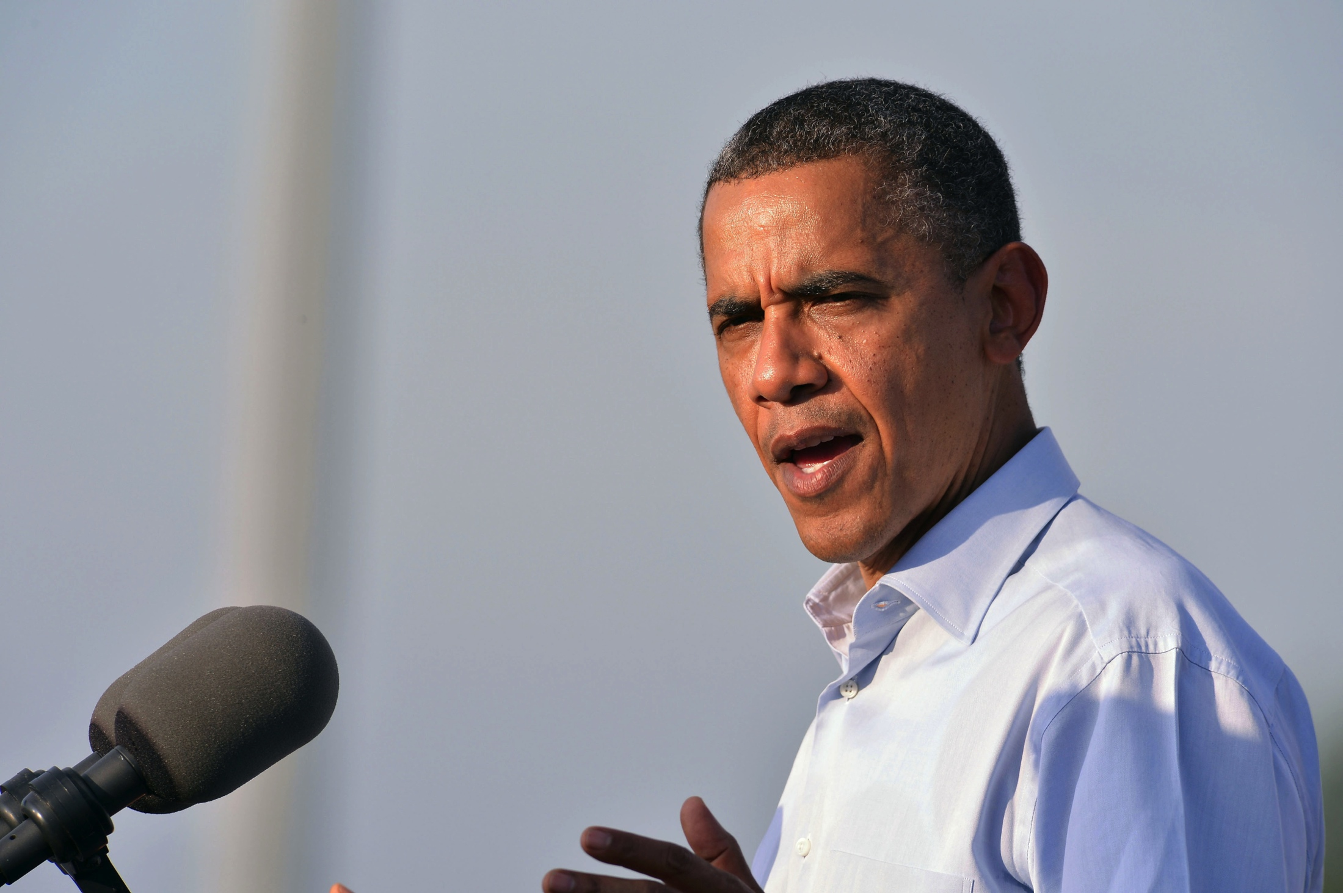
But usually it doesn’t affect the result

Slide 14
Need to Reason About Equivalence!
≈

Slide 15
It Works!

Slide 16
Summary
Goal: automatically diagnose network problems
Approach: iteratively alter history
Check us out:
ucb-sts.github.com/sts/

Slide 17
Backup

Slide 18
References
[1] V. Soundararajan and K. Govil. Challenges in building scalable virtualized datacenter management. SIGOPS Operating Systems Review ’10.
[2] A. Greenberg, J. R. Hamilton, N. Jain, S. Kandula, C. Kim, P. Lahiri, D. A. Maltz, P. Patel, and S. Sengupta. VL2: a scalable and flexible data center network, Sec. 3.4. SIGCOMM ’09.

Slide 19
Simulator
Notes:
This is a really high-level depiction of our system. Essentially what we’re going to do is simulate the entire execution of the physical network. In a single process, we model switches in the network. We then run control servers on top of this, but we interpose on all of the communication channels.
Mechanisn to explore those research questions! Not a software artefact….
Mark properties: delay, re-ordering, failure modes, ….

