Slide 1
The Click Modular Router
Robert Morris, Eddie Kohler, John Jannotti, Frans Kaashoek (MIT), 1999
Presented by Colin Scott

Slide 2
Outline
Motivation
Overview
Discussion

Slide 3
Motivation
Router Software
Is expected to do much more than routing (firewall, prioritize, classify differentiated services, tunnel, filter, perform NAT), and the expectations are growing
Is not flexible or extensible. Designs are monolithic, closed, and static
∴ A new application model is needed

Slide 4
Solution - Click Modular Router
Underlying Idea: Programmable Routing
View a router as a directed graph of elements
Packets move from element to element
Extensions simply require the addition/transposition of elements
Three new concepts:
Pull processing
Flow based router context
Explicit queues

Slide 5
The Architecture
Elements:
Building blocks – Each represents a single router function
Overall functionality determined by connecting a group of elements into a graph
Input and Output ports:
Every element has one or more input and output ports
Ports can be push, pull, or agnostic
Connections must match: pull to pull, push to push, or either to agnostic
Configuration strings:
Initialize the per-element state, customize element behavior

Slide 6
An example:
IP router

Slide 7
The Architecture..Continued
Push and Pull processing
Certain tasks are better suited to one or the other, e.g.
Packet schedulers are easily expressed using pull inputs
Packet processing best implemented as a series of push elements
A queue is a push to pull converter

Slide 8
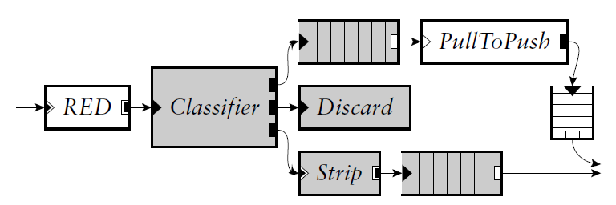
The Architecture..Continued
Flow based router context
The topology graph can be queried as to what elements are downstream,upstream, etc..
Filters can be passed to stop processing (e.g., “return all downstream elements up until queues”)
Best example use is RED – examine the total downstream queue length for congestion estimation

Slide 9
The Architecture..Continued
Explicit Queues
Click elements do not have implicit queues on their input and output ports
Queues are explicit elements
This enables valuable configurations that are difficult to arrange otherwise, e.g.
a single queue feeding multiple interfaces,
a queue feeding a traffic shaper on the way to an interface
Important for performance

Slide 10
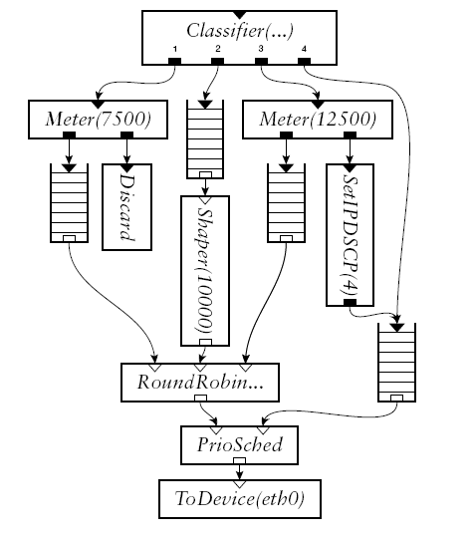
Router extensions
Differentiated Services
Classification, tagging, shaping, dropping, queuing, and scheduling functions.
Rate-limiting elements
Best effort delivery

Slide 11
Results on a Linux setup
73000 packets/sec – 90% as fast as Linux IP

Slide 12
Similar Systems
Focused on end-nodes, where information flow is vertical
(device to user), rather than horizontal (device to device)
x-kernel
Composing network protocols in a layered fashion
“Session” nodes
Scout
Path-oriented processing
Implicit queues
Unix System V Streams
Imprecise control over queuing, scheduling
XORP
Modularize the control plane – inspired by Click

Slide 13
Discussion
Did Click influence the way we think about routing software?
Who’s “we”?
Academia?
Industry?

Slide 14
Discussion
What made Click influential?
[ Eddie Kohler’s thoughts ]

Slide 15
Discussion
Why hasn’t Industry adopted Click?
Software routers aren’t fast enough
Forwarding handled by specialized hardware on the NIC itself
Legacy code
Lack of incentives

Slide 16
Discussion
Many types of I/O handling would benefit from
modular design, not just packet forwarding
Video streaming
Web requests
Handling terminal input
Etc.

Slide 17
An aside: The evolution of router software
Early routers were essentially general purpose computers
Today, high-performance routers resemble supercomputers • Exploit parallelism • Specialized hardware components
• Until 1980s (1st generation): standard computer • Early 1990s (2nd generation): delegate to interfaces -- switching fabric • Late 1990s (3rd generation): distributed architecture • Today: distributed over multiple racks

Slide 18
Limitations
Lack of explicit support for inter-node communication
Connections are governed by packet-flow. Implementing shared elements or communication that is not part of the packet flow, e.g. routing tables, is difficult.
Didn’t figure out how to schedule CPU time amongst competing push and pull paths

Slide 19
One goal is to go back and see how the authors thought of the work at the time they wrote the paper, versus how we think about the work today. What are the characteristics of papers that turn out to be important?

