Slide 1
How Secure are Secure Interdomain Routing Protocols? Or, How I learned to avoid rambling ☺
By Goldberg et al., SIGCOMM 2010
Presented by Colin Scott
(Several slides stolen from the authors as well.)

Slide 2
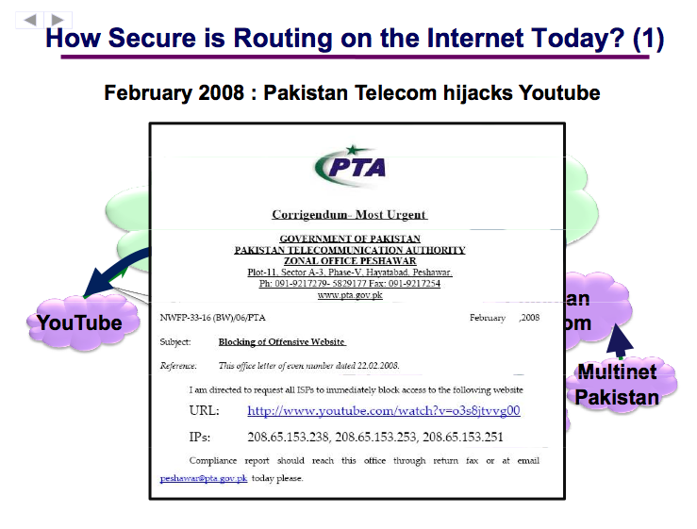

Slide 3
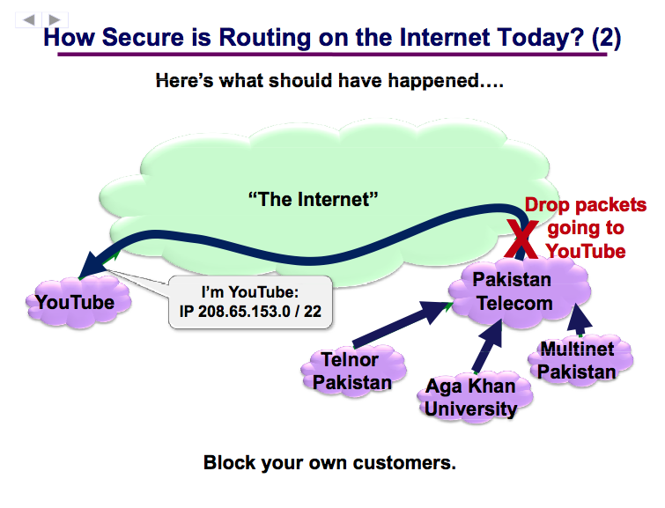

Slide 4
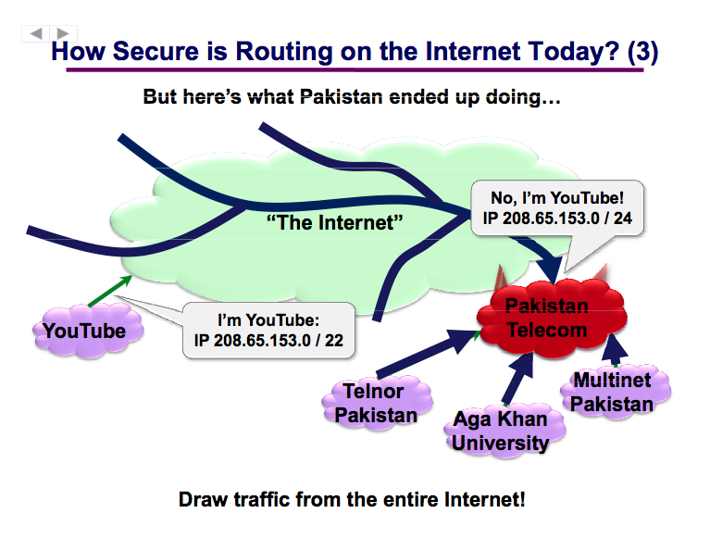

Slide 5
Overview
“BGP attraction attacks” can cause major problems
Prefix hijacks causing blackholes, loss of connectivity
… e.g., Pakistan Telecom / YouTube incident
BGP “Man-In-The-Middle” attacks
… e.g., Pilosov & Kapela traffic interception demo
Several security extensions have been proposed for BGP
origin authentication (ROA/RPKI) < soBGP < S-BGP
Defensive filtering

Slide 6
Overview(continued)
This paper seeks to quantify and compare the different proposals using simulations on AS topology data
The authors find that all of the secure protocols are somewhat vulnerable to attack (will discuss)
While secure protocols ensure that the paths announced are to some extent ‘legitimate’, manipulating export policies is a still a powerful mechanism for attracting traffic
They also present some interesting findings (won’t discuss)
Tier-2’s can do the most damage.
The “optimal” attack strategy is provably hard to find.

Slide 7
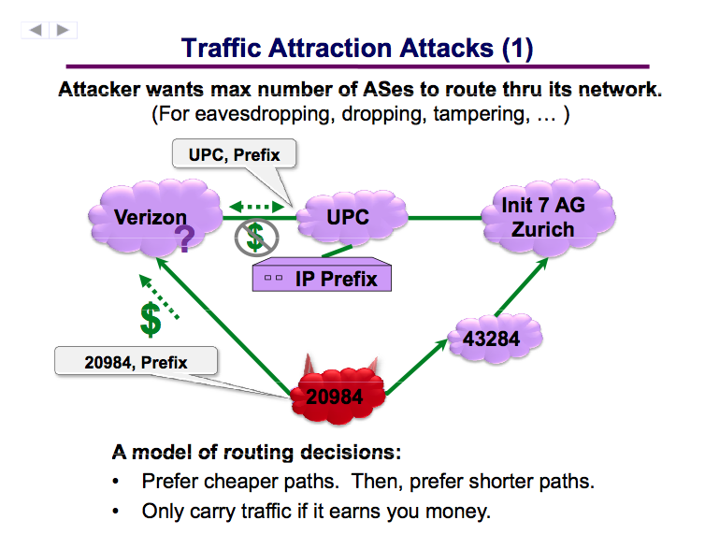
An attraction attack:
Notes:
What this illustrates: EXPORT POLICIES MATTER MORE THAN THE PATH ITSELF

Slide 8
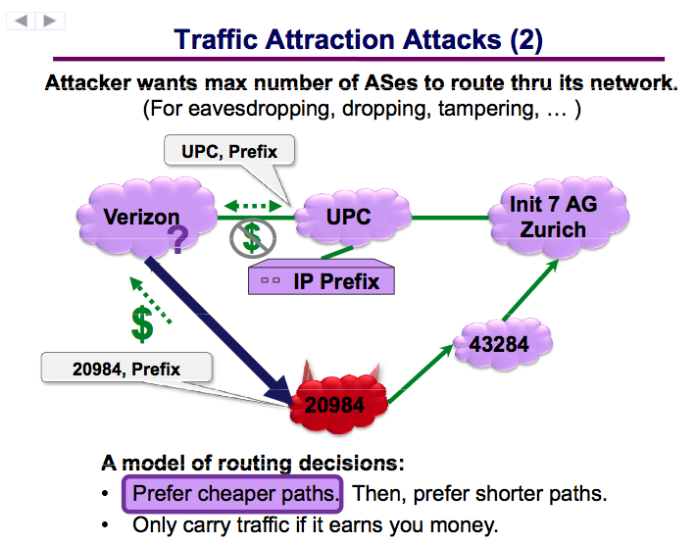

Slide 9
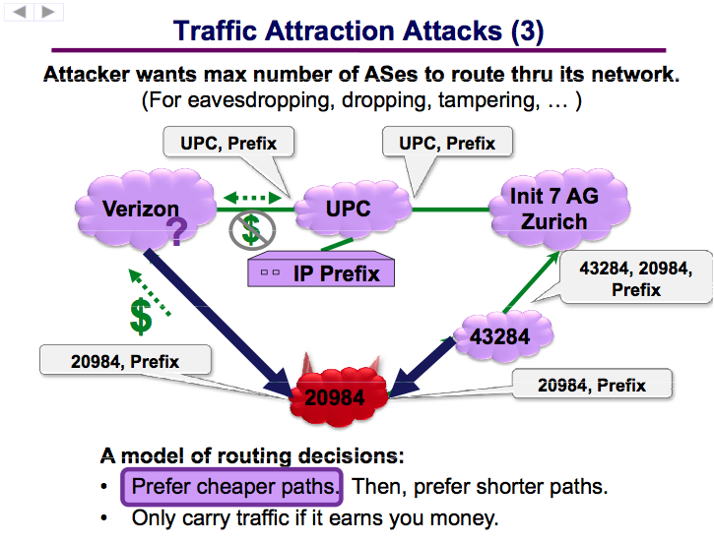

Slide 10
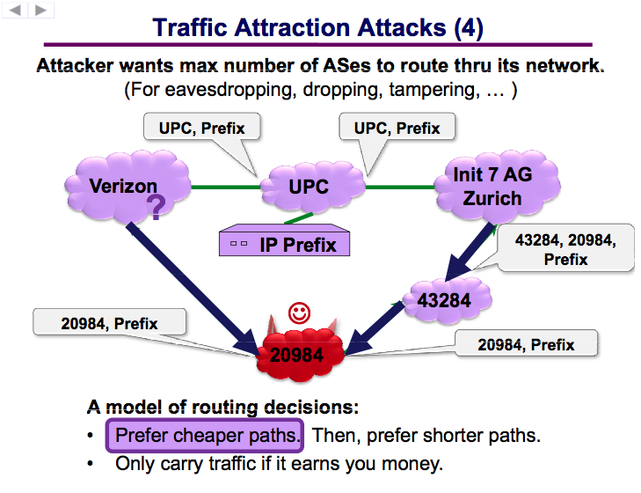

Slide 11
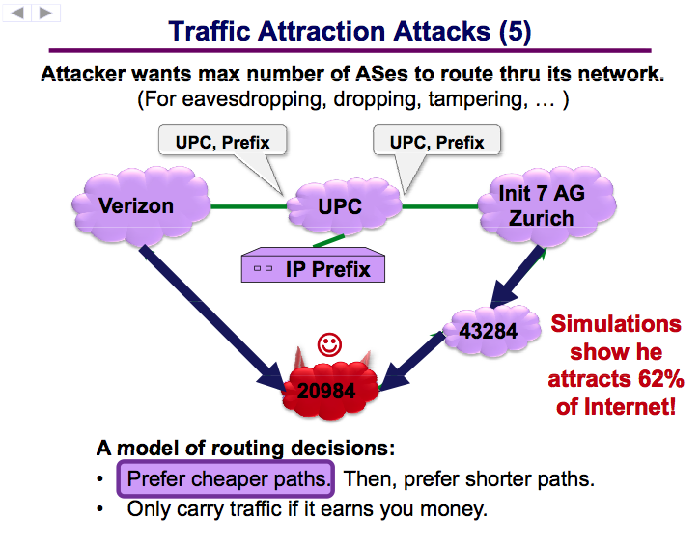

Slide 12
Secure Interdomain Routing
Several security extensions have been proposed.
Defensive Filtering
Prevent stub network spoofing
BGP + Origin Authentication:
Prevent prefix hijacks
Hack! Bad guys, just prepend the real origin ASN to your own.

Slide 13
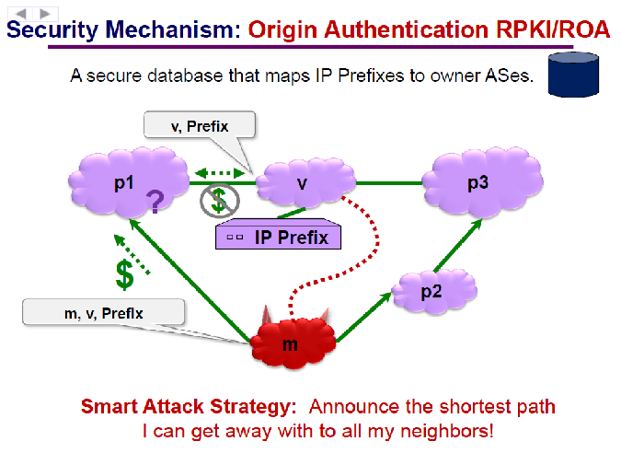

Slide 14
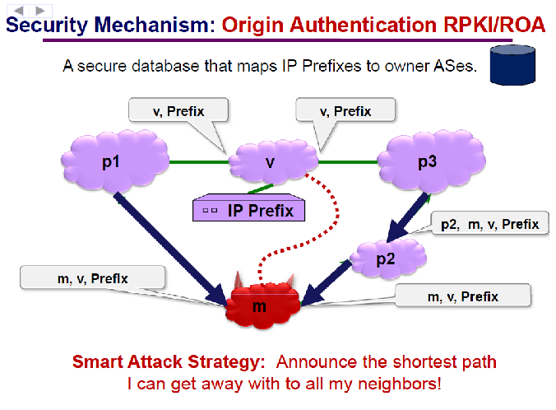

Slide 15
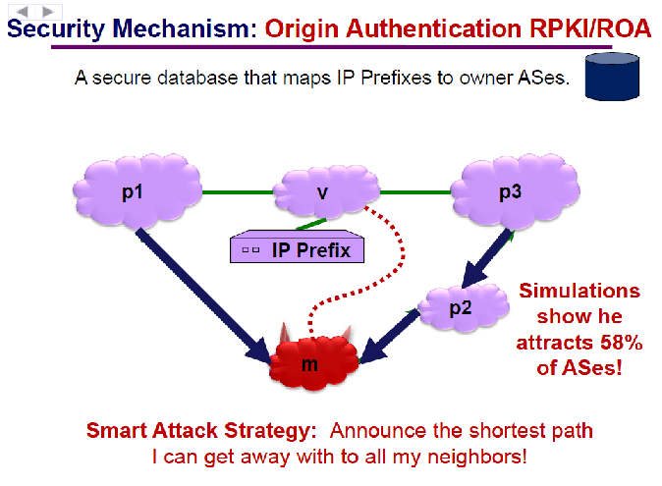

Slide 16
Secure Interdomain Routing
soBGP (‘secure origin’)
Verify that the announced path physically exists.
Hack! Bad guys can announce a fake path that passes through real ASes.
S-BGP (‘Secure BGP’):
Cryptographically sign the routing announcements in order to provide path verification
This should fix it, right?
Notes:
Before I say what’s wrong with S-BGP, let’s return to this point that export policies are the most important a

Slide 17
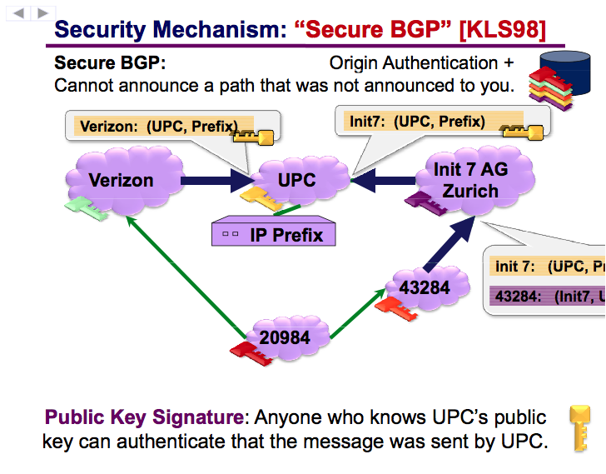

Slide 18
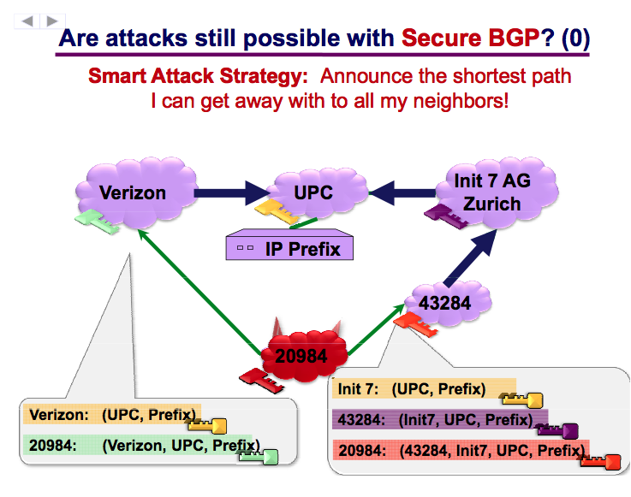

Slide 19
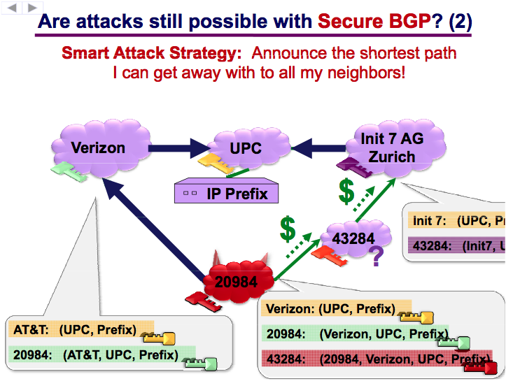

Slide 20
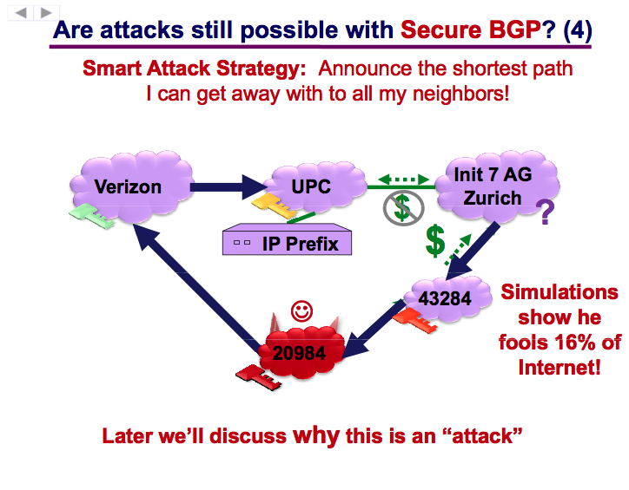
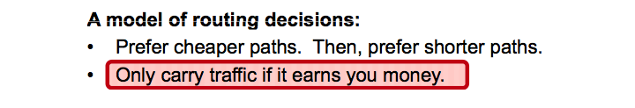

Slide 21
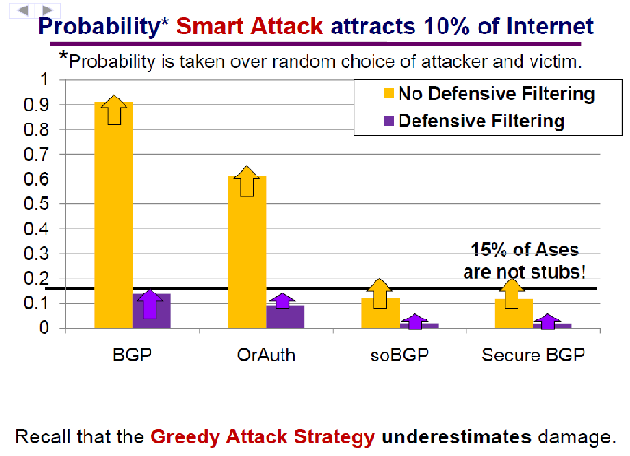

Slide 22
Summary
Main Contributions:
Securing interdomain routing is really hard
None of the security proposals are completely effective
Constraining the paths announced is not sufficient; manipulating export policies is still an effective attack vector
Finding the optimal attack strategy is NP-Hard
Limitations:
Incomplete AS topology data
Simplistic routing model
Doesn’t consider which ASes are attracting traffic, or what traffic is diverted

Slide 23
Discussion
Does adding a backwards-compatible layer of security on top of a vulnerable protocol really give you security? (the same question applies to DNSSEC)
What problems discussed by the authors (or others!) are inherent to the fundamental problem of interdomain routing? Which are specific to BGP?

Slide 24
Discussion
To what degree do we need to understand the characteristics of a protocol before deploying it in the wild?
Some of these proposals are over a decade old. Why haven’t they been adopted?
Is there anything interesting to discuss from the paper that I skipped? ☺

Slide 25
