Slide 1

Troubleshooting SDN Control Software with Minimal Causal Sequences
Colin Scott, Andreas Wundsam, Barath Raghavan, Aurojit Panda, Andrew Or, Jefferson Lai, Eugene Huang, Zhi Liu, Ahmed El-Hassany, Sam Whitlock, Hrishikesh B. Acharya, Kyriakos Zarifis, Arvind Krishnamurthy, Scott Shenker

Slide 2
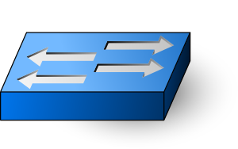
SDN is a Distributed System
Controller 1
Controller 2
Controller N
Notes:
TODO: Say more? Multiple controllers for scale/HA, managing multiple switches, with no single entity having a global view.

Slide 3
Distributed Systems are Bug-Prone
Distributed correctness faults:
Race conditions
Atomicity violations
Deadlock
Livelock
…
+ Normal software bugs
Notes:
We’re interested in bugs that cause safety violations. Messages might be lost, etc.

Slide 4
Example Bug (Floodlight, 2012)
Crash
Master
Ping
Pong
Ping
Backup
Master
Notify
Notify
ACK
Blackhole persists!
Switch
Link Failure

Slide 5
Best Practice: Logs
Human analysis of log files
Notes:
From what I saw at Nicira and Google, the most common way to troubleshoot these problems is for a human to analyze log files

Slide 6
Best Practice: Logs
Crash
Master
Ping
Pong
Ping
Backup
Master
Notify
Notify
ACK
Blackhole persists!
Switch
Link Failure
Notes:
The developer is not given this nice, concise log!

Slide 7
Best Practice: Logs
?
Controller A
Switch 1
Switch 2
Switch3
Controller B
Switch 4
Switch 5
Switch 6
Controller C
Switch 7
Switch 8
Switch 9
…
Notes:
TODO: add forward pointer to how large real logs are.

Slide 8
Our Goal
Allow developers to focus on fixing the underlying bug
Notes:
While this kind of debugging isn’t very visibile to researchers,
This is a real problem in the commercial world
Our intent was to build real techniques that can be integrated into existing commercial testbeds
That would cope with real software

Slide 9
Problem Statement
Identify a minimal sequence of inputs that triggers the bug
in a blackbox fashion
Notes:
TODO: crucial point: want to do this in a blackbox fashion.
TODO: maybe say “approximate”?

Slide 10
Why minimization?
Smaller event traces are easier to understand
G. A. Miller. The Magical Number Seven, Plus or Minus Two: Some Limits on Our Capacity for Processing Information. Psychological Review ’56.

Slide 11

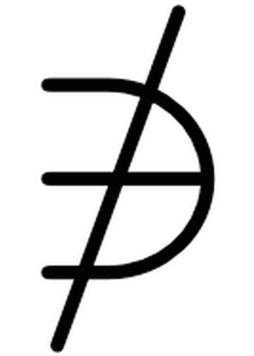
Minimal Causal Sequence
Output:
V(i.e. violation occurs)
V

Slide 12
Minimal Causal Sequence
?
Controller A
Switch 1
Switch 2
Switch3
Controller B
Switch 4
Switch 5
Switch 6
Controller C
Switch 7
Switch 8
Switch 9
…

Slide 13
Minimal Causal Sequence
Crash
Master
Ping
Pong
Ping
Backup
Master
Notify
Notify
ACK
Blackhole persists!
Switch
Link Failure
Notes:
The developer is not given this nice, concise log!

Slide 14
Outline
What are we trying to do?
How do we do it?
Does it work?
Notes:
“I’m going to first try to convince you that there is a real problem with the way troubleshooting is done today.
Then I’m going to describe a system and the techniques we apply within this system to make troubleshooting easier.
Then I’ll end by showing you how well the system works.

Slide 15
Where Bugs are Found
Symptoms found:
On developer’s local machine (unit and integration tests)
Notes:
TODO: swap order. Production is too late. Because it’s too late, they employ QA testbeds to find bugs before they’re released into the wild. But testbeds are hard to debug! Too many events.
Describe what kinds of bugs these might be: loop, blackhole, breach of tenant isolation.
Take more time. Unit test, their own code. Integration test, it's on your local machine. QA, random inputs, hard to understand, QA infrastructure gives us infrastructure to replay. Then production is too late.

Slide 16
Where Bugs are Found
Symptoms found:
On developer’s local machine (unit and integration tests)
In production environment
Notes:
TODO: swap order. Production is too late. Because it’s too late, they employ QA testbeds to find bugs before they’re released into the wild. But testbeds are hard to debug! Too many events.
Describe what kinds of bugs these might be: loop, blackhole, breach of tenant isolation.
Take more time. Unit test, their own code. Integration test, it's on your local machine. QA, random inputs, hard to understand, QA infrastructure gives us infrastructure to replay. Then production is too late.

Slide 17
Where Bugs are Found
Symptoms found:
On developer’s local machine (unit and integration tests)
In production environment
On quality assurance testbed
Notes:
VERBAL: as I’ll show you in the evaluation,
Describe what kinds of bugs these might be: loop, blackhole, breach of tenant isolation.
Take more time. Unit test, their own code. Integration test, it's on your local machine. QA, random inputs, hard to understand, QA infrastructure gives us infrastructure to replay. Then production is too late.

Slide 18
Approach: Delta Debugging¹ Replay
✔
✗
?
1. A. Zeller et al. Simplifying and Isolating Failure-Inducing Input. IEEE TSE ’02
Notes:
Signpost: how do we do it? Key slide!
Right now the cuts we make are based on time. But you could imagine doing this slicing based on nodes in the topology, or combinations of types of events.
If any of you are aware of the work, this technique is called delta debugging.
When you apply delta debugging to a distributed system rather than a single program, you run into some challenges.

Slide 19
Approach: Modify Testbed
Controller 1
Controller N
Control Software
QA Testbed
Test Coordinator
Notes:
We use the *same*, preexisting QA infrastructure that companies already have in place. We just need to employ our techniques to this infrastucture.

Slide 20
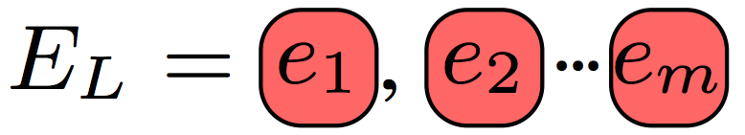
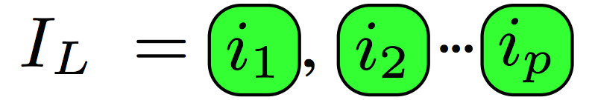
Testbed Observables
Invariant violation detected by testbed
Event Sequence:
External events (link failures, host migrations,..) injected by testbed
Internal events (message deliveries) observed by testbed (incomplete)

Slide 21

Approach: Delta Debugging¹ Replay
Events (link failures, crashes, host migrations) injected by test orchestrator
✔
✗
?
1. A. Zeller et al. Simplifying and Isolating Failure-Inducing Input. IEEE TSE ’02
Notes:
TODO: describe what would happen during interference, in a concise way.
Right now the cuts we make are based on time. But you could imagine doing this slicing based on nodes in the topology, or combinations of types of events.
If any of you are aware of the work, this technique is called delta debugging.
When you apply delta debugging to a distributed system rather than a single program, you run into some challenges.

Slide 22
Key Point
Must Carefully Schedule Replay Events To Achieve Minimization!
Notes:
Verbal: And this is our contribution

Slide 23
Challenges
Asynchrony
Divergent execution
Non-determinism
Notes:
NOTE: as you can probably tell, these are general challenges. Here we develop practical heuristics for dealing with them that are emperically validated. We’re currently working on developing a model to show how to provide provable guarentees on how we cope with them.
TODO: cut these subbullets?

Slide 24
Challenge: Asynchrony
Asynchrony definition:
No fixed upper bound on relative speed of processors
No fixed upper bound on time for messages to be delivered
Dwork & Lynch. Consensus in the Presence of Partial Synchrony. JACM ‘88

Slide 25
Challenge: Asynchrony
Need to maintain original event order
Crash
Master
Ping
Ping
Pong
Timeout
Backup
Master
port_status
port_status
ACK
Blackhole persists!
Switch
Link Failure
Timeout

Slide 26
Challenge: Asynchrony
Need to maintain original event order
Crash
Master
Ping
Ping
Pong
Timeout
Backup
New Routing Table!
Master
port_status
Blackhole avoided!
Switch
Link Failure
Notes:
NOTE: as we replay subsequences, we’re going to try to keep as many of these causal dependencies from the original intact. Next slide:

Slide 27
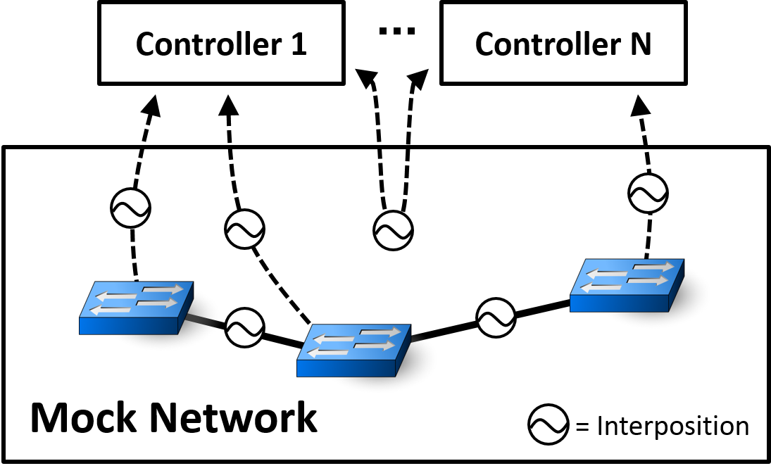
Coping with Asynchrony
Use interposition to maintain causal dependencies
Notes:
NOTE: interposition gives us messages during the *recording* phase.=
And we achieve this by interposing on the internal events. As we observe messages, we allow them through in a way that is consistent with the causal dependencies from the original execution.
If you were a company with a QA testbed, you would just need to add interposition. We built our own, since no open source were available for SDN

Slide 28
Challenge: Divergence
Asynchrony
Divergent execution
Syntactic Changes
Absent Events
Unexpected Events
Non-determinism

Slide 29
Divergence: Absent Internal Events
Prune Earlier Input..
Crash
Master
Ping
Pong
Ping
Backup
Master
Policy change
Notify
Notify
ACK
Switch
Link Failure
Host Migration

Slide 30
Divergence: Absent Internal Events
Some Events No Longer Appear
Crash
Master
Ping
Pong
Ping
Backup
Master
Policy change
Notify
Switch
Link Failure
Host Migration

Slide 31
Solution: Peek Ahead
Infer which internal events will occur
Crash
Master
Ping
Pong
Ping
Backup
Master
Policy change
Notify
Switch
Link Failure
Host Migration
Notes:
TODO: Say: take a snapshot

Slide 32
Challenge: Non-determinism
Asynchrony
Divergent execution
Non-determinism

Slide 33
Coping With Non-Determinism
Replay multiple times per subsequence
Assuming i.i.d., probability of not finding bug modeled by:
If not i.i.d., override gettimeofday(), multiplex sockets, interpose on logging statements
Notes:
Other tricks:
- multiplexed sockets
- override gettimeofday and rand
- interpose on logging library
- interpose on intra-controller messages

Slide 34
Approach Recap
Replay events in QA testbed
Apply delta debugging to inputs
Asynchrony: interpose on messages
Divergence: infer absent events
Non-determinism: replay multiple times

Slide 35
Outline
What are we trying to do?
How do we do it?
Does it work?
Notes:
“I’m going to first try to convince you that there is a real problem with the way troubleshooting is done today.
Then I’m going to describe a system and the techniques we apply within this system to make troubleshooting easier.
Then I’ll end by showing you how well the system works.

Slide 36
Evaluation Methodology
Evaluate on 5 open source SDN controllers (Floodlight, NOX, POX, Frenetic, ONOS)
Quantify minimization for:
Synthetic bugs
Bugs found in the wild
Qualitatively relay experience troubleshooting with MCSes

Slide 37
Case Studies
1596
719
17 case studies total
Substantial minimization except for 1 case
Conservative input sizes
Not replayable
(n)
(m)
Discovered Bugs
Known Bugs
Synthetic Bugs
Notes:
First note that in all cases except for one, were were able to substantially decrease the initial input size. And note that these initial input sizes are small compared to what you would find in a production QA testbed. We found the bugs quickly. And we also showed that

Slide 38
Comparison to Naïve Replay
Naïve replay: ignore internal events
Naïve replay often not able to replay at all
5 / 7 discovered bugs not replayable
1 / 7 synthetic bugs not replayable
Naïve replay did better in one case
2 event MCS vs. 7 event MCS with our techniques

Slide 39
Qualitative Results
15 / 17 MCSes useful for debugging
1 non-replayable case (not surprising)
1 misleading MCS (expected)

Slide 40
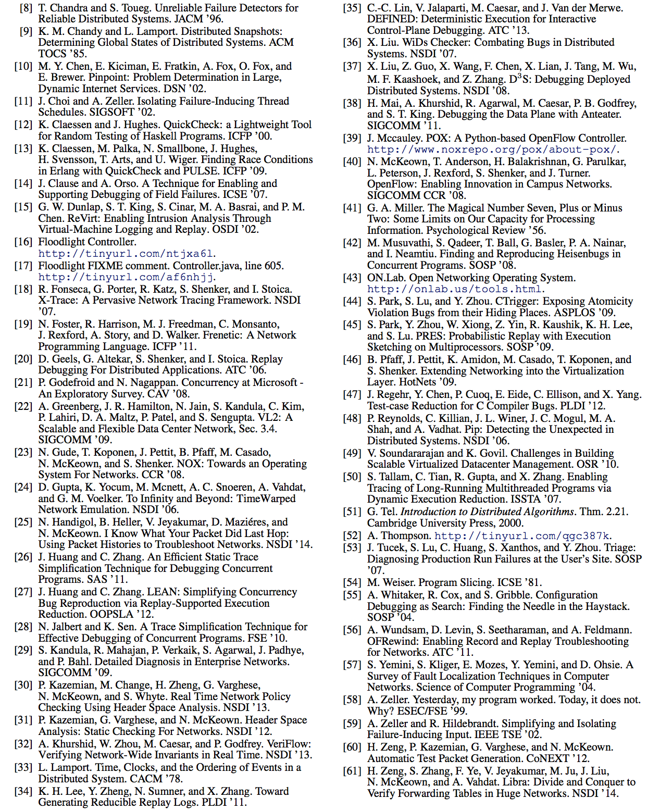
Related Work
Notes:
There’s work that assumes deterministic replay, and attempts to minimize thread schedules leading up to bugs. There’s also work on applying program analysis to reason about whether events are relevant.
In one sentence, we’re the first

Slide 41
Conclusion
Possible to automatically minimize execution traces for SDN control software
System (23K+ lines of Python) evaluated on 5 open source SDN controllers (Floodlight, NOX, POX, Frenetic, ONOS) and one proprietary controller
Currently generalizing, formalizing approach
ucb-sts.github.com/sts/
Notes:
NOTE: we’re applying to other distributed systems, largely because we don’t believe our technique is specific to SDN
To sum up, I hope I've convinced you that we identified a real problem, built a real system to minimize execution traces, and showed that it really works.
The source code for the system, and replayable traces for all of our case studies are available online at this URL. The system is actively being used, and we’re currently integrating into the development workflow for ONOS.
We're now doing this in a more formalized manner, not just unsatisfying empirical heuristics. because we don’t actually believe that there’s anything about our technique that’s specific

Slide 42
Backup

Slide 43
Related work
Thread Schedule Minimization
Isolating Failure-Inducing Thread Schedules. SIGSOFT ’02.
A Trace Simplification Technique for Effective Debugging of Concurrent Programs. FSE ’10.
Program Flow Analysis
Enabling Tracing of Long-Running Multithreaded Programs via Dynamic Execution Reduction. ISSTA ’07.
Toward Generating Reducible Replay Logs. PLDI ’11.
Best-Effort Replay of Field Failures
A Technique for Enabling and Supporting Debugging of Field Failures. ICSE ’07.
Triage: Diagnosing Production Run Failures at the User’s Site. SOSP ’07.

Slide 44
Bugs are costly and time consuming
Software bugs cost US economy $59.5 Billion in 2002 [1]
Developers spend ~50% of their time debugging [2]
Best developers devoted to debugging
National Institute of Standards and Technology 2002 Annual Report
P. Godefroid et al., Concurrency at Microsoft- An Exploratory Study. CAV ‘08
Notes:
REPLACE: with a real, concrete example.

Slide 45
Ongoing work
Formal analysis of approach
Apply to other distributed systems (databases, consensus protocols)
Investigate effectiveness of various interposition points
Integrate STS into ONOS (ON.Lab) development workflow

Slide 46
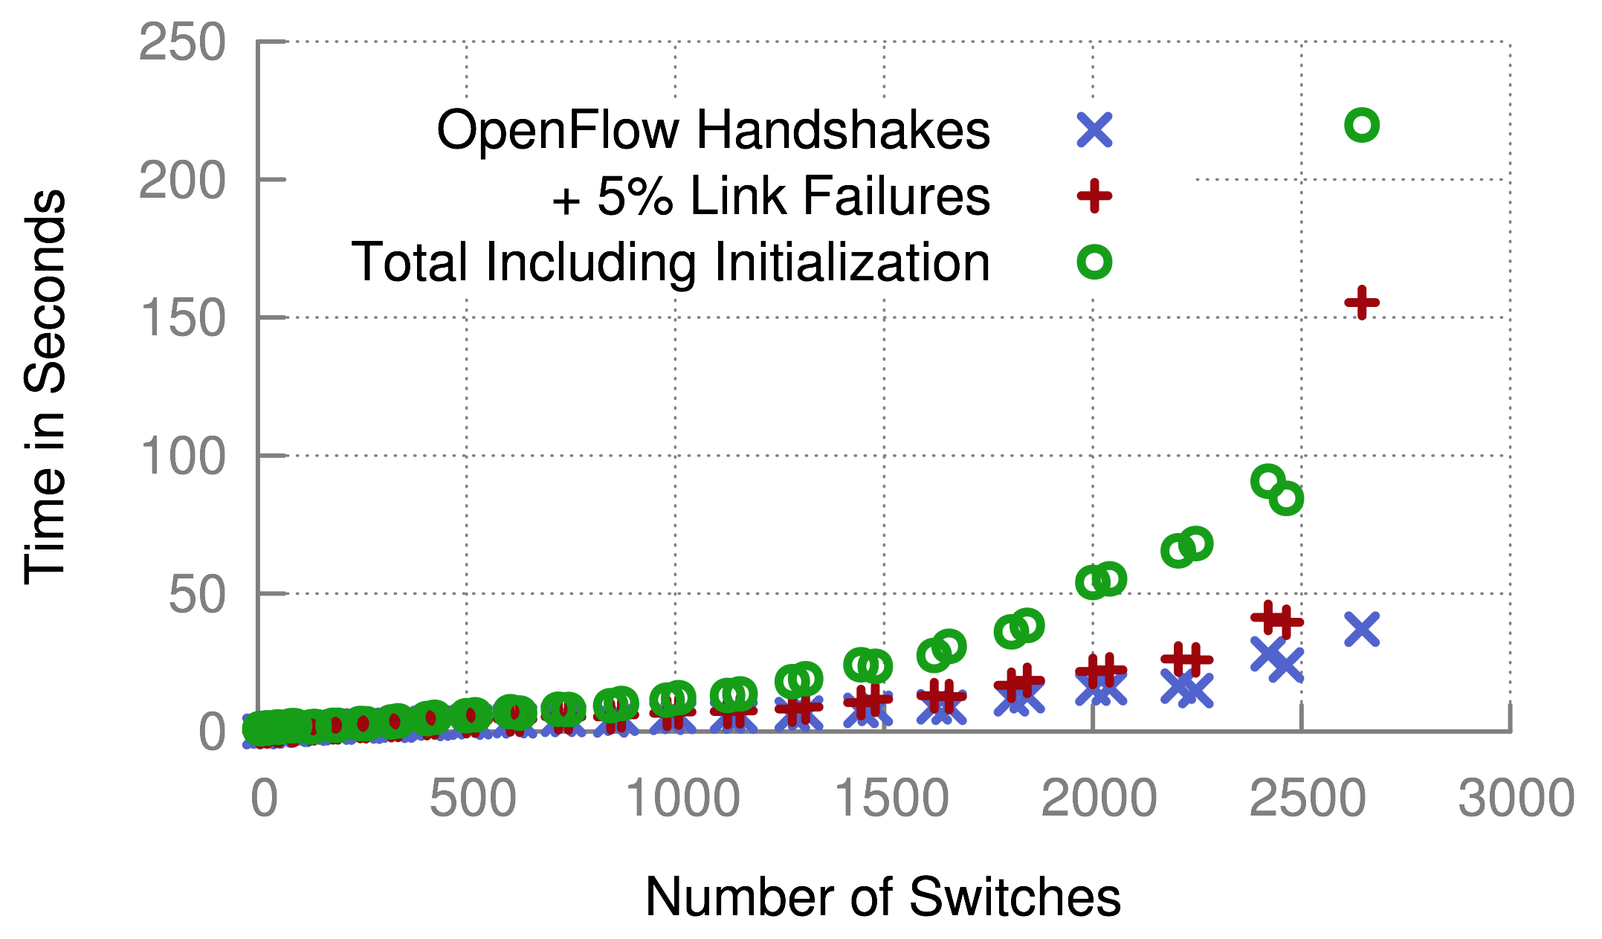
Scalability

Slide 47
Case Studies
Techniques provide notable benefit vs. naïve replay
15 / 17 MCSes useful for debugging
misleading (expected)
non-replayable
inflated
Not replayable
Not replayable
Not replayable
Not replayable
Not replayable
Not replayable
Not replayable
Discovered Bugs
Known Bugs
Synthetic Bugs
Notes:
First note that our techniques are a notable improvement over naïve, especially for discovered bugs, which are the ones we care about.
All of our case studies except three were beneficial in helping us find the root cause of the bug.

Slide 48
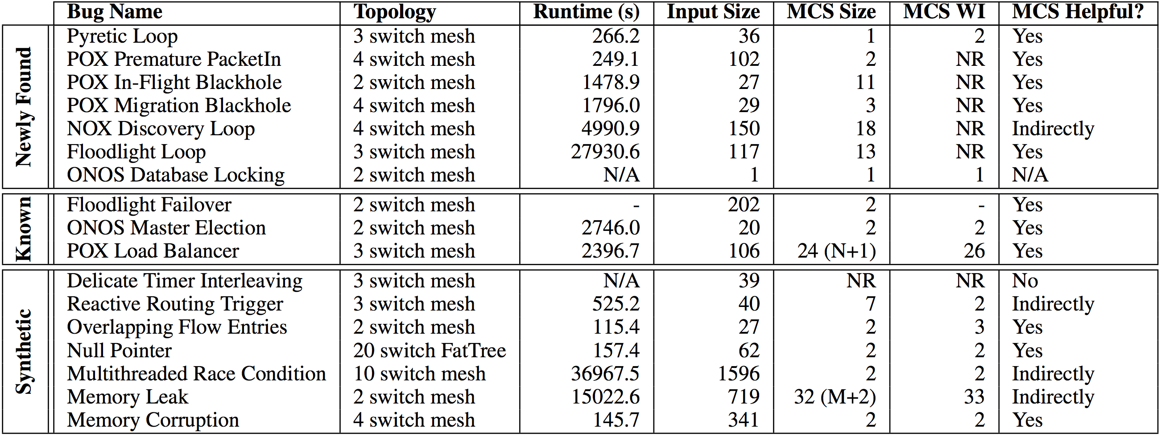
Case Studies
Notes:
Take more time. Defend against input sizes being small.

Slide 49
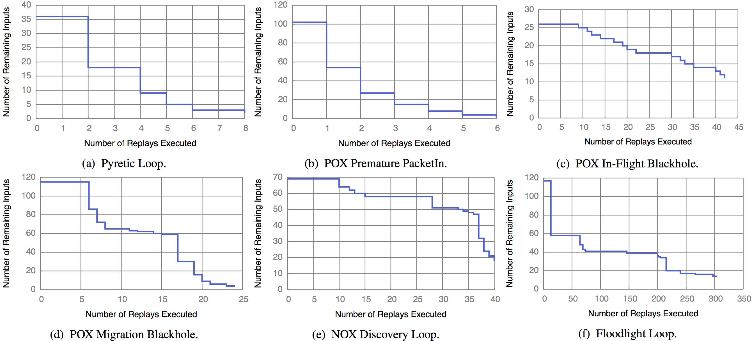
Runtime

Slide 50
Coping with Non-Determinism

Slide 51
Replay Requirements
Need to maintain original happens-before relation
Includes internal events
Message Deliveries
State Transitions
Notes:
Now once we have this replay infrastructure in place, we need to schedule the test inputs chosen by delta debugging in a way that maximizes our chances that we’ll be able to reproduce the bug, so that delta debugging can minimize the trace as much as possible. The formal requirement for guarenteeing this outcome is that we need to …

Slide 52
Naïve Replay Approach
Schedule events according to wall-clock time
t₁ t₂ t₃ t₄ t₅t₆t₇ t₈ t₉ t₁₀
Notes:
Not related work, just the most obvious thing to do.
But as we’ll show in the evaluation, this doesn’t work!
TODO: not so sure.

Slide 53
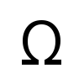
Complexity
Best Case | Worst Case
Delta Debugging: (log n) replays Each replay: O(n) events Total: (nlog n) | Delta Debugging: O(n) replays Each replay: O(n) events Total: O(n²)
Notes:
Key issue is not complexity, it’s running in parallel overnight. Reduce dev time at all costs!
Optimizations:
- can be parallelized
Can take periodic snapshots
Causal annotations

Slide 54
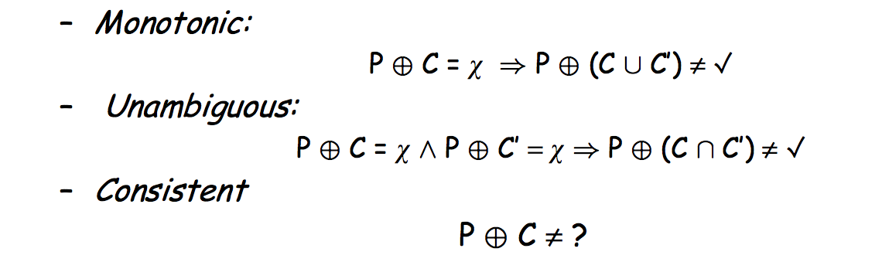
Assumptions of Delta Debugging

Slide 55
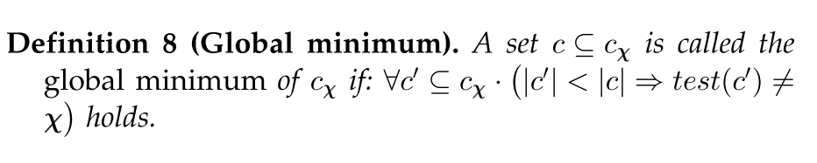
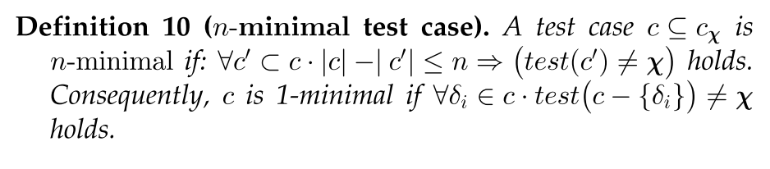
Local vs. Global Minimality

Slide 56
Forensic Analysis of Production Logs
Logs need to capture causality: Lamport Clocks or accurate NTP
Need clear mapping between input/internal events and simulated events
Must remove redundantly logged events
Might employ causally consistent snapshots to cope with length of logs

Slide 57
Instrumentation Complexity
Code to override gettimeofday(), interpose on logging statements, and multiplex sockets:
415 LOC for POX (Python)
722 LOC for Floodlight (Java)

Slide 58
Improvements
Many improvements:
Parallelize delta debugging
Smarter delta debugging time splits
Apply program flow analysis to further prune
Compress time (override gettimeofday)

Slide 59
Divergence: Syntactic Changes
Prune Earlier Input..
Crash
Master
Ping
Seq=3
Pong
Seq=4
Ping
Seq=5
Timeout
Backup
Master
port_status
xid=12
port_status
xid=13
ACK
Switch
Link Failure
Timeout

Slide 60
Divergence: Syntactic Changes
Sequence Numbers Differ!
Crash
Master
Ping
Seq=2
Pong
Seq=3
Ping
Seq=4
Timeout
Backup
Master
port_status
xid=11
port_status
xid=12
ACK
Switch
Link Failure
Timeout

Slide 61
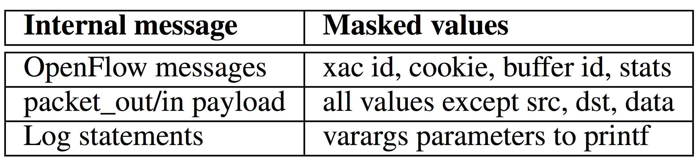
Solution: Equivalence Classes
Mask Over Extraneous Fields

Slide 62
Solution: Peek ahead

Slide 63
Divergence: Unexpected Events
Prune Input..
Master
Crash
Ping
Pong
Ping
…
Backup
Master
Switch
Notes:
TODO: slide is broken. X on switch shouldn’t be there.

Slide 64
Divergence: Unexpected Events
Unexpected Events Appear
Master
Crash
Ping
Pong
Ping
…
Backup
Master
LLDP
Switch
Notes:
TODO: slide is broken. X on switch shouldn’t be there.

Slide 65
Solution: Emperical Heuristic
Theory:
Divergent paths → Exponential possibilities
Practice:
Allow unexpected events through

