Slide 1
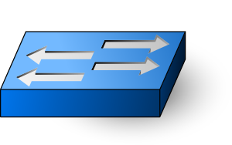
Controller 1
Controller N
Mock Network
= Interposition

