Slide 1
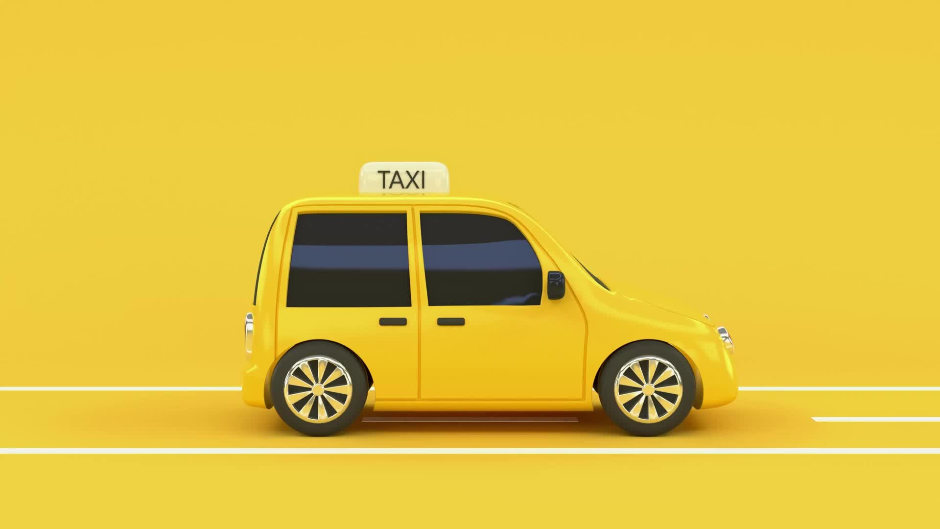
Yellow Taxi vs Rideshare
Hwimyeong Baek
Colin Seiler

Slide 2
Research Problem and Project Recap
 | Taxi | Rideshare
Avg Filesize | 30-60 MB | 500 MB
Avg Row Count | 5 Million | 18 Million
Total Filesize | 4.5 GB | 45 GB
Compare Cost and Availability of Taxis vs Rideshare Services
Three Research Objectives:
Test hot-button area usage (MSG, Penn, LGA/JFK/EWR)
Neighborhood Popularity and Cost
Down-the-line predictive fare-comparison tool across Taxi, Uber, and Lyft

Slide 3
Data Profiling, Cleaning, and Transformation

Slide 4
Data Profiling
Loaded and examined data in a per-file manner
Examined each files total values, nulls, and percentiles
Highlighted number of outlier and negative values on a per-file basis
Examined the number of unique values in categorical columns and their normalized distributions
Detected and highlighted the number of duplicate rows in every file
Examined and compared the schema across every file

Slide 5
Transformation and Cleaning
Profiling highlighted a major issue, schema drift
Process required casting types of integers on some files from 64 bytes to 32 bytes
Airport_fee column eventually shifted to airport_fee. A minor inconvenience that required fixing
Also revealed massive general data issue in numeric columns
Distances and sales in some cases were negative or extreme outliers
Trimmed at 120 miles grounded at distance to Philadelphia (~97 miles) and the Hamptons (~120 miles)

Slide 6
Processing at Scale
Download
Profile
Clean
Analyze
Download Raw files, profile dataset, clean bad values, build analysis
Ridiculous size of datasets requires us to delete raw tables as we process
Arguments built into pipeline allowing us to choose whether to download, whether to run on yellow taxis, rideshare, or both, and whether to delete on processing

Slide 7
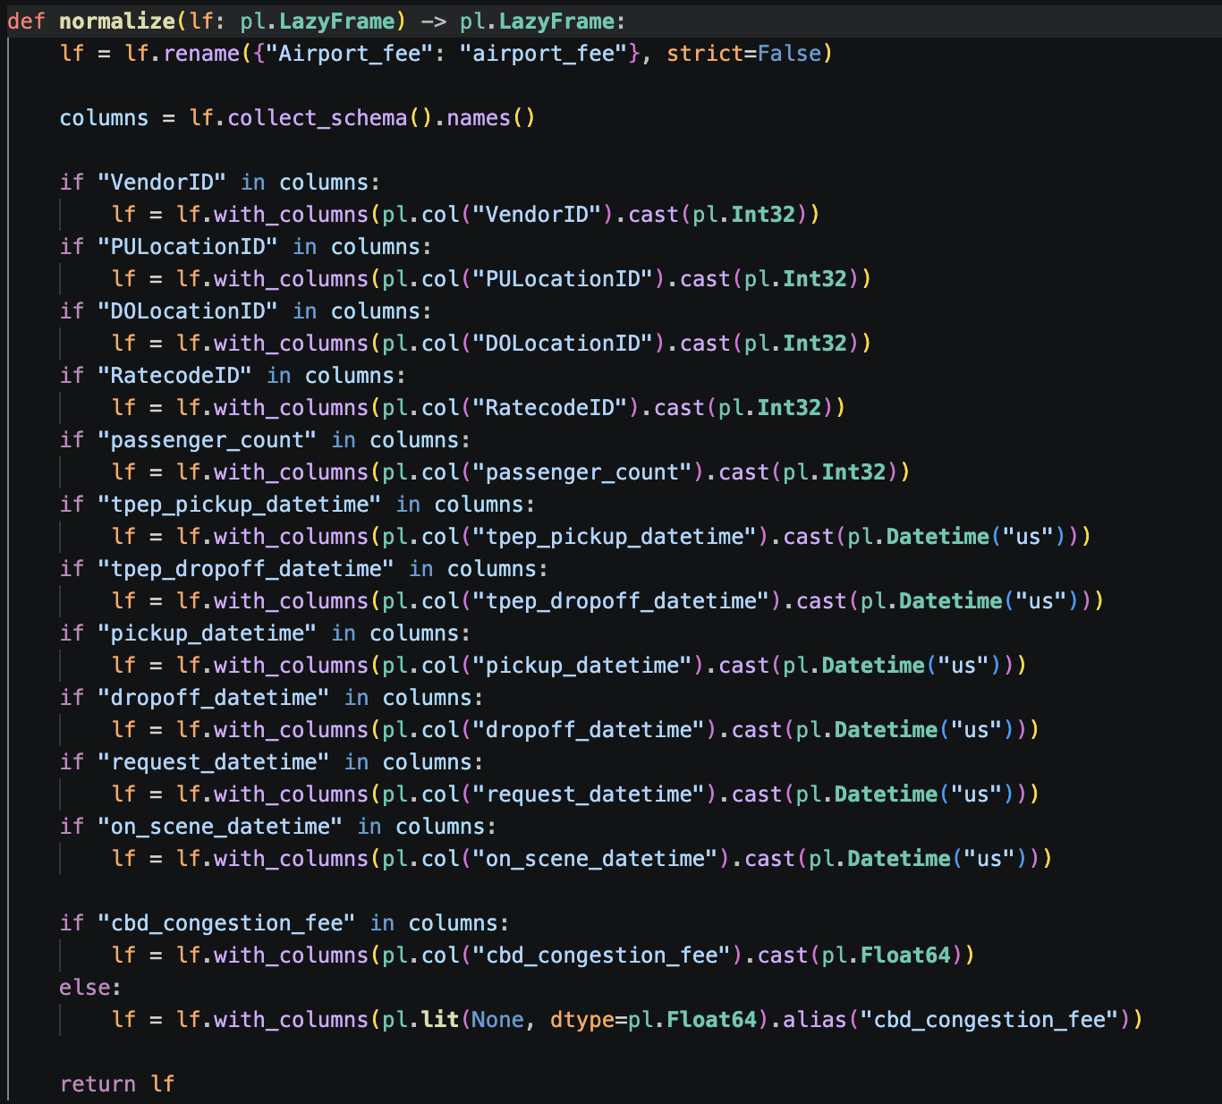
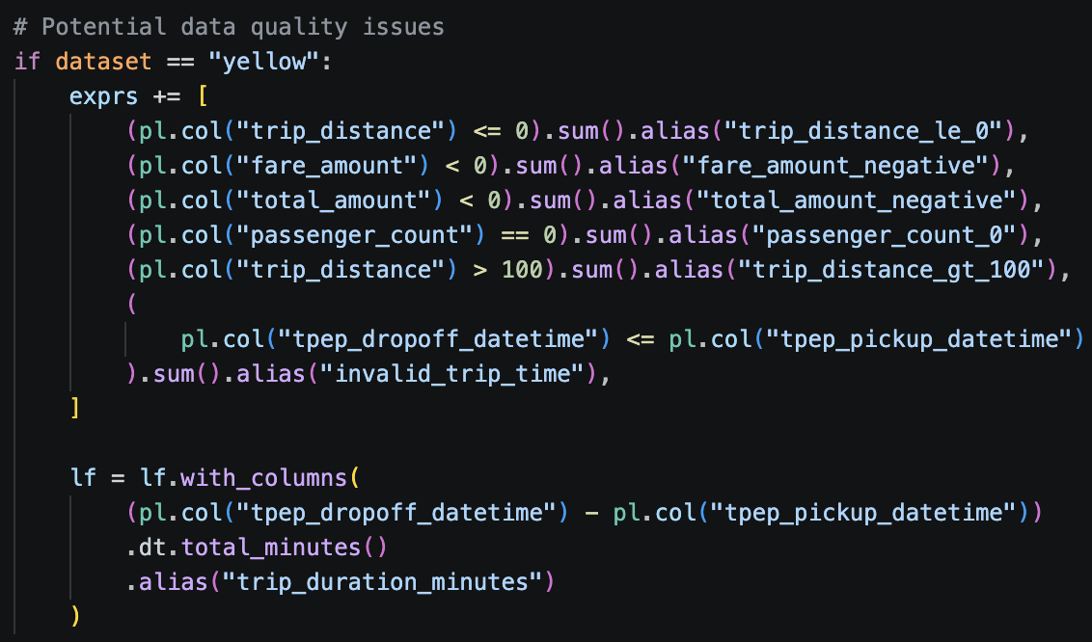
Processing at Scale

Slide 8
Processing at Scale
This is an appropriate strategy to handle ridiculous amount of files and rows within those files
Polars Lazy Dataframe allows us to scan specific parts of each file specifically. Allows us to only load into memory parts of the dataframe we actually need.
Attempts to load dataframes as raw files failed quickly going out of memory. We attempted to use Lazyframe streaming as well but this uses disk storage, something we are short on at this size of work.

Slide 9
Exploratory Data Analysis

Slide 10
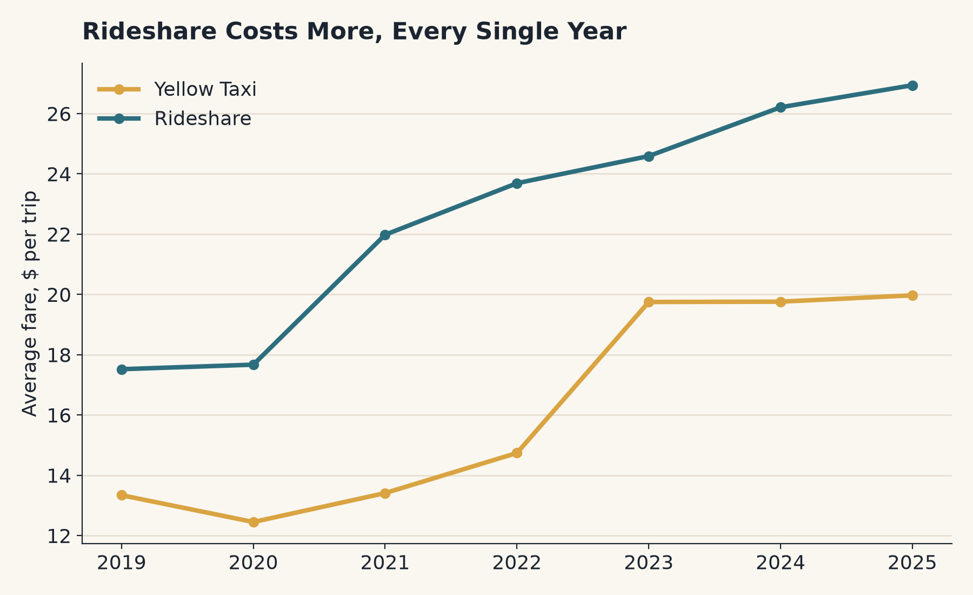
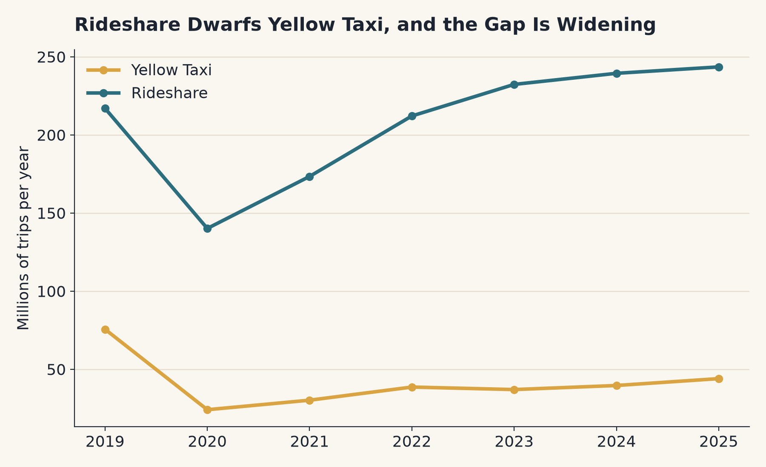
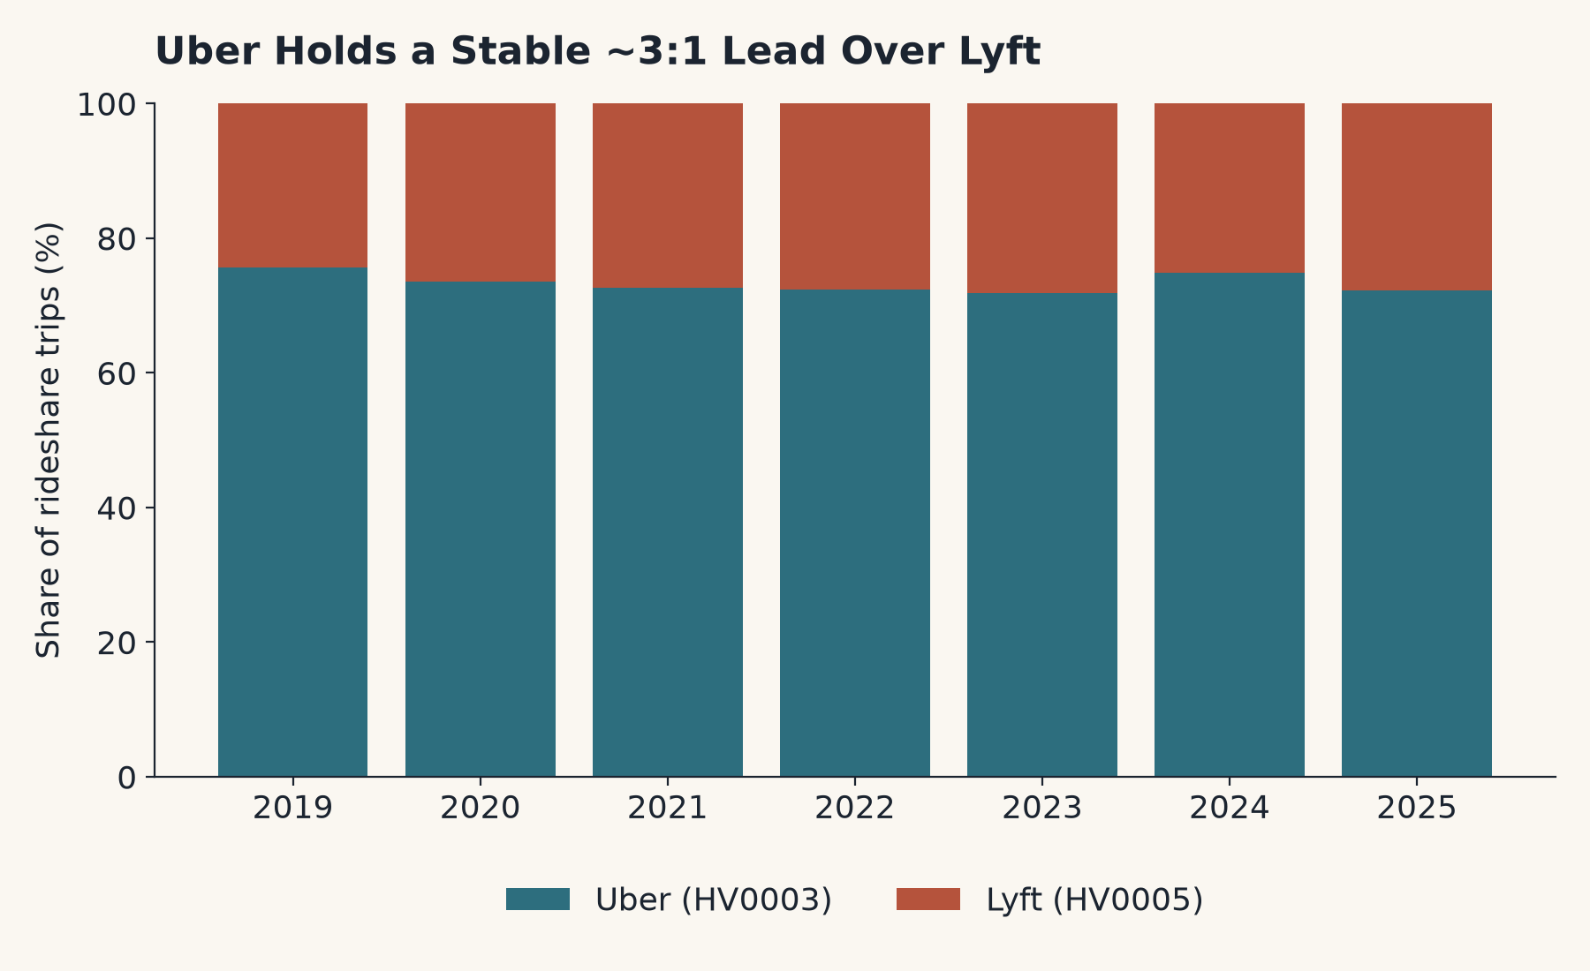
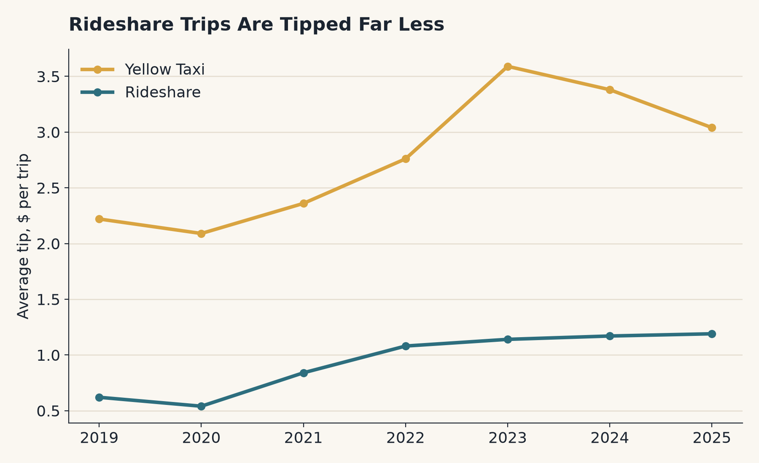

Slide 11
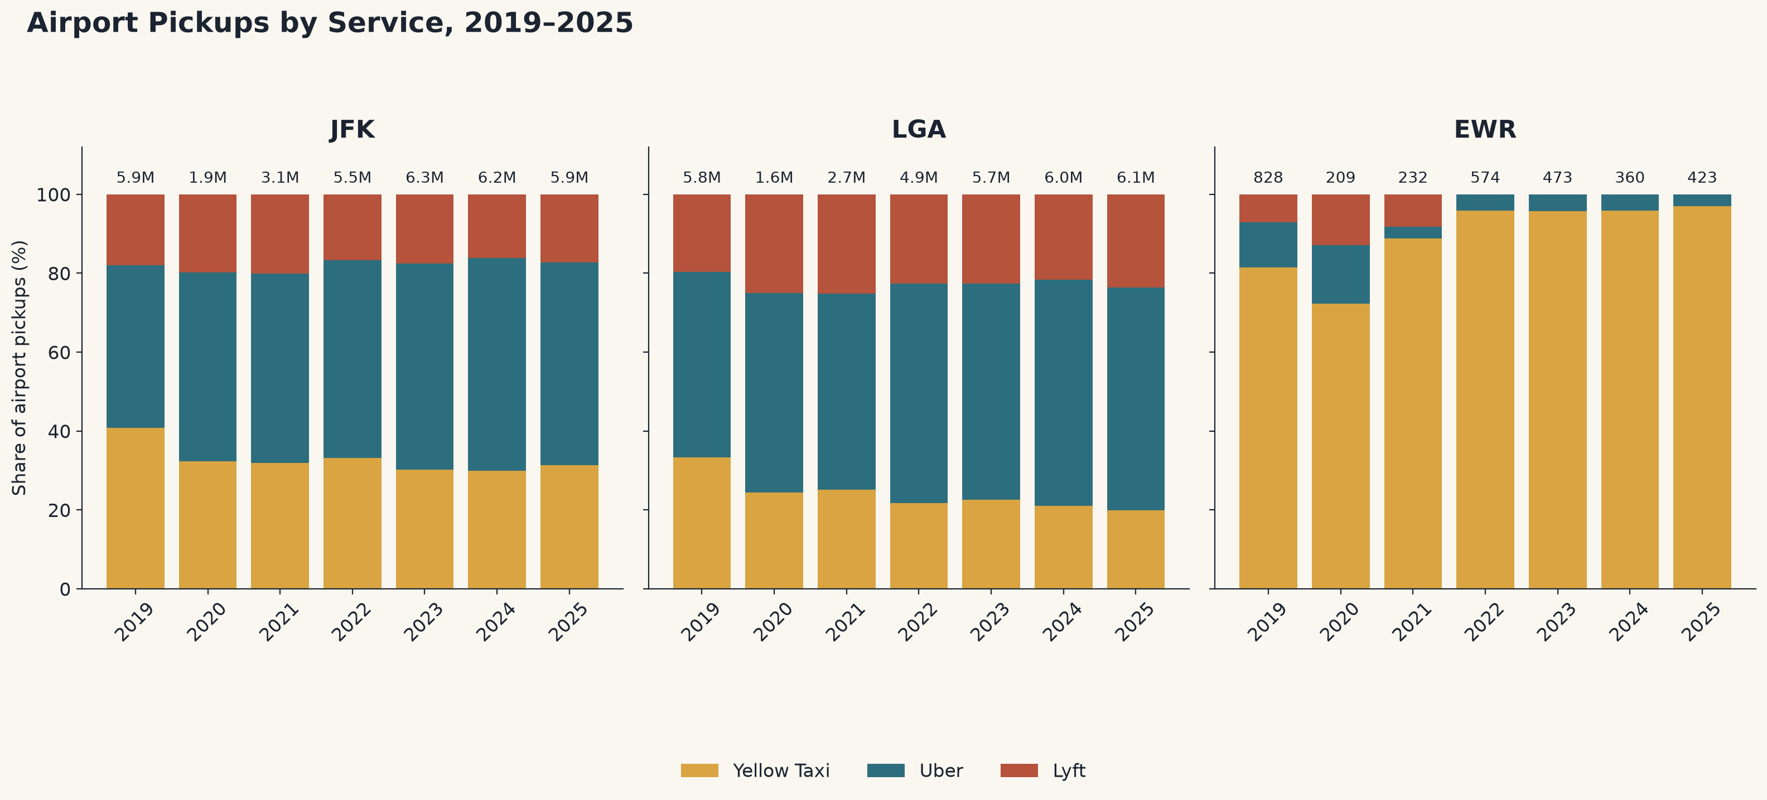
Airport Pickups at the Newark (EWR) airport may be biased in this dataset. TLC dataset is unclear on whether taxis originating from EWR count in data or only those originating in the NYC bounds. The low data counts are most likely from a lack of outgoing taxis from this location.

Slide 12
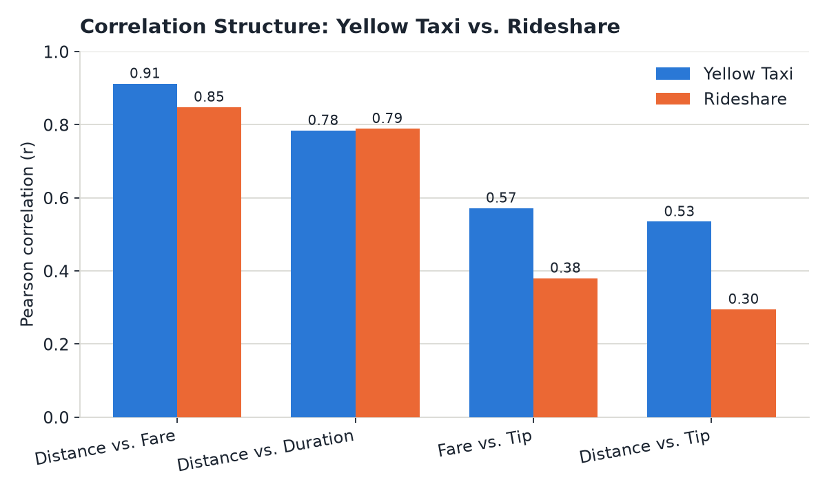
Correlations
Reviewing the correlations of a few key categories between yellow taxis and rideshare.
Tips for Taxis have some correlation for fare and for distance. Meanwhile rideshares have almost no correlation, suggesting something else lends to tip amount.
In both cases, distance and fare are highly correlated. The slightly lower correlation in rideshare may be due to surge pricing or may have some minimum pricing built in.

Slide 13
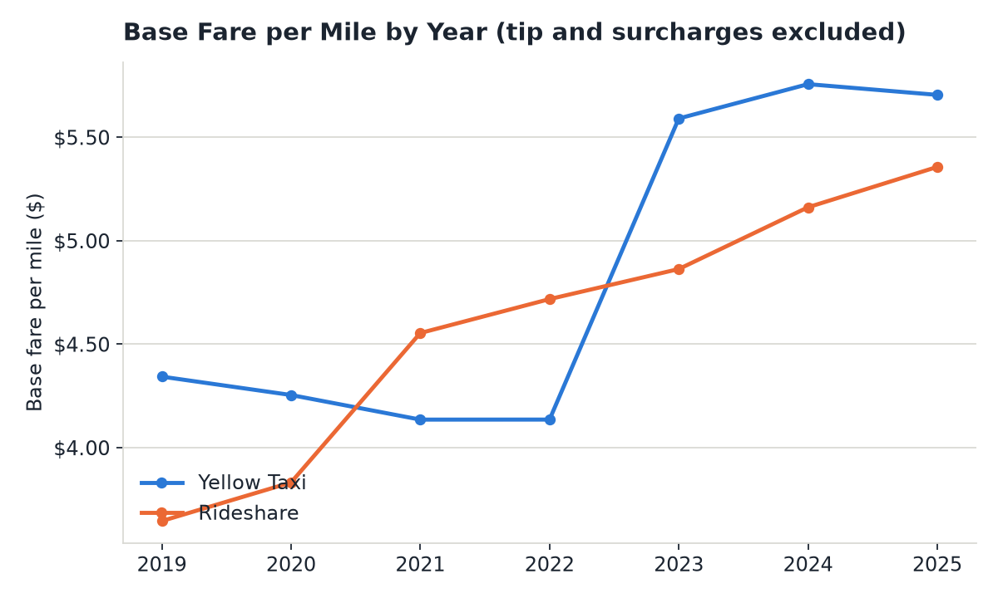
Base Fare per Mile
Meanwhile an examination of base fare per mile shows a steady rise for the rideshare costs. Meanwhile taxis see no movement until a large spike following 2022.
A large spike could be due to a number of reasons. Giving up on fighting rideshare pricing, fallout from covid, or some other reason may be the result of this. It will require further digging to see if we can find a reason.

Slide 14
Lessons Learned and Next Steps
One immediate issue that popped was the absolute size of files as mentioned. While our current process works and works well, the amount of storage that is required is too high for a personal computer. The next phase’s move to big data control on Databricks will allow us to fix this issue permanently.
Initial scraping did not work because of trailing spaces on href links. Always be careful and remember to normalize strings properly.

Slide 15
Questions?

