Slide 1
A Simple Reinforcement Learning System Development based on Q-learning
Guangfei Zhu
12/05/2018

Slide 2
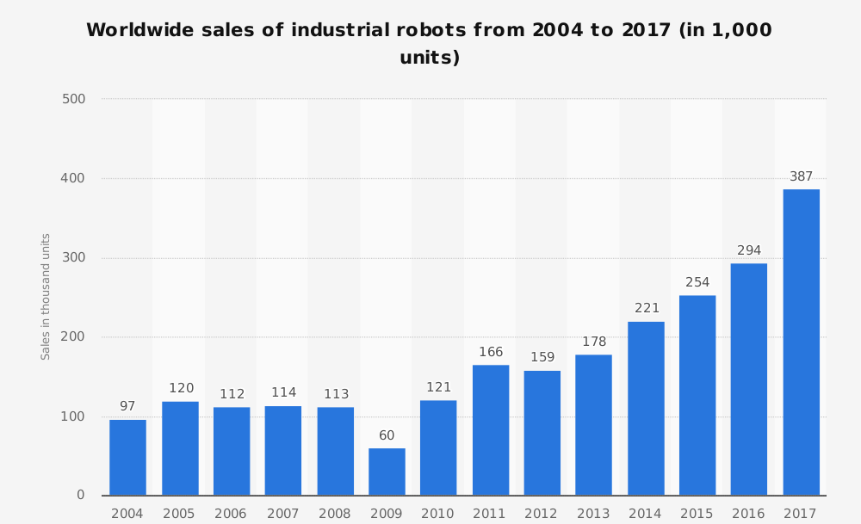
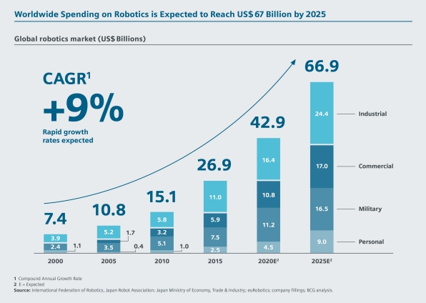
Background
High demand for industrial robots: higher efficiency and lower cost;
However, most of current industrial robots are designed for specifically individual goals such as pushing and navigation

Slide 3
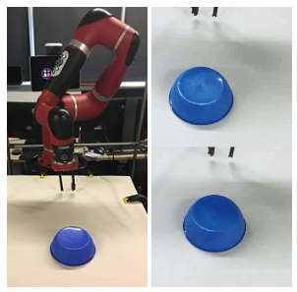
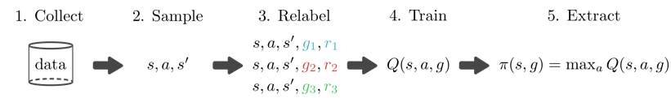
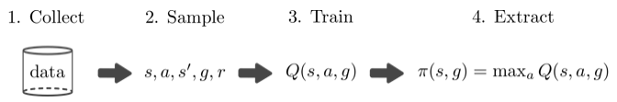
Research Question
Make a step toward the challenging goal of general-purpose tasks implementation.
Combination of Q-learning and VAEs:
As a start, simple cases are implemented (6 by 6 grids): VAEs does not work → manually generate cases.
VAEs
Q-learning
2018, Nair
Manually generate data
Q-learning

Slide 4
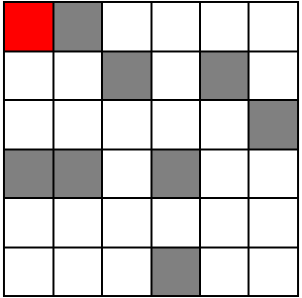
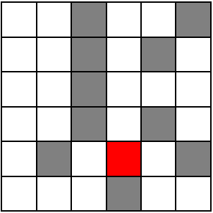
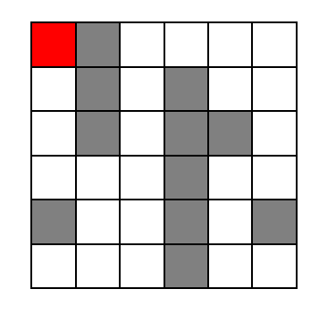
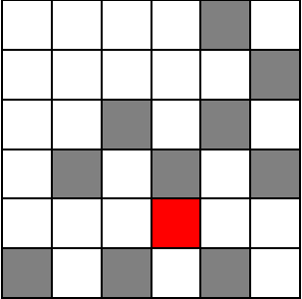
1. Training Data Generation
Goal: To generate data for Q-learning
Data: 32 cases in total
White: path; Grey: barrier (try to avoid); Red: goal

Slide 5

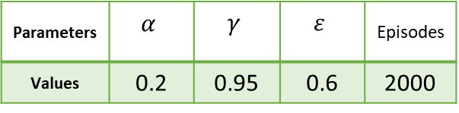
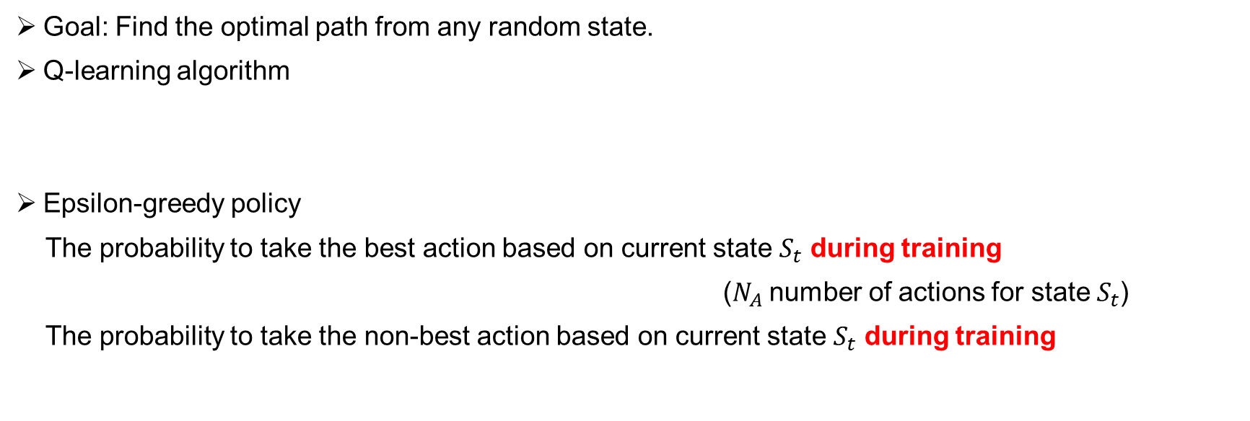



2. Q-Learning and Epsilon-Greedy Policy
Goal: Find the optimal path from any random state.
Q-learning algorithm
Epsilon-greedy policy
The probability to take the best action based on current state $S_{t}$ during training
($N_{A}$ number of actions for state $S_{t}$)
The probability to take the non-best action based on current state $S_{t}$ during training
$$Q\left(S_{t},A_{t}\right)←Q\left(S_{t},A_{t}\right)+α\left[R_{t+1}+γ\max_{a}{Q\left(S_{t+1},a\right)}−Q\left(S_{t},A_{t}\right)\right]$$
$$1−ε+\frac{ε}{N_{A}}$$
$$\frac{ε}{N_{A}}$$
$1−ε+\frac{ε}{N_{A}}$=$1−0.6+\frac{0.6}{4}=0.55$
Parameters | $$α$$ | $$γ$$ | $$ε$$ | Episodes
Values | 0.2 | 0.95 | 0.6 | 2000
$\frac{ε}{N_{A}}$=$\frac{0.6}{4}=0.15$

Slide 6
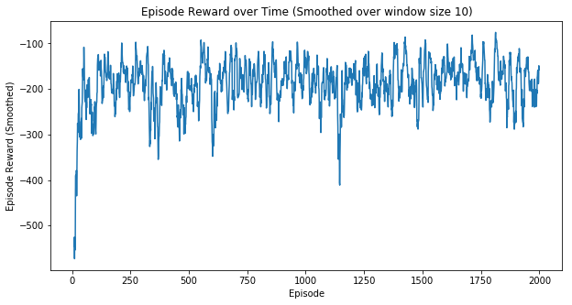
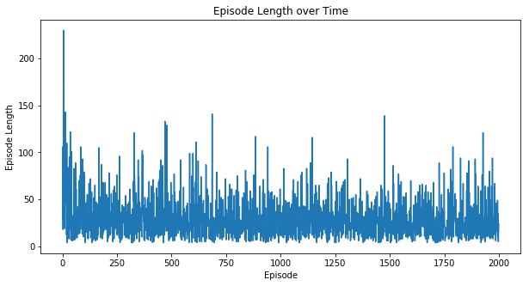
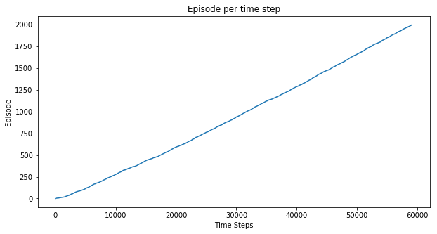
3. Results: Episode and Related Rewards
2000 Episodes are enough for training (about 5 s)
-- oscillation of episode reward is smaller
-- oscillation of episode length is smaller

Slide 7
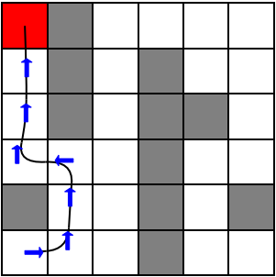
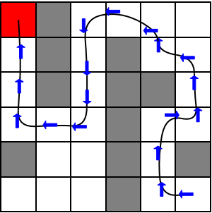
3. Results: Optimal Path
Create a human-computer interaction interface
After training, one could choose any random cell as an initial state → the agent will help find the optimal path

Slide 8
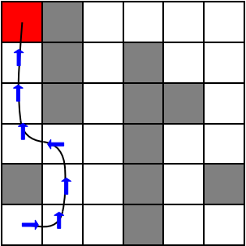
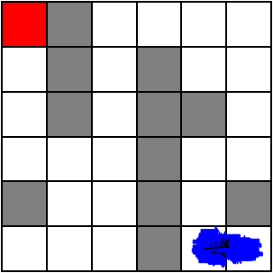


3. Results: Effect of Epsilon
Best action probability: $1−ε+\frac{ε}{N_{A}}$=$1−0.1+\frac{0.1}{4}=0.925$
$$ε =0.1$$
Non-best action probability: $\frac{ε}{N_{A}}$=$\frac{0.1}{4}=0.025$
Get trapped in local optima

Slide 9
Future Work
Extend the 6 by 6 grid to more complex geometries so that VAEs could be applied
Two or more goals are expected to set to help the agent to find the best path to the best local goals

