Slide 1
Social Graphs and Semantic Analytics
Colin Bell <colin.bell@uwaterloo.ca>
Director, Enterprise Architecture
Information Systems and Technology (IST)
University of Waterloo
Prepared guest lecture for Class 11 of W16 cs330.

Slide 2
Foundations
Infrastructure
Business Use
Managerial and Social Issues
Building

Slide 3
Foundations: Starting from…
Business Intelligence (BI)
Data Warehousing / Big Data
Social IT
Today we are going to talk about next gen BI and the tools / technologies being used at the bleeding edge to make sense of big data.
“Business Intelligence 2.0”
Graph databases
Semantic-aware analytics

Slide 4
Outline: Class 11 – Guest Lecture “Social Graphs and Semantic Analytics”
Foundations
Graph (mathematics)
Semantics (linguistics)
Infrastructure
Web 2.0
Web 3.0
Business Uses
Social Graph
Financial Risk
Textual Meta-Analysis
Managerial and Social Issues
Profiling
Information Leakage
False Positives
Building
Where would you start?

Slide 5
Foundations: Graph
Definition:
Set V of vertices.
Set E of unordered (edge) and ordered (arc) pairs of vertices.
Denoted as G(V,E).
Types:
Undirected Graph (G_{u})
Directed Graph (G_{d})
Mixed Graph (G_{x})
Multigraph (G_{m})
Graph. Encyclopedia of Mathematics. URL: http://www.encyclopediaofmath.org/index.php?title=Graph&oldid=37438
http://bit.ly/1Ue3Jby

Slide 6
Foundations: Semantics
Definition: Semantics
The branch of linguistics and logic concerned with meaning. There are a number of branches and sub branches of semantics, including:
formal semantics, which studies the logical aspects of meaning, such as sense, reference, implication, and logical form,
lexical semantics, which studies word meanings and word relations, and;
conceptual semantics, which studies the cognitive structure of meaning.
We are interested in Computational Semantics, the study of how to automate the process of constructing and reasoning with meaning representations [source: https://en.wikipedia.org/wiki/Computational_semantics]
Semantics. Oxford Dictionary Online. URL:
http://www.oxforddictionaries.com/us/definition/american_english/semantics
http://bit.ly/1pYQ8bg

Slide 7
Foundations: Semantic Models
a.k.a. Semantic Networks
We can combine the concepts of graphs and semantics to build what are called semantic models.
Example:

Slide 8
NOTE Infrastructure: Web 2.0
This is a whirlwind tour of Web 2.0 technologies. This is to give you a frame of reference not an exhaustive understanding.
If you miss the details, do not fret.

Slide 9
Infrastructure: Web 2.0- Social
A number of concepts and technologies make up what we think of as Web 2.0. We’ll look at a few:
HTTP: Hypertext Transfer Protocol
URLs: Uniform Resource Locators
A specific type of Uniform Resource Identifier (URI)
HTML: Hypertext Markup Language
With JavaScript and Cascading Style Sheets (CSS)
XML: Extensible Markup Language
Web Services:
SOAP: Simple Object Access Protocol
RESTful JSON: Representational State Transfer JavaScript Object Notation

Slide 10
Web 2.0: HTTP
Hypertext Transfer Protocol (HTTP)
Provides a simple dialect (verbs + structure) to ask for, give, and receive hypertext/hypermedia-based information.
Usually transferred using Transmission Control Protocol (TCP) over Internet Protocol (IP) switched networks.
Allows creation of a graph containing ‘hypertext’ vertices (nodes) linked across ‘hyperlink’ arcs.
The basis of the World Wide Web we know today.

Slide 11
Web 2.0: HTTP
See: https://tools.ietf.org/pdf/rfc7231.pdf

Slide 12
Web 2.0: HTTP
See: https://tools.ietf.org/pdf/rfc7231.pdf

Slide 13
Web 2.0: URLs / URIs
A Uniform Resource Locator (URL) is a specific class of Uniform Resource Identifier (URIs)
See: https://www.ietf.org/rfc/rfc3986.txt
The standardized structure of a string to allow items to be uniquely identified (URI). Sometimes items are best identified by its location (URL).
Pattern:
foo://example.com:8042/over/there?name=ferret#nose \_/ \______________/\_________/ \_________/ \__/
| | | | |
scheme authority path query fragment
Example from IETF RFC3986

Slide 14
Web 2.0: HTML w/ (JS + CSS)
Hypertext Markup Language (HTML)
See: https://www.w3.org/TR/html5/
Most modern websites include JavaScript (JS) to allow for ‘dynamic’ interactions.
See: http://www.ecma-international.org/ecma-262/5.1/
Data (HTML) and dynamic logic (JavaScript) is separated from visual presentation using Cascading Style Sheets (CSS).
See: https://www.w3.org/TR/CSS/

Slide 15
Web 2.0: Example HTML
http://ist.uwaterloo.ca/~cpbell/1161.cs330/SOURCES/HTML-example/
<!DOCTYPE html>
<html>
<head>
<meta charset="utf-8" />
<script type="text/javascript"src="script.js”>
</script>
<link rel="stylesheet”
type="text/css”
href="style.css">
</link>
</head>
<body>
<h1>Example HTML</h1>
<button onclick="sayHello('world')">
Click Me
</button>
</body>
</html>

Slide 16
Web 2.0: Example JavaScript
http://ist.uwaterloo.ca/~cpbell/1161.cs330/SOURCES/HTML-example/
function sayMessage(parameter) {
window.alert(parameter)
}

Slide 17
Web 2.0: Example CSS
http://ist.uwaterloo.ca/~cpbell/1161.cs330/SOURCES/HTML-example/
button {
background-color: #4CAF50; /* Green */
border: none;
color: white;
padding: 15px 32px;
text-align: center;
text-decoration: none;
display: inline-block;
font-size: 16px;
}
body { background-color: lightgreen; }
h1 { color: darkgreen;
margin-left: 20px;
}

Slide 18
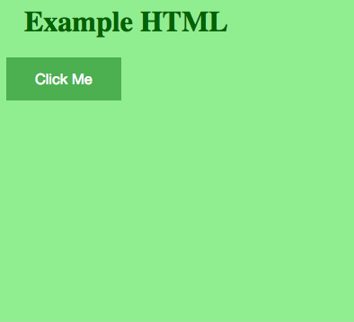
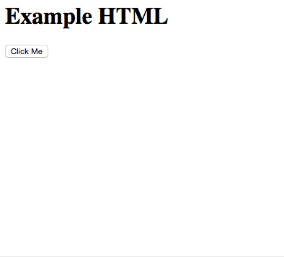
Web 2.0: HTML Example
http://ist.uwaterloo.ca/~cpbell/1161.cs330/SOURCES/HTML-example/
With CSS + JavaScript
Without CSS + JavaScript

Slide 19
Web 2.0: XML
Extensible Markup Language (XML)
See: https://www.w3.org/TR/xml/
Provides a way to structure (aka ‘markup’) arbitrary text content with tags so a computers and humans can read it.
Ostensibly the parent of HTML.
Expands on an older format called the Standard Generalized Markup Language (SGML).
Example uses:
Microsoft Office Files (docx, xlsx, pptx)
Really Simple Syndication (RSS) feeds
https://en.wikipedia.org/wiki/List_of_XML_markup_languages

Slide 20
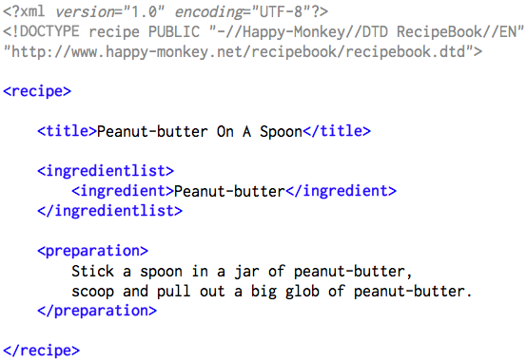
Web 2.0: XML Example
Public Domain from: https://en.wikipedia.org/wiki/File:RecipeBook_XML_Example.png

Slide 21
Web 2.0: Web Services
Today you learned about a number of ‘Social IT’ innovations– the innovations that moved the WWW from its Web 1.0 early past to its Web 2.0 social present.
One of the key elements of the Web 2.0- Social Web revolution was the ability to access data from different services (Wikis, Blogs, Microblogs, etc.)
Application Programming Interfaces (APIs) were key to this. When APIs work over HTTP, they are called ‘Web Services.’
“A Web Service is a software system designed to support interoperable machine-to-machine interaction over a network.” source: https://www.w3.org/TR/2004/NOTE-ws-gloss-20040211/#webservice

Slide 22
Web 2.0: SOAP
Simple Object Access Protocol (SOAP)
See: https://www.w3.org/TR/soap12/
``A SOAP message is an ordinary XML document containing the following elements:
An Envelope element that identifies the XML document as a SOAP message
A Header element that contains header information
A Body element that contains call and response information
A Fault element containing errors and status information’’
From http://www.w3schools.com/xml/xml_soap.asp

Slide 23
Web 2.0: RESTful JSON
Representational State Transfer (REST)
See Fielding, Roy Thomas. Architectural Styles and the Design of Network-based Software Architectures. Doctoral dissertation, University of California, Irvine, 2000. @ http://bit.ly/1eTY8AI
Architecture that uses HTTP and URIs/URLs to convey information constrained in specific ways.
JavaScript Object Notation (JSON)
JSON: http://www.json.org/
A lightweight data-interchange format built on a (1) collection of name/value pairs and (2) an ordered list of values.

Slide 24
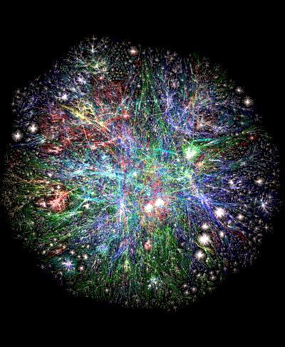
Web 2.0: WWW
What is the World Wide Web (WWW):
A huge directed graph of connected text and multimedia (nodes aka. vertices) across links (arcs).
The links are not very informative.
Knowing that one node links to another does not provide useful ‘rich’ context.
Connections do not have meaning outside of ‘link’.
”Graph of World Wide Web” source: http://www.bordalierinstitute.com/
See more large network datasets at:
https://snap.stanford.edu/data/#web

Slide 25
Motivation: Web 3.0
Simple links do not say much.
Human inference can (sort of) fill in the blanks.
We want computers to do the hard work.
A human can look at 4 articles / social media profiles.
A human cannot look at billions of articles / social media profiles.

Slide 26
Motivation: Web 3.0
Can we combine these two graphs into something a computer can understand and use to infer meaning / relationships?

Slide 27
Motivation: Web 3.0

Slide 28
Infrastructure: Web 3.0- Semantic
To help deal with this lack of meaning on links, the World Wide Web Consortium (W3C) has been working to develop a suite technologies to encode semantics.
They are referred to as Web 3.0- “Semantic Web.”
These technologies are built on the W3C’s previous standards– the Web 1.0 and Web 2.0 standards.
They are:
RDF: Resource Description Framework
OWL: Web Ontology Language
SPARQL: RDF Query Language

