Slide 1
Social Graphs and Semantic Analytics
Colin Bell <colin.bell@uwaterloo.ca>
Director, Enterprise Architecture
Information Systems and Technology (IST)
University of Waterloo
Prepared guest lecture for Class 11 of W16 cs330.

Slide 2
Foundations
Infrastructure
Business Use
Managerial and Social Issues
Building

Slide 3
Foundations: Starting from…
Business Intelligence (BI)
Data Warehousing / Big Data
Today we are going to talk about next gen BI and the tools / technologies being used at the bleeding edge to make sense of big data.
“Business Intelligence 2.0”
Graph databases
Semantic-aware analytics

Slide 4
Outline: Class 11 – Guest Lecture “Social Graphs and Semantic Analytics”
Foundations
Graph (mathematics)
Semantics (linguistics)
Infrastructure
Web 2.0
Web 3.0
Business Uses
Social Graph
Financial Risk
Textual Meta-Analysis
Managerial and Social Issues
Profiling
Information Leakage
False Positives
Building
Where would you start?

Slide 5
Foundations: Graph
Definition:
Set V of vertices.
Set E of unordered (edge) and ordered (arc) pairs of vertices.
Denoted as G(V,E).
Types:
Undirected Graph (G_{u})
Directed Graph (G_{d})
Mixed Graph (G_{x})
Multigraph (G_{m})
Graph. Encyclopedia of Mathematics. URL: http://www.encyclopediaofmath.org/index.php?title=Graph&oldid=37438
http://bit.ly/1Ue3Jby

Slide 6
Foundations: Semantics
Definition: Semantics
The branch of linguistics and logic concerned with meaning. There are a number of branches and sub branches of semantics, including:
formal semantics, which studies the logical aspects of meaning, such as sense, reference, implication, and logical form,
lexical semantics, which studies word meanings and word relations, and;
conceptual semantics, which studies the cognitive structure of meaning.
We are interested in Computational Semantics, the study of how to automate the process of constructing and reasoning with meaning representations [source: https://en.wikipedia.org/wiki/Computational_semantics]
Semantics. Oxford Dictionary Online. URL:
http://www.oxforddictionaries.com/us/definition/american_english/semantics
http://bit.ly/1pYQ8bg

Slide 7
Foundations: Semantic Models
a.k.a. Semantic Networks
We can combine the concepts of graphs and semantics to build what are called semantic models.
Example:

Slide 8
Infrastructure: Web 2.0- Social
A number of concepts and technologies make up what we think of as Web 2.0:
HTTP: Hypertext Transfer Protocol
URLs: Uniform Resource Locators
A specific type of Uniform Resource Identifier (URI)
HTML: Hypertext Markup Language
With JavaScript and Cascading Style Sheets (CSS)
XML: Extensible Markup Language
Web Services:
SOAP: Simple Object Access Protocol
RESTful JSON: Representational State Transfer JavaScript Object Notation

Slide 9
Web 2.0: HTTP
Hypertext Transfer Protocol (HTTP)
Provides a simple dialect (verbs + structure) to ask for, give, and receive hypertext-based information.
Usually transferred using Transmission Control Protocol (TCP) over Internet Protocol (IP) switched networks.
Allows creation of a graph containing ‘hypertext’ vertices (nodes) linked across ‘hyperlink’ arcs.
The basis of the World Wide Web we know today.

Slide 10
Web 2.0: HTTP
See: https://tools.ietf.org/pdf/rfc7231.pdf

Slide 11
Web 2.0: HTTP
See: https://tools.ietf.org/pdf/rfc7231.pdf

Slide 12
Web 2.0: URLs / URIs
A Uniform Resource Locator (URL) is a specific class of Uniform Resource Identifier (URIs)
See: https://www.ietf.org/rfc/rfc3986.txt
The standardized structure of a string to allow items to be uniquely identified (URI). Sometimes items are best identified by its location (URL).
Pattern:
foo://example.com:8042/over/there?name=ferret#nose \_/ \______________/\_________/ \_________/ \__/
| | | | |
scheme authority path query fragment
Example from IETF RFC3986

Slide 13
Web 2.0: HTML w/ (JS + CSS)
Hypertext Markup Language (HTML)
See: https://www.w3.org/TR/html5/
Most modern websites include JavaScript (JS) to allow for ‘dynamic’ interactions.
See: http://www.ecma-international.org/ecma-262/5.1/
Data (HTML) and dynamic logic (JavaScript) is separated from visual presentation using Cascading Style Sheets (CSS).
See: https://www.w3.org/TR/CSS/

Slide 14
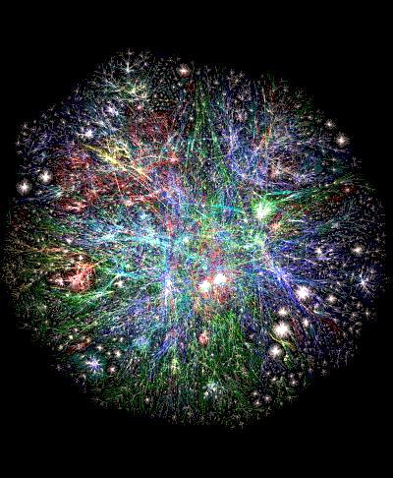
Web 2.0: WWW
”Graph of World Wide Web” source: http://www.bordalierinstitute.com/
See more large network datasets at:
https://snap.stanford.edu/data/#web

Slide 15
Web 2.0: XML

Slide 16
Web 2.0: Web Services

Slide 17
Web 2.0: SOAP

Slide 18
Web 2.0: RESTful JSON

Slide 19
Infrastructure: Web 3.0- Semantic

