Slide 1

OUCC 2015
Inspiring Innovation
Presentation:
Service Oriented Enterprise (SOE) Presenter: Colin Bell (Director, Enterprise Architecture – University of Waterloo) Date: May 4, 2015

Slide 2
Outline
Service Oriented Enterprise (SOE)
“The Cloud”
Service Delivery Models
Deployment Models
Economies of Scale
What is a Service?
Definitions
Practical Definition
Graphical Representation
Building the Service Oriented Enterprise
Service Management w/ ITIL
Enterprise Architecture (EA)
Definition
Framework
EA BOK
Business Service Reference Models
Service-Oriented Architectures (SOA)

Slide 3
Definition: Cloud Computing
Cloud computing is the use of computing resources (hardware and software) that are delivered as a service over a network (typically the Internet). The name comes from the use of a cloud-shaped symbol as an abstraction for the complex infrastructure it contains in system diagrams. Cloud computing entrusts remote services with a user’s data, software and computation.
Source: http://en.wikipedia.org/wiki/Cloud_computing (2012)

Slide 4
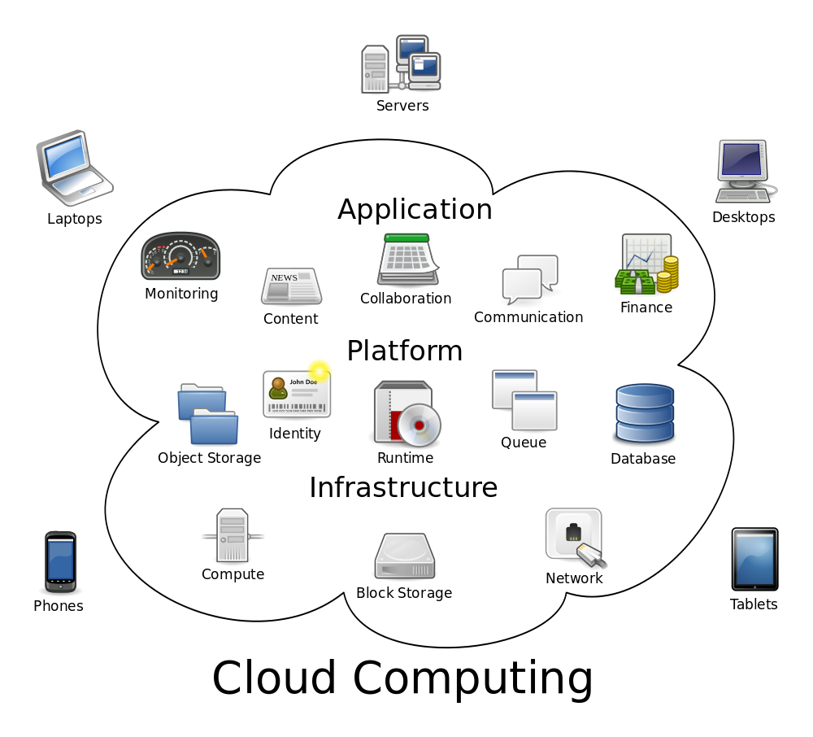
Image: Cloud Computing
Source: http://en.wikipedia.org/wiki/Cloud_computing#/media/File:Cloud_computing.svg

Slide 5
Cloud Service Delivery Models
Software (Application) as a Service (SaaS)
Platform as a Service (PaaS)
Infrastructure as a Service (IaaS)

Slide 6
SaaS - Software (Application) as a Service
Traits:
providers install and operate application software,
very little flexibility— you get what is provided, and;
users do not worry about underlying platform or infrastructure.
Examples:
GMail / Google Apps
Hotmail / Microsoft Office 365
Salesforce
Desire 2 Learn / Brightspace

Slide 7
PaaS - Platform as a Service
Traits:
provides users with an infrastructure pre-configured with a suite of tools,
often users are locked into a particular development suite, database, and Web server, and;
users can build and run software in a controlled environment.
Examples:
Google App Engine
Engine Yard
Heroku

Slide 8
IaaS - Infrastructure as a Service
Traits:
low-level access to basic computing components,
can choose own OS, software stack, and configuration settings, and;
clients are given their own virtual networks and data centre.
Examples:
Amazon AWS
Microsoft Azure
Rackspace Cloud

Slide 9
Economies of Scale Benefits
SaaS > PaaS > IaaS
Why?
Less Flexibility + Fewer Features
⇒ Increased Specialization for Service Provider (decreasing per-unit costs)
⇒ Increased Prospective Customer Base for Service Provider (lower barrier to entry)

Slide 10
Cloud Deployment Models
Public Cloud
Infrastructure that is owned by a corporation who sells their services to the general public.
Community Cloud
Infrastructure that is shared amongst like-entities. Municipalities, Governments, non-Profit Organizations, and Non-Governmental Organizations often share these services.
Private Cloud
Infrastructure that is operated solely for a single entity.
Hybrid Cloud
A composition of two or more clouds that are separate at the lowest Infrastructure levels while allowing interconnection at higher levels.

Slide 11
Value Generation (Impact++) vs. Cost
By improving specialization, the cost of production (of services) can be driven down. By increasing the number of customers, revenue can increase as as marginal costs decrease.
Economies of scale is kicking in.
When someone else can provide service for less, do we consider the Opportunity Cost?
Is maintaining the status quo a good idea?
What ’higher value’ things could we be doing to make the organization more productive?

Slide 12
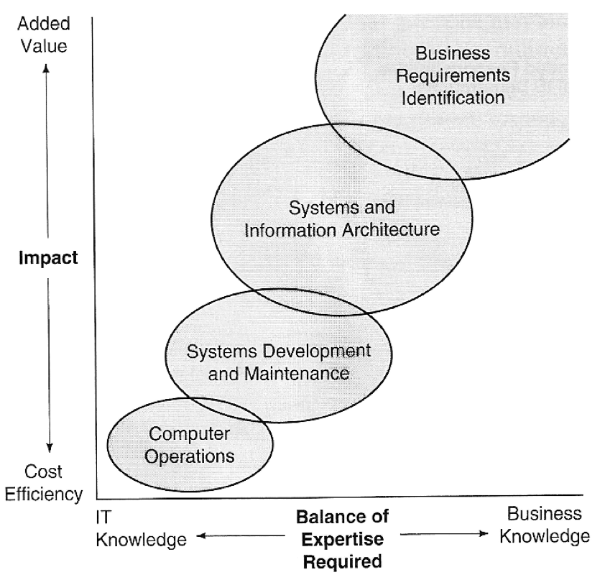
1994: Wentworth Research Program
Source: George Cox, Time to Reshape the IS Department? Wentworth Research Program (now part of Gartner
EXP, Stamford, CT), June 1994.

Slide 13
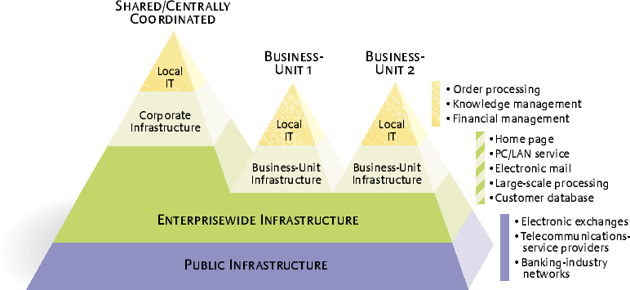
Centre for Information Systems Research (CISR) Multi-unit Portfolio Model
Source: MIT Sloan CISR, Weill P., Broadbent M. 2002

Slide 14
What is a Service?
Basic Definition
Inputs + Functionality = Output
Formal Definition
See: Journal of Software, July 2006
Aliaksei Yanchuk, Alexander Ivanyukovich, Maurizio Marchese “Towards a Mathematical Foundation for Service-Oriented Applications Design”

Slide 15
What is a Service?
Basic Definition
Inputs + Functionality = Output
Practical Definition
Inputs = (effort, data, contract, connection)
Functionality (unknown to user -> technology, process, people)
Output = (results)

Slide 16
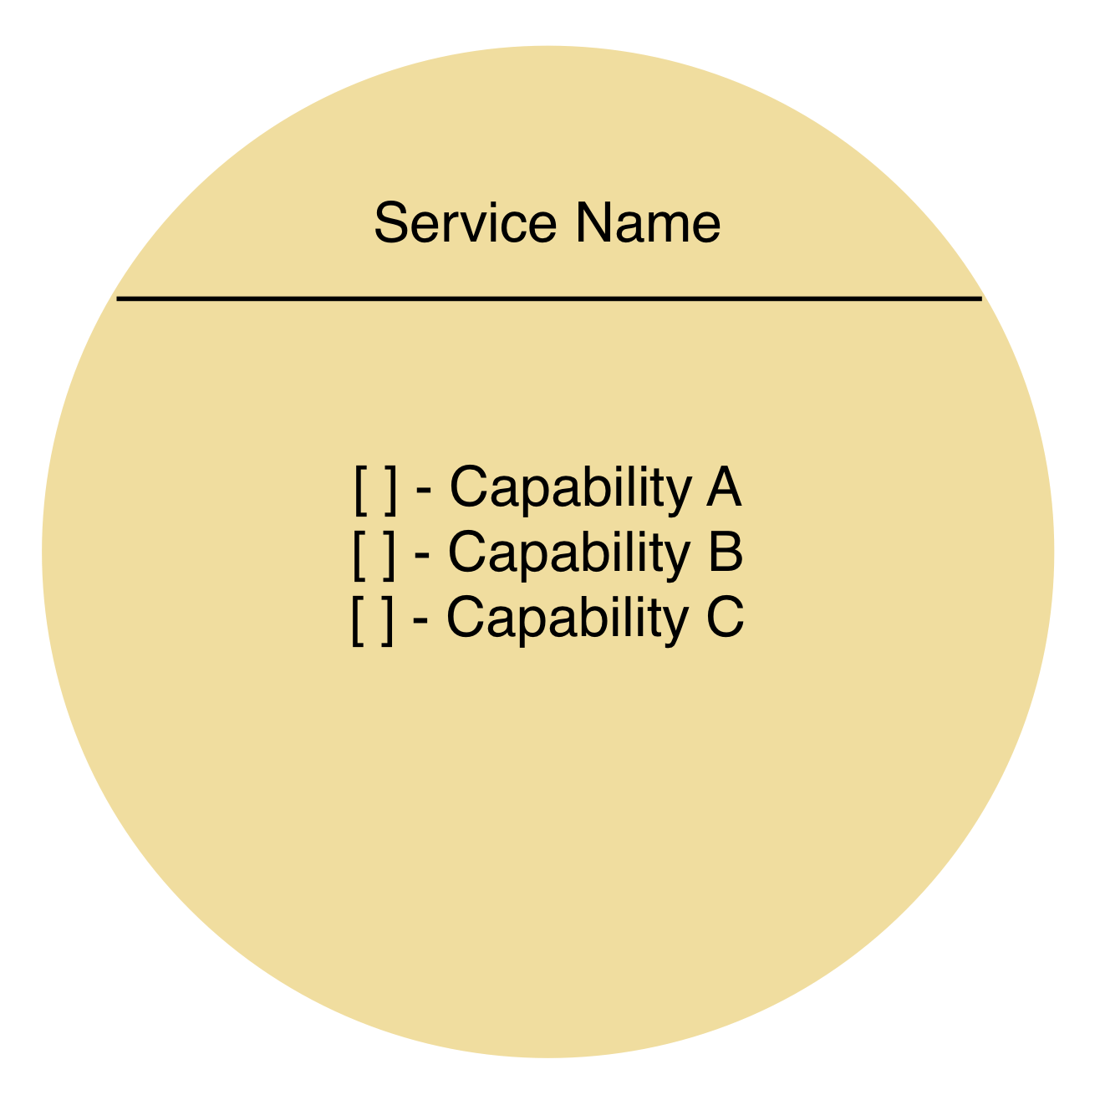
What is a Service?
Source: http://servicetechbooks.com/pdf/SOA_Principles_Poster.pdf

Slide 17
Information Technology Infrastructure Library (ITIL)
Quotes from: http://en.wikipedia.org/wiki/ITIL
Service Strategy
provides guidance on clarification and prioritization of service-provider investments in services.
Service Design
provides good-practice guidance on the design of IT services, processes, and other aspects of the service management effort.
Service Transition
relates to the delivery of services required by a business into live/operational use, and often encompasses the ”project” side of IT rather than.

Slide 18
Information Technology Infrastructure Library (ITIL)
Quotes from: http://en.wikipedia.org/wiki/ITIL
Service Operation
aims to provide leading practice for achieving the delivery of agreed levels of services both to end-users and the customers (where ”customers” refer to those individuals who pay for the service and negotiate the Service Level Agreements (SLAs).
Continual Service Improvement
aims to align and realign IT services to changing business needs by identifying and implementing improvements to the IT services that support the business processes.

Slide 19
Enterprise Architecture (EA)
Gartner:
Enterprise architecture (EA) is a discipline for proactively and holistically leading enterprise responses to disruptive forces by identifying and analyzing the execution of change toward desired business vision and outcomes. EA delivers value by presenting business and IT leaders with signature-ready recommendations for adjusting policies and projects to achieve target business outcomes that capitalize on relevant business disruptions. EA is used to steer decision making toward the evolution of the future state architecture.
Source: http://www.gartner.com/it-glossary/enterprise-architecture-ea/

Slide 20
Enterprise Architecture (EA)
Human readable:
Enterprise architecture (EA) is a discipline for taking a structured approach to studying, documenting, designing, planning, and facilitating change within an organization. The goal of EA is to allow an enterprise to better identify high-value opportunities and help it effectively capitalize on them.

Slide 21
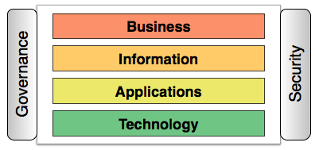
Enterprise Architecture (EA)

Slide 22
Zachman Framework for Enterprise Architecture (EA)
Information Systems Management In Practice (7th Ed.) by McNurlin, C.B; Sprague, R.H. [Prentice Hall, 2008]
Zachman Columns:
“What” Things + Data
“How” Processes
“Where” Network
“Who” People
“When” Events + Times
“Why” Strategies + Motivations
Zachman Rows:
“Contextual” Planner /Enterprise View
“Conceptual” Owner / Business View
“Logical” Designer / Architect View
“Physical” Builder / Engineer View
“Detailed” Technician View
“Functional” Operator View

Slide 23
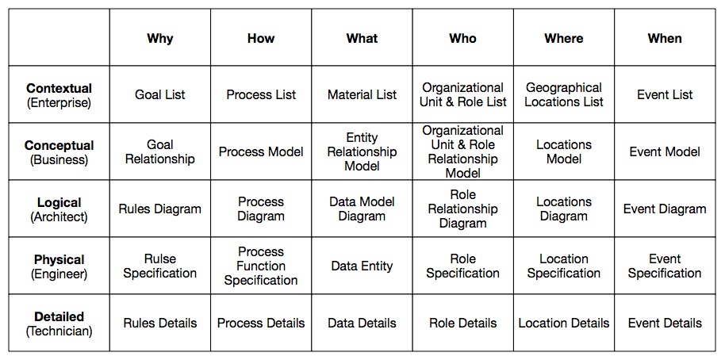
Zachman Framework for Enterprise Architecture (EA)
Information Systems Management In Practice (7th Ed.) by McNurlin, C.B; Sprague, R.H. [Prentice Hall, 2008]

Slide 24
Enterprise Architecture Body of Knowledge (EA BOK)
Zachman is one of many Frameworks.
Enterprise Architecture has a slew of approaches, not one size fits all.
To learn more visit the MITRE EA BOK:
http://www2.mitre.org/public/eabok/

Slide 25
Business Service Reference Models
Governments of Canada Strategic Reference Model (GSRM)
Canadian Government Model, built up from Municipal Models.
Defines Service Types and Service Output Types
Supports Modelling Languages like Service Integration and Accountability (SIAM) and Program Service Alignment Model (PSAM)
Office of Management and Budget (OMB) Federal Enterprise Architecture (FEA) Service Component Reference Model (SRM)
US Federal Government Model, built up from Agency Models.

Slide 26
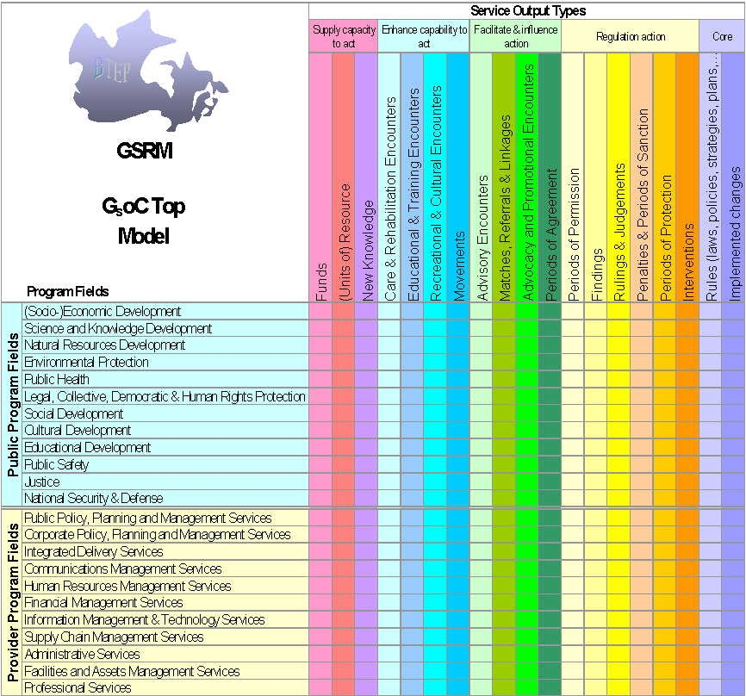
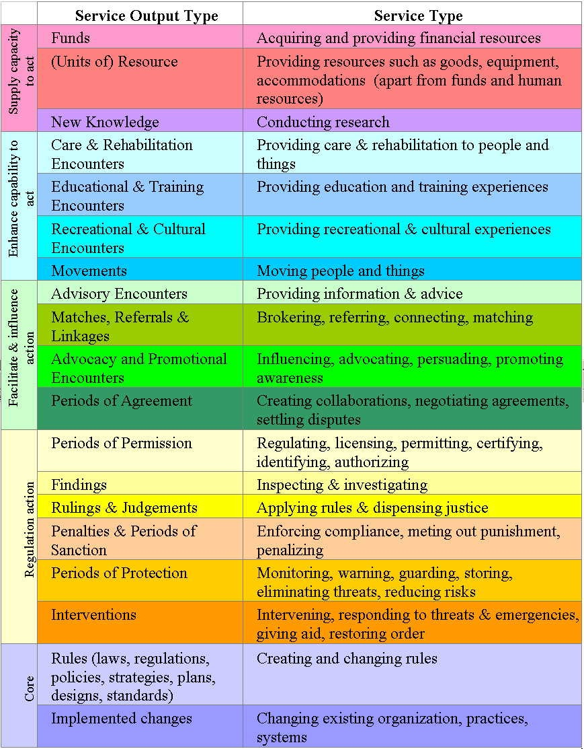
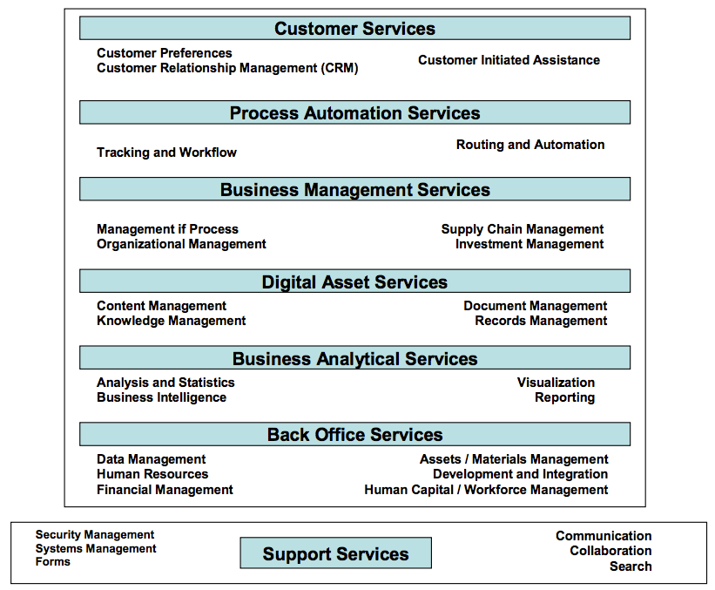
Business Service Reference Models
BTEP GSRM
OMB FEA SRM

Slide 27
A Service Oriented Enterprise (SOE)
… is created when both Business and IT are Service-Oriented in their endeavours.
Alignment is far easier to govern when business and IT are modelled as connected value chains from back office through business to our clients.

Slide 28
Service-Oriented Architectures (SOA)
In software engineering, a service-oriented architecture (SOA) is a set of principles and methodologies for designing and developing software in the form of interoperable services. These services are well-defined business functionalities that are built as software components (discrete pieces of code and/or data structures) that can be reused for different purposes. SOA design principles are used during the phases of systems development and integration.”

Slide 29
SOA Principles: Quick and Dirty
loosely couple at all costs
never require a particular operating system or technology
keep services unassociated until runtime
do not allow any embedded links between services
only communicate over documented channels
only communicate through documented interfaces
to build on top of other services (compose) at quality and to
spec, SLA underpinning contracts (UCs) are required

Slide 30
SOA Principles: Thomas Erl View
http://www.soaposters.com/
Standardized Service Contract
Services within the same service inventory are in compliance with the same contract design standards.
Service Loose Coupling
Service contracts impose low consumer coupling requirements and are themselves decoupled from their surrounding environment.
Service Abstraction
Service contracts only contain essential information and information about services is limited to what is published in service contracts.

Slide 31
SOA Principles: Thomas Erl View
http://www.soaposters.com/
Service Reusability
Services contain and express agnostic logic and can be positioned as reusable enterprise resources.
Service Autonomy
Services exercise a high level of control over their underlying runtime execution environment.
Service Statelessness
Services minimize resource consumption by deferring the management of state information when necessary.

Slide 32
Why SOA? Ask Stevey!
Case: Amazon vs. Google
Steve Yegge’s ”Stevey’s Google Platforms Rant”
Engineer at Google released a rant on Google+ around Oct 2011.
A user error with Google+ led to a Google employee posting a rant against Google.
He had worked at Amazon before Google and ranted about where Google was failing.

Slide 33
Why SOA? Ask Stevey!
In 2002, Jeff Bezos (founder + CEO of Amazon) issued a mandate.
All teams will henceforth expose their data and functionality through service interfaces.
Teams must communicate with each other through these interfaces
There will be no other form of interprocess communication allowed: no direct linking, no direct reads of another team’s data store, no shared-memory model, no back-doors whatsoever. The only communication allowed is via service interface calls over the network.

Slide 34
Why SOA? Ask Stevey!
It doesn’t matter what technology they use. HTTP, Corba, Pubsub, custom protocols – doesn’t matter. Bezos doesn’t care.
All service interfaces, without exception, must be designed from the ground up to be externalizable. That is to say, the team must plan and design to be able to expose the interface to developers in the outside world. No exceptions.

Slide 35
Why SOA? Ask Stevey!
Lessons from a massive undertaking of building SOA at Amazon:
pager escalation can get hard. need metrics and reporting
every single one of your peer teams becomes a potential denial of service
monitoring and QA are the same thing in SOAs
a universal service registration mechanism is a powerful thing to have
follow-on benefits are compelling

Slide 36
Why SOA? Ask Stevey!
Steve then explains... as hard as SOA was, it was the Right Thing to do.
He goes on to stress that Amazon’s abilities as a provider of Infrastructure and a Platform far outstrip Google because of one ultimate thing:
Accessibility!
If someone should be able to access something and cannot get it through a Service, it represents a HUGE roadblock to the Organization’s success.

Slide 37
Why SOA? Ask Stevey!
Moral of the story:
There is evidence that an organization is able to thrive in their market after adopting an SOA mandate They were able to develop marketable value-add functionality following their adoption of SOA. They accomplished this by imposing a requirement that everyone always use ’Services.’ Amazon used a series of Lego blocks to combine functionality in a wide variety of ways.

Slide 38
Why SOA? Ask Stevey!
Moral of the story:
There is evidence that an organization is able to thrive in their market after adopting an SOA mandate They were able to develop marketable value-add functionality following their adoption of SOA. They accomplished this by imposing a requirement that everyone always use ’Services.’ Amazon used a series of Lego blocks to combine functionality in a wide variety of ways.

Slide 39
Governance: the questions we need to ask.
If we continue duplicating high cost / low impact work across our organizations (province?) what is the Opportunity Cost?
How are resources provisioned to support activities? If funds flow to decentralized parties / agents, how do we convince them to share services?
Can a discipline like Enterprise Architecture help?
How can we help our business clients see the value of modelling their activities as services? How do we build complete models that allow the value chain from back office to client to be measured?

Slide 40
Game Plan for building an SOE
Control what you can.
Get IT in order, build radical Service-Orientation within your organizations.
Learn what it means to be Service-Oriented. Trial by fire.
Make your mistakes, pick yourself up, and learn from them.
Adopt LEAN and Agile mindsets. Business value is the primary driver. Fail early, learn often is the new IT mantra.
Help the Business learn to think radical Service-Orientation.

Slide 41

OUCC 2015
Inspiring Innovation
Questions & Answers

