Slide 1
Progress IST-EA: Role, Responsibilities, and Activities
Colin Bell
Nov 5, 2015

Slide 2
Outline
Enterprise Architecture (EA) Group Basics
Mission
Responsibilities
Director Accountabilities
Structure
Required Competencies
Services
Subsection Roadmaps
Staged Development Plans
Scope
Activities and Progress

Slide 3
Enterprise Architecture (EA): Mission
The mandate of this group is to develop the enterprise architecture strategy, framework and program for the university that addresses both current and future information management and information technology needs.
https://uwaterloo.ca/information-systems-technology/about/organizational-structure/enterprise-architecture-ea

Slide 4
Enterprise Architecture (EA): Responsibilities
Integration Development
(e.g., web, mobile, other)
Strategic Innovations
Information Management
Usability
Enterprise Architecture
https://uwaterloo.ca/information-systems-technology/about/organizational-structure/enterprise-architecture-ea

Slide 5
Enterprise Architecture (EA): Director Accountabilities
Establish direction and priorities for EA section.
Effective utilization of EA section resources.
EA strategy, framework, and models.
Business, Information, Technical, and Solution Architectures
Whole University (Faculty and Academic Support Areas)
Advise other IST sections and broader Community
Provides Thought Leadership
Architecture Governance
Communicates Standards
Stakeholder Management
Faculties and Academic Support Areas
http://www.hr.uwaterloo.ca/.jd/00001462.html

Slide 6
Enterprise Architecture (EA) Logical + Organizational Structure
EA
Colin Bell
Architecture Practice
Business and Information
Strategic
EIM: Information Management
EDM: Data Management
ECM: Content Management
Sarah Vela
Maher Shinouda
John Kemp (Cognos)
Gina Reichard (OnBase)

Slide 7
Enterprise Architecture (EA) Required Competencies
Robust EA Section Portfolio
Architecture Practice and EIM Practice must have visions/roadmaps, be moving along them.
Strong Relationships with Collaborators
Efficient and Effective Governance
Continually Grow Staff Capabilities
Maintain a Focus on Service Orientation

Slide 8
Enterprise Architecture (EA) Section Development Roadmaps
Architecture Practice (ARCH)
Starting from first principles. New approach with new team and new ideas on campus. No starting point.
Enterprise Information Management (EIM)
Enterprise Data Management (EDM)
Move from ‘Cognos’ focused team to tool agnostic, EDM team. Data Driven; work with IAP and Information Stewards to empower Data Driven Decision making on campus.
Enterprise Content Management (ECM)
Move from ‘OnBase’ team to tool agnostic, ECM team. Digitalization; work with University Records Manager and AIGC to establish standards and implement in technology.

Slide 9
Enterprise Architecture (EA) Services
Architecture Practice Consulting
Architectural ‘fire-fighting’ / urgent problems
Procurement Support
Archeological Digs (diagramming, documenting)
EDM Consulting + Implementation
Semantic + Data Modeling / Schemas
Database Performance
Data Warehousing + BI toolset Implementation Services
ECM Consulting + Implementation
University Records Management Technology Standards
OnBase Implementation Services

Slide 10
Architecture Practice (IST-EA-ARCH)
Roadmap + Scope

Slide 11
Enterprise Architecture (EA) Architecture Practice Roadmap
Stage 1
(#50) Planning and Building EA Foundation @ Waterloo
Foundational Research. Identify Stakeholders and Working Domain Architects
Stage 2
(#51) Establish Framework and Working Model (Tools, Methodologies, Processes)
Stage 3
(#52,#86) Develop / Refine EA Product and Practices
Living “Current State,” Adapting “Future State,” w/ Roadmaps
“Foundational” Architecture -> Fire Fighting
“Operational” Architecture (Project by Project) -> IST Architecture
Current State Architecture with Future State Directions
Kaizen “Tactical” Architecture (Unit) -> “Strategic” Architecture (Waterloo)
Fall 2015
2017
2018

Slide 12
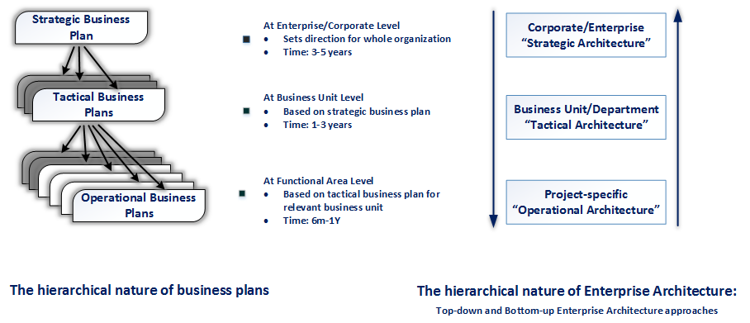
Enterprise Architecture (EA) Architecture Practice Scope

Slide 13
EA-ARCH: Activities / Progress
Fire-Fighting / URGENT Needs
Policy 73 IP Disclosure Form
SugarCRM for RO MUR
Strategic Innovations
WatCACE Researcher Portal
Procurement / Re-implementation
Office of Research: Research Portal
Finance + HR
Integration Analysis

Slide 14
EA-ARCH: Activities / Progress
Develop EA “Manual” to describe tools
Diagrams
Catalogs
Matricies
Support ‘List’ Processes
Project
Application Risk
Processes

Slide 15
Enterprise Data Management (IST-EA-EIM-EDM)
Roadmap + Scope

Slide 16
Enterprise Data Management (EDM) Roadmap
Stage 1
(#42) Cognos On-Going Platform & Project Work
Stage 2
(#44) Enterprise Data Management Development
Stage 3
(#45) Towards Enterprise Data Management Practice
Develop API creation capability.
Continue and complete migrations (Lib, Fin, RO, GSO, HR).
Production Cognos and Data Warehousing for Waterloo Users
Experiment with Microsoft Business Intelligence
Get all source data into common warehousing. Support long-term analytics.
Improve APIs, reporting, security, and reduce overall number of copies of data at rest.

Slide 17
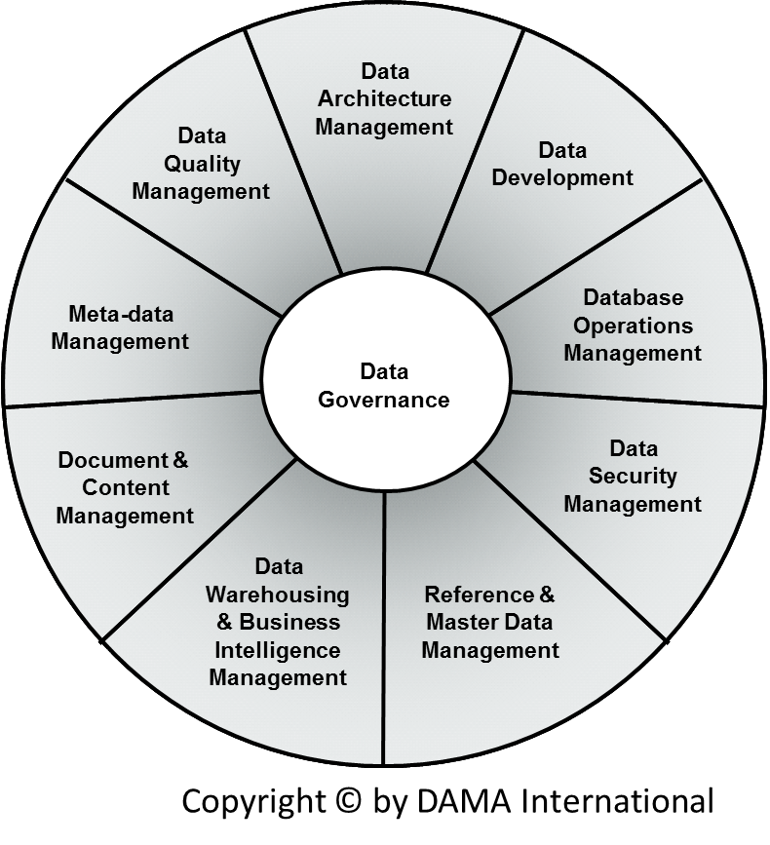


Enterprise Data Management (EDM) Scope
http://dama.org
http://edmcouncil.org

Slide 18
EA-EIM-EDM: Activities / Progress
Cognos 7 -> 10:
Library (in testing)
HR (complete)
Safety Office (in testing)
Centre for Teaching Excellence (CTE) (in development)
D2L Cube Creation (in development)
Cognos 7 -> MSBI
GSO (complete)

Slide 19
EA-EIM-EDM: Activities / Progress
Data Warehousing / Analytics Support
IAP MS SQL and MSBI upgrades
CTE data warehousing / analytics design
OAT Applicant data
API Creation
Velocity
Maturity Development
Application of DCAM to Waterloo

Slide 20
Enterprise Content Management (IST-EA-EIM-ECM)
Roadmap

Slide 21
Enterprise Content Management (ECM) Roadmap
Stage 1
(#46) OnBase On-Going Platform & Project Work
Stage 2
(#48) Enterprise Content Management Development
Stage 3
(#49) Towards Enterprise Content Management Practice
Improve Integration and Interfaces w/ SSO + ERP system improvements.
Improvements for existing customers (RO, GSO) and new customers.
Maintenance of OnBase. Upgrades and required system changes.
Explore Integration / Connection to other Content Systems (Sharepoint, WCMS)
Clarify Information Governance Practices at AIGC. Build ECM Working Group.
Establish global standards and procedures with University Records Manager.

Slide 22
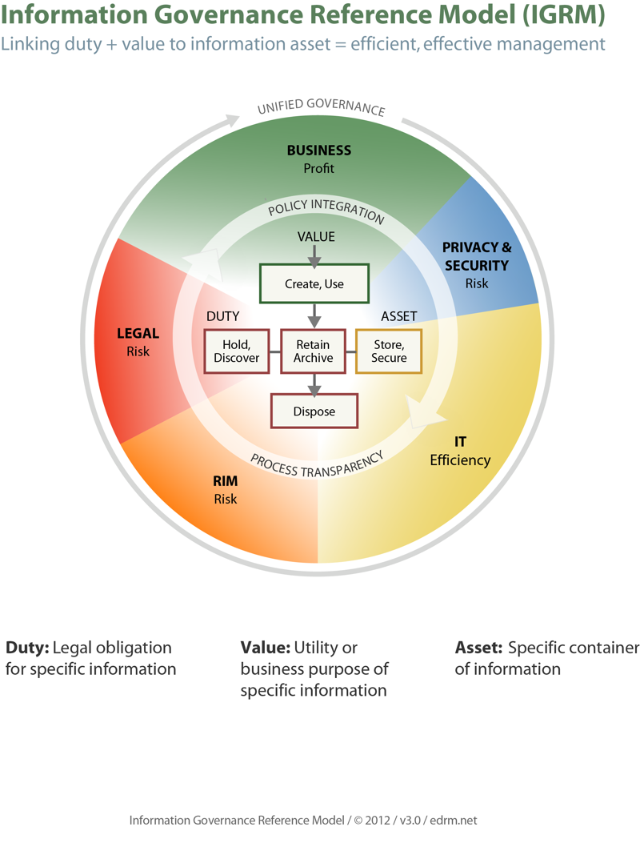
Enterprise Content Management (ECM) Scope
http://dama.org
http://edrm.net

Slide 23
EA-EIM-ECM: Activities / Progress
OnBase Platform Upgrade
Completed in Summer 2015
OnBase Improvements
Contracts + Procurement
GSO
Registrar’s Office
Central Stores Digital Imaging Roadmap

