Slide 1
Enterprise Architecture (EA) at Waterloo: What's it all about?
Colin Bell – Director, Enterprise Architecture
Maher Shinouda – Strategic Architect
Sarah Vela – Business / Information Architect
December 7, 2015

Slide 2
Outline
Who → Enterprise Architecture (EA) Group
Why → EA Value Proposition
What → the “Enterprise Architecture”
How → EA Process and Maturity Model
Where → are we today
When → can you get involved

Slide 3
WHO? Enterprise Architecture Group

Slide 4
Who – The enterprise architecture group
Mandate
The mandate of this group is to develop the enterprise architecture strategy, framework and program for the university that addresses both current and future information management and information technology needs.

Slide 5
Who – The enterprise architecture group
Mandate
The mandate of this group is to develop the enterprise architecture strategy, framework and program for the university that addresses both current and future information management and information technology needs.

Slide 6
Who – The enterprise architecture group
Responsibilities
Integration Development (e.g., web, mobile, other)
Strategic Innovations
Information Management
Usability
Enterprise Architecture

Slide 7
Who – The enterprise architecture group
Director, EA
Colin Bell
Architecture Practice
Business and Information
Strategic
EIM: Information Management
EDM: Data Management
ECM: Content Management
Sarah Vela
Maher Shinouda
John Kemp (Cognos)
Gina Reichard (OnBase)

Slide 8
WHY? Enterprise Architecture value proposition
Notes:
We want to begin by introducing Enterprise Architecture through a strawdog story. The ideas and problems introduced in this story are meant to be representative of the problems an enterprise faces when widespread change is occurring simultaneously across multiple areas of the business.
DISCLAIMER: All characters appearing in this work are fictitious. Any resemblance to real persons, living or dead, is purely coincidental.
Let’s start with an enterprise called ACME Academy. ACME has been operating for a number of years and has two core missions: training coyotes and developing innovative roadrunner counter measures. To fulfill these missions, ACME maintains a number business units that support their core missions.
To fulfill their core missions, ACME must:
- Find high quality coyotes and convince them to train with ACME.
- Deliver top-notch training facilities and services to keep coyotes at ACME.
- Find the best and the brightest roadrunner specialists and convince them to join ACME’s cause.
- Provide a series of support services and facilities to allow these specialists to focus on their work.
In support of these core missions, ACME must maintain or acquire business units to:
- Manage finances.
- Support the coyotes in training.
- Support the individuals and teams that work on roadrunner innovations.
- Support the individuals that manage finances, support the coyotes, and support the innovators.
- Keep records and information about the activities of ACME Incorporated.
- Maintain a physical space for everyone to work (the ACME Incorporated campus).
- Create anvils, magic ‘tunnel’ paint, and other “tools of the trade.”
- Market, advertise, and seek support for the ACME mission.
- Plan how ACME will respond to changes in the world around it.
- Manage / Administer the whole orchestra of individuals that make up ACME.
- NOTE: This list is not complete.
As ACME is a modern enterprise, business units require technology to fulfill their respective mandates.
This provides the basis for our story. With this in mind, we will discuss a common challenge experienced by every modern enterprise.
In an effort to better serve the core missions of the enterprise, business units are constantly on the look out to improve themselves. They want to be efficient and effective to better support the core mission of the enterprise. To do this, changes to business processes and underlying technology are required.
A business unit has individuals working with technology the way it works today. This is the referred to as the ‘current state’. They have some combination of technologies that support their operations. Often times other units of the enterprise rely on these technologies for something local to them. Work flows from one business unit to another through some combination of process, people, and technology. Sometimes that technology is paper and pen. More often than not, as it is 2015, that technology is some combination of IT systems.
One day a business unit identifies some problem with their current technology. For this example we will look at the anvil production line in the ACME Academy ‘Anvil Department.’ The Anvil Department has a production management system that keeps track of how many anvils are needed, when they are needed, and how much iron ore is needed to make them. They realize that the tool they’ve been using for years fails to capture and validate some key information on the way into the production system. They learned this the hard way after creating and delivering 200 anvils when the requestor only needed 2. They’ve always known there was a problem with validation but they always cautioned users to be careful. This one slipped through and, while it seems like a simple fix, the system vendor has moved on to a new version and doesn’t support changing the system they are running on.
ACME Anvil has a decision to make. How do they fix the problem? As the problem is with the old production management system, they immediate think “let’s buy a new one.” ACME’s anvil department then sets off on a journey to buy a new production management system. They issue an RFP that describes what their old system does with a special focus on that pesky capture and validation problem– they know their requirements “we need our old system plus these features.”
When responses come in ACME is faced with a first question: Cloud or On-Premise. They decide on Cloud because it seems easy. It won’t require them to worry about the ACME IT department (which always seems to be a bottleneck). They can sign on the dotted line and get a new production management system. They’ve made a decision to start a transition– they have an ‘intermediate state’ defined.
Then implementation starts. As this is a cloud solution it is up and running quickly. They get a login screen, create some accounts, and they are off to the races. Anvils are being produced and there will never be a mistake again. Champagne for all!
Three weeks go by when the anvil department receives a call. The ACME finance department is asking why the anvil department hasn’t validated their monthly expenses in the finance system. After some digging they realize there was a process in the old system that ran a report and put the output on a network share. The people involved thought the new system dealt with that so they didn’t mention it. Turns out that old report does not exist in the new system. They scrape the bottom of their budget (running a little over) and contract the cloud provider to make the report for them. Close call but all is resolved. Back to anvil production.
Then another couple weeks go by and they receive a call from the ACME police saying a former employee had been stopped with a car full of anvils. They look at the production management system and realize that person had been requesting anvils for weeks. The anvil department phones HR to ask why they weren’t notified of this person’s departure. The HR department tells them they don’t notify everyone, they update the central authentication system. A couple more phone calls and the anvil department realizes they need IT to help configure the central authentication system for use in their cloud solution. Luckily the protocol is supported by the cloud solution so anvil schedules some ‘emergency’ work with the ACME IT department.
Next there is a phone call from someone in the innovation department. They say they’ve figured out a brilliant new alloy for the anvils and they’d like to start asking for alloy anvils instead of iron. The anvil department looks at the tool and realizes there is no way to set ‘alloy’ as an option. They tell the requestor to just use the ‘notes’ field in the submission form. When they start looking through the production management system they realize that they can only track ordering of iron ore anvils. To track the alloy instead, they need to manually read all requests and see if they want alloy and order the alloy separate from the iron ore.
Then the HR department calls. The auditors have reviewed the enterprise operations and ACME has had major problems with anvil related injuries. They ask the anvil department to initiate a training program to keep people from receiving anvils without the necessary training. They realize that their system does not support this and, so, they have to go shopping for a new anvil training system. They pay a new vendor and the original cloud vendor to build a nice slick integrated anvil production management system with safety interlocks.
Everything was good… for a time.
Then the finance department called again. They’ve got a new system coming. The anvil department is told it will need to find money in its budget to upgrade the custom integration with the old system to support the new system.
Not long after that, the HR department is calling again. They’ve got a new system coming too. They will need the anvil department to update their training system and integration to support the new system.
No sooner than the HR department has hung up, the ACME police calling again. There is another person with anvils that should not have them. They discover an order number with the anvils that they trace back to a person named ‘closetsystem.’ They determine that one of employees in the innovation department has ‘innovated’ around a problem– they’ve built an automatic system locally that orders anvils based on a camera taking pictures of a storage closet.

Slide 9
Why – EA Value Proposition

Slide 10
Why – EA Value Proposition

Slide 11
Why – EA Value Proposition

Slide 12
Why – EA Value Proposition

Slide 13
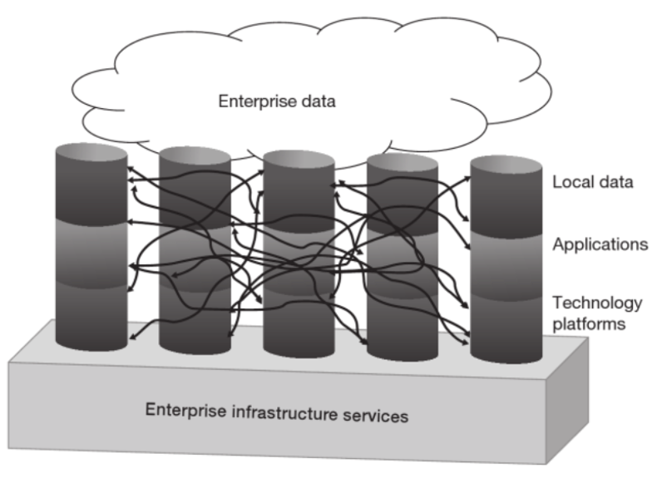
Why – EA Value Proposition
P. Weill and J.W. Ross. IT Savvy: What Top Executives Must Know to Go from Pain to Gain.
Harvard Business Press, 2009.

Slide 14
Why – EA Value Proposition
“Spaghetti Architecture”
Each unit is trying to optimize locally.
Many unknown interdependencies are created.
Increased costs (to maintain)
Increased risks (to change)
Local optima artificially constrain the search for global optima.
This limits the whole enterprise’s ability to improve.

Slide 15
Why – EA Value Proposition
This is where Enterprise Architecture (EA) helps.
Divide and Conquer

Slide 16
Enterprise Architecture (EA)
Notes:
IST-EA’s Simplified Definitions
=========================
Business Architecture: Vision, strategy, goals, objectives. It covers business units, functions, services, processes, and capabilities.
Information Architecture: Describes how enterprise information is organized and accessed.
Applications Architecture: Describes applications’ structures, capabilities, and their interrelations.
Technology Architecture: Describes the hardware and software infrastructure that support the applications and their interactions.

Slide 17
Why – EA Value Proposition
Objective of Enterprise Architecture (EA):
Document the whole enterprise to capture Business need through to Technology.
Support planning and acquisition (buy or build) of enterprise components that are:
Robust
Flexible
Reusable
Efficient (ordered)
Effective (capable)

Slide 18
WHAT? The “Enterprise Architecture”

Slide 19
What IS Enterprise Architecture?
Multiple definitions and approaches exist.
Enterprises must reach consensus about what EA is to them (often captured in an “Enterprise Architecture Framework”)
Some ‘big’ EAFs exist: Zachman, TOGAF, FEAF
Many enterprises build hybrids to fit their needs.
What is the “University of Waterloo Enterprise Architecture Framework” ?

Slide 20
Enterprise Architecture definitions
Gartner
Federation of Enterprise Architecture Professional Organizations (FEAPO)
Maher’s definition in IST-EA’s 3-year Plan
Notes:
Gartner(http://www.gartner.com/it-glossary/enterprise-architecture-ea/): Enterprise architecture (EA) is a discipline for proactively and holistically leading enterprise responses to disruptive forces by identifying and analyzing the execution of change toward desired business vision and outcomes. EA delivers value by presenting business and IT leaders with signature-ready recommendations for adjusting policies and projects to achieve target business outcomes that capitalize on relevant business disruptions.
Wikipedia(https://en.wikipedia.org/wiki/Enterprise_architecture): Enterprise architecture (EA) is "a well-defined practice for conducting enterprise analysis, design, planning, and implementation, using a holistic approach at all times, for the successful development and execution of strategy. Enterprise architecture applies architecture principles and practices to guide organizations through the business, information, process, and technology changes necessary to execute their strategies. These practices utilize the various aspects of an enterprise to identify, motivate, and achieve these changes.".^{[1]}
=> BASED ON: Federation of Enterprise Architecture Professional Organizations: FEAPO - http://feapo.org/wp-content/uploads/2013/11/Common-Perspectives-on-Enterprise-Architecture-v15.pdf
IST-EA’s 3-year plan(): Enterprise Architecture (EA) is the overall representation of an enterprise’s business and information technology. EA plays a key role in formulating and implementing the strategic plans of an enterprise. It provides architectural principles, standards and guidelines to inform the procurement, development and deployment of an integrated technology ecosystem. The ultimate goal of EA is to meet the business needs within the enterprise in an efficient, sustainable, agile and adaptable manner.

Slide 21
Enterprise Architecture definitions
Current framework definition:
Whitehouse Common Approach to Federal Enterprise Architecture:
“An Enterprise Architecture is a strategic information asset base, which defines the mission; the information necessary to perform the mission, the technologies necessary to perform the mission, and the transitional processes for implementing new technologies in response to changing mission needs. An EA includes a baseline architecture, a target architecture, and a sequencing plan.”
Notes:
Whitehouse (https://www.whitehouse.gov/sites/default/files/omb/assets/egov_docs/common_approach_to_federal_ea.pdf): Enterprise Architecture means a strategic information asset base, which defines the mission; the information necessary to perform the mission, the technologies necessary to perform the mission, and the transitional processes for implementing new technologies in response to changing mission needs; and includes a baseline architecture, a target architecture, and a sequencing plan.

Slide 22
Enterprise Architecture (EA) Domains
Notes:
IST-EA’s Simplified Definitions
=========================
Business Architecture: Vision, strategy, goals, objectives. It covers business units, functions, services, processes, and capabilities.
Information Architecture: Describes how enterprise information is organized and accessed.
Applications Architecture: Describes applications’ structures, capabilities, and their interrelations.
Technology Architecture: Describes the hardware and software infrastructure that support the applications and their interactions.

Slide 23
Enterprise Architecture (EA) Domains
Business Architecture (BA) defines the business strategy, organization, business capabilities and key business processes which realize those business capabilities
Information Architecture (IA) describes the fundamental organization of the data assets and data management resources that support an enterprise’s business processes and enabling application systems
SOURCE: California Enterprise Architecture Framework 2.0
Notes:
IST-EA’s Simplified Definitions
=========================
Business Architecture: Vision, strategy, goals, objectives. It covers business units, functions, services, processes, and capabilities.
Information Architecture: Describes how enterprise information is organized and accessed.
Applications Architecture: Describes applications’ structures, capabilities, and their interrelations.
Technology Architecture: Describes the hardware and software infrastructure that support the applications and their interactions.

Slide 24
Enterprise Architecture (EA) Domains
Applications Architecture (AA) describes the structure and behavior of the major kinds of application systems, their key components, their interactions, and their relationships to the core business processes
Technology Architecture (TA) describes the logical software and hardware capabilities that are required to support the deployment of business, information, and application services. This includes IT infrastructure, middleware, networks, communications, processing, and standards
SOURCE: California Enterprise Architecture Framework 2.0
Notes:
IST-EA’s Simplified Definitions
=========================
Business Architecture: Vision, strategy, goals, objectives. It covers business units, functions, services, processes, and capabilities.
Information Architecture: Describes how enterprise information is organized and accessed.
Applications Architecture: Describes applications’ structures, capabilities, and their interrelations.
Technology Architecture: Describes the hardware and software infrastructure that support the applications and their interactions.

Slide 25
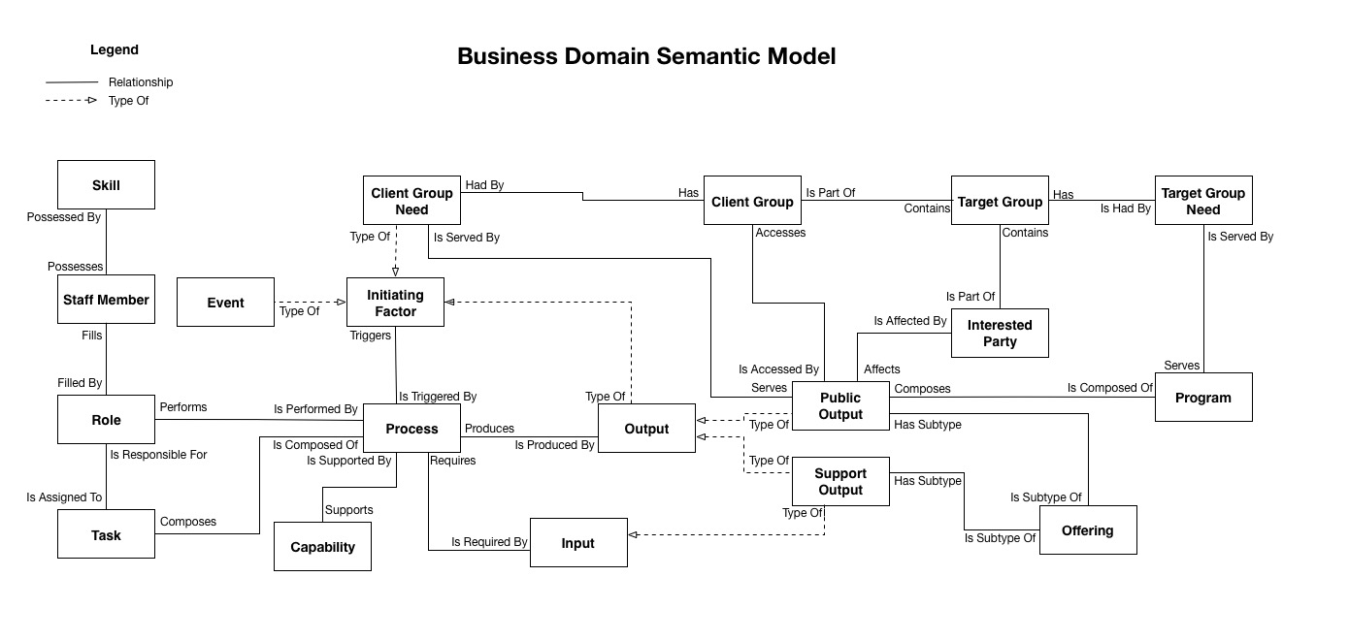
Business Architecture

Slide 26
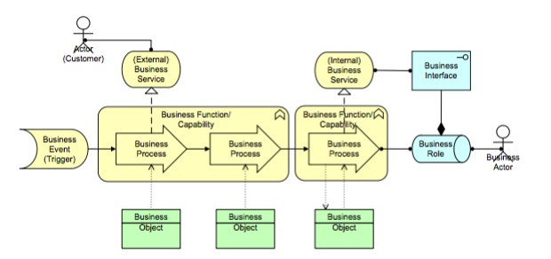
Business Architecture
SOURCE: California Enterprise Architecture Framework 2.0

Slide 27
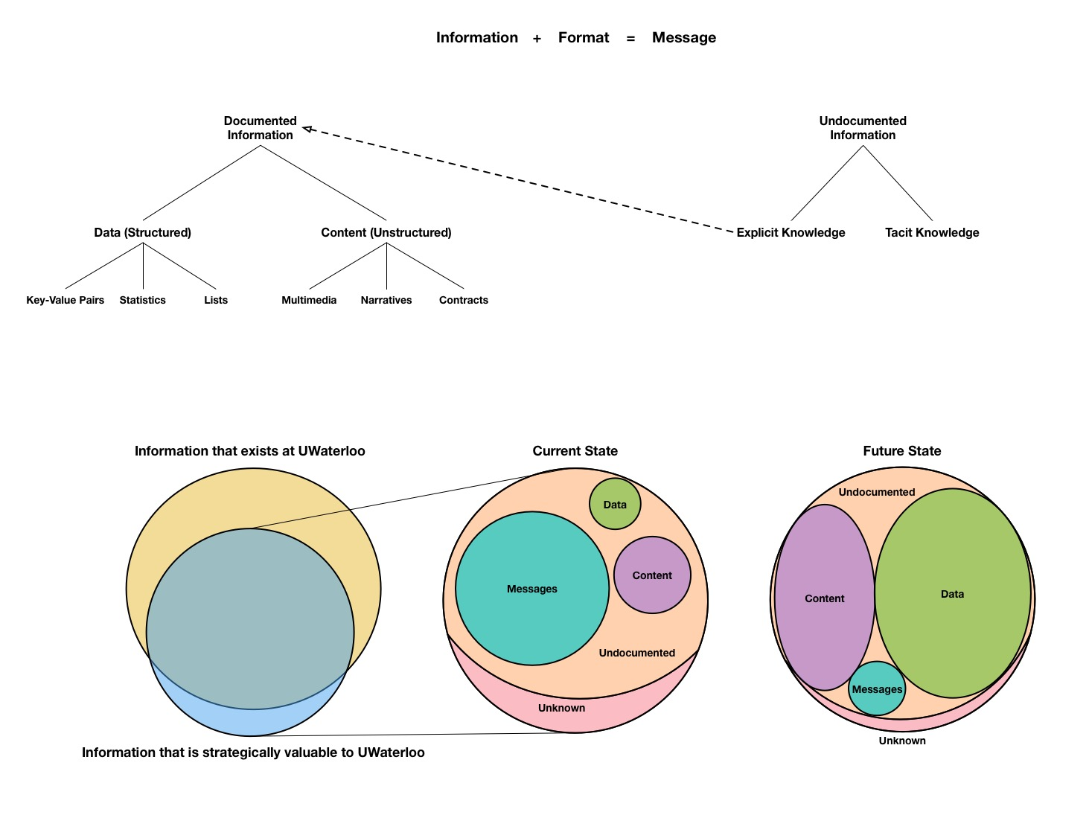
Information Architecture

Slide 28
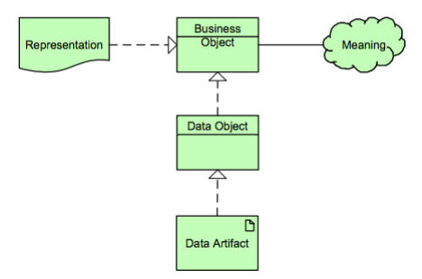
Information Architecture
SOURCE: California Enterprise Architecture Framework 2.0

Slide 29
Applications Architecture

Slide 30
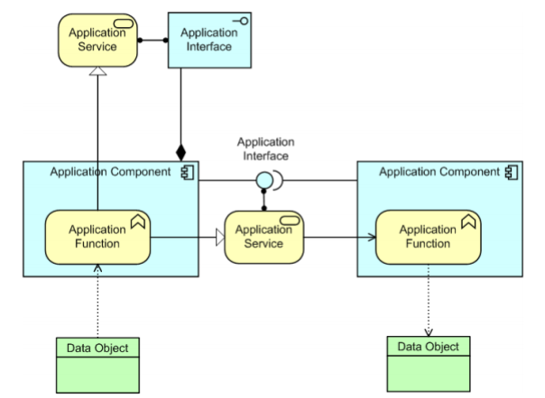
Applications Architecture
SOURCE: California Enterprise Architecture Framework 2.0

Slide 31
Technology Architecture

Slide 32
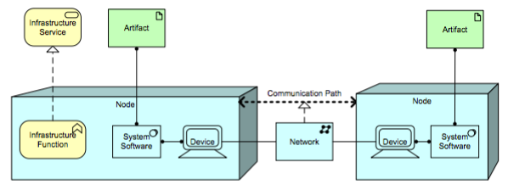
Technology Architecture
SOURCE: California Enterprise Architecture Framework 2.0

Slide 33
Waterloo’s EA– SIMPLE Domain Hierarchy Model
Notes:
IST-EA’s Simplified Definitions
=========================
Business Architecture: Vision, strategy, goals, objectives. It covers business units, functions, services, processes, and capabilities.
Information Architecture: Describes how enterprise information is organized and accessed.
Applications Architecture: Describes applications’ structures, capabilities, and their interrelations.
Technology Architecture: Describes the hardware and software infrastructure that support the applications and their interactions.
Security Architecture: Describes all aspects related to applications and data security, along with a set of guidelines and procedures for building secure environments.

Slide 34
Waterloo’s EA– SIMPLE Domain Hierarchy MODEL
It is not that “simple.”
No single viewpoint works for all needs.
Many architecture documents (artifacts) can benefit the enterprise independent of documentation from other domains.
EA is not a ‘stack’ of work. We need another view.

Slide 35
Waterloo’s EA– SIMPLE Domain Banded MODEL

Slide 36
Waterloo’s EA– DOMAIN INTERCONNECTED MODEL

Slide 37
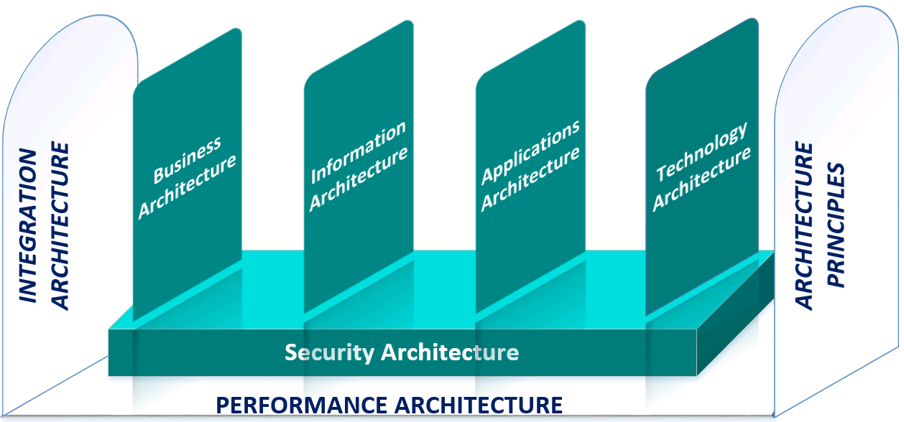
Waterloo’s EA- Governance Unpacked
Notes:
Governance unpacks to be:
- Integration Architecture: A business-centric integration architecture approach that provides the necessary standards and guidelines to connect disparate data, processes, systems, services, expertise, and knowledge together to drive business towards achieving its goals.
Performance Architecture: Performance architecture is the mean to evaluate the progress of the enterprise strategic goals and objectives. It defines metrics and measures to evaluate business and IT processes and their outcome and captures systems’ quality attributes such as usability, reliability, scalability, interoperability, and maintainability.
Architecture Principles: Guide IT decision-making and activities and form the foundation of the University IT architecture standards, and guidelines.

Slide 38
HOW? EA Process and Maturity Model

Slide 39
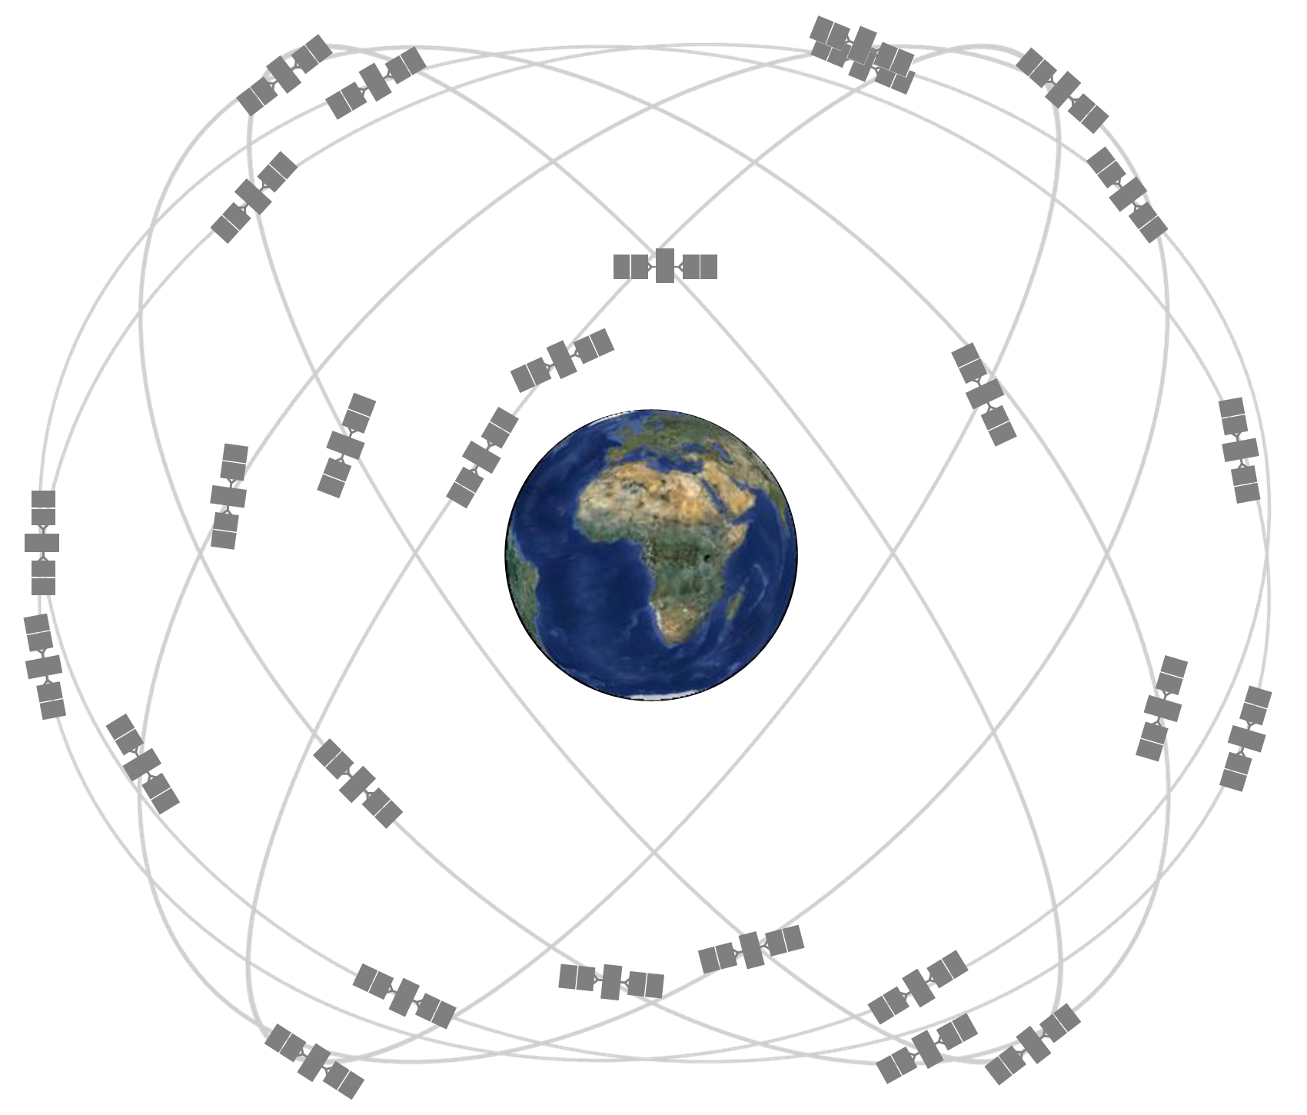
Enterprise Architecture Process – GPS Analogy
SOURCE: http://www.gps.gov/

Slide 40
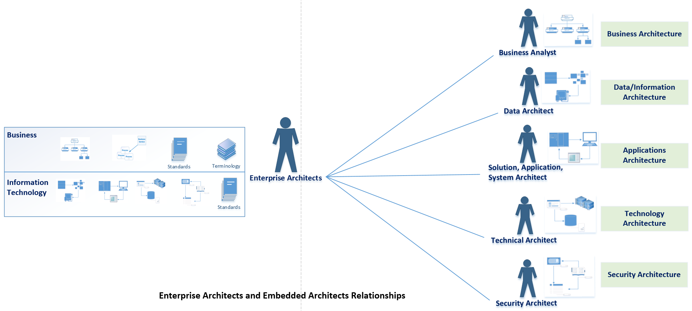
Enterprise Architecture Process

Slide 41
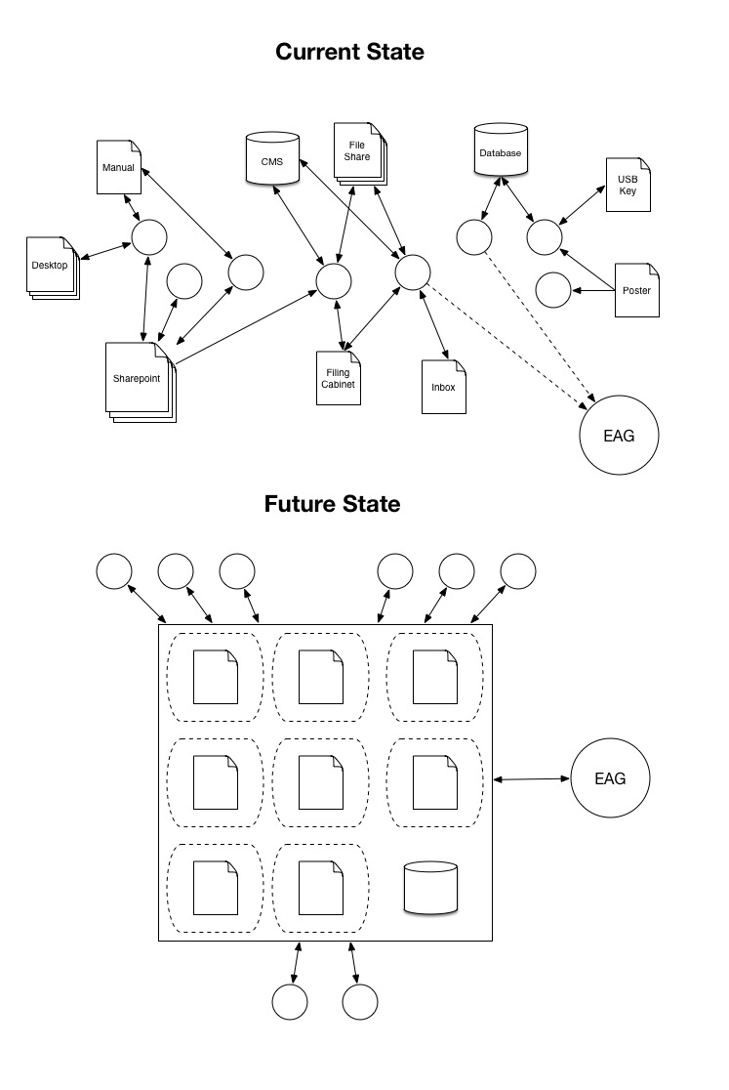
EA Artifact Repository – Current state

Slide 42
EA Artifact Repository – Proposed Future state

Slide 43
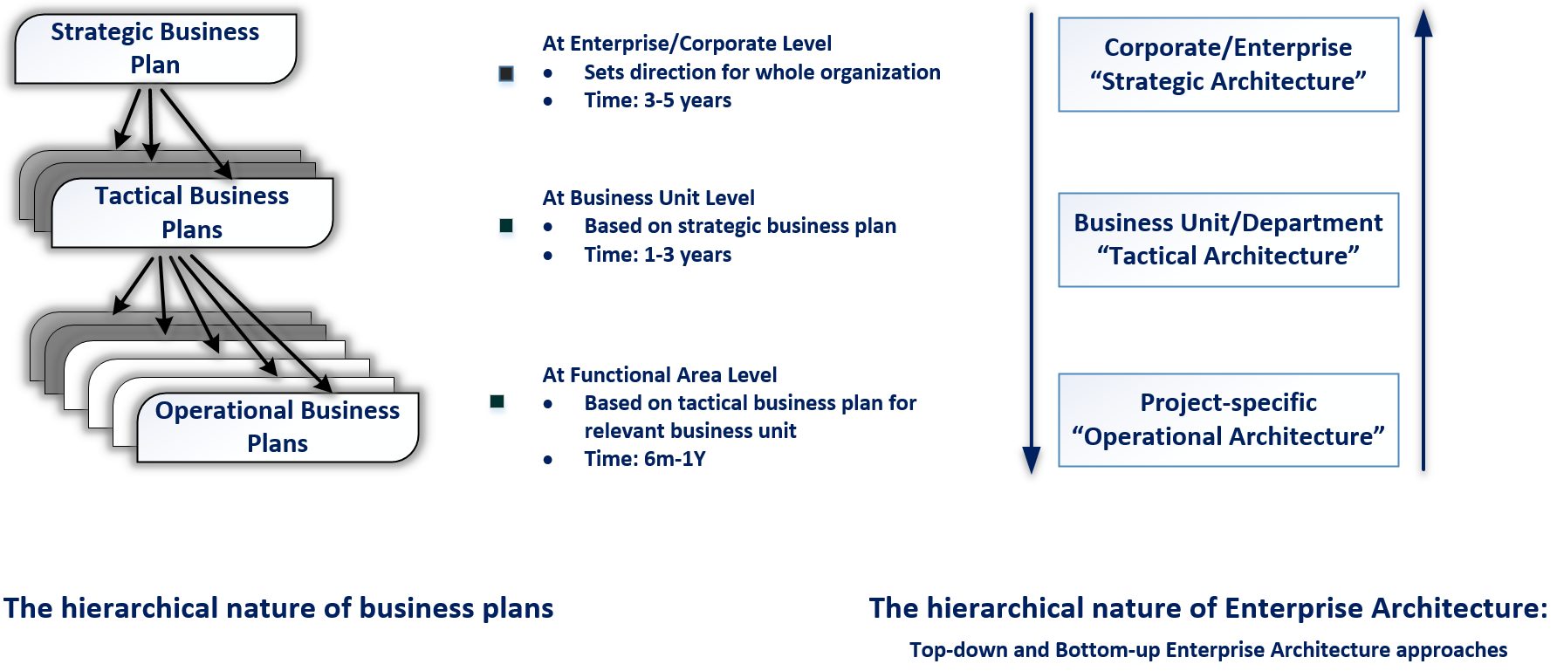
Enterprise Architecture Process

Slide 44
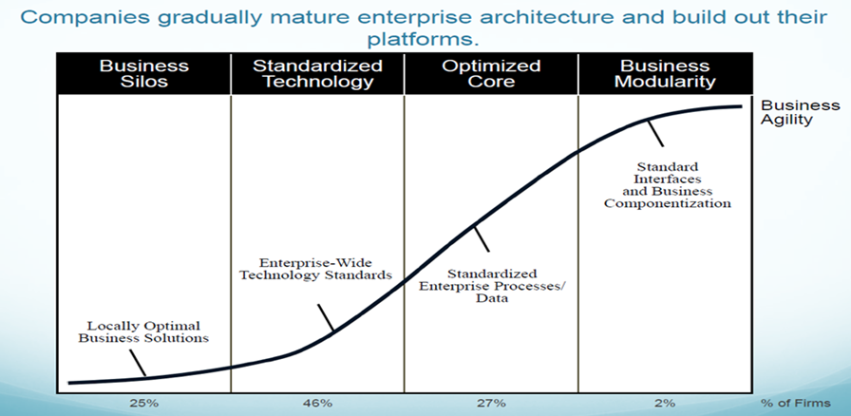
Enterprise Architecture Maturity Model
Source: Enterprise Architecture as Strategy: Creating Foundation for Business Execution,
J. Ross, P Well, D. Robertson, HBS Press, 2006.

Slide 45
WHERE? Are we today

Slide 46
Along Maturity Model- Just starting.
Less than 1 year with full architecture team.
Foundational research amassed.
Preparing release of University of Waterloo Enterprise Architecture Framework.
Guide will provide the body of the University of Waterloo Enterprise Architecture Framework. Roles and responsibilities, definitions, etc.
Manual will provide easy-to-follow guidance for EA users and contributors.
Book will provide background research and lessons learned guidance to others attempting to develop a hybrid Enterprise Architecture Framework in their own enterprises.

Slide 47
Along Maturity Model- Building required skills.
Developing Enterprise Information Management (EIM) capability to augment EA.
Enterprise Data Management (EDM)
Business Intelligence
Data Warehousing
Data Definitions
Data Access
Enterprise Content Management (ECM)
Document and Records Management
Standards and Procedures

Slide 48
Project Involvement – Architecture
Finance Implementation
HR Re-Implementation
WCMS ‘full-stack’ review
Business Architecture Pilot

Slide 49
Project Involvement – Strategic Innovations
WatCACE Research Portal
Policy 73 IP Metrics
JIRA / Confluence Experimentation

Slide 50
Project Involvement – INTEGRATIONS
HR / Finance Integration Normalization
Developing API Capabilities
Warehousing Student Data (QUEST)

Slide 51
When? Can you get involved

Slide 52
Get involved NOW!
Many of you are creating architecture artifacts today.
The EA team needs to know about your work to begin understanding how to leverage it towards a ‘strategic information asset base.’
We are archeologists, ethnographers, and documenters. You are the architects!

Slide 53
Where do you have expertise?
Notes:
IST-EA’s Simplified Definitions
=========================
Business Architecture: Vision, strategy, goals, objectives. It covers business units, functions, services, processes, and capabilities.
Information Architecture: Describes how enterprise information is organized and accessed.
Applications Architecture: Describes applications’ structures, capabilities, and their interrelations.
Technology Architecture: Describes the hardware and software infrastructure that support the applications and their interactions.

Slide 54
We are ready when you are!
Website:
https://uwaterloo.ca/information-systems-technology/about/organizational-structure/enterprise-architecture-ea
Links to framework documentation will be released here.
Contact:
Direct email to ist-ea@uwaterloo.ca

Slide 55
Contact the University of Waterloo Enterprise Architecture Group
@
ist-ea@uwaterloo.ca
Notes:
To add a photo to this slide, click the Picture icon in the content area (first column of icons, second row). Navigate to the photo you would like to insert. PowerPoint will auto-resize the photo to fit the area. If you are unhappy with the results, you can either:
Manually resize your photo to 6.4” high x 10” wide using an image editor. Then, insert it via Home>Insert>Picture.
Insert your picture as-is via Home>Insert>Picture. Then, select your photo and choose Format. Resize and crop your photo using the editing tools in PowerPoint.

