Slide 1
Data Management at the University of Waterloo
Colin Bell
Director, Enterprise Architecture
University of Waterloo
cpbell@uwaterloo.ca
May 10, 2016
Presented at the 2016 Saskatchewan Connections Conference

Slide 2
Agenda
Legislation
IPC Design Principles
Data Management Principles
Data Management at Waterloo

Slide 3
Data Management in Ontario Higher Education
The Office of the Information and Privacy Commissioner (IPC) is responsible for ensuring compliance with Ontario’s access and privacy laws. https://www.ipc.on.ca
Freedom of Information and Protection of Privacy Act (FIPPA), R.S.O. 1990, c. F.31
http://bit.ly/1FmppGD

Slide 4
Privacy 101
Information Privacy is the right of an individual to exercise control over the collection, use, disclosure and retention of his or her personal information, including his or her student records.
It is a legal matter.
It is not an IT matter.
Privacy ≠ Secrecy

Slide 5
Privacy Principles
1 | Accountability
2 | Identifying Purposes
3 | Consent
4 | Limiting Collection
5 | Limiting Use, Disclosure and Retention
6 | Accuracy
7 | Safeguards
8 | Openness
9 | Individual Access
10 | Challenging Compliance

Slide 6
No Privacy without Security
Information Security - CIA Triad:
Confidentiality - restricted access is enforced and maintained as expected.
Integrity - assurance information can be trusted.
Availability - access is possible when required.
C
Info
Sec
I
A

Slide 7

Access 101
Underlying Concept:
Citizens need information to take part in democratic process.
Information should be shared widely to those who need access (while respecting privacy and confidentiality).
Individual Privacy is a core value to the public.

Slide 8
Access 101
(cont’d)
Through Freedom of Information (FOI) Requests, the public has a right to access records in an institution’s custody or control unless:
an exemption applies; or
it is determined that the request is frivolous or vexatious; or
the information is excluded from Legislation.

Slide 9
Access 101
(cont’d)
Must sever and release non-exempt portions and provide reasons for exemption.
Directory of Records required to list all available records and personal information banks.
All decisions made can be reviewed by the Information & Privacy Commissioner (IPC).

Slide 10
Routine Disclosure
“In the spirit of the Act, unless there is a statutory requirement or reason not to release the information, routine disclosure should become the norm.”
Information/Privacy Commissioner Guidelines on Routine Disclosure

Slide 11
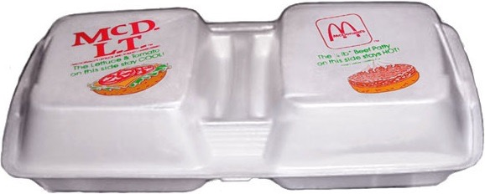
Hot Side Hot
Cool Side Crisp
McDLT

Slide 12


Hot Side Hot
Cool Side Crisp
Confidential
Public
McDLT

Slide 13
IPC: Privacy by Design (PbD)
Proactive not Reactive; Preventative not Remedial
Privacy as the Default Setting
Privacy Embedded into Design
Full Functionality — Positive-Sum, not Zero-Sum
End-to-End Security — Full Lifecycle Protection
Visibility and Transparency — Keep it Open
Respect for User Privacy — Keep it User-Centric
http://bit.ly/2cYsvwP

Slide 14
IPC: Access by Design (AbD)
Proactive, not Reactive
Access Embedded into Design
Openness and Transparency = Accountability
Fosters Collaboration
Enhances Efficient Government
Makes Access Truly Accessible
Increases Quality of Information
http://bit.ly/2cDrycI

Slide 15
Summary
We are in control and custody of information.
Some of that information is confidential.
Some of that information is public.
The IPC recommends public information should be subject to routine disclosure.
The IPC provides design principles (PbD, AbD) to guide us as we design business processes and technology.

Slide 16
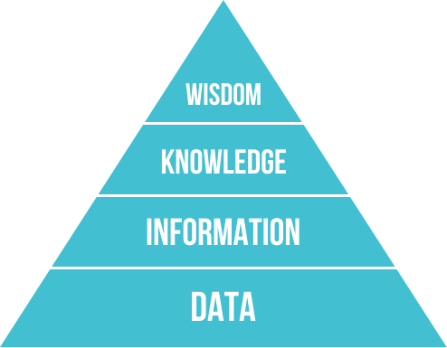
DIKW
Data, Information, Knowledge, Wisdom
Data – Facts without context.
Information – Data “in formation”, data in context.
Knowledge – Information in context. The ability to answer questions based on information; to know how something happens.
Wisdom – Being able to act (based on knowledge) to amplify positive/dampen negative outcomes.
"DIKW Pyramid" by Longlivetheux - Own work. Licensed under CC BY-SA 4.0 via Commons
https://commons.wikimedia.org/wiki/File:DIKW_Pyramid.svg#/media/File:DIKW_Pyramid.svg
http://bit.ly/1M9qaoC

Slide 17
DIKW
Data, Information, Knowledge, Wisdom
Data – 24
Information – Temperature in office: 24°C
Knowledge – The air conditioner should prevent the temperature from rising over 21°C
Wisdom – The air conditioner requires maintenance.
"DIKW Pyramid" by Longlivetheux - Own work. Licensed under CC BY-SA 4.0 via Commons
https://commons.wikimedia.org/wiki/File:DIKW_Pyramid.svg#/media/File:DIKW_Pyramid.svg
http://bit.ly/1M9qaoC

Slide 18
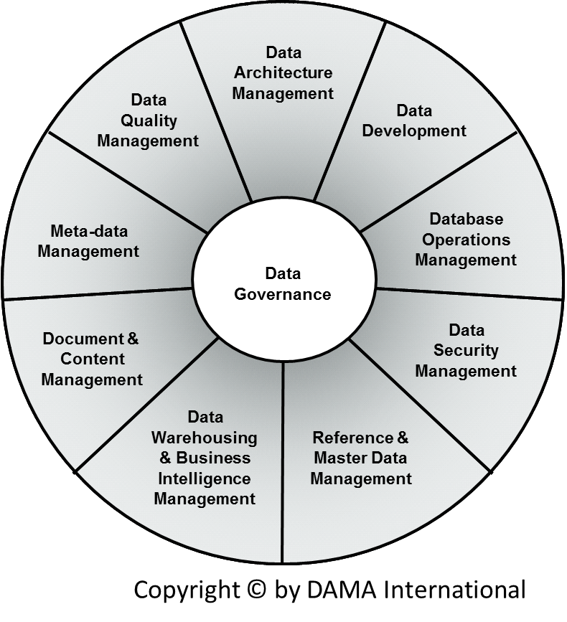
Data Management
DAMA DMBOK
Data Governance
Data Architecture Management
Data Development
Data Operations Management
Data Security Management
Reference and Master Data Management
Data Warehousing and Business Intelligence
Document and Content Management
Meta-data Management
Data Quality Management
http://bit.ly/1KuHRV4

Slide 19
Data Management
Data Governance – planning, supervision and control over data management and use
Data Architecture Management – connection of data to the larger Enterprise Architecture strategy
Data Development – analysis, design, building, testing, deployment and maintenance
Database Operations Management – support for structured physical data assets
Data Security Management – ensuring privacy, confidentiality and appropriate access
http://bit.ly/1KuHRV4

Slide 20
Data Management
Reference & Master Data Management – managing golden versions and replicas
Data Warehousing & Business Intelligence Management – enabling access to decision support data for reporting and analysis
Document & Content Management – storing, protecting, indexing and enabling access to data found in unstructured sources (electronic files and physical records)
Meta Data Management – integrating, controlling and delivering meta data
Data Quality Management – defining, monitoring and improving data quality
http://bit.ly/1KuHRV4

Slide 21
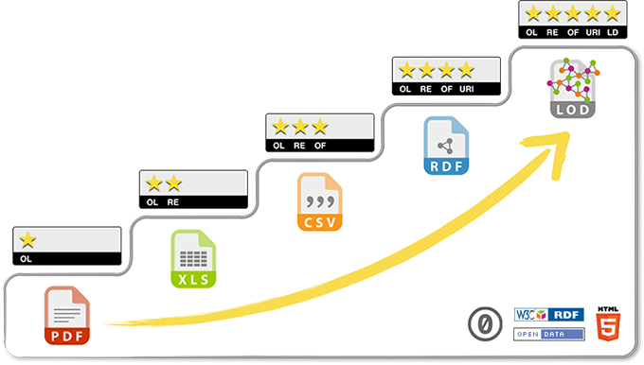
5-Star Data
Tim Berners-Lee Open Data Model
http://5stardata.info/en/

Slide 22
5-Star Data
★ | Available on the web (whatever format) but with an open licence, to be Open Data
★★ | Available as machine-readable structured data (e.g. excel instead of image scan of a table)
★★★ | as (2) plus non-proprietary format (e.g. CSV instead of excel)
★★★★ | All the above plus, Use open standards from W3C (RDF and SPARQL) to identify things, so that people can point at your stuff
★★★★★ | All the above, plus: Link your data to other people’s data to provide context
http://bit.ly/21MR3Zt

Slide 23

Example: Student Portal
https://uwaterloo.ca/student-portal/

Slide 24
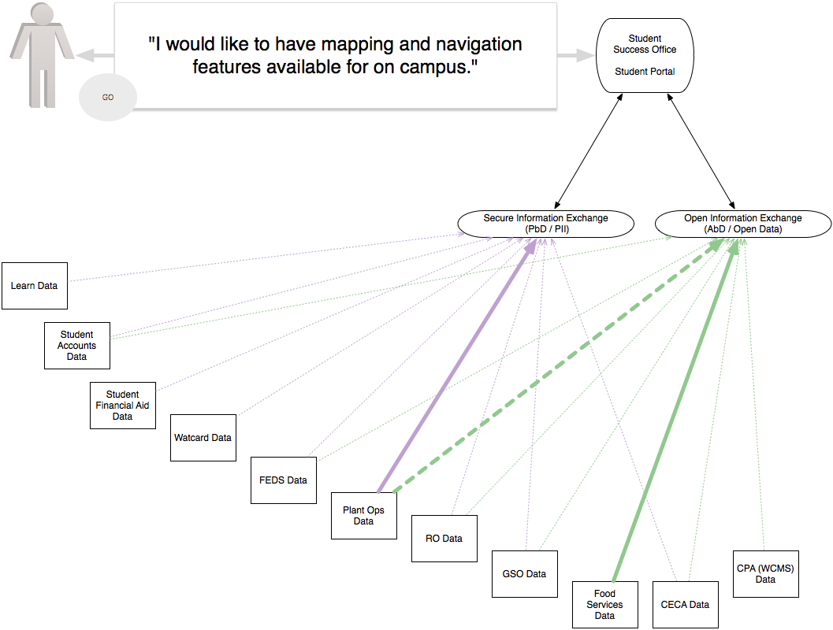

Slide 25
Governance

Slide 26
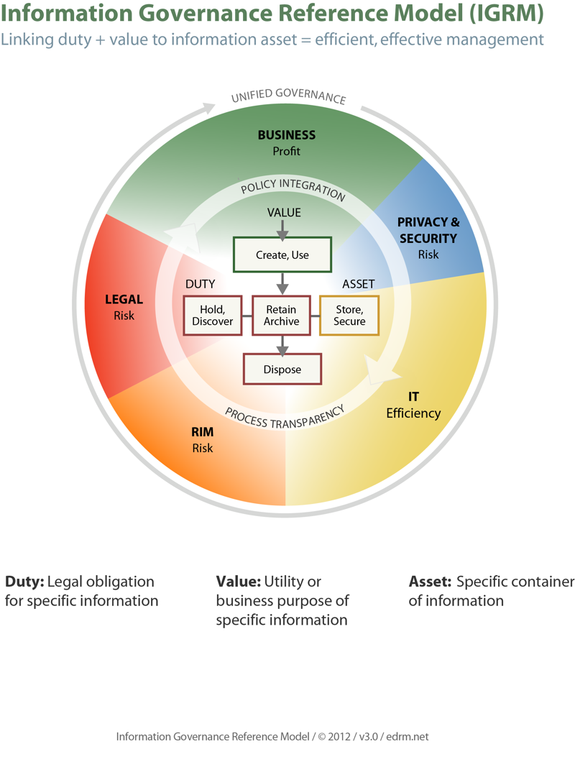
http://bit.ly/1jDqgia

Slide 27
Data Management at Waterloo
Core “Business” Data
Finance
Human Resources
Student Information
Research Information

Slide 28
Data Management at Waterloo
Core “Business” Data
Finance
Human Resources
Student Information
Research Information
Other Data
Research Data
On People
Corporate Partner Owned
Healthcare Data

Slide 29
Data Management at Waterloo
Core “Business” Data
Finance
Human Resources
Student Information
Research Information
Other Data
Research Data
On People
Corporate Partner Owned
Healthcare Data

Slide 30
Data Management at Waterloo
OLTP
Online Transaction
Processing
Business Data
ODS
Operational Data
Stores
Confidential
OLAP
Online Analytical
Processing
ANON
OLAP
Anonymized* OLAP
Public
* http://nvlpubs.nist.gov/nistpubs/ir/2015/NIST.IR.8053.pdf

Slide 31
Data Management at Waterloo
Strengths
Weaknesses
Opportunities
Threats

Slide 32
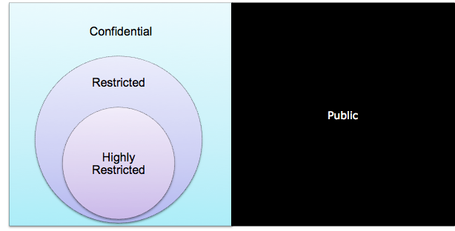
Waterloo Strengths
Policy 8 - Information Security
Roles + Responsibilities (Steward >> Custodian >> User)
Information Security Classifications
https://uwaterloo.ca/secretariat-general-counsel/policies-procedures-guidelines/policy-8

Slide 33
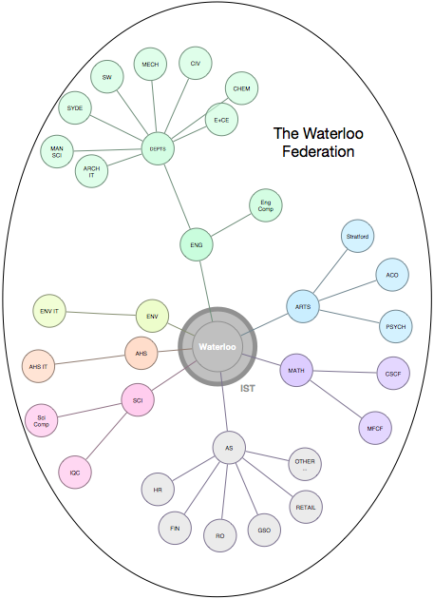
Waterloo Strengths
Decentralized
Federated Organization

Slide 34
Waterloo Strengths
Statement on Information Management
Information is “Vital Asset”
Recognize information’s part in governance, administration, service planning and delivery, and performance management of University.

Slide 35
Waterloo Strengths
Open Data is well established and growing.
https://api.uwaterloo.ca
Shift to Confidential Data is underway.
Moving up the 5-Star Data Model.

Slide 36
Waterloo Weaknesses
Policy 8 - Information Security
AND …
Policy 11 - University Risk Management
Policy 12 - Records Management
Policy 13 - Archives
Policy 19 - Access to and Release of Student Information
Others?

Slide 37
Waterloo Weaknesses
Decentralized
Federated Organization

Slide 38


Waterloo Opportunities
EDM Council (http://edmcouncil.org) Membership
Financial firms really care about their data.
Data Management Capability Assessment Model (DCAM) provides tool to measure state.
Not a perfect fit for Higher Ed, but we are using their tools as a starting point.

Slide 39
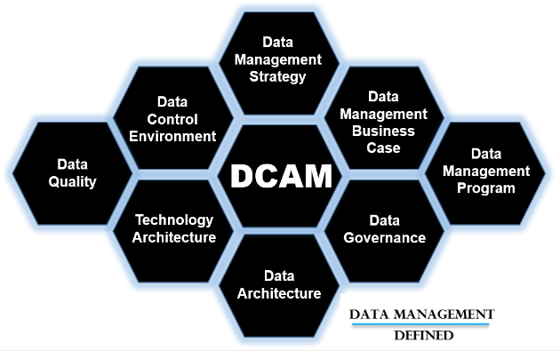
Waterloo Opportunities

Slide 40
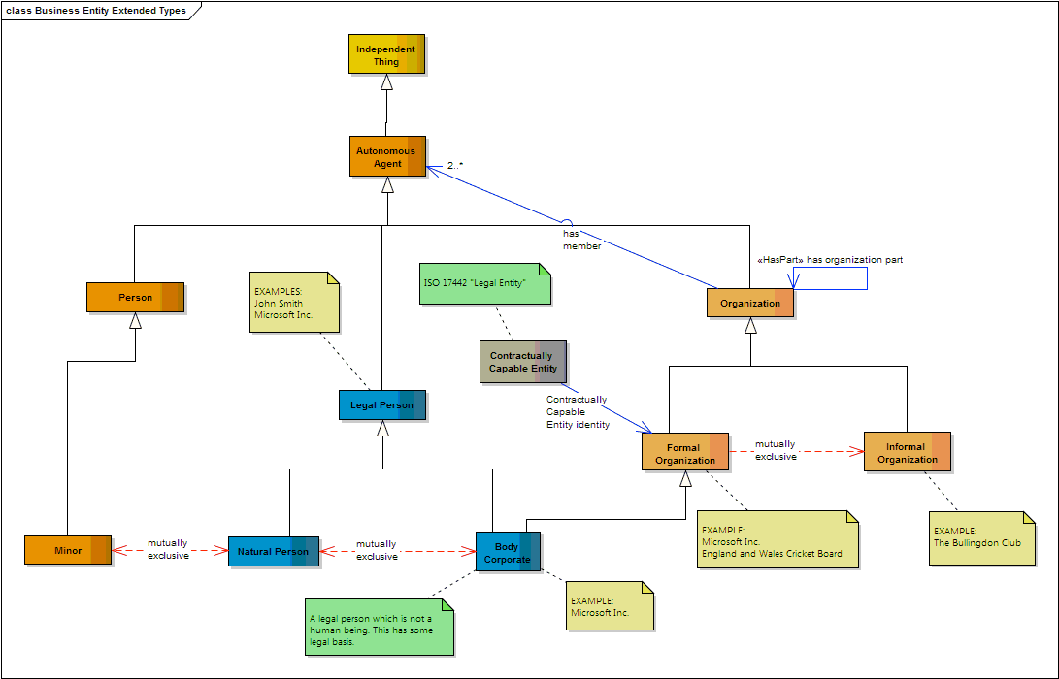

Waterloo Opportunities
Learning from EDM Council (http://edmcouncil.org)
Data meaning, quality, and integration issues are being solved with Web 3.0 “Semantic Web” technologies.
d

Slide 41





Waterloo Opportunities
Innovation in the decentralized areas brings multiple tools onto campus.

Slide 42
Waterloo Threats
Multiple tools in distributed use lead to non-standard results.
NEED: Accepted and shared data warehousing.
NEED: Documented meaning, metadata + taxonomies. (ontology?)
More often than not data is ‘copied’ into local spreadsheets. “It’s easier.”
We need rock solid data to make decisions.

Slide 43
Questions + Answers
Or comments… how do your organizations deal with data management?

Slide 44
Thank you!

Slide 45
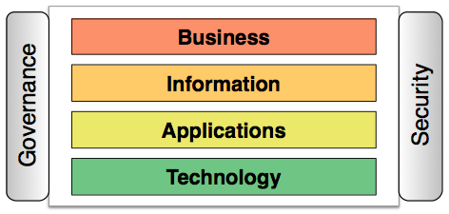
Injury Time:
Enterprise Architecture

