Slide 1

Ontario Connections
May 2014

Slide 2

The Freedom of Information and Protection of Privacy Act (FIPPA) came into effect in 1988
The Municipal Freedom of Information and Protection of Privacy Act (MFIPPA) came into effect in 1991
FIPPA applies to government ministries, colleges, universities, hospitals, and most provincial agencies
MFIPPA applies to municipalities, school boards, public library boards, police services, agencies and commissions

Slide 3


Residents need information to take part in the democratic process
Government is accountable to the public
Information should be shared widely to those who need access (while respecting privacy and confidentiality)
Individual Privacy is a core value to the public

Slide 4


To provide a right of access to government information
Information should be available to the public
Exemptions from access should be necessary, limited and specific and only used when there is a compelling reason
Access decisions may be independently reviewed by the Information & Privacy Commissioner
Personal privacy must be protected and individuals have a right of access to their own personal information

Slide 5


Freedom of Information (FOI) should be the responsibility of everyone – not a nuisance to be minimized
Decisions should not turn into a legal exercise
Good records management is a must – including e-mails and e-records (all records are covered under the Act, regardless of their medium)
It is everyone’s responsibility in government to be aware of how the Act affects their daily job

Slide 6

The public has a right of access to records in an institution’s custody or control unless:
  an exemption applies; or
  it is determined that the request is frivolous or vexatious; or
  the information is excluded from the legislation

Slide 7

Must sever and release non-exempt portions and provide reasons for exemption
Directory of Records required to list all available records and personal information banks
All decisions made can be reviewed by the Information & Privacy Commissioner (IPC)

Slide 8

MFIPPA
Government relations (s.9)
Third Party Information (s.10)
Personal Privacy (s.14)
FIPPA
Cabinet Records (s.12)
Third Party Information
(s. 17)
Personal Privacy (s.21)

Slide 9


Information received in confidence from Federal, Provincial or foreign Government
Must be withheld unless consent is obtained from other level of Government
Government does not include other municipalities or municipal agencies

Slide 10

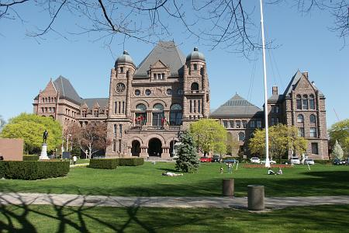
Where the disclosure would reveal the substance of deliberations of the Executive Council or its committees

Slide 11


To qualify for this exemption, information must:
  Reveal a trade secret or scientific, technical, commercial, financial or labour relations information;
  Supplied by the third party in confidence;
  The third party must show that disclosure would cause certain harms.
Notice to affected party required
Affected party may consent to disclosure
Notes:
a) Prejudice the third party’s competitive
position or
b) Result in information no longer being supplied to the insitution or
c) Result in an undue loss or gain to someone.

Slide 12


Recorded information about an identifiable individual
Education, work history, medical, financial, numbers (SIN, Health), home address, phone, opinions, etc.
Must be withheld except in limited situations (consent given, public health or safety, public records, or research purposes)
Employee or business contact information is not considered personal information
Emails or documents created by government employees are not their personal information (depends on the content)

Slide 13

FIPPA
Advice and Recommendations (s.13)
Law Enforcement (s.14)
Relations with other Government (s.15)
Defence of Canada (s.16)
Economic Interests of Ontario (s.18)
Solicitor-Client Privilege (s.19)
Danger to Safety and Health (s.20)
Endangered Species (s.21.1)
Publicly Available Records (s.22)

Slide 14

MFIPPA
Draft By-Law (s.6)
Advice & Recommendations (s.7)
Law Enforcement (s.8)
Economic & Other Interests (s.11)
Solicitor-Client Privilege (s.12)
Danger to Safety or Health (s.13)
Information to be published (s.15)

Slide 15

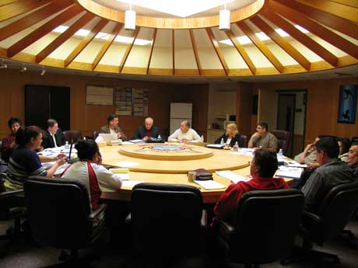
Closed meetings of Council, Committee or Board/ governing body or its committees of an educational institution
Draft by-laws, in camera reports or deliberations of a closed meeting
Must be disclosed if subject considered in public meeting or after 20 years
Notes:
FIPPA has a similar clause however it only applies to an educational institution and if a statute authorizes holding the meeting in the absence of the public

Slide 16


Advice or recommendations provided by a public servant or consultant to a decision-maker
Exceptions:
Factual material or statistical survey
Reports by a valuator (whether an employee or not)
Environmental impact statements
Efficiency reports or studies
Reports containing the results of a field research undertaken before the formation of a policy proposal
A feasibility study or other technical study, including cost estimate, relating to a government policy or project

Slide 17


Disclosure could reasonably be expected to
  Interfere with a law enforcement matter or investigation
  Reveal investigative techniques
  Endanger security of building or property
  Disclose identity of confidential source of information
Facilitate commission of unlawful act or hamper the control of crime
Must disclose routine inspection reports and reports on degree of success in a law enforcement program

Slide 18


Disclosure could reasonably be expected to:
Prejudice the economic interests or competitive position of an institution
Be injurious to the financial interests of the Government or its ability to manage the economy of Ontario
May refuse to disclose a record that contains:
Information with monetary value
Research prepared by an employee, prior to publication
Negotiating strategies and plans
Personnel or administrative plans not yet in operation
Proposed plans, policies or projects

Slide 19


Applies to records that are:
subject to solicitor-client privilege
prepared by or for institution’s lawyers for use in giving legal advice or in contemplation of or for use in litigation
examples: legal opinions, requests to lawyers for advice, lawsuits
Notes:
Communications privilege can be lost where the client forwards the information to external parties outside of the government, thereby “waiving” privilege.

Slide 20


Disclosure could seriously threaten the safety or health of an individual
Examples: address of resident who makes a complaint about neighbour, full names or work locations of staff who are subject to serious threats

Slide 21

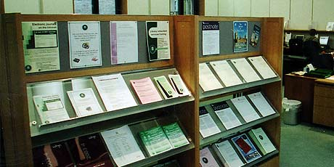
Information in the record that has been published or is currently available to the public (eg. assessment rolls or Land Registry Office)
Government records that are expected to be published within 90 days of the request for information

Slide 22

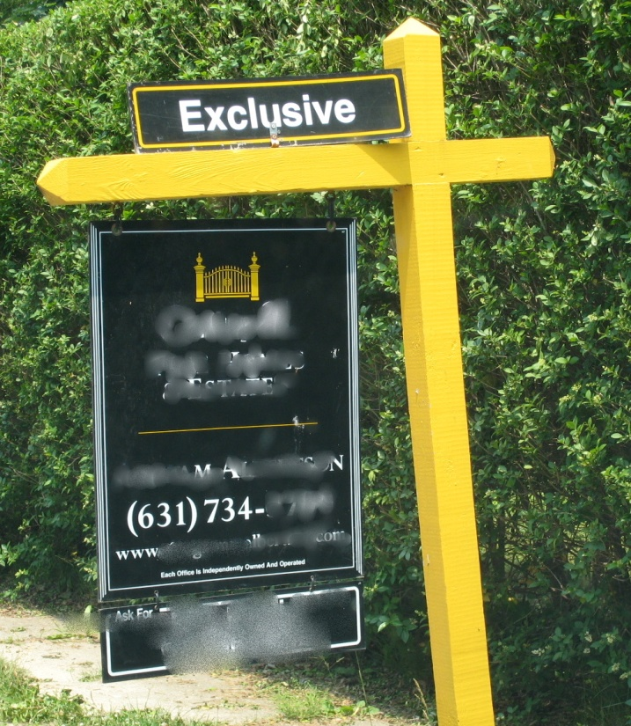
Sets out the types of records that fall outside the scope of the Act
Labour Relations Exclusion
    Excludes employment or labour relations records
    Examples: grievances, negotiations
    Exception: Expense claims and agreements
Prosecution Records
    The Act does not apply to a record relating to a prosecution if all proceedings have not been completed.

Slide 23

Written request and fee
Adequate description of request
Clarifying and/or narrowing a request
Tracking the request
Request for a fee waiver
Identification of specific media format requested
Consent for disclosure if applicable
Forwarding/transferring requests to other institutions

Slide 24

Formal, documented request – via email or memo
Option of a copy of original request (personal identifiers severed
Deadline for response
Interpreting the request
Request for large amounts of records
Time extensions
Fee estimate – what is covered? Whose rate?
Concerns/recommendations regarding disclosure

Slide 25

Obtain copies, not originals
Difference between responsive/non-responsive
Pages should be numbered
Integrity – complete, nothing withheld, thorough search
Review the records for concerns
Apply exemptions to sever (redact) information

Slide 26

Decisions are made by the “Head”
30-day timeline for response begins as soon as the written request and the $5.00 fee is received (30-days includes search, review and decision as to what is released)
Extension on the 30-days may be taken for large volumes or outside consultations
Fee schedule set by regulation
Prescribed access/appeal procedures
Notes:
Municipalities - typically the Clerk
Provincial - Minister

Slide 27

Within statutory timeframe (30 days)
Re-state request
Decision clearly states – access in full, access in part, no records found, time extensions, etc.
Fees explained – severing, photocopying, search time, media format, etc.
Appeal provisions
Contact information

Slide 28

To clarify the request
To explain the process to the requester
To respond to an requester’s questions about an access decision
To assist the requester and to respond without delay, openly, accurately, and completely, in keeping with duty to assist a requester

Slide 29

The regulations sets out four types of fees:
  Search and Preparation
  Computer programming and Data processing
  Photocopying
  Delivery of the responsive records
Notes:
Fee estimates for search and preparation time must be in accordance with the legislation and reasonable in the circumstances of the request
A fee estimate can not include time spent on the following activities;
Transferring an application to an other public body
Preparing a fee estimate
Reviewing the responsive records to determine whether any exceptions to disclosure apply, prior to severing of the records
Copying records supplied to the applicant
Preapring an explanation of the records to the applicant
An applicant has up to 30 days from the day the estimate is given to indicate if it is accepted or to modify the request to change the amount of the fee

Slide 30

Mandatory Application Fee - $5.00
Photocopies - $0.20/page
Searching, Preparation, Severing - $30.00/hour
Computer Programming - $60.00/hour
Other costs specified in invoice
50% of Estimate Fees may be required before processing (estimates of $100 or more)
Processing Fees may be waived
Appeal Fees - $25.00 or $10.00 (personal information)

Slide 31

Time is chargeable for the following search and preparation activities:
  Search to locate responsive records
    Reviewing file lists or systems to determine locations of responsive records
    Gathering records or retrieving records from storage
  Preparation of responsive records
    Copying the original records to have copies
    Severing the records by redacting the exempt information and noting the specific provisions on the severed records

Slide 32

Ensure that only chargeable activities are included in estimate
Determine the best approach to calculate how much time may be needed (case by case)
Whenever possible, estimate search and/or preparation time based on a sample of the records

Slide 33

The following exemptions do not apply if a compelling public interest outweighs their purpose:
Advice to government (s.7/s.13)
Relations with other government (s.9/s.15)
Third Party Information (s.10/s.17)
Economic and other interests (s.11/s.18)
Danger to Safety and Health (s.13/s.20)
Personal Privacy (s.14/s.21)
Fish and Wildlife species at risk (s.21.1-FIPPA)
Must be public as opposed to “personal” interest
Often raised by appellants as an issue on appeal
The individual seeking its application bears the burden of proof

Slide 34

May refuse request for access
Must state reasons in decision letter, right to appeal
Request is part of pattern of conduct to abuse right of access or interfere with operations
Request is made in bad faith
Request is for a purpose other than to obtain access

Slide 35

Right of appeal on any issue in access decision
Appellant must pay fees to appeal
Mediation is first step to resolve appeal
Oral hearings may be convened
Adjudication – institution must file representations, affidavits
Order of the IPC is binding on the institution
May request order to be reconsidered by IPC
Judicial review of an order by court may also be filed

Slide 36


“In the spirit of the Act, unless there is a statutory requirement or reason not to release the information, routine disclosure should become the norm.”
  Information/Privacy Commissioner Guidelines on Routine Disclosure

Slide 37

Where a record can be provided routinely
Where information is published proactively (website/regular reports/open data)
More cost effective than formal access
Better service and transparency to the public

Slide 38

If disclosure is mandated by another piece of legislation, release the record routinely/proactively
Delegate authority to front line staff/provide training
Any type of record released regularly without exemption should be added to your routine disclosure plan
All newly created types of records should be reviewed as candidates for routine disclosure
Develop online search systems for the public
Provide raw datasets for Open Data

Slide 39

Where possible, standard reports and records should be modified to remove exempt information
Can parts of a record be routinely released if not all of it?
Review list of record series regularly for additions to your routine disclosure plan
Personal information should be available to individuals routinely

Slide 40

COURT SERVICES
Routine Disclosure Plan
Court Administration
Copies of original tickets issued (Part 3 Information, Certificate of Offence)
$2.00 administrative fee charged per copy; $3.50 if copy is certified.
Copies of Motion paperwork (charter motions, etc.), including judicial orders
Same administrative fees apply.
Note: With the exception of an application for an Order of Examination under the Mental Health Act, court documents relating to the Provincial Offences Act are publicly accessible, unless otherwise ordered by the Court.
Court Support
Requests for transcripts of court proceedings
Regulated fee charged by Provincial regulation.
Financial statements available through annual financial reports.

Slide 41

Staff appointed in each Department
Power to assign specific tasks to staff
Locate records; document search
Assist in identifying records not to be disclosed

Slide 42

Days 1-2: Receive, log, acknowledge and forward requests to Department
Days 3-15: Department searches, retrieves, copies and reviews records for issues
Days 16-23: Coordinator reviews records, applies exemptions, consults on issues and drafts decision
Days 24-30: Decision maker reviews and decides, issues letter to requester with records

Slide 43

Follow-up process where Departments overdue with their response to Coordinator (Day 15)
Department Head notified that response is overdue
If no response within 2 days of overdue notice, Senior Executive notified of overdue response
Objective: to ensure 100% compliance with 30-day statutory timeline

