Slide 1
Privacy Basics under FIPPA and MFIPPA
Ontario Connections 2015
May 21, 2015
Rob Candy, Manager, Privacy and Open Information, City of Toronto
Gilles Fourchet, Director Privacy, Canada Health Infoway
Colin Bell, Director Enterprise Architecture, University of Waterloo

Slide 2
Agenda
What is Privacy
(M)FIPPA Privacy Requirements
Privacy Issues and Examples
Privacy Best Practices

Slide 3
What is Privacy?
Information Privacy is the right of an individual to exercise control over the collection, use, disclosure and retention of his or her personal information, including his or her personal health information
It is a legal matter
No Privacy without Security
Rely on reasonableness
Not complicated to implement
It is not an IT matter
Privacy ≠ Secrecy

Slide 4
Sidenote: Information Security
Information Security practitioners speak of the “CIA Triad”
Confidentiality
Limit access to information to authorized parties.
Integrity
Assure information can be trusted.
Availability
Make information available when required.
C
I
Info
Sec
A
Notes:
Really quick introduction to “Information Security” concepts.

Slide 5
Sidenote: Designing for Security
Layout a blueprint, fill in the details.
Sometimes called “Security Architecture” and is often part of a larger “Enterprise Architecture”
Security 101 coming soon.
Notes:
Introduce future of Security 101 program. We would like to see “Access, Privacy, and Security 101” courses made available in recurring fashion through the connections events.
In this, state that ‘privacy’ requirements for our Secuirt with constraints and context at the Business layer. Information, Applications, and Technology design all come on the back of how we are governed within a particular business context (legislation).

Slide 6
Privacy Legislation
(Municipal) Freedom of Information and Protection of Privacy Act ((M)FIPPA)
Personal Health Information Protection Act (PHIPA)
Child and Family Services Act (CFSA)
Services and Supports to Promote the Social Inclusion of Persons with Developmental Disabilities Act (SIPDDA)
Mental Health Act
Etc…
Personal Information Protection and Electronic Documents Act (PIPEDA)
Privacy Act

Slide 7
Privacy in Ontario’s Public Sector
FIPPA applies to
Ministries, agencies, boards, commissions, universities and colleges, hospitals
Generally does not apply to your HR records
MFIPPA applies to
Municipalities,
Local organizations such as libraries and police services
Oversight and Complaint Body
IPC

Slide 8
Privacy Principles
1. | Accountability | 6. | Accuracy
2. | Identifying Purposes | 7. | Safeguards
3. | Consent | 8. | Openness
4. | Limiting Collection | 9. | Individual Access
5. | Limiting Use, Disclosure and Retention | 10. | Challenging Compliance

Slide 9
Privacy Principles (con’t)
1. Accountability
An organization is responsible for personal information under its control and shall designate an individual or individuals who are accountable for the organization’s compliance with the following principles.
Key points
Must have somebody accountable for the organization
The identity of this person must be provided upon request
A Governance must be in place
Notes:
Section:
FIPPA - S10
MFIPPA – S3, S4

Slide 10
Privacy Principles (con’t)
2. Identifying Purposes
The purposes for which personal information is collected shall be identified by the organization at or before the time the information is collected.
Key points
Must be documented
Should be specified to the person before or at the time of collection
Must have the legal authority to do it
Notes:
Section:
FIPPA – S39, S65.1(4) (collection by provider for the purpose of a designated service)
MFIPPA – S29

Slide 11
Privacy Principles (con’t)
3. Consent
The knowledge and consent of the individual are required for the collection, use, or disclosure of personal information, except where inappropriate.
Key points
Can be expressed or implied
Must be knowledgeable
Cannot use misleading or deceptive practice
Cannot bundle data collected
Opt-in vs opt-out
Notes:
Section:
Collection
FIPPA - S65.1(4) (collection by provider for the purpose of a designated service)
MFIPPA –
Use
FIPPA: S41
MFIPPA: S31
disclosure:
FIPPA: S17.(3), S21, S42
MFIPPA: S9.(2), 10.(2), 14.(1), S32

Slide 12
Privacy Principles (con’t)
4. Limiting Collection
The collection of personal information shall be limited to that which is necessary for the purposes identified by the organization. Information shall be collected by fair and lawful means.
Key points
Connected to the “Identifying Purposes” and “Consent” principles
You cannot lose something you do not have
The more data the more sensitive
Notes:
Section:
FIPPA – S39
MFIPPA – S29

Slide 13
Privacy Principles (con’t)
5. Limiting Use, Disclosure, and Retention
Personal information shall not be used or disclosed for purposes other than those for which it was collected, except with the consent of the individual or as required by law. Personal information shall be retained only as long as necessary for the fulfilment of those purposes.
Key points
Connected to the “Consent” principle
Some legislative requirements
Records Management Guidelines and Procedures
Control vs Custody
Notes:
The org that has control decides when a given record has to be disposed of and the org that has custody does it.
Section:
Use
FIPPA: S41
MFIPPA: S31
disclosure:
FIPPA: S17.(3), S21, S42
MFIPPA: S9.(2), 10.(2), 14.(1), S32

Slide 14
Privacy Principles (con’t)
6. Accuracy
Personal information shall be as accurate, complete, and up-to-date as is necessary for the purposes for which it is to be used.
Key point
Connected to the “Openness” and “Individual Access” principles
Notes:
Section:
FIPPA – S40.(2)
MFIPPA – S30. (2)

Slide 15
Privacy Principles (con’t)
7. Safeguards
Personal information shall be protected by security safeguards appropriate to the sensitivity of the information.
Key points
Must be reasonable in the circumstances
Includes transfer and disposition (in addition to confidentiality and integrity)
Anonymous ≠ de-identified
Notes:
Section:
FIPPA – RRO 1990, Reg 459 Disposal of Personal Information
MFIPPA –

Slide 16
Privacy Principles (con’t)
8. Openness
An organization shall make readily available to individuals specific information about its policies and practices relating to the management of personal information.
9. Individual Access
Upon request, an individual shall be informed of the existence, use, and disclosure of his or her personal information and shall be given access to that information. An individual shall be able to challenge the accuracy and completeness of the information and have it amended as appropriate.
Notes:
Openness - Section:
FIPPA – S39
MFIPPA – S29

Slide 17
Privacy Principles (con’t)
10. Challenging Compliance
An individual shall be able to address a challenge concerning compliance with the above¹ principles to the designated individual or individuals accountable for the organization’s compliance.
¹ Read “previous 9”
Notes:
Section:
FIPPA – S29
MFIPPA – S22

Slide 18
Privacy Principles
1. | Accountability | 6. | Accuracy
2. | Identifying Purposes | 7. | Safeguards
3. | Consent | 8. | Openness
4. | Limiting Collection | 9. | Individual Access
5. | Limiting Use, Disclosure and Retention | 10. | Challenging Compliance

Slide 19
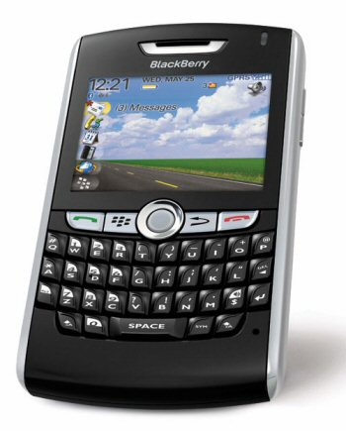
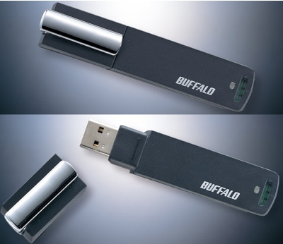
Peripheral Devices
9,000 USB sticks have been found by the dry cleaners in the UK during the last year, a recent survey revealed by Textile Services Association
The survey included 500 dry cleaners, who found an average two memory sticks
Sunrise Propane explosion: Evacuated people’s personal information was put on a memory stick and lost.
Notes:
-universal, portable, store a lot
-password, encryption

Slide 20
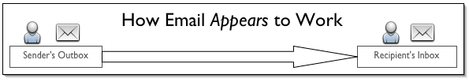
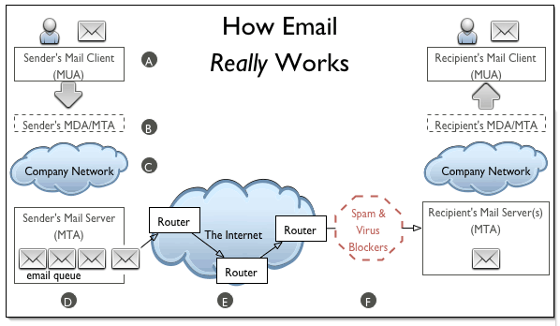
How e-mail Works
Mail User Area (MUA)
Mail Delivery Agent (MDA)
Mail Transfer Agent (MTA)
Notes:
-name@toronto.ca →name@toronto.ca SAFE
-name@toronto.ca -> @yahoo.ca NOT SAFE
-like sending a post card

Slide 21
E-mail
Never send personal health information or refer to a identifier via e-mail
If you receive an e-mail intended for someone else, notify the sender and delete the e-mail immediately.
decide if other ways to send the message would offer better privacy protection and security, e.g., a letter or memo by confidential mail.
Keep your e-mail user and distribution lists up-to date.
Verify the recipient(s)’ name, title and e-mail address in the GroupWise Address Book before you send an e-mail.

Slide 22
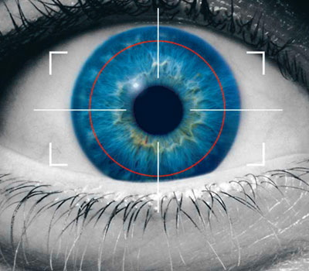
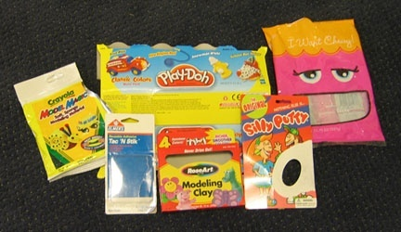
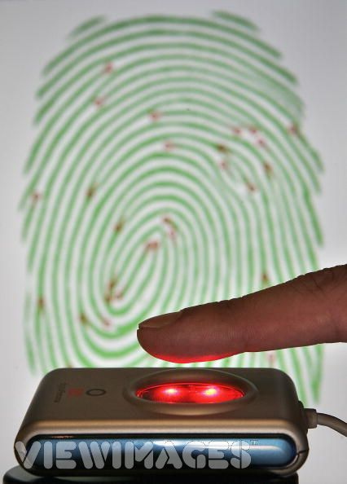
Biometrics
Notes:
- Biometrics: consists of methods for uniquely recognizing humans based upon one or more intrinsic physical or behavioral traits. In computer science, in particular, biometrics is used as a form of identity access management and access control. It is also used to identify individuals in groups that are under surveillance.
Question: vault full of silver, does it make sense to make the door out of gold?
-eg. finger print reader on a laptop

Slide 23
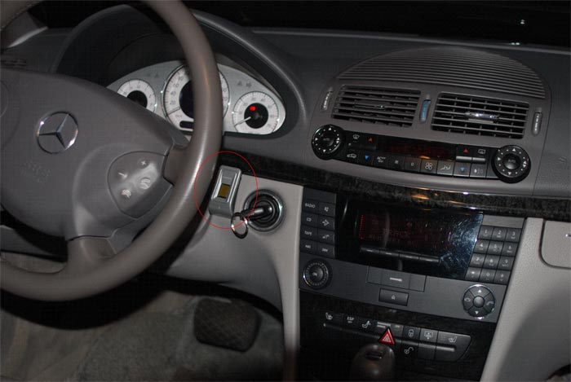
Biometrics
Malaysia car thieves steal finger
Police in Malaysia are hunting for members of a violent gang who chopped off a car owner's finger to get around the vehicle's hi-tech security system
Notes:
Question: vault full of silver, does it make sense to make the door out of gold?
-lose credit card – cancel it
-forget pin # - change it
-finger print theft - ???

Slide 24
Collection
Collection of personal information
No person shall collect personal information on behalf of an institution unless the collection is authorized by statute, used for the purposes of law enforcement or necessary to the proper administration of a lawfully authorized activity.
Application forms
On-line surveys
Telephone subscriptions
E-mail collection
Notes:
-statute – authority
-law enforcement
-administration - law
Direct Collection
An institution shall collect personal information only directly from the individual to whom the information relates
-eg. Former Metro – “Metro Counts” mandatory equity survey asked for – country of origin, ethnicity, aboriginal, physically challenged
-managers asked to complete forms (? Accuracy, consent)→IPC
-Outcome: never have a mandatory equity survey, destroy data base, head of HR to explain why.

Slide 25
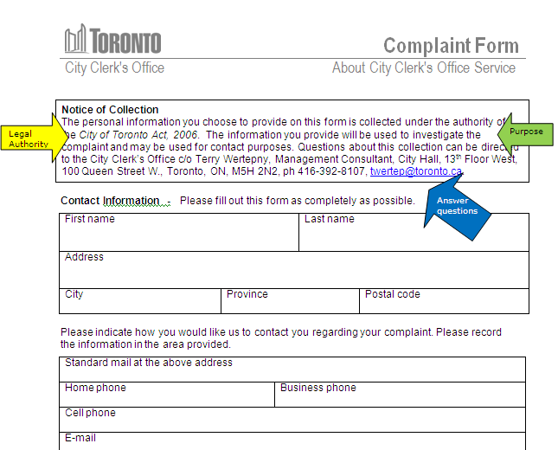
Notice of Collection Statement
Notes:
-sample

Slide 26
Requests for Disclosure
to aid an investigation undertaken with a view to a law enforcement proceeding or from which a law enforcement proceeding is likely to result
the disclosure is made to an officer or employee of the institution who needs the record in the performance of his or her duties and if the disclosure is necessary and proper in the discharge of the institution’s functions;
if the person to whom the information relates has identified that information in particular and consented to its disclosure;
Consent
32 b
Officer/
Employee
32 d
Law Enforcement
32 g
Act of Legislature/
Parliament
32 e
Examples include Canada Customs and Revenue Agency , WSIB, the College of Nurses, and Coroners
Notes:
Do you need it to do your job?
-is not FOI
-someone approaches you on the job “I need this file”, your answer is NO
-person receiving the information is not braking the law
-person giving the information can get into trouble
-An institution shall not disclose personal information in its custody or under its control

Slide 27
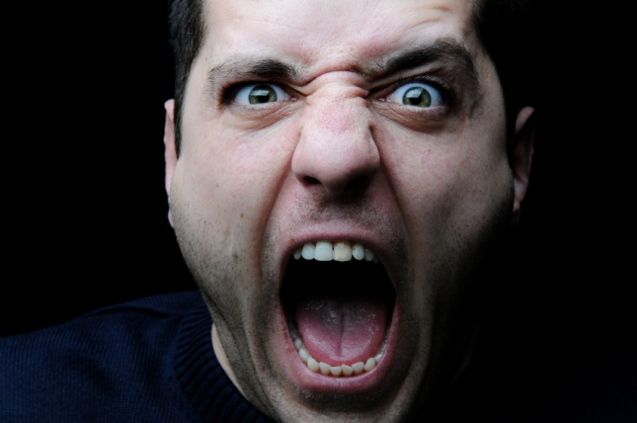
Privacy Breach
When an institution allows by intent or mistake the disclosure of personal information or records containing personal information.
Any size
All have consequences
Notes:
-eg. Old City Hall, 2007 garbage bags filled with personal information (names, addresses, DL#, violations)
-eg. Person with TB tested false positive, sent to wrong address, posted at place of work
-eg. Email example

Slide 28
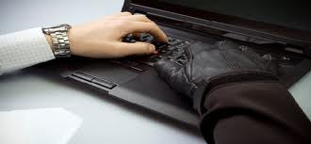
Revenue Canada
Four computers with confidential information on more than 120,000 taxpayers in Canada were stolen from Revenue Canada’s offices in Laval, Quebec.
Dates of birth and Social Insurance numbers were included in the files. Source: National Post, Ottawa, Ontario, September 30, 2003.

Slide 29
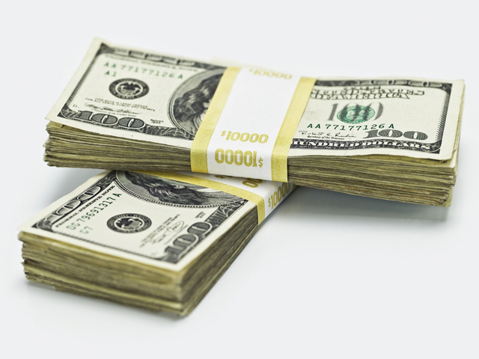
Information is Power
4 Computers with a street Value of $50 = $200
An identity theft ring busted in Alberta in 2005 was paying $25 for the name and SIN of individuals.
120,000 x $25 = $3 million dollars
Information is Money!

Slide 30
Cost
Loss of Trust in the Institution
Your Job
Potential Lawsuits against the institution
Financial harm
Child abduction
Physical harm/Stalker
Notes:
-not illegal to have someone's credit card #, photo
-illegal when you use the information to defraud
-confidence to report a complaint

Slide 31
Managing a Breach
Contain
Contact Privacy Unit
Document
Confirm the Scope
Identify those effected
Determine the policies procedures responsible
Mitigate
Time is important
Notes:
-not let it happen in the first place
- Look to policies and standards

Slide 32
Best Practices
The law provides a ground floor for privacy practices but it doesn’t tell us how to protect privacy.
Best practices serve as policy and guidelines that allow us to put standards and compliance into practice
Clean Desk
Disclosure
Secure disposal
Password Guidelines
Notes:
Link to policy and guidelines (only not specific)
-law is the ground floor
-need to enforce through guidelines
-clean desk: lock it up
-secure disposal: red bins, next slide
-password: next slide

Slide 33
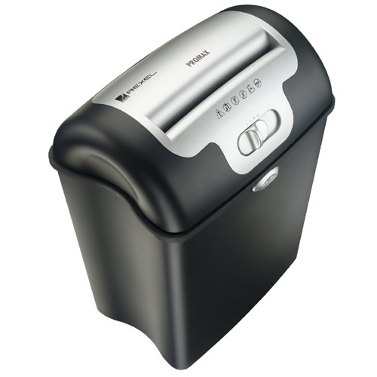
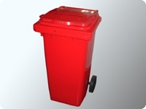
Secure Disposal
Red Bins
Shredders
Never put anything with a name on it in the garbage or a blue recycling bin
The number one source for material used for identity theft is the garbage.
Notes:
-name on it -> red bin

Slide 34

Sick Kids’ laptop theft angers Privacy Commissioner
A laptop computer containing the personal health information of 2,900 patients at the Hospital for Sick Children was stolen on January 4th, 2007.
Sick Kids doctor loses data on 3,300 patients on April 21, 2007.

Slide 35
Working outside of the Office
If you put it down some one will take it
Briefcase-laptop-smart-phone-notebook
Consider if you need to take it home
Prioritize work that doesn’t contain personal information wherever possible
Notes:
-put it down – take it
-? Work at home use a SECURE ACCESS TOKEN

Slide 36

Questions?

Slide 37
Thank You
Rob Candy - rcandy @toronto.ca
Gilles Fourchet - gfourchet@Infoway-inforoute.ca
Colin Bell - colin.bell@uwaterloo.ca

