Slide 1
Creating Visualizations while Exploring Data
Colin Beveridge, Scott Partacz, Abbey Guilliat, Lucas Stefanic

Slide 2
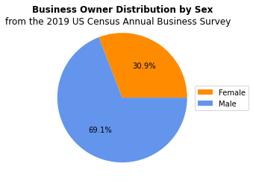
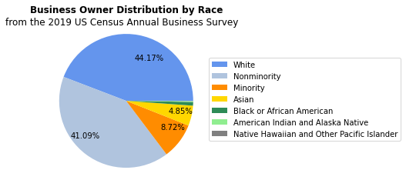
Characteristics of Business Owners

Slide 3
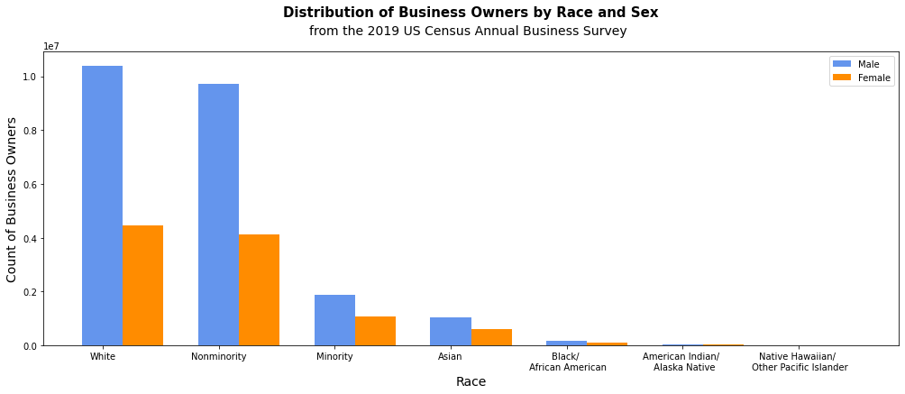
Characteristics of Business Owners

Slide 4
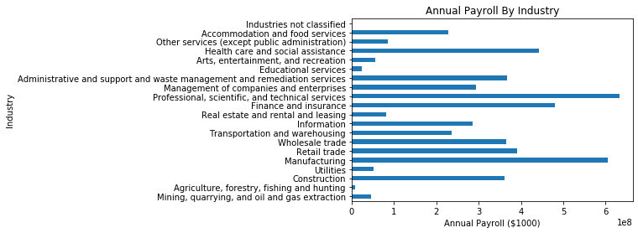
Annual Payroll of Industries

Slide 5
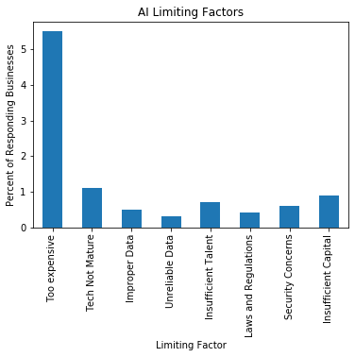
Technology Characteristics of Business

Slide 6
Plotly graphs using Dash…

